Slide 1
RESOURCE NETWORKING
5th ANNUAL PEER NETWORKING CONFERENCE
Monica scott, MS, CAC-AD, CCDC, RPS
&
Tiffinee scott, MS, CCAR-TOT, MHFA-TOT
Notes:
Set up the next slide by discussing the role of the Peer in building Recovery Capital
One of the essential aspects of Peer Support is assisting the PIR increase their ability to maintain recovery, this is know as Recovery Capital.

Slide 2

Recovery capital defined…..
It is all the internal attributes and strengths and external resources a Peer can utilize that empowers one to believe that recovery is possible and provides a firm foundation with which long term recovery can be built and maintained.
Notes:
Break down the simplicity of this concept for non-clinical persons. The internal attributes and strengths are those qualities of the PIR that the Peer will utilize for self motivation. The External Resources are the services the Peer is able to connect the PIR with in the role of Resource Broker

Slide 3
– is a Peer Recovery Specialist who assists with directing the route or course of another, for the purpose of obtaining resources and other assets to increase external Recovery Capital.
RECOVERY RESOURCE BROKER
Notes:
Define Recovery Resource Broker
Provide the linkage information between being a Resource Broker and the 8 Dimensions of Wellness

Slide 4
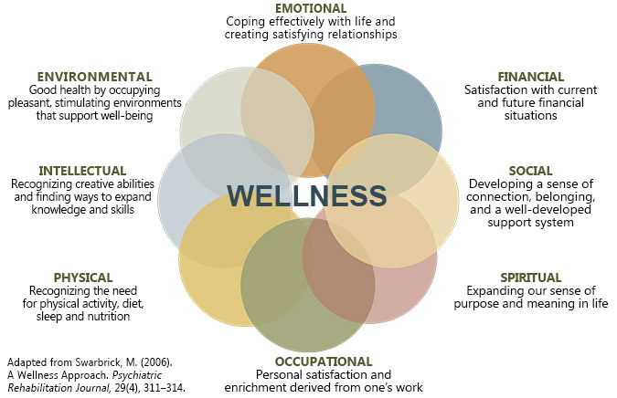
8 DIMENSIONS OF WELLNESS
Notes:
Whenever you are assisting a Peer with building external Recovery Capital, use the 8 Dimensions of Wellness as a guide for becoming a great Recovery Resource Broker

Slide 5

?
?
?
?
?
RESOURCE BROKER
Notes:
Ask the group to identify the types of resources associated with the 8 Dimensions of Wellness they currently have as part of their Resource Material
Identify where the gaps are located on your Resource Grid

Slide 6

EFFECTIVE REFERRAL
THERE ARE SEVERAL COMPONENTS THAT PRODUCE AN EFFECTIVE REFERRAL
Notes:
Ask the group to identify the essential elements that make an effective referral

Slide 7

IDENTIFY COMPONENTS OF AN
EFFECTIVE REFERRAL

Slide 8

REFERRAL
COMPONENTS
AGENCY NAME
AGENCY SERVICES
CONTACT PERSON
CONTACT NUMBER
REFERRAL DATE & TIME

Slide 9
TYPES OF
REFERRALS
DIRECT HANDOFF
Making the direct connection
Escorting the Person In Recovery to the referral location
WARM HANDOFF
Contacting the agency prior to the referral
Provide the agency contact with the name of the PIR
Ensure the PIR has all the information to contact the agency to set up initial appointment
Notes:
Define the difference between a direct handoff and a warm handoff

Slide 10
RESOURCE
DEVELOPMENT
Notes:
Each Peer will use the Resource Grid to complete the next section of resource development.
Each person at the table will be given an opportunity to answer questions related their respective places of employment and

Slide 11
NETWORKING
OPPORTUNITY
PART 1
Name & Title
Place of Employment
What innovative services does your agency offer?
What is your role in providing these services?

Slide 12
WHAT NEW RESOUCES DID YOU LEARN ABOUT?
Notes:
ALLOW ONE PERSON FROM EACH TABLE TO SHARE WITH THE GROUP AT LEAST ONE NEW RESOURCE THEY WERE ABLE TO OBTAIN FROM THE NETWORKING SESSION

Slide 13


Slide 14
COMMUNITY RESOURCE GUIDE
LEVEL ONE
Emergency Services
Crisis Services
Behavioral Health provider
Criminal Justice Services
Notes:
Refer to the Community Resources Guide to identify the vast amount of additional services to add to your resource development plan

Slide 15
COMMUNITY RESOURCE GUIDE
LEVEL TWO
Education
Family Services
Literacy Programs
Housing
Medical Service
Shelters/Homeless Services
Veteran

Slide 16
RESOURCE SHARING
PART 2
Identify services available to you (Housing, Financial support, Family resources, Food banks, harm reduction, homeless, crisis services, job readiness, re-entry)
What resources would you like to see in your jurisdiction?
What resources are your still lacking from your Resource Grid?

Slide 17
WHAT NEW SERVICES DID YOU LEARN ABOUT?
Notes:
ALLOW ONE PERSON FROM EACH TABLE TO SHARE WITH THE GROUP AT LEAST ONE NEW SERVICE THEY WERE ABLE TO OBTAIN IN THEIR JURISDICTION

Slide 18


