Slide 1
Peer Support and Involuntary Treatment
Annette Hanson, MD
Assistant Professor
Director, Forensic Psychiatry Fellowship
University of Maryland

Slide 2
Eighteenth and Nineteenth Centuries:
Era of Social Reform

Slide 3
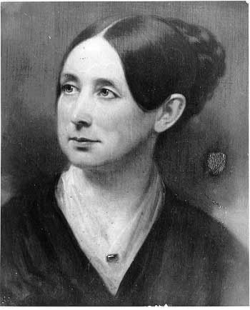
Dorothea Dix
An 1841 visit to a Massachusetts jail lead to a national campaign to improve conditions for people with mental illness.
Notes:
Eighteenth and Nineteenth Centuries: Era of Social Reform
Civil libertarians were concerned about the wellbeing of people with mental illness, but also crossed over into the rehabilitation of criminals. Criminality and mental illness were often equated in the Nineteenth Century.
“Madam, the mad do not feel cold.”
Women were not allowed to testify before Congress, so she met quietly behind the scenes to lobby for the creation of our state hospital system.

Slide 4
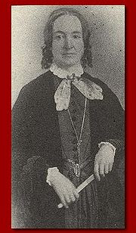
Mrs. E. P. W. Packard
“The subjection of the wife was the cure of the husband.”
The Prisoners’ Hidden Life, or Insane Asylums Unveiled (1868)
Notes:
Committed to the Illinois State Hospital for the Insane in 1860 by her husband after repeated disagreements over religion. Her husband was a Calvinist, but she disagreed with their beliefs and threatened to join the Methodists. She was held for three years. After her release she and eight other married women testified before the Illinois legislature about their experiences in the psychiatric hospital. As a result, a law was passed allowing commitment hearings to be held before a jury.
Mrs. Packard went on to travel across the country lobbying for stricter commitment laws specifically as they applied to married women. She also advocated for women’s rights generally, since at that time women and children were considered the property of their husbands.

Slide 5
Late Twentieth Century

Slide 6
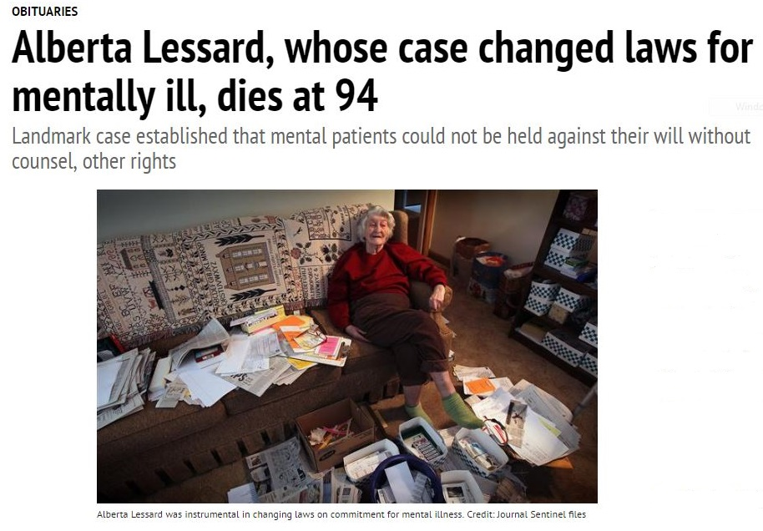
Alberta Lessard (1972)
Notes:
Alberta Lessard was a teacher who was fired from two jobs due to conflict with the administration. She was brought to the hospital by police for an emergency evaluation because she called the university incessantly to get her job back. When the police arrived she believed they had been sent to kill her by President Nixon and tried to jump out of her bedroom window. She was admitted to a hospital in Wisconsin and was held after two judicial hearings that she was not told about or allowed to attend.
A Wisconsin legal aid organization took up her cause, and her case was heard by the US Supreme Court in 1972. Lessard v Schmidt created all the due process protections that we now take for granted: a notice of hearing and rights, representation, and ability to call and confront witnesses.

Slide 7
Where We’re At Today
All states have involuntary admission procedures with common elements:
Statutory time limits
Notice of hearing and rights
Independent hearing (judicial or administrative)
Right to call and confront witnesses
Time-limited commitment
Mandatory periodic review of commitment
Notes:
After the SCOTUS decision, Lessard became homeless. Her best friend, a psychiatric nurse, became a police officer who occasionally brought her food or took her in for emergency evaluations. When she wanted to be admitted voluntarily, she was denied admission. Her family eventually obtained guardianship and she was placed in a nursing home where she was visited regularly by her longtime friend, now the police chief.

Slide 8
Current Events and Mental Health Law

Slide 9
Conclusion: Protect Society or Protect the Individual?
Mental illness
Addiction
Intellectual disability
Minority groups
Prisoners

Slide 10
Preparation for Civil Commitment
Health-General §10-613 et. seq.
Application for admission
Two certificates (valid for one week)
Individual has a mental disorder
Is a danger to the life or safety of self or others
Requires inpatient care (no less restrictive alternative)
Is unable or unwilling to be voluntarily admitted
Must give patient a notice of rights
Involuntary admission hearing within 10 days
Right to appeal and six month review

Slide 11
Preparation for Civil Commitment
During the “observation period” (after certs filed but before hearing), patient may sign in voluntarily at any time OR be discharged if not in need of admission
Hearing is in the hospital, before an administrative law judge
Patient has a right to have help from a lawyer
Patient has a right to be present at the hearing
May question people who testify
Has a right to speak to the judge
**Being committed does not mean medication can be given involuntarily unless there’s an emergency**

Slide 12
Preparation for a Clinical Review Panel
Medication can be given in an emergency if the patient is dangerous on the unit, but less intrusive interventions should be tried first
Involuntary medication in a non-emergency can only be done after a person is civilly committed
A clinical review panel is used to decide if medication can be be given
The type of medication is decided by the panel, after considering input from the patient

Slide 13
Preparation for a Clinical Review Panel
Health-General §10-708 et. seq.
Two psychiatrist and a non-psychiatrist mental health professional
Patient has a right to speak and ask questions
Patient has a right to a lay advisor
Patient has a right to know their diagnosis, and any risks, benefits, and side effects of the proposed treatment
Panel must gather information about why treatment is refused and consider proposals from patient, including treatment alternatives

Slide 14
Preparation for a Clinical Review Panel
Health-General §10-708 et. seq.
Medication may be approved if patient is at risk of remaining both mentally ill and dangerous: 1. Due to symptoms that lead to admission, 2. Would be dangerous if released, 3. Would be at risk of being unable to care for basic needs
CRP order must specify the names, doses, and frequency of any ordered meds and their alternatives
Valid for 90 days
Lay advisor gives notice of right to appeal and contact info for Legal Aid
Notes:
Clinical Review Panels
Involuntary meds OK in an emergency
In non-emergency:
Patient must be committed first
Clinical review panel (two physician/psychiatrists, one non-physician mental health professional)
Patient gets notice of hearing and explanation of rights (to attend and participate, call witnesses, ask questions, have lay advisor)
Medication may be administered if patient remains seriously mentally ill and dangerous as a result of mental illness
Patient must be given notice of:
Right to appeal to administrative law judge, and later to a circuit court, access to either an advocate or legal counsel
Appeal must be filed within 48 hours, ALJ hearing held within seven days. Hospital must prove need for med by preponderance of the evidence.
Patient may appeal to circuit court within 14 days, hearing must be held within seven days
An order is valid for 90 days **but does not carry over to correctional facilities**

Slide 15
Patient Rights and the Resident Grievance System

Slide 16
Patient Rights and the Resident Grievance System
Protection and Advocacy for Individuals with Mental Illness Act (PAIMI) 42 U.S.C. §10801 et. seq.
Civil Rights of Institutionalized Persons Act
42 U.S.C. §1997 et. seq. (1980)
State Patient Bill of Rights
Health-General §10-700

Slide 17
Health-General §10-700
Individualized treatment plan
Freedom from restraints
Written notice of rights
Access to telephone, mail, visitors
Vote and own property
Clinical review panel
Confidential records

Slide 18
Other Common Protections
Clean and safe environment
Freedom from physical or emotional abuse
Freedom from discrimination
Participation in religious services
Exercise of other basic constitutional freedoms

Slide 19
Limitations
Must be based on medical necessity
Limitation documented in medical record, with basis for decision
Decision must be reviewed every 30 days
Examples: hospital security, protection of third party, protection from self-harm
Notes:
Be treated in a humane fashion
Be free from restraints or seclusion, except in emergency when your behavior places you or others at serious threat of violence or injury
Voluntarily use the Quiet Room, at your request or the request of staff
Be protected from harm or abuse Except for medical reasons that are written by a physician:
Send and receive mail
Reasonable use of the telephone
Receive visitors during reasonable visiting hours
Talk with your attorney or clergy at all reasonable hours
Talk with your doctor or other staff concerning your medication, treatment, diagnosis, or prognosis
Appropriate assessment and management of pain
Participate in making your treatment plan
Have your records kept confidential and request to review your medical record
Refuse to participate in physically intrusive research
Refuse medication except:
When you are dangerous to yourself or others, or
If you are an involuntary patient, after approval of the medication by a Clinical Review Panel
Complain or initiate a grievance
Exercise your civil rights such as voting and owning property

Slide 20
The Resident Grievance System
Rights advisor (10 days)
Unit director (5 days)
Resident rights committee (5 days)
CEO (15 days)
Central review committee (10 days)
Pro bono legal services (MD Legal Aid)
https://health.maryland.gov/yourrights/Pages/Resources.aspx
Has list of rights advisors phone numbers and LAP for each facility
To report complaints 1 (800) 747-7454
Notes:
Four Stages and Many Parties
Rights advisor (10 days)
Unit director (5 days)
Resident rights committee (5 days)
CEO (15 days)
Central review committee (10 days)
Pro bono legal services (MD Legal Aid)
https://health.maryland.gov/yourrights/Pages/Resources.aspx
Has list of rights advisors phone numbers and LAP for each facility
To report complaints 1 (800) 747-7454

Slide 21
Final Advice
Ask questions, you have a right to know what your doctor is thinking about
Keep your own notes
Don’t be defensive and keep your temper in check
Consider using a psychiatric advance directive
Know your rights and exercise them

