Slide 1
Incedo Provider Portal (IPP): Utilizing Client-Level COVID-19 Vaccine Status Data Files
Clinical Services Division (Adults and Older Adults)

Slide 2
Training Session Outline
Training Session Purpose and Objectives
Client-level COVID-19 Vaccination Status Data
Maryland COVID-19 Vaccination Rates
Provider-Level Vaccine Status Data Access
Provider Outreach
Discussing COVID-19 Vaccination with Clients

Slide 3
Training Session Purpose and Objectives
Purpose:
To provide an overview of the functionality of the Incedo Provider Portal (IPP) for access to client-level COVID-19 vaccination status data and to review strategies for provider use of this data to inform targeted vaccine inreach/outreach efforts
Objectives:
Following this training, participants will be able to:
Describe the nature and type of the COVID-19 vaccination status data available.
Navigate the IPP to access and retrieve client-level COVID-19 vaccination status data.
Identify data-driven strategies to increase provider vaccination rates.

Slide 4
Client-level COVID-19 Vaccination Status Data
Client-level COVID-19 vaccination status data files are uploaded weekly to the IPP for each provider site.
Data files contain the name and contact information of individuals served by each provider site and has the following specific data fields.
    Provider name and type, Optum provider ID, Site ID, address including state, city, and zip code, telephone number, and jurisdiction.
    Patient ID and full name, address including state, city and zip code, county of residence, telephone number, and date of birth.

Slide 5
Maryland COVID-19 Vaccination Rates
Vaccination rates for individuals with behavioral health diagnoses, ages 12 and older, served by the PBHS are lagging far behind those for the general population in Maryland (Data as of 09/05/21).
PBHS participants

Slide 6
Optum COVID-19 Report Information

Slide 7
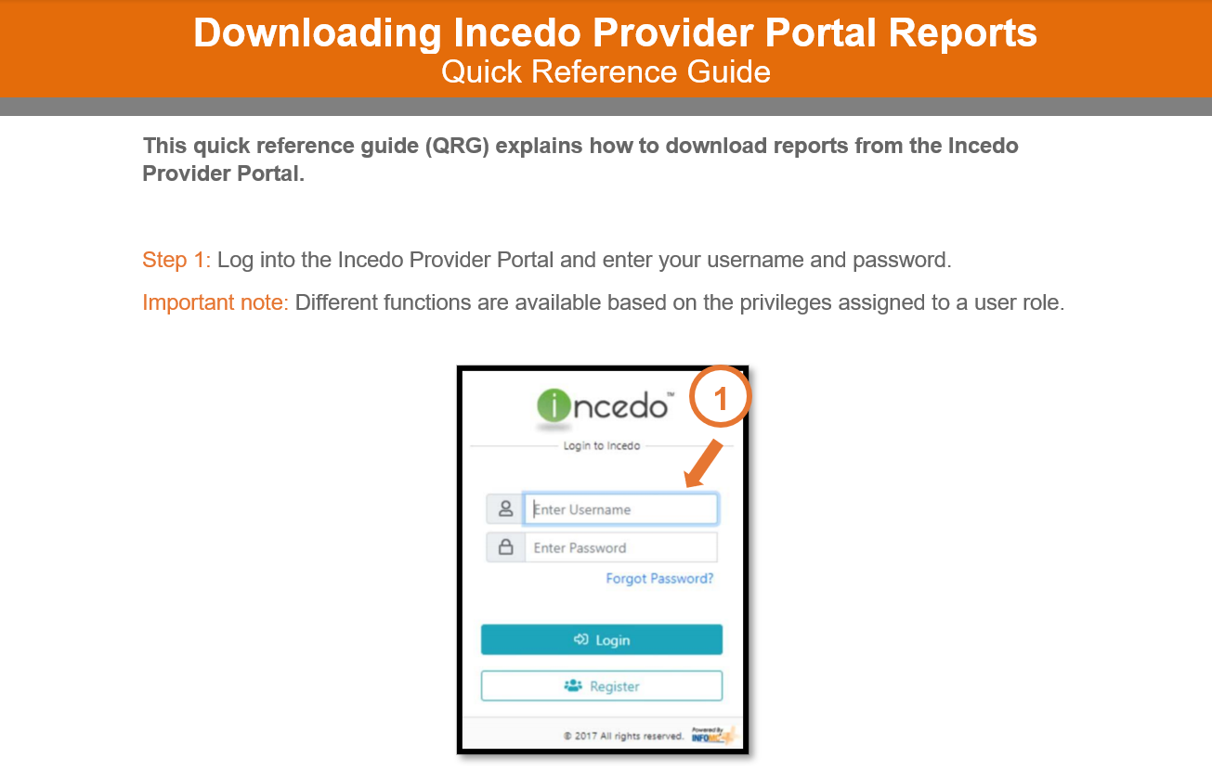
Obtaining data

Slide 8
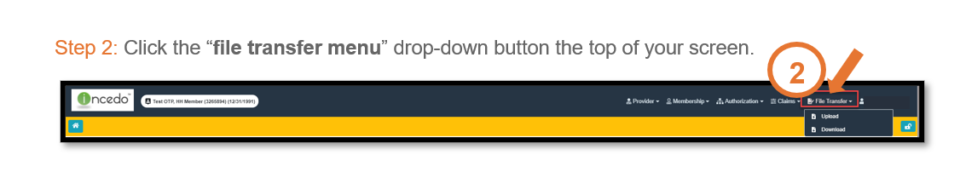
Obtaining data: File Transfer Menu

Slide 9
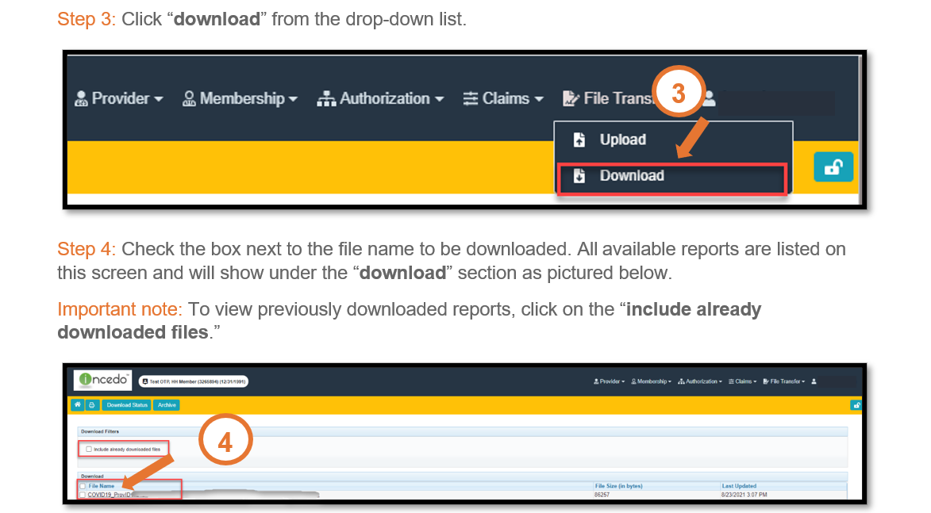
Obtaining data: Download

Slide 10
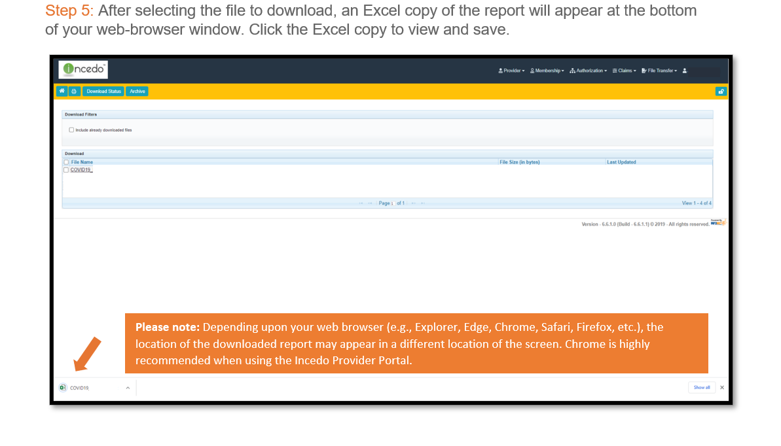
Obtaining data: Report Download

Slide 11
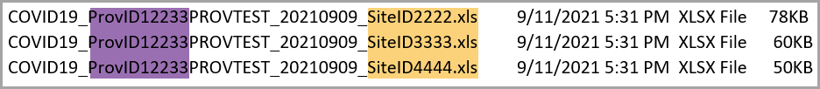
Report
The weekly provider report will:
Designate the vaccine status as partially vaccinated, fully vaccinated, or unvaccinated
Contain contact information for each service recipient.
Only give data to providers on individuals who are engaged in behavioral health services service within their agency or practice.
File naming convention
The file will be named as shown below
If a provider has multiple site locations, each site will get a report
Notes:
We got one spreadsheet from Sheba with all the necessary information on members who are vaccinated, unvaccinated, and partially vaccinated. The reporting team used the master file we received and split it up into individual files by Provider ID and Site ID. The individual files were then loaded into the Incedo provider portal. The most recent report we did had 3073 files.
The Optum Maryland Public Behavioral Health System (PBHS) claims data files are crossmatched weekly with the Immunet database to determine the COVID-19 vaccination status (fully vaccinated, partially vaccinated, or unvaccinated) for any individual, aged 12 or older, who is actively engaged in service behavioral health services with a PBHS provider enrolled in Optum Maryland. The Optum claims data set excludes out-of-state behavioral health service providers; individuals who have had services on fewer than four service dates since September 2020; and individuals who only had claims paid for assessment/evaluation, inpatient, emergency room, and/or laboratory services.
We are starting to receive questions from providers as to how to access the vaccination status information in the Incedo Provider Portal. We would like to work with you to schedule a series of webinars for providers to be co-facilitated by BHA and Optum Maryland staff.

Slide 12
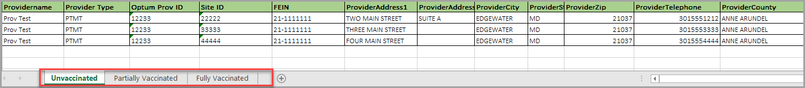
Report
The weekly provider report will:
Designate the vaccine status as partially vaccinated, fully vaccinated, or unvaccinated
Contain contact information for each service recipient.
Only give data to providers on individuals who are engaged in behavioral health services service within their agency or practice.

Slide 13
Access to Download reports
Users will need permission to view/access the transfer/download menu in Incedo
Options if you can’t access the transfer/download menu in Incedo
Ask your Incedo Administrator to download the reports for you
Ask an individual on the claims team to download the report for you

Slide 14
Provider-Level Vaccine Status Data Access
The weekly provider report designates the vaccine status as partially vaccinated, fully vaccinated, or unvaccinated.
It gives access to vaccine status data to providers only on individuals who are engaged in behavioral health services within their agency or practice.
Providers should leverage their trusted client relationships and care coordination experience to increase their vaccination outreach efforts.
They should utilize the weekly updated client-level COVID-19 vaccine status data files on IPP to identify individuals who have not yet been vaccinated against COVID-19

Slide 15
Provider Outreach
Develop a strategy to engage with identified unvaccinated individuals and support them to reduce barriers to vaccine access.
Work with clients and other stakeholders to identify specific vaccine barriers including concern about safety, accessibility, and side effects of the COVID-19 vaccine and design tailored interventions to address those challenges.
Communicate regularly with your jurisdiction to report the vaccination status of individuals served in your practice, vaccine barriers, and interventions implemented to increase vaccine uptake.
Connect with Optum Maryland for technical assistance on the use and functionality of Client-level COVID-19 vaccine status data on the IPP.

Slide 16
Discussing COVID-19 Vaccination with Clients
Initiate discussion about COVID-19 vaccination to every unvaccinated client.
Provide assurance of vaccine safety, efficacy, availability, and no cost.
Highlight the collective and individual benefits of vaccination.
Tailor messages to include any relevant reasons why COVID-19 vaccination might be important for that unvaccinated client.
Utilize the following BHA, MDH, and CDC guidelines/resources to answer client’s questions and to provide them with accurate information.
  https://health.maryland.gov/bha/Pages/bha-covid-19.aspx
  https://covidlink.maryland.gov/content/faqs/
  https://www.cdc.gov/vaccines/covid-19/hcp/answering-questions.html

Slide 17
Make a strong recommendation
Patient responds in 1 of 3 ways:
Yes
Not sure
No
No resistance
Ambivalence
Resistance
Vaccinate
Use motivational interviewing
1
2
3
4
5
Explore thoughts
Reflect back
change talk
Engage in collaborative
(2-way) conversation
Support autonomy and
decision-making
Summarize

