Slide 1
Finding Purpose and Results in the Pursuit of Health Equity
Stephanie Slowly, MSW, LCSW-C
June 10, 2021

Slide 2
Today’s Objective
Impact of Racial Trauma
Let’s do and activity!
Defining key terms
Shedding some light on the matter
Impact of finding your purpose
Signs of Burnout
Doing our part-Call to action
Next Steps

Slide 3
Let’s Do an exercise
Center and Grounding ourselves: This moment is for us

Slide 4
Key Questions to Ask yourself
What Are You Willing to Struggle for?
What Makes You Forget to Eat?
How Are You Going to Save the World?
If You Knew You Were Going to Die One Year from Today, What Would You Do and How Would You Want to be Remembered?
Notes:
What Are You Willing to Struggle for?
Fulfillment involves effort, trial-and-error, failure and learning.
What Makes You Forget to Eat?
When are you are so immersed in an activity that time passes without you realizing? Psychologist call this flow.
How Are You Going to Save the World?
You may not end world hunger, but you can make a difference. Instead of focusing too much on finding yourself, lose yourself in something larger.
If You Knew You Were Going to Die One Year from Today, What Would You Do and How Would You Want to be Remembered?
How do you really want to spend your time? What do you want your legacy to be?

Slide 5
Key Terms
Purpose: the reason why something is done or used; the aim or intention of something. The feeling of being determined to do or achieve something; the aim or goal of a person, what a person is trying to do, be or become.
Drive: a generalized state of readiness precipitating or motivating an activity or course of action. Drive is hypothetical in nature, usually created by deprivation of a needed substance (e.g., food), the presence of negative stimuli (e.g., pain, cold), or the occurrence of negative events. Drive is said to be necessary for stimuli or events to serve as reinforcers.
Micro aggressions: a statement, action, or incident regarded as an instance of indirect, subtle, or unintentional discrimination against members of a marginalized group such as a racial or ethnic minority.
Health Equity: means that everyone has a fair and just opportunity to be as healthy as possible. This requires removing obstacles to health such as poverty, discrimination, and their consequences, including powerlessness and lack of access to good jobs with fair pay, quality education and housing, safe environments, and health care.
Self- Actualization: the complete realization of that of which one is capable, involving maximum development of abilities and full involvement in and appreciation for life, particularly as manifest in peak experiences
Burn-out: is a psychological syndrome emerging as a prolonged response to chronic interpersonal stressors on the job. The three key dimensions of this response are an overwhelming exhaustion, feelings of cynicism and detachment from the job, and a sense of ineffectiveness and lack of accomplishment.
Notes:
Purpose Definition: https://www.merriam-webster.com/dictionary/purpose
Drive Definition: https://dictionary.apa.org/drive
Health Equity Definition: https://www.rwjf.org/en/library/research/2017/05/what-is-health-equity-.html
Self Actualization Definition: https://dictionary.apa.org/self-actualization
Burn out Definition: https://www.ncbi.nlm.nih.gov

Slide 6
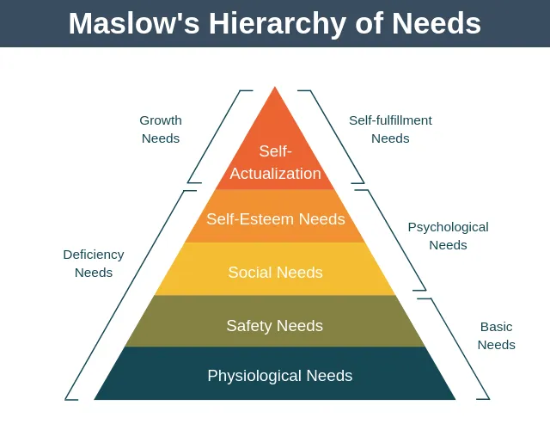
Hierarchy of Needs
Finding Your Purpose

Slide 7
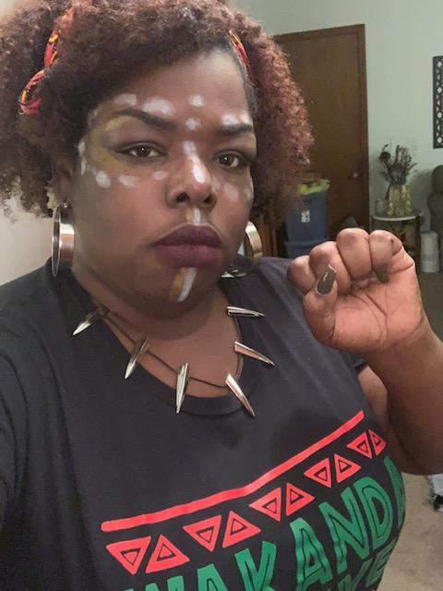
Shedding Some Light on the Matter: Who am I?
I am Jamaican-American
I am Public Health Servant
I am Equity Advocate
I am Social Worker
I am native of Prince George’s County
I have roots In Mississippi

Slide 8
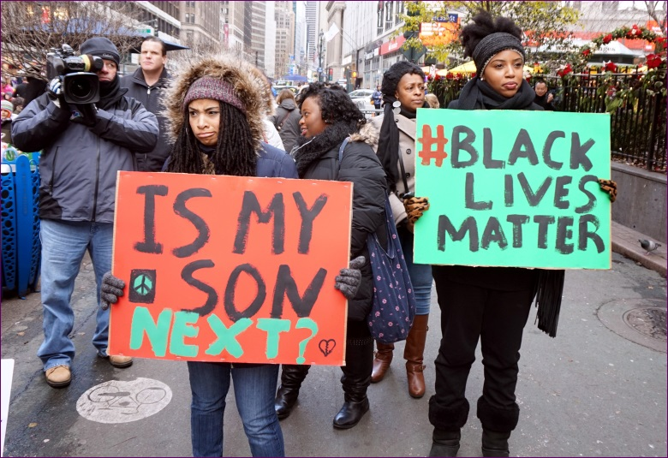
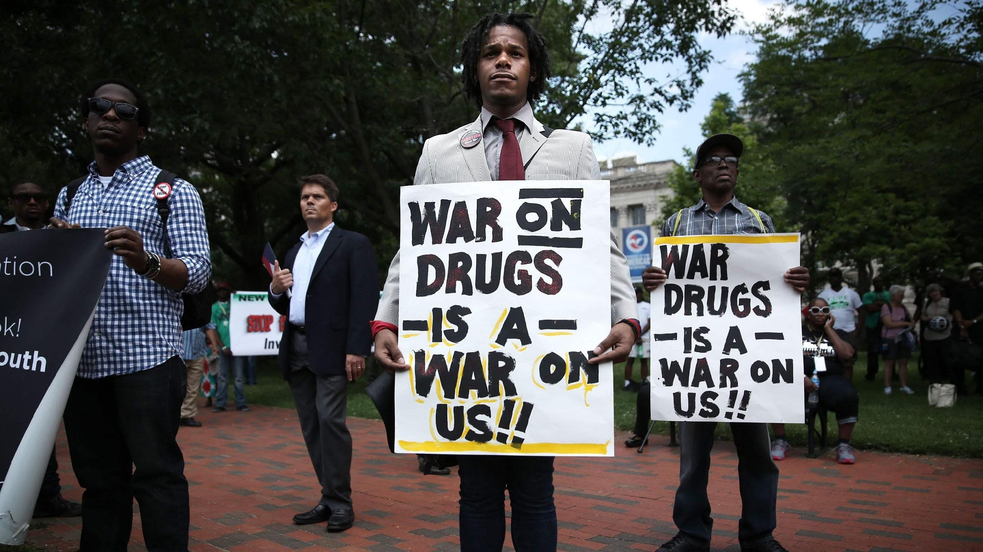
Images Have Meaning
Finding Your Purpose
Notes:
Historical images have may compelled you to this profession.

Slide 9
Images Have Meaning
Impact of Racial Trauma
Ms. Breonna Taylor
March 13, 2020
Mr. George Floyd
May 25, 2020
Notes:
In this era of having witnessed multiple police killings of African American boys and men and girls and women either directly or vicariously through media accounts, communities of Color may experience post trauma symptoms. According to Boston College Website

Slide 10
Behavioral Health Equity Group
Finding your purpose
Mission:
Create a behavioral health system and administration that is equitable, accessible, and provides quality services to all Marylanders.
Vision:
Through collaboration with stakeholders and community engagement, implement practices and services that include, recognize and value all individuals, regardless of their age, culture, disability, gender identity, ethnicity, race, religious and/or sexual orientation

Slide 11
Behavioral Health Equity Group Strategic Plan and Core Elements
Finding your purpose
Data Evaluation
Funding & Resource Allocation
Policies and Procedures
Partnership & Collaboration
Awareness, Outreach & Community Engagement
Program Development & Implementation

Slide 12
Behavioral Health Equity Group Projects
Finding your purpose
Partnering with the Maryland Office of Minority Health and Health Disparities
Mental Health and
Racism Symposium
Partnering with local systems managers
(BHI & BHAC)
Mental Health First Aid training for Community-Based Programs
BHA Annual Conference
2021

Slide 13
What can impact purpose
Finding Your Purpose
Physical and mental well-being (taking care of our body and mind, using stress-reduction techniques and building mental resilience)
Belonging and recognition (being part of something much larger than themselves, feeling valued and validated)
Personally, treasured activities (things we do that make us feel good – hobbies, spending time with our family and friends)
Spiritual closeness and connectedness (a feeling that all living things in the world are interrelated). It should be noted, that religion can be part of spirituality, but spirituality goes beyond religion.

Slide 14
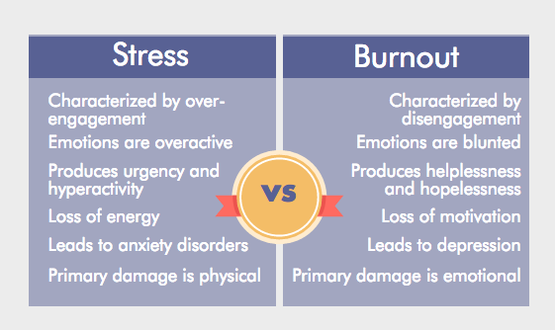
What is the impact of Burnout
Finding your purpose
Notes:
Providers are not exempt from these feelings and should also note they are

Slide 15
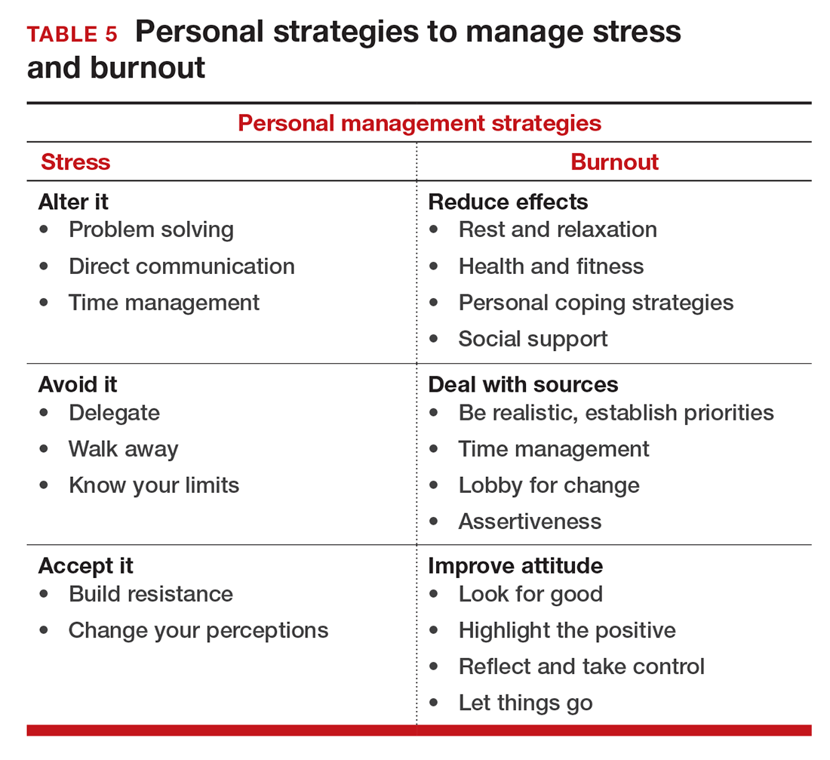
What is the impact of Burnout
Finding your purpose
The impact trauma can have on mental health:
Create a hostile and invalidating work or campus climate
Perpetuate stereotype threat
Create physical health problems
Saturate the broader society with cues that signal devaluation of social group identities
Lower work productivity and problem-solving abilities, and be partially responsible for creating inequities in education, employment and health care.

Slide 16
What can you impact purpose: Questions to consider ( Home vs Work)
Finding Your Purpose
Home
Are you maintaining and nurturing relationships with spouse partner or significant other?
What family heritage or cultural tradition do you value?
Work
How much of the time is spent doing things that make you feel energized & engaged?
Are you seeking opportunities where your strengths are most needed and utilized?
Are you surrounded by people that inspire empower, and encourage you to be a better person?
Do you understand the impact your work has on clients, employees or customers?

Slide 17
How to Heal Microaggression
Finding your purpose
Can one ever heal from racial microaggression?
3 Truths that one must adopt:
Your Experience Are Real
Your Feelings Are Valid
You Deserve To Heal
You have the right to prioritize YOUR mental health, safety and well-being.

Slide 18
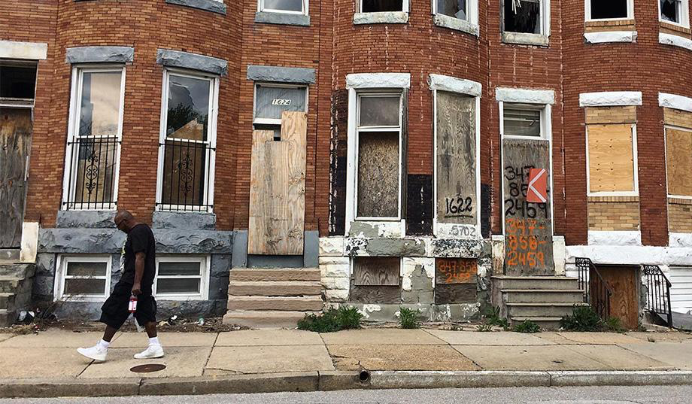
What is the impact on mental health? Life Expectancy – 79 years vs. 70 years
Impact of Racial Trauma

Slide 19
Doing Our Part: Call to Action
Impact of Racial Trauma
Self-awareness through reflection: Gain deeper insight through journaling to contemplate and discover your “best self
Take time to recharge:
Consider a short break or a longer vacation to rest and recover so you can be refreshed for what’s next.
Share your coins: Don’t
underestimate the impact you
have on others. Imagine your
life experiences as valuable
coins. Share them but also get inspired as a “coin” collector.
Notes:
In pursuit of your purpose
Self- Care
Be Courageous
Be Fearless
Be Daring in the face of adversity

Slide 20
Takeaways and Next Steps
Impact of Racial Trauma

Slide 21
Some Resources for you
Impact of Racial Trauma
BHA COVID-19 Response webpage
KIRWAN INSTITUTE
Guideline to responding to mental health trauma for healthcare workers
Understanding the burnout experience.
Normalized stress and compassion fatigue
Defining your purpose

Slide 22
CME Accreditation and Designation
CMEs will be available at no cost, as will Participant Certificates, which for other disciplines can
qualify for continuing education credit.
This activity has been planned and implemented in accordance with the Essential Areas and
policies of the Accreditation Council for Continuing Medical Education (ACCME) through the
joint providership of MedChi, The Maryland State Medical Society and the Behavioral Health
Administration of the Maryland Department of Health. MedChi is accredited by the ACCME to
provide continuing medical education for physicians. CMEs will be available at no cost, as will
Participant Certificates, which for other disciplines can qualify for continuing education credit.
MedChi designates this webinar educational activity for a maximum of 1 AMA PRA Category 1
Credits™. Physicians should claim only the credit commensurate with the extent of their
participation in the activity, as should other disciplines who claim credit for Participant
Certificates. For CME/Participant Certificate questions please contact Steve Whitefield at
steven.whitefield@maryland.gov.

Slide 23
CME Disclosures
Presenters and Planners: Aliya Jones, MD and Steve Whitefield, MD have reported no relevant financial relationships to disclose. Stephanie Slowly, MSW, LCSW-C and Shanta Powell, MD have reported no relevant financial relationships to disclose.
MedChi CME Reviewers: The reviewers from the MedChi Committee On Scientific Activities (COSA) for this activity have reported no relevant financial relationships to disclose.

Slide 24
TELL YOUR STORY
What challenged me today?
What did we Learn today?
What was my A Ha moment?
What will I do differently ?

Slide 25
You are Born on Purpose For a Purpose you are Required to Live on Purpose. ~S. Slowly

Slide 26
Questions??

Slide 27
THANK YOU
Stephanie Slowly, MSW LCSW-C
Director, Systems Management
Behavioral Health Administration
Stephanie.slowly1@maryland.gov

