Slide 1

GMHCN
Celebrating
25 YEARS OF RECOVERY + HOPE + WELLNESS
Mission Statement
"Our mission is to promote recovery through advocacy, education, employment, empowerment, peer support and self help, and to unite as one voice to support the priorities set each year at the annual conference."

Slide 2
GMHCN
The Georgia Mental Health Consumer Network is a non-profit corporation founded in 1991 by consumers of state services for mental health, developmental disabilities, and addictive diseases. It hosts one of the largest statewide annual conferences held by people in recovery from behavioral health concerns in the nation. The corporation evolved from a meeting of 30 peer leaders held in Tucker, Georgia in October of 1990. And now has grown to over 4000 members across the state.

Slide 3
GMHCN Projects
Certified Peer Specialist (CPS) Project
Peer Support, Wellness and Respite Centers (PSWRC)
Peer Mentoring & Forensic Peer Mentoring
Double Trouble in Recovery (DTR)
Whole Health Action Management (WHAM)
Mental Health First Aid (MHFA)
RESPECT Institute
Recovery Community Organizations
Recovery Focused Transformation (RFT)

Slide 4

An Overview

Slide 5
On Recovery and Hope…
Definitions of Recovery and Hope
Recovery is a deeply personal, unique, and self-determined journey through which an individual strives to reach his/her full potential. Persons in recovery improve their health and wellness by taking responsibility in pursuing a fulfilling and contributing life while embracing difficulties one has faced. Recovery is not a gift from any system. Recovery is nurtured by relationships and environments that provide hope, empowerment, choices and opportunities. Recovery belongs to the person. It is a right, and it is the responsibility of us all.
Hope is the belief that one has both the ability and the opportunity to engage in the recovery process.

Slide 6
So, What Is A CPS, Anyway?

Slide 7
GEORGIA CPS PROJECT
MISSION STATEMENT
It is the mission of the Georgia Certified Peer Specialist Project to identify, train, certify, and provide ongoing support and education to consumers of behavioral health services, to provide peer support as part of the Georgia behavioral health service system and to promote self-determination, personal responsibility and empowerment inherent in self-directed recovery.

Slide 8
Georgia CPS Project Origins and History:
Originally funded through a federal grant from the Substance Abuse, Mental Health, Services Administration’s, Center for Mental Health Services.
The Statewide Consumer Networking grant was secured and administered by the Georgia Mental Health Consumer Network in collaboration with the Georgia Department of Behavioral Health and Developmental Disabilities (DBHDD).
Currently funded by DBHDD in collaboration with the Office of Recovery Transformation.

Slide 9
Georgia CPS Project Origins and History:
Since 2001 the Georgia Certified Peer Specialist Project has held 60 CPS trainings.
To date, over 1600 peers have achieved their CPS certifications in Georgia and more than half of these peers are currently working in the Behavioral Health System.
5 Trainings annually (45 peers per training)
5 different training locations across Georgia
5 Testing periods annually

Slide 10
Application Requirements for CPS Training:
Hold at least a GED or High School diploma.
Be at least 18 years of age.
Have a diagnosis of mental illness or a dual diagnosis of mental illness and addictive disease.
Strong desire to self-identify as a person in recovery from a behavioral health diagnosis.
Demonstrate strong reading comprehension and written communication skills.
Have demonstrated experience with leadership, advocacy, or governance.
Be well grounded in recovery.

Slide 11
CPS Training Course Content
Using Your Recovery Story as a Recovery Tool
The Shift to Recovery and Resiliency
The Role of Peer Support Services
Creating Recovery Cultures
Five Stages in the Recovery Process
Problem Solving With Individuals
Facing Your Fears
Combating Negative Self-talk

Slide 12
CPS Training Course Content
Trauma Informed Care
Facilitating Recovery Dialogues
Effective Listening and the Art of Asking Questions
Shared Decision Making
Ethics and Professional Boundaries
Power, Conflict and Integrity in the Workplace
Person-First Language

Slide 13
CPS Training Course Content
raining Course Content
Cultural Competency
Documentation
Person-Centered Planning
Advocacy
Wellness Recovery Action Plan (WRAP)
Whole Health Action Management (WHAM - Overview)
Supported Employment
Double Trouble In Recovery (DTR)

Slide 14
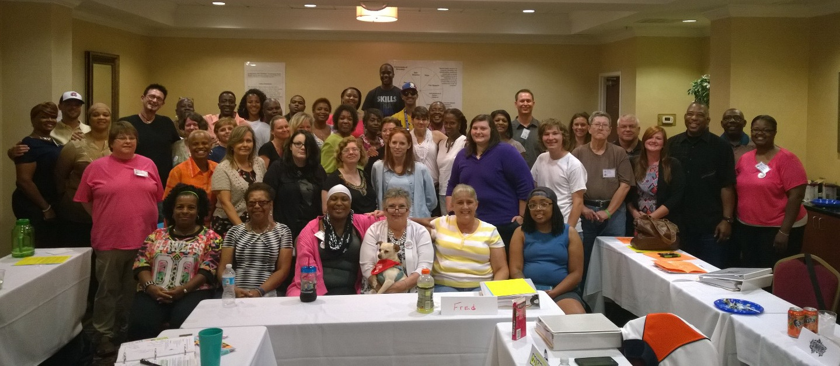
Georgia CPS Project Origins and History:
The
48th
CPS
Training
Class

Slide 15
Whole Health and Wellness Coach (WHWC) Whole Health Action Management (WHAM) 10 Whole Health Resiliency Factors
Additional Services a CPS Provides
1) Stress Management
2) Healthy Eating
3) Physical Activity
4) Restful Sleep
5) Service to Others
6) Support Network
7) Optimism Based on Positive
Expectations
8) Cognitive Skills to Avoid
Negative Thinking
9) Spiritual Beliefs and
Practices
10) A Sense of Meaning and
Purpose

Slide 16
CPS’s in Georgia now have four specific areas of focus:
CPS
CPS-AD (Certified Addiction Empowerment Specialist)
CPS-P (Parent)
CPS- Y (Youth)

Slide 17
CPS-AD (Addictive Disease) CARES (Certified Addiction Recovery Empowerment Specialist)
The Certified Addiction Recovery Empowerment Specialist program was developed by the Georgia Council on Substance Abuse to create a workforce of peers to provide addiction recovery support services to the communities of Georgia. Funded by Georgia's Department of Behavioral Health and Developmental Disabilities, the CARES program is the first of its kind in the country to be Medicaid billable.

Slide 18
Parent Certified Peer Specialist (CPS-P)
A CPS-P is the parent or legal guardian (in a permanent relationship for at least 3 years) of a child who is living with a mental health, substance use or a co occurring diagnosis who provides support to other parents who are raising a child with similar behavioral health conditions.
First Class held - November 2013
130 CPS-P have been trained

Slide 19
Youth Certified Peer Specialist (CPS-Y)
A CPS-Y is an individual who is a young adult, ages 18 through age 26, with lived experience who received behavioral health services as a youth, and is willing and able to self-identify as a person who has or is receiving behavioral health services and is prepared to use that experience in helping others.
First Class held – September 2015 –
42 CPS–Y have been trained

Slide 20
Supporting both Individual and Family Recovery Family Recovery
Serving the entire Family (family can be biological or identified)
Engaging the Youth and Family around prevention, interventions and support to resilience
Intentionally including the family to become actively involved
Equipping the Youth and Family with tools and resources that will sustain wellness
Encourages the Family to focus on strengths and assets and look beyond the “illness”
Promoting Family preservation

Slide 21
Benefits of a CPS to the Healthcare System
The training and certification process prepares CPSs to promote hope, personal responsibility, empowerment, education, and self-determination in the communities in which they serve. Certified Peer Specialists are part of the shift that is taking place in the Georgia Mental Health System from one that focuses on the individual's illness to one that focuses on the individual's strengths.

Slide 22
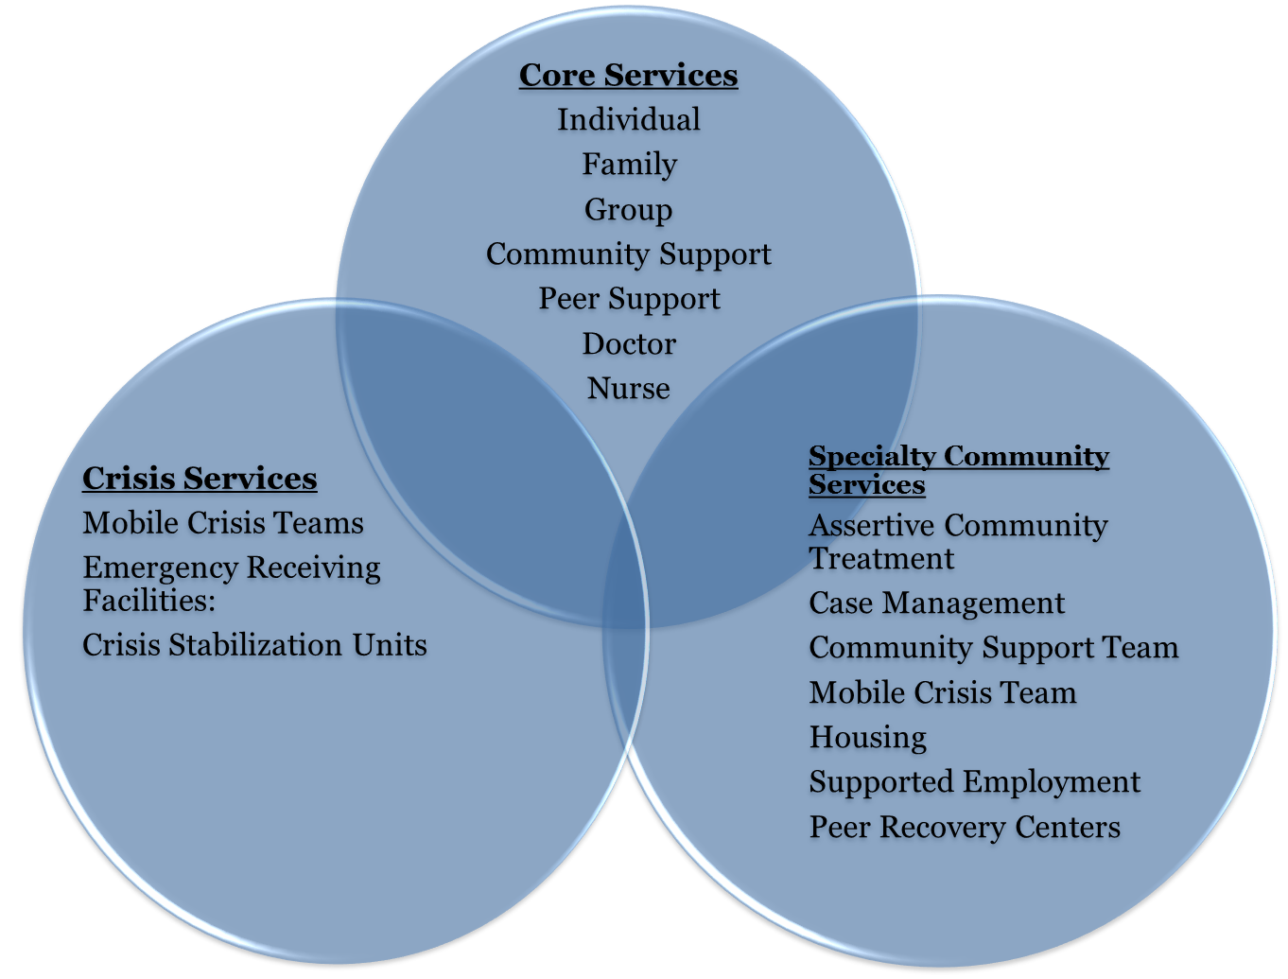
A Broad Array of Community-Based Services

Slide 23
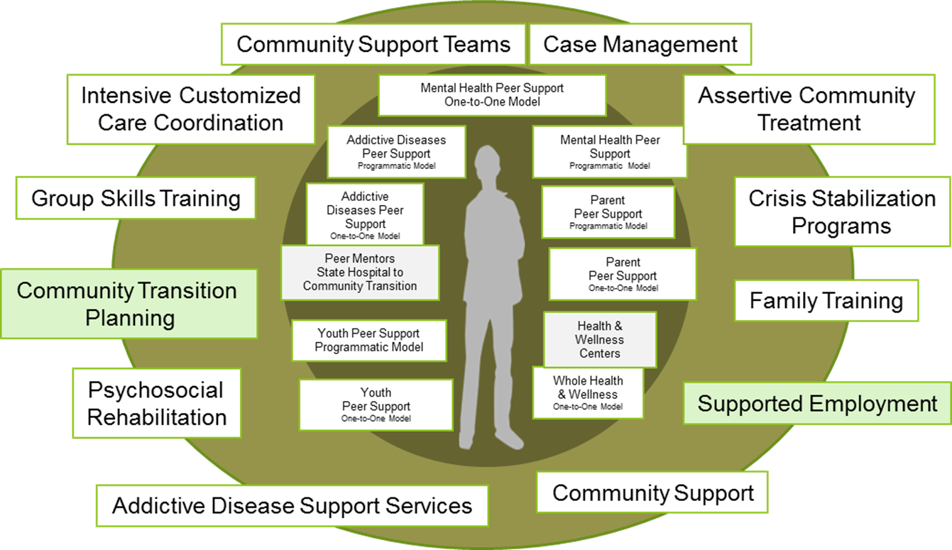
DBHDD Services that employ CPSs

Slide 24
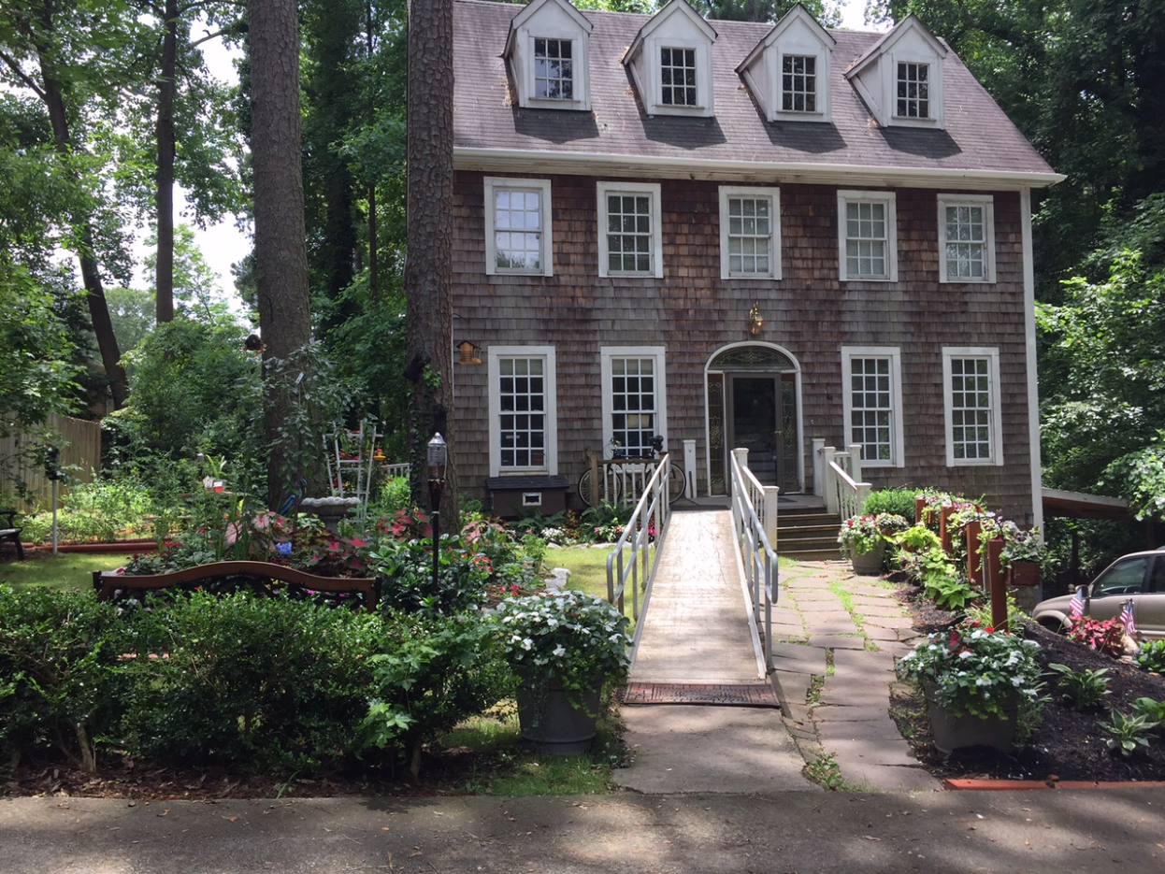
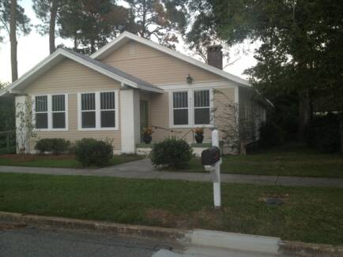
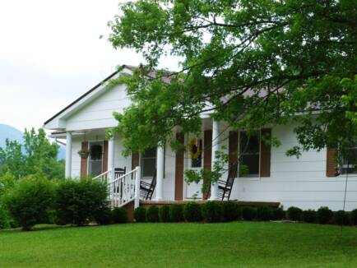
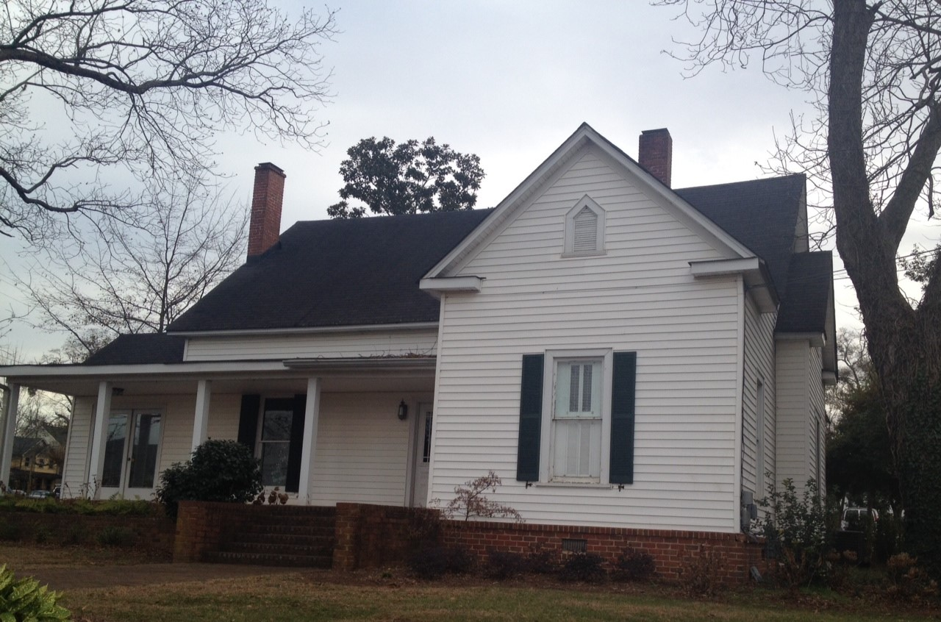
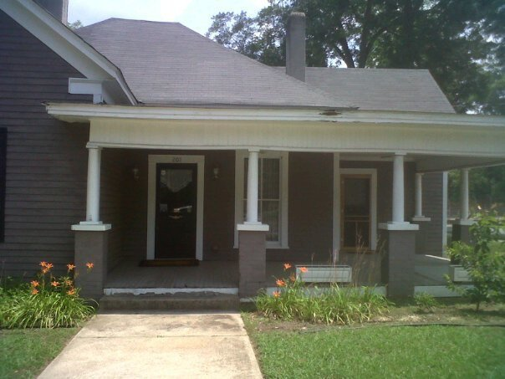
GMHCN Peer Support, Wellness and Respite Centers in Georgia
Colquitt County
September 2014
Dekalb County
January 2008
White County
June 2012
Henry County
September 2014
Bartow County
June 2012

Slide 25
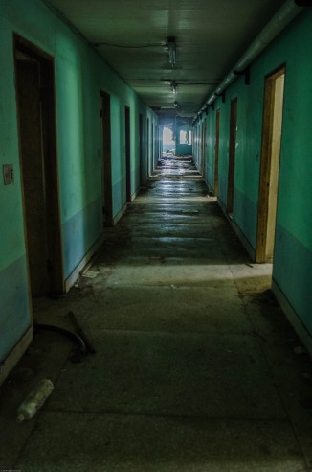
Traditional Services
Traditional behavioral health crisis services can be a study in what not to do. At a time when people need the support of family and friends, they are often isolated in hospital emergency departments and behavioral health units, forced to take unwanted medications, and are deprived of various personal rights.

Slide 26

Hospitalization
Often the only resource or support service available to individuals experiencing a behavioral health crisis or an acute exacerbation of symptoms
(Agar-Jacomb & Read, 2009; Burns-Lynch & Salzer, 2001; Fenton, Mosher, Herrell & Blyler, 1998; Mosher, 1999; Toprac, Sherman Sherman, Holzer, et al 1996) et al., 1996).
This is problematic on a number of levels.

Slide 27
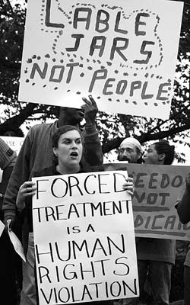
Alternatives
Creation of Peer-run Respite Centers, in part, is because of consumer/survivors’ experience with force/coercion/trauma experienced in institutions.
For many, clearly something isn’t “working” with historical reliance on institutions and psychiatric drugs

Slide 28
Many state systems are funding effective alternatives to traditional crisis services. a number of peer-run respite models have developed, both as part of cost containment and transition to a recovery-oriented system of care. Peer respites are increasing in prevalence and becoming more standardized.
Peer run respite centers are for individuals living with mental health and/or substance use concerns. Respite Centers offer a supportive, home-like environment during times of increased distress. Respite stays are typically short-term.

Slide 29

Impact of Respite
Relieves pressure off of hospitals/crisis centers
Studies have shown a 70% decrease in utilization of inpatient and emergency services for peers accessing respite services vs peers not having access to respite services.
Additionally, studies have shown, a longer stay in respite was associated with fewer hours of inpatient and emergency service use.
[Croft, B., & İsvan, N. (2015). Impact of the 2nd Story Peer Respite Program on Use of Inpatient and Emergency Services. Psychiatric Services, 66(6), 632-637.]

Slide 30
History of the PSWRCs
GMHCN & DBHDD
Study Tour in December 2007
Staff hired + IPS training in January 2008
Grand Opening on January 30, 2008
Challenges and triumphs with the neighborhood

Slide 31
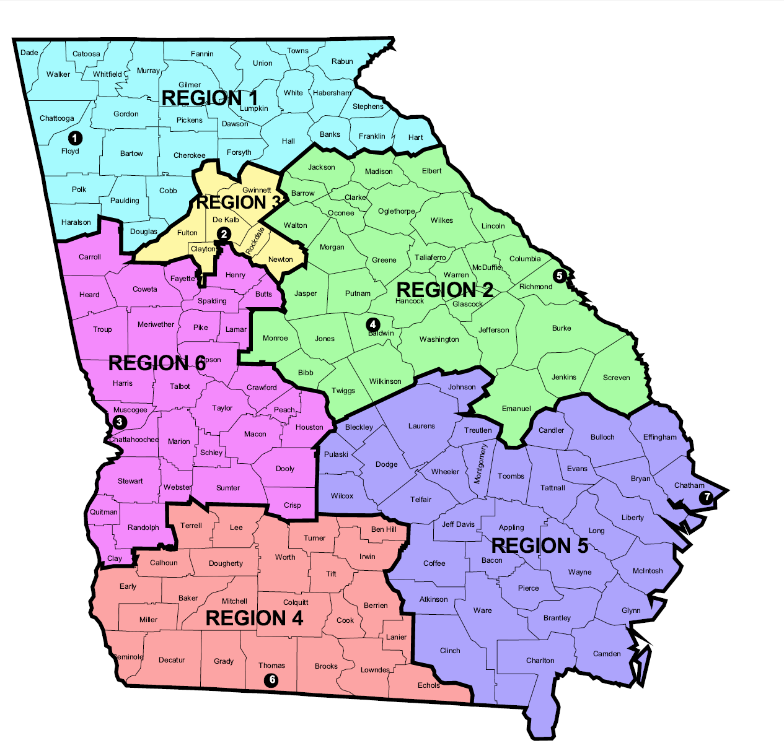
Funded by the Department of Behavioral Health and Developmental Disabilities

Slide 32

Certified Peer Specialist (CPS)
Intentional Peer Support (IPS)
Trauma-Informed Peer Support
Wellness Recovery Action Plan (WRAP)
Whole Health Action Management (WHAM)
Hearing Voices Support Training
GMHCN Policies & Procedures
OSHA
CPR / First Aid
Additional trainings throughout Georgia

Slide 33
Intentional Peer Support (IPS)
IPS is unique from traditional human services because:
IPS relationships are viewed as partnerships that invite and inspire both parties to learn and grow, rather than as one person needing to ‘help’ another.
IPS doesn’t start with the assumption of a problem. With IPS, each of us pays attention to how we have learned to make sense of our experiences, then uses the relationship to create new ways of seeing, thinking, and doing.
IPS Promotes a trauma-informed way of relating
IPS examines our lives in the context of mutually accountable relationships and communities — looking beyond the mere notion of individual responsibility for change.
IPS encourages us to increasingly live and move towards what we want instead of focusing on what we need to stop or avoid doing.

Slide 34




Intentional Peer Support (IPS)
Connection
Worldview
Mutuality
Moving Toward

Slide 35
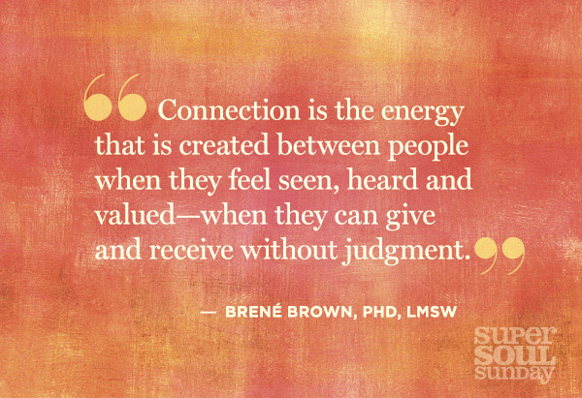
Connection

Slide 36
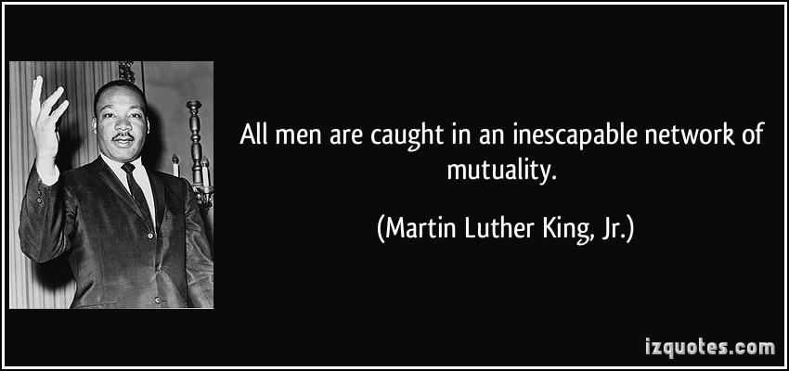
Mutuality

Slide 37
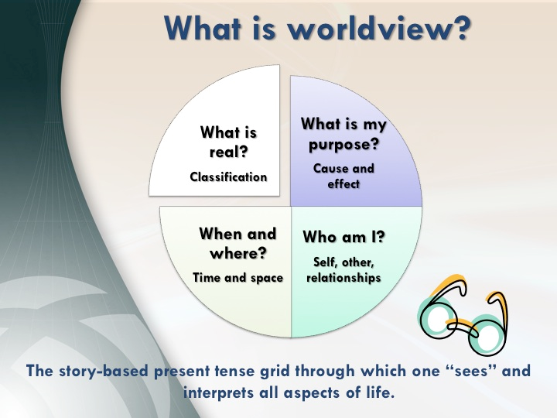

Slide 38
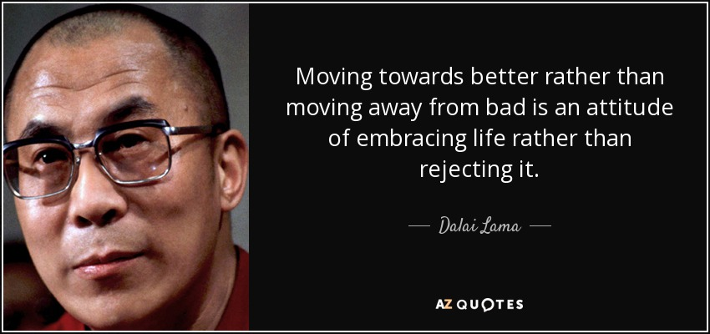
Moving Toward

Slide 39

Co-Reflection
Each staff meets with every other staff
once a month
Coworker relationships are negotiated during co-reflections
Co-reflections help to maintain
a friendly work environment

Slide 40



Trauma Informed Environment
We recognize that trauma often appears
in the experiences of our peers
We maintain an atmosphere of respect and dignity

Slide 41
Trauma in the Literature
Overwhelming evidence demonstrates that trauma can lead to “mental health problems” in adulthood.
The vast majority of people diagnosed with major psychiatric disorders have histories of trauma
Trauma is correlated more with major psychiatric disorders than anything else

Slide 42

Defining Trauma
“Trauma is something that happened to you that still haunts you today. And if it doesn’t still haunt you, it did for a long long time.”
~ IPS Training Participant
Notes:
Jayme

Slide 43
Peer Support, Wellness and Respite Center Services
24/7 Warm Line
Respite
Daily Wellness Activities
Computers/Internet Access
Community Resources

Slide 44


24/7 Warm Line
Peers throughout the state of Georgia utilize our Warm Line 24 hours a day
Peer support over the phone
Partnership with Georgia Crisis and Access Line
Peers supporting peers

Slide 45







Wellness Activities
Daily activities address whole health, wellness and having a life in the community

Slide 46

Daily Wellness Activities DBHDD Deliverables
Wellness Recovery Action Plan (WRAP)
Double Trouble in Recovery (DTR)
Computer Skills Training
Financial Planning
Housing Support

Slide 47
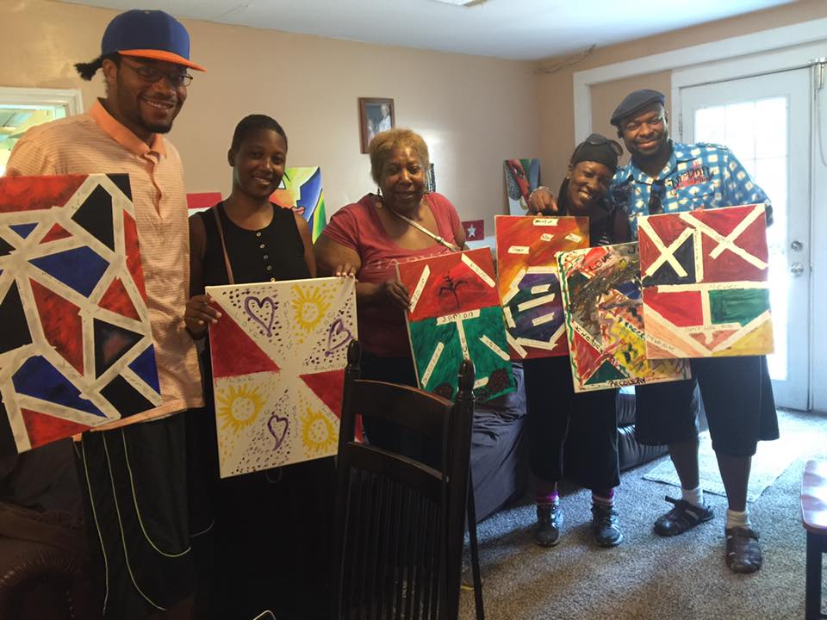
Certified Peer Specialists use their lived experiences to facilitate wellness activities
Art Explorations
Lyrical Expressions
Creative Writing
YMCA
Bowling
Trauma-Informed Peer Support
Hearing Voices Network (HVN)
Sacred Space
Resource Support

Slide 48

PeerZone Workshops are a series of up to 20 three-hour peer-led workshops for people who experience mental distress and addiction. The workshops provide a fun, interactive and safe structure for participants to share their experiences, learn self-management and expand their horizons.
Since 2013 PeerZone has certified over 200 facilitators in Australia, New Zealand, Canada and the USA.

Slide 49

Respite
Alternative to inpatient hospitalization
Crisis as opportunity
Utilize community resources
Three respite rooms per PSWRC (15 total)
Proactive Conversation to establish peer relationships before a respite stay is needed
Eligible every 30 days

Slide 50
The majority of respite guests report that accessing respite prevented a inpatient hospitalization
Data compiled from anonymous Evaluation/Feedback forms offered each month to all peers who use PSWRC services

Slide 51

A word from our peers
" I had a major trauma and was preparing to go to crisis but a friend convinced me to try this instead. Amazing! "
" Respite is much better and more effective than the hospital “
" I can relax and I feel respected “
“Respite offers more freedom [than hospitalization] and being treated like a human being.”
“This was a place of recovery.”

Slide 52

Links Georgia Mental Health Consumer Network Department of Behavioral Health and Developmental Disabilities Georgia Peer Support, Wellness, and Respite Centers Georgia Crisis and Access Line Georgia Certified Peer Specialist Project Intentional Peer Support WRAP

Slide 53
Thank You!
To reach me:
Sherry Jenkins Tucker, CPS, MA, ITE
Executive Director
Georgia Mental Health Consumer Network
246 Sycamore Street
Suite 260
Decatur, GA 30030
404-421-5683
sjtucker@gmhcn.org

