Slide 1
Highlights of Trauma Informed Care
Ruth Anne McCormick, Ph.D, RN
Jennifer Tuerke, CPRS, RPS

Slide 2
Substance Abuse and Mental Health Services Adm.
(SAMHSA)
Definition of Trauma:
...trauma results from an event, a series of events, or a set of circumstances that is experienced by an individual as physically or emotionally harmful or life threatening and that has lasting adverse effects on the individual’s functioning and mental, physical, social, emotional or spiritual well-being.”
SAMHSA: 2014, p.7

Slide 3
Principles of Trauma Informed Care
Basic principles of Trauma Informed Care (SAMHSA) include:
Safety
Trustworthiness and transparency
Peer Support
Collaboration and mutuality

Slide 4
Additional Principles
Empowerment and choice
Culture, historical and gender issues.
*These principles are supported by the Center for Disease Control (CDC) office of Public Health Preparedness and Response, National Center for Trauma Informed Care (NCTIC) as well as SAMHSA.

Slide 5

Use of Trauma Principles
The previously mentioned principles are tools which can guide the interaction for the Peer Support Specialist. These principles are the basic foundation for trauma informed care. Safety may be the first principle to use in working with peers.

Slide 6

Trauma Informed Care
Trauma informed care is considered to be the way in which you approach a person with consideration of safety and a sense of empowerment with respect to their culture and recovery.

Slide 7
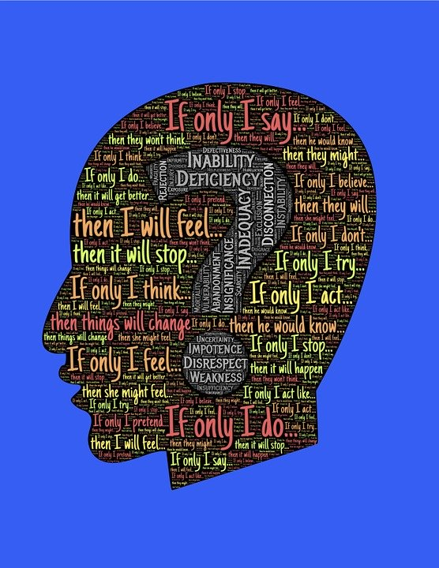
The Effect of Trauma
Trauma issues are specific to the person. No two people have the same response to trauma.
Responding to trauma may effect the person short term or for their lifetime.
Identifying strengths and coping skills help with healing.

Slide 8
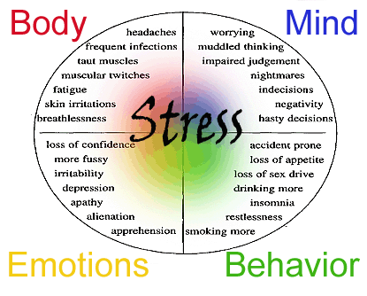
Trauma as a Reaction

Slide 9
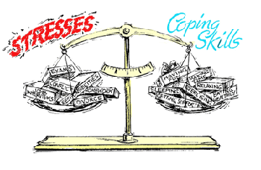
Coping with Trauma
Coping skills are often paired with the person’s strengths and it may be helpful to identify past coping skills which were previously helpful.
Know that you can identify resources which tip the scale!

Slide 10
Resilience and Recovery
Resilience is the ability to bounce back and adapt to change (whether positive or negative change).
With the experience of trauma, persons have the ability to use resilience when they are able.
However, re-traumatization may occur and Peers are encouraged to work on this by using recovery components.

Slide 11
Trauma Informed Care: A Universal Approach
Data suggests that over 90% of people engaged in the public behavioral health care system have experienced trauma.
Does a Peer need to know about someone’s trauma in order to use trauma informed Peer services?
Why or why not?

Slide 12
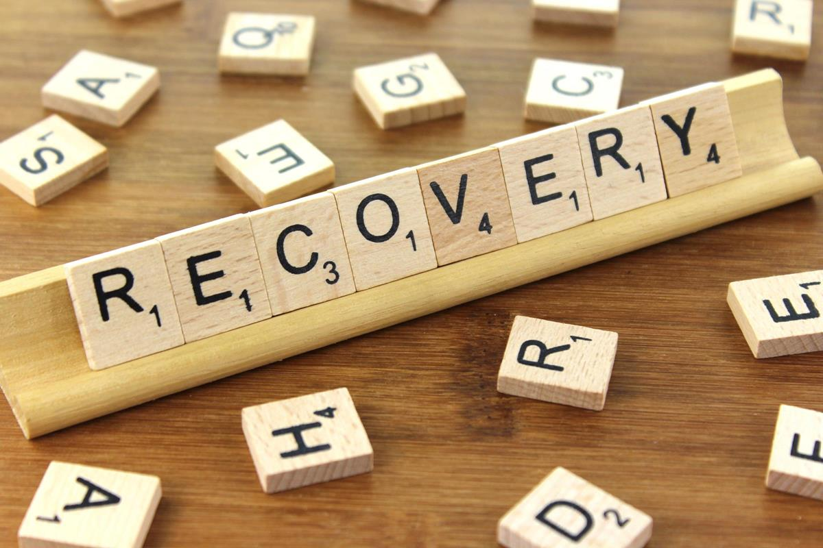
Recovery Components
Person-Driven
Many Pathways
Holistic
Peer Supported
Relationships
Culture
Addresses Trauma
Strengths/Responsibility
Respect
HOPE
Source: SAMHSA; Working Definition of Recovery, 2012

Slide 13
Case Presentation
Group discussion by all participants. Groups will be identified by the workshop presenters.
Answer questions in your group and present your group decisions to the larger audience after all the questions have been answered.
Each group will be responsible to pick a leader to present their work.
Additional comments can be made after all the groups have presented their work.
Read the Case Presentation before discussion.

Slide 14
Trauma and Adverse Childhood Experiences
Research: Relationship between childhood abuse and issues affecting adult health (commonly known as the ACE Study).
Longitudinal study supported by Kaiser-Permanente.
Researched by Drs. Felitti and Anda, et. al (initial work from 1995-1997 was published in 1998).
This work included 17,000 adults from age 19-57 and identified three areas of concern: abuse, neglect and household dysfunction in relation to risk of health behaviors.

Slide 15
Adverse Childhood Experience (ACE) Test
See handout.
This test is for you only and not to be shared. The results are listed on the back of your paper. Most everyone has been exposed to trauma. You need to know where you are and what are your re-traumatizing situations. We will discuss these ideas more in depth at our all day workshop.

Slide 16
I Have a High ACE Score, Now What?
Remember, an ACE Score is not a life sentence. People heal, grow and thrive!
Focus on strengths: you are HERE, helping others, making a positive difference.
Talk about your feelings with your sponsor, therapist, support group, etc.
You are among friends. We have shared experiences with recovery from trauma.
Call the Core Service Agency at your local Health Department. Ask about trauma therapy options in your county.
For additional support or information: Jennifer Tuerke: (443) 309-6457 and
Ruth Anne McCormick: drram612@gmail.com

