Slide 1

Providing Support to Families who have loss someone to Drug Overdose
Annette March-Grier, RN, CFSP

Slide 2
Did You Know?
Overdose deaths outnumber traffic fatalities in the US?
Did you know that someone dies every 14 minutes from drug overdose in this country?
In 2011 data came out showing that prescription medication overdose deaths outnumbered heroin and cocaine deaths combined.
Overdose deaths outnumbered prostate cancer deaths and are nearing the number of breast cancer deaths.

Slide 5

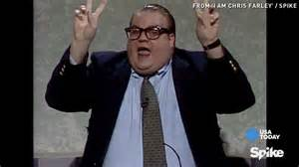
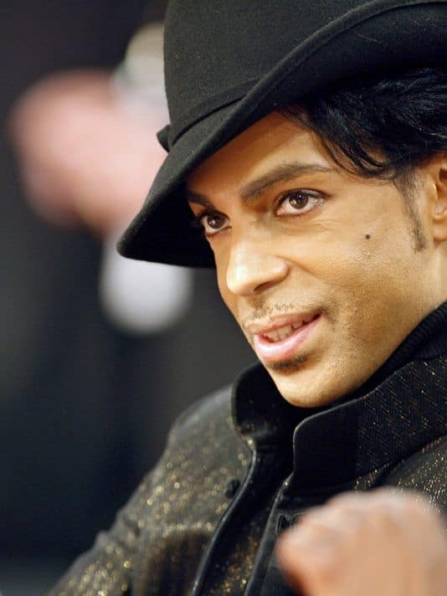

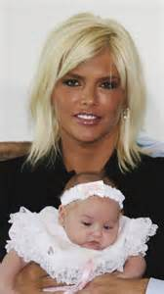
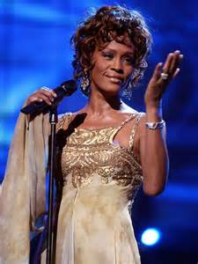

Celebrities Overdose Deaths
Anna Nicole Smith 39)
Michael Jackson (50)
Heath Ledger(28)
Whitney Houston (48)
Cory Monteith (31)
Chris Farely (33)
Prince (57)
Notes:
Even with more money and treatment people lose the battle every day
Real people behind those statistics and real people grieving.

Slide 6
Under researched Academically
An exhaustive search for entries on grief or bereavement and overdose (or drug) deaths from Med-line, Psych-Info, and the Social Science Index yielded only two research notes on the topic. Both studies were done outside the United States: one a Brazilian study (da Silva, Noto, & Formigoni, 2007), and the other a British study (Guy, 2004).

Slide 7
Addiction is a chronic disease of the brain that can lead to an overdose that causes death. As more and more people are touched by addiction, more and more families are left with the grief of an overdose death
Notes:
For example, the disease of breast cancer attacks cells in the breast and the disease of diabetes, attacks cells in the metabolism system. The diseases of addiction (drug addiction or alcoholism) change cells in the brain, which is why addiction is a brain disease, and why addiction causes behavioral changes — it changes the way the brain works, and given the brain controls everything we think, feel, say and do, those addiction-related brain changes, change a person’s behaviors.

Slide 8
Grief, A Natural Healing Process
Normal Grief
Grief is a normal, internalized reaction to the loss of a person, thing or idea. It is our emotional response to loss.
Mourning means taking the internal experience of grief and expressing it outside of us. It is the cultural expression of grief as seen in rituals.

Slide 9
Normal Grief
Bereavement is the state of having lost something, whether it be significant others, things or a sense of self. This state can range from the death of parent, the destruction of home, to the loss of dreams, dignity and self respect

Slide 10
Grieving is one of the most Stressful Events we encounter
Stress is….
The way we interpret life’s experiences and in the attitudes and feelings we invent about what has happened.
Any obstacle in the way of our preferred reality.
Stress is the process of adjusting and adapting to circumstances. The process of healing psychic bruises and working out ways to deal with obstacles that threaten our well being.

Slide 11
The stress of grief causes
Saddness
Anger
Guilt and self reproach
Anxiety
Numbness
Loneliness
Fatigue
Helplessness
Shock
Yearning
Emancipation
Relief

Slide 12
Cognitive Physical
Disbelief
Confusion
Preoccupation
Sense of Presence
Hallucinations
Absent mindedness
Stomach pain
Tightness in chest
Oversensitivity
Weakness
Short of breath
Dry mouth
Euphoria

Slide 13
Complicated Grief Issues
When life issues are unexpressed or unacknowledged, they become locked in frozen blocks of time.
The natural flow of grief is inhibited.
Unable to process

Slide 14
Factors that Contribute to Complicated Grief
Sudden or traumatic death
Social stigma of death
Multiple losses
Ambiguous relationship with deceased
Lack of support systems
Previous mental or physical health disorders
History of victimization or abuse

Slide 15
What Makes Grief from Overdose Unique and Complicated
More Pronounced Feelings
Blame Self, friends, other family members for the death
Guilt is stronger-death could have been prevented
Guilt behind the reality of living with someone with an addiction
Anger of not knowing someone we love was using drugs
Sense of helplessness and powerlessness

Slide 16
Grief Work
Acceptance of the discomfort generated by looking realistically at the loss.
Participate actively in the work of mourning instead of trying to escape or deny it.
To realize that grieving can be delayed but not postponed indefinitely.

Slide 17
The Four Task of Mourning J. William Worden
Acknowledge the reality of the loss
To work through the pain of grief
To adjust the environment in which the deceased is missing.
Externally, Internally & Spiritually
To emotionally relocate the deceased and move on with life- reinvest.

Slide 18
Definitions
Unintentional/Accidental Overdose: Person did not mean to take their own life by overdosing
Intentional/Suicidal Overdose: Person intended to end their life by overdosing
Ambiguous Grief: When we grieve a person who is still alive, but the relationship and the person as we know them has changed.
Disenfranchised Grief: is a term describing grief that is not acknowledged by society. ...

Slide 19
Death Feels Avoidable or Preventable
Much like suicide
Could have been avoided
Complicated emotions..guilt, shame blame, fear and isolation

Slide 20
Guilt With Overdose
Guilt that you could have done something to prevent the loss.
Guilt that your loved one suffered from addiction.
Guilt that the death brings a sense of relief.
Guilt that you were not aware of their drug use or substance dependence.
Notes:
Friends and family may feel guilt that they could have or should have done something to prevent
Guilt that the family member suffered from addiction (i.e. a parent, spouse, etc. feeling it is their fault the person who died developed an addiction)
Guilt if the death brings a sense of relief after years of addiction impacting family and friends.
Obsession over actions done/not done to support the person who died.

Slide 21
Guilt vs. Shame with Overdose
Guilt is on our own perception that we could or should have done in a certain situation.
Shame is based on our perception that others think. Guilt is the idea that one did something bad, whereas shame is the belief that one is bad.
Guilt is a feeling about an action
Shame is a feeling about the self.
Notes:
In the case of overdose death, shame can manifest in various ways.

Slide 22
Shame
Shame that the family member suffered from addiction
Shame for enabling the person who died.
Shame for not doing enough to “help” the person who died.
Shame for the person who died –less worthy of mourning for
Notes:
(i.e. a parent believing others think it was their fault or they were a bad parent for having a child who suffers from addiction)
(feeling that others blame that person for their addiction and/or death, and hence are less worthy of mourning)

Slide 23
Blame
Blame toward those who used drugs/alcohol with the person who died.
Self-blame for the person developing an addiction.
Self-blame for the person’s death.
Blame toward the person who died for their own death.
Blame toward family members for not preventing the death.
Obsession over actions done/not done to support the person who died.
Notes:
Though there is little research around the grief experience of survivors of overdose deaths, the study by Feigelman, Jordan and Gorman (2011) found a greater incidence of blame among and between parents of children who died of drug related deaths (as well as those who had children die by suicide).
Nearly 50% of parents who lost a child to overdose or suicide reported blame comments being made by one or more of their significant others. It is easier and easier to understand why people don’t speak up about addiction and overdose deaths, isn’t it?!

Slide 24
Stigma and Isolation
Families suffer silence due to feelings of stigma, guilt and shame
Difficulty accepting the circumstances of the death (denial about drug involvement).
Reluctance to openly discuss the cause of death.
Reluctance to participate in support groups or counseling.
Hesitance to seek support from friends and family members.

Slide 25
Stigma and Isolation
Difficulty accepting the circumstances of the death (denial about drug involvement).
Reluctance to openly discuss the cause of death.
Reluctance to participate in support groups or counseling.
Hesitance to seek support from friends and family members.
People say stupid things and terrible comments by friends and family
People make the them feel this death is not as worthy of grief and mourning like other deaths
Notes:
In the same Feigelman et al (2011) study, 50% of parents who lost a child to suicide or overdose deaths did not find the support that they expected from their significant others, contributing to feelings of isolation. People say stupid things to us all the time as grievers. Overdose deaths can bring out some of those especially terrible comments that drive us further into isolation. People make us feel this death is not as worthy of grief and mourning as other deaths, which throws it in the complicated category of disenfranchised grief.

Slide 26
Fear and Anxiety
The reality that people you would never expect can be affected
Fear of other family members becoming addicted
Fear of another family member or self relapsing
Fear that someone else might overdose

Slide 27

Grief Due to Overdose
Notes:
https://youtu.be/LaYHhelF1iw

Slide 28
Counseling Principals
Help the Survivor Actualize the loss
Help the survivor to identify and experience feelings
Assist Living Without the Deceased
Help find meaning in the loss
Provide time to grieve
Interpret normal behavior
Allow for individual differences
Examine defenses and coping styles
Identify pathology and Refer

Slide 29
Task of Grief Work
Acknowledge the Reality of the Loss
Facing the reality of the circumstances of the death
Accept the role of substance in the death
Finding your own way to face the role of the drugs in the loss
Be honest with self about the circumstances of the loss and address complicated feelings
Leave a tribute to the person on International Overdose Awareness Day
Notes:
Denial of the role of the substances in the loved one’s death is not surprising due to the stigma and blame.

Slide 30
The Role of the Facilitator/Helper
Be present physically, as well as emotionally.
Rendering security and support
especially important during the initial shock
physical contact, (hugging, touching) especially after the rituals are completed and everyone returns to their life.
Let your genuine concern and caring show
Encourage the griever to talk about the deceased

Slide 31
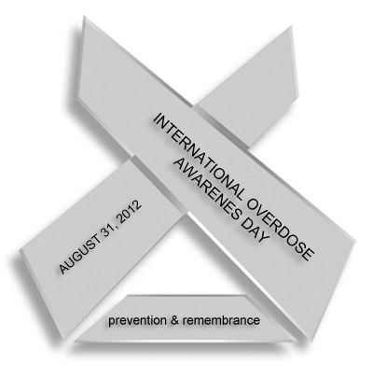
Express Feelings
2. Work Through the Pain and Express Feelings
Find someway to express the emotions that come with addiction and drug related death
Talk to a therapist, family member or friend
Write, art, music, photography
Commemorate Overdose awareness month,
on August 31st
Wear a silver overdose awareness pin

Slide 32
Understand the Addiction
Read to learn more about addiction
Recognize it’s a disease like any other disease
You are powerless over someone’s addiction
Money and love in the world still cannot always beat addiction
A deeper understanding of addiction does help to keep guilt in a normal, manageable, range rather than spiraling, obsession or becoming consumed by anxiety.

Slide 33
Adjustment
Allow open honest discussion about the absence of loved one and absence of worries
Help find meaning in the loss/death
How has family roles changed since the dath
Examine coping styles
Seek help if necessary
What spiritual awakenings have occurred.

Slide 34
Relocation and Reinvestment
Search for forgiveness
Don’t rush into new relationships or caring for someone else too soon.
Loosen the ties to the one who has died and forge a new type of relationship with them based on memory, spirit and love.
Celebrate them with meaning
You do not “forget” them to move on

Slide 35
Find Support
Avoid People who Aren’t Helping/ map out a support system
Let family and friends know the kind of support needed
Get some space when needed
Be open to ask for and accept help
Identify needs
Identify the best person to help you

Slide 36
Learn About Specific Resources
GRASP (Grief Recovery After Substance Passing
Broken No More
Mom’s Tell
Al-anon and Nar-anon are family support groups for family members of those suffering from alcoholism or addiction. They are not grief groups.
Call your local hospice
Look for a support Group

Slide 37
What “Not To Do”
Do not allow the griever to remain isolated.
Do not let your own sense of helplessness keep you from reaching out.
Do not encourage responses inappropriate to grief, ie., “don’t cry”
Do not encourage tranquilizers to avoid somatic distress

Slide 38
What “Not to Do”
Do not be afraid to mention the loved one’s name to the griever
Do not be surprised if the griever talks about many of the same things repeatedly.
Do not let your own needs determine the experience for the griever.
Do not expect the bereaved to be the same person after the loss.
Do not tell them their loved one is not suffering any more

Slide 39
What “Not To Do”
Don not feel compelled to answer the “Whys” of the bereaved.
Do not try to make the griever feel better by sharing your experiences too early in the loss.
Do not try to explain the loss in religious or philosophical terms too early
Avoid Cliché’s around grief.

Slide 40
The Seven Laws of Better Listening
Spend more time listening
Find interest in the other person
Stay out of the way
Listen to what people mean between the lines
Take notes
Assume the proper stance
Be aware of your filters
Notes:
Spend more time listening Let other people finish speaking. Resist the temptation to interrupt or anticipate what others will say. Poor listeners talk too much.
2. Find interest in the other person A basic barrier to listening is labeling a topic or person uninteresting. If you believe something to be dull and uninteresting, it will be. The skilled listener knows there are no boring subjects, only bored people
3. Stay out of the way A good listener keeps the communication path open. One way is to give feedback by asking open-ended questions. Giving advice is setting up a barrier instead of listening.
4. Listen to what people mean between the lines A message has both content (words, for example) and feelings. Listening involves paying attention to both-the total meaning.
5. Take notes We think faster than we talk. This imbalance invites daydreams and distractions, but it also makes careful listening possible. It provides time to evaluate the message, and time to take notes. Note taking is NOT only for the classroom. It can be helpful during telephone conversations, talking to a doctor, designer, tax advisor, lawyer, insurance agent,
6. Assume the proper stance Body position can influence feelings. Taking a posture that shows lack of interest (arms folded, slouched back, no eye contact, etc.) can create or amplify feelings of boredom. Assuming the stance of an attentive listener can actually improve listening.
7. Be aware of your filters We all have built in “earlids” to filter out what we don’t want to hear. People have different filters based on their culture, upbringing and gender. Men and women often have different kinds of filters, and that causes listening problems. If you become aware of your own filters (even without changing them) you will improve your listening

Slide 41
The Art of Questioning
Leading – For example, “Would you like to talk about it?” “What happened then?” “Could you tell me more?”
Open-Ended – Use open-ended questions to expand the discussion – for example, lead with: “How? What? Where? Who? Which?”
Close-Ended – Use closed-ended questions to prompt for specifics – for example, lead with: “Is? Are? Do? Did? Can? Could? Would?
Reflective - Can help people understand more about what they said – for example, someone tells you, “I’m worried I won’t remember…” Reflective Q: “It sounds like you would like some help remembering?”

Slide 42
Communication Blockers:
These roadblocks to communication can stop communication dead in its tracks:
“Why” questions – They tend to make people defensive.
Quick reassurance – Saying things like, “Don’t worry about that”
Advising – “I think the best thing for you is to move to assisted living.”
Digging for information - And forcing someone to talk about something they would rather not talk about.
Patronizing – “You poor thing, I know just how you feel.”
Preaching – “You should…” Or, “You shouldn’t…”
Interrupting - Shows you aren’t interested in what someone is saying.

Slide 43
Empathy & The Art of Listening
One-upping – “I’m so tired myself. I couldn’t get any work done either.”
Advising/Fixing – “Maybe you should get more sleep.” “Maybe you should…”
Educating – “There’s a good book you should get on sleep and productivity.”
Analyzing – “You know, this seems to be a pattern of yours.”
Consoling – “That’s too bad. I’m sure tomorrow things will go better.”
Discounting – “Okay, but shouldn’t you just be glad you have a job.”

Slide 44
Empathy & The Art of Listening (cont.)
Some Things We Can Say To Express Empathy:
“I hear you.” – Said with sincerity, meets a person’s need to be heard.
“Tell me more.” – Said with sincerity, shows you are really interested.
“Wow.” – Said softly, gives the speaker a sense you are listening.
“I don’t even know what to say right now, I’m just grateful you told me.” – When someone is in a difficult place, this may be all you have to say.

Slide 45
Emotional Validation
A Basic Human Need:
Emotional validation is something we all seek and crave far more than we realize. When we are upset, angry, frustrated, disappointed or hurt, our tendency is to want to discuss our feelings with others so we can get it off our chest.
However, getting things off our chest by telling others about our feelings is not always satisfying or cathartic. If the person to whom we vent simply looks at us and shrugs or responds by giving us advice or by telling us what we did wrong, we won't feel any better and we will probably feel worse after speaking with them.

Slide 46
Emotional Validation (cont.)
What we seek when venting to others is for that person to 'get it', to understand what happened to us and why we feel the way we do. We want them to validate our feelings by conveying that understanding to us and to do so with a dollop of sympathy or empathy.
When we are extremely angry or upset, we tell someone why and they totally get it truly and effectively validates our feelings. As a result, the relief and catharsis we experience is tremendous! Only then can we actually let go of at least some of the feelings we had built up. It is that which feels like an authentic visceral 'release'

Slide 47
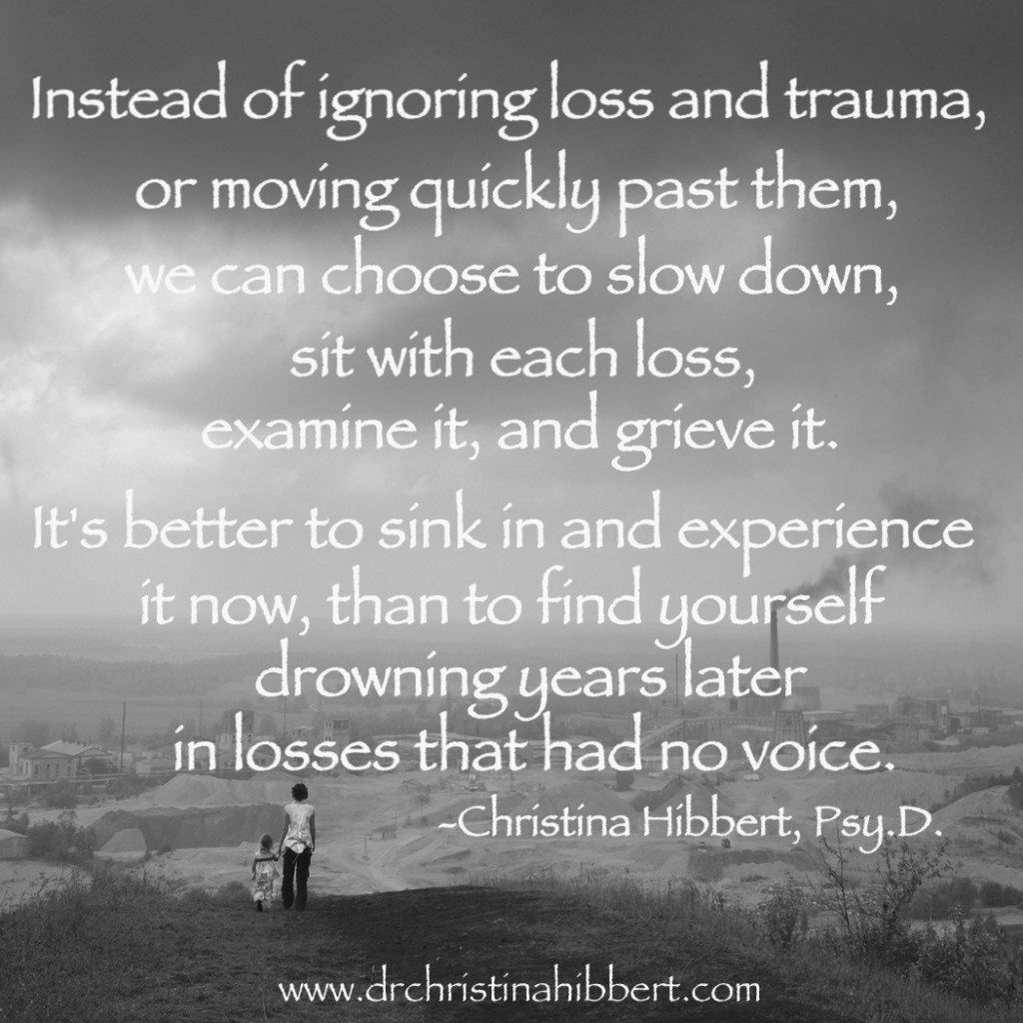

Slide 48
Resources
“The Art of Listening”. Learning Seed, 641 W. Lake Street Chicago, IL 60661 Copyright 2007 Learning Seed.
Wolfelt, Alan D. Ph.D. C.T. “Reframing PTSD as Traumatic Grief” The Center for Loss & Life Transition, 2014 Copyright
www.whatsyourgrief.com/the-grief-of-an-overdose-death
http://www.newbeginningsdrugrehab.org/guide-to-dealing-with-death-of-addict

