Slide 1
The Hearts of the Homeless

Slide 2
PATH
Projects for Assistance in Transition from Homelessness

Slide 3
PATH
Created under the McKinney-Vento Act, The PATH (Projects for Assistance in Transition from Homelessness) Program, is a formula grant program that funds the 50 States, District of Columbia, Puerto Rico, and four U.S. Territories to support service delivery to individuals with serious mental illnesses, as well as individuals with co-occurring substance use disorders, who are homeless or at risk of becoming homeless.

Slide 4
Target Populations
Individuals who are homeless and have low or no income.
Individuals who suffer with a serious mental illness or are dually-diagnosed.
Individuals who are at imminent risk of becoming homeless.

Slide 5
Program Importance
Finding permanent housing solution for people with a serious mental illness
Reducing duration and incidence of homelessness with people who have a serious mental illness
Provide intensive case management services
Educate and link to services

Slide 6
Outreach and Engagement
“Outreach can be broadly defined as sending social services or health delivery personnel away from a facility in to the arena where people live and congregate” (Able-Peterson & Bucy)
Outreach is the entryway to services and safety that otherwise might not be available for some homeless people. It serves as the crucial link between the streets and services (McMurray-Avila)

Slide 7
Outreach and Engagement
“The overarching goal of outreach is to help break the bonds imposed by homelessness. Outreach, at it’s best, helps people move toward a life of greater health and personal stability. In so doing, they are able to discover more fully their own sense of identity purpose, find meaningful work and activity, and establish a sense of place and belonging in the larger community” (Kraybill)

Slide 8
Engagement
Engagement is crucial: It is described as the process by which a trusting relationship between worker and client is established”
Engagement provides context for assessing needs, defining service goals, and agreeing on a plan for delivering these services.

Slide 9
WORDS WITH FRIENDS
Consistency hope Discover PATIENCE
Motivation Drive Practical gentleness
Inspiration desire listener Attraction
Compassion Guide PEER friend IMPACT ALL-KNOWING
Willingness Coordinate TEACHER
Notes:
These are words that define some of the characteristics of an outreach worker and if you notice I didn’t list credentials such as LCSW-C, PHd or even MD. These are characteristics that are both the minimum and maximum requirement for an individual seeking to assist via outreach and engagement.

Slide 10
Shelters in Carroll County
Clients Served in Shelter
 | FY16 | FY17
Cold Weather | 163 | 188
Women’s | 96 | 94
Men’s | 36 | 40
Family | 77 | 85
Safe Haven | 47 | 46

Slide 11
Community Meals
Sunday:
Monday: approximately 100 meals served
Tuesday:
Wednesday:
Thursday: approximately 80 meals served
Friday: approximately 100 meals served
Saturday:

Slide 12
Services
MVA
Doctor/dental appointments
Referrals for mental health assessments
Transportation
Banking
Recovery supports
Support Groups
Health Insurance
Supplemental Food Program
Government Phone
OEND
Case Management Services
Relevant Housing Services

Slide 13
Stigma: Myth
The Hearts of the Homeless
  They all have a substance use disorder
  They want to be out there
  They don’t have incomes
  They lost their homes due to using
  They are all criminals
  They have no families

Slide 14
Stigma: Truth
People love them: they have loved ones who care about them
They want to be employed
They are in mental health treatment
Some were victims of uncontrollable circumstance
They are more prone to be victims of crime rather than the perpetrator
They have feelings

Slide 15
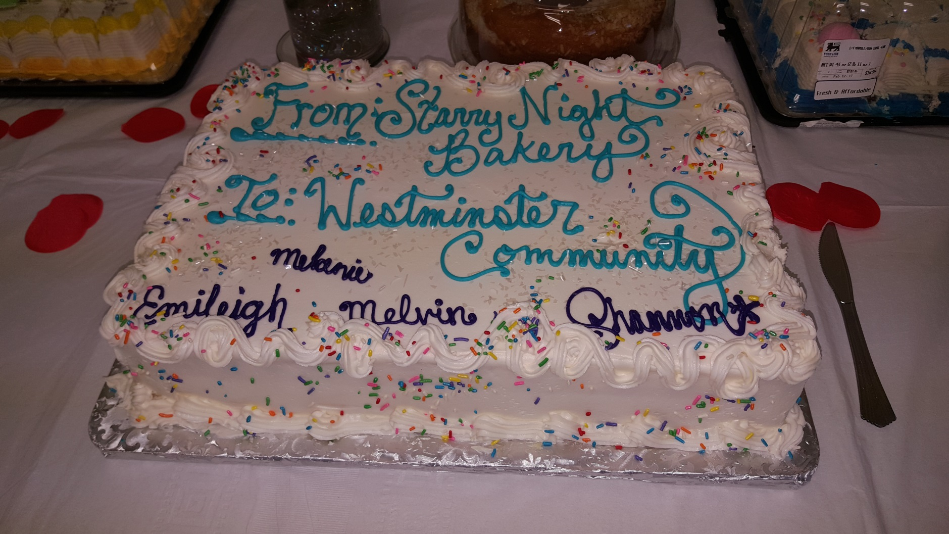
Social Engagement

Slide 16

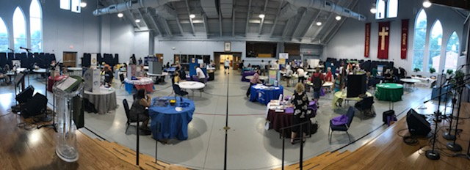
Resource Fair

Slide 17
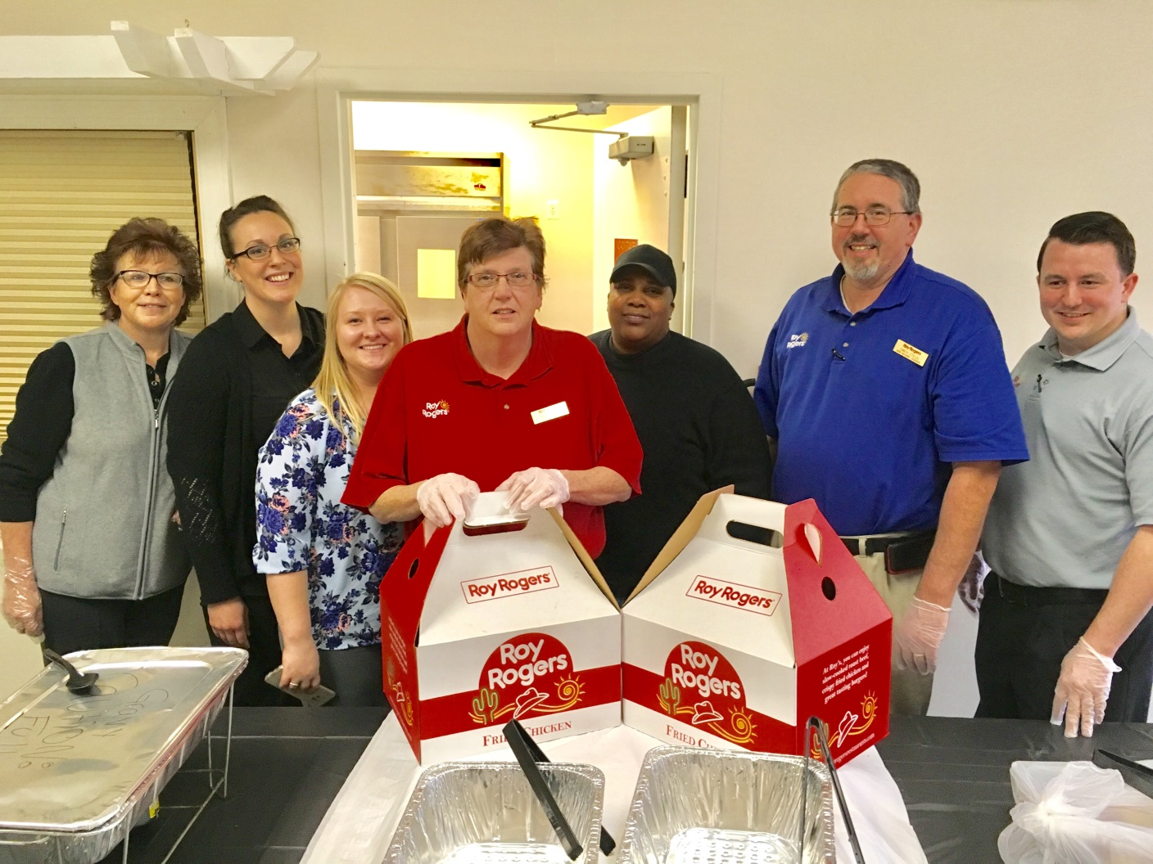
Self-Care for the Homeless

Slide 18
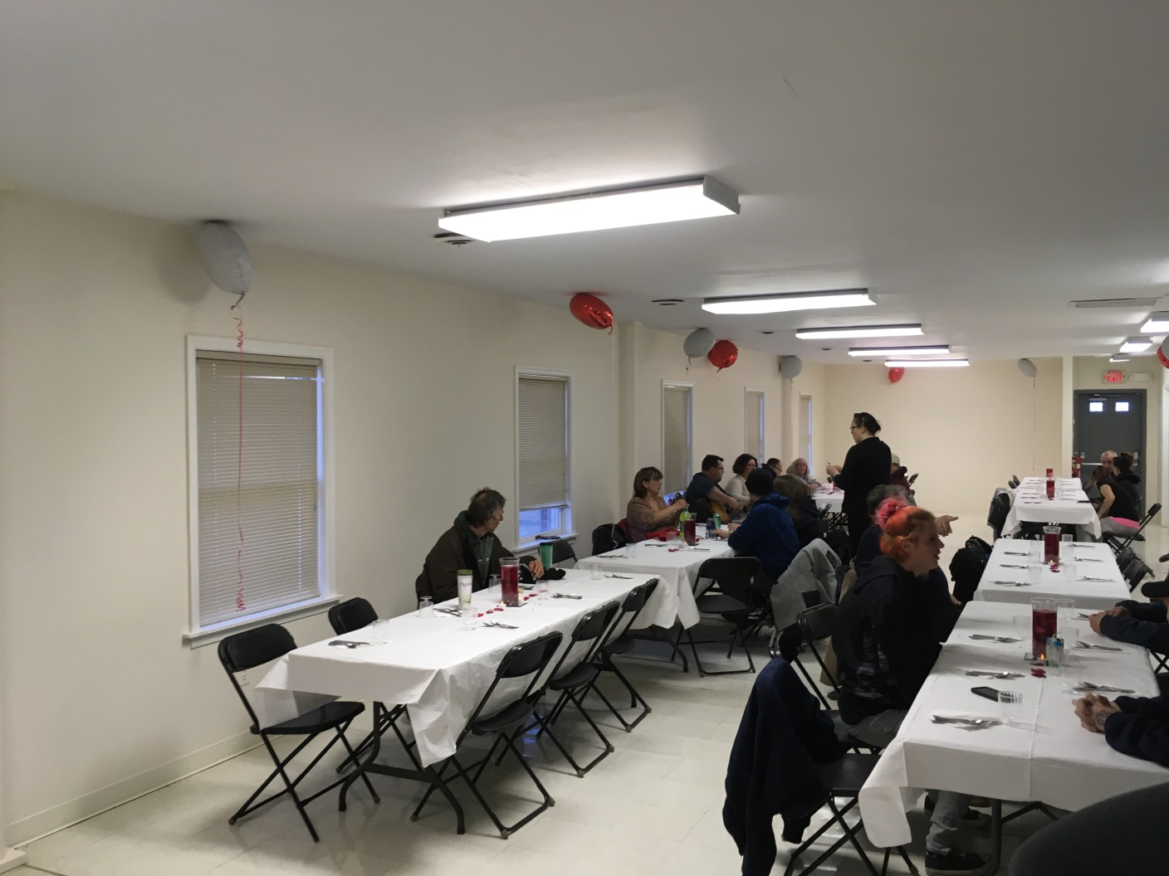
Self-Care

Slide 19
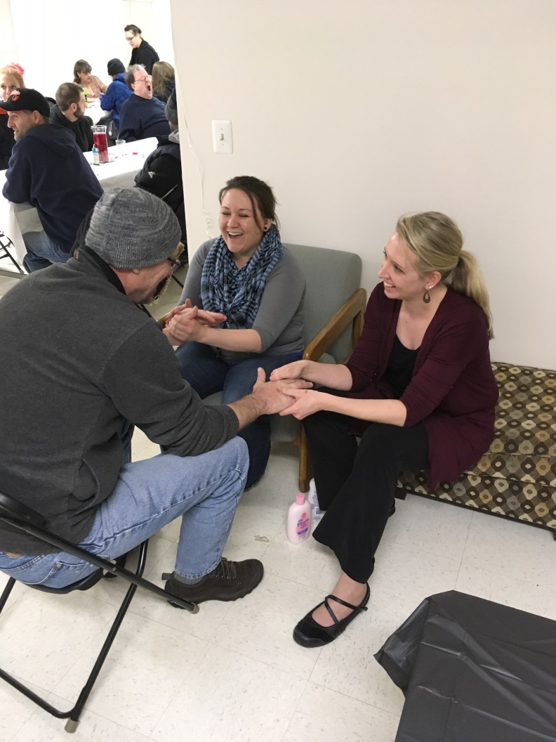
Self-Care

Slide 20
Thank You

