Slide 1
Harm Reduction for Peer Recovery Specialists
Radical Love
Katie Carroll, CPRS
& Jennifer Tuerke CPRS, RPS
Notes:
Introduce authors and presenter. Explain that this is a brief introduction to Harm Reduction and it’s application in Peer Work. We don’t have much time today, but please look for additional training opportunities throughout the state in the year ahead.

Slide 2
Training Objectives
By the end of this section you will be able to:
Define harm reduction.
Recognize key principles of harm reduction.
Identify the need for harm reduction.
Identify examples of harm reduction programs and techniques.
Define cultural humility.

Slide 3
Glossary
PWID- People Who Inject Drugs
PWUD- People Who Use Drugs
PLWHA- People Living with HIV/AIDS
SUDs- Substance Use Disorders
SAS- Syringe Access Services
SEP- Syringe Exchange Program
SSP- Syringe Service Program
AOD- Alcohol & Other Drugs
STI- Sexually Transmitted Infection
Notes:
Compare to IDU which is Injection Drug User and notice how a P was placed at the beginning to humanize the action using person centered language

Slide 4
What is Harm Reduction?
Notes:
Ask what Harm Reduction is or ask for someone’s own definition.
Use this as a way to open the training. Helps you gauge the level of understanding in the room.

Slide 5
Harm Reduction
Practical strategies that reduce the negative consequences associated with drug use and other risk behaviors (ex: sex work; commercial or survivor).
In relation to drug use it incorporates a spectrum of strategies including safer use, managed use, abstinence.
Harm reduction strategies meet people “where they’re at (but don’t leave them there).
Notes:
Explain how harm reduction has its roots in drug use, particularly injection drug use while broadening to apply to other risk behaviors that may be associated with drug use or sex work.
Harm Reduction:
Accepts that some ways of using are safer than others and applies evidence based interventions (i.e. syringe access, overdose prevention) to reduce negative consequences of drug use or sex work (i.e. overdose fatalities, HIV/HCV transmission, injection related wounds)
Moves past judgment of another person to address their drug use and the harm that is occurring to that person.
Recognizes a continuum of use, modeling the stages of change theory.
Does not make drug use acceptable; its accepting that people use drugs (pragmatic/realistic)
Works to ELICIT POSITIVE CHANGE

Slide 6
And Risk Reduction
Employs various strategies and approaches to reduce individual physical and social harms associated with risk taking behaviors.
Applies a holistic approach.
Notes:
The risks are the ones we take when actively using drugs, the ways and means to get drugs.
Harm Reduction includes risk reduction that considers the whole person, taking into account mental and social factors, rather than just the physical symptoms of a disease.

Slide 7
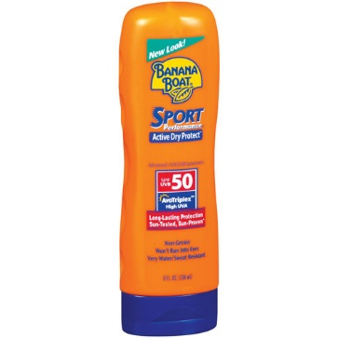
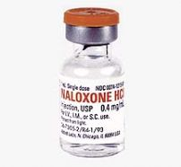
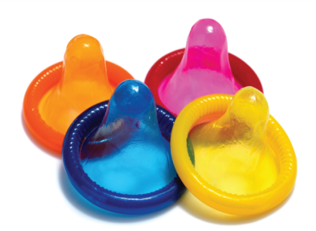
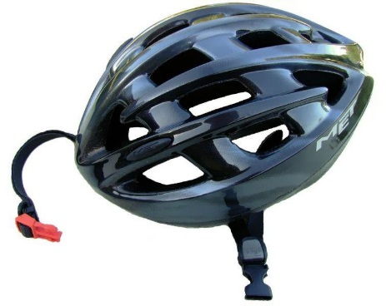
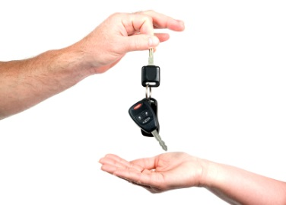
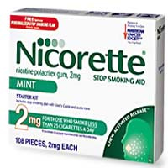
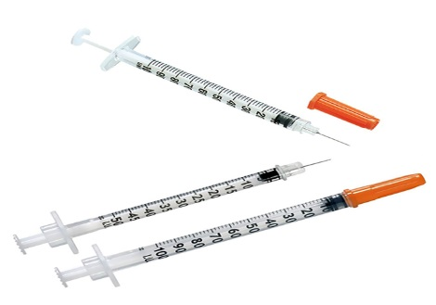
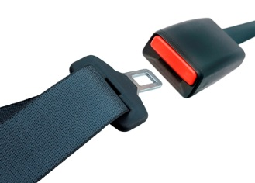
Examples of Harm and Risk Reduction
Sunscreen
Naloxone
Condoms
Helmets
Designated Drivers
Needle Exchange
Seatbelts
Nicotine Gum
Notes:
There are many examples of harm and risk reduction in every day life. Here are just some examples.

Slide 8
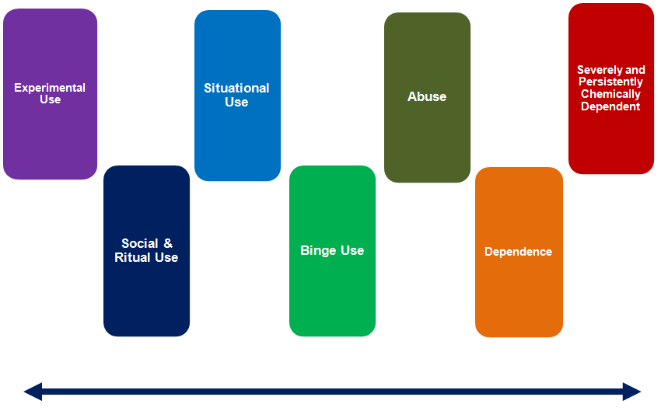
Continuum of Use
Notes:
This is the clinical way of looking at the Continuum of Use.

Slide 9
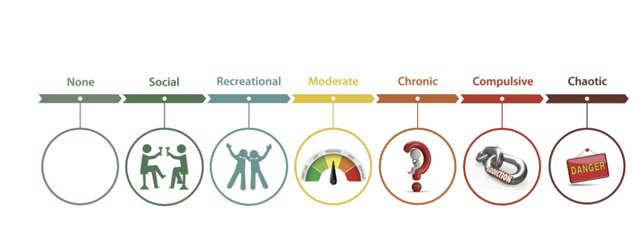
Harm reduction continuum
Notes:
The non-clinical way to look at the continuum of use. Harm reduction is not for or against drug use. Strategies involve understanding that some stages of drug use are safer than others. Abstinence is one end of the spectrum of use. It does not have to be the end goal in order to engage in harm reduction strategies. It incorporates a realistic viewpoint that people are using drugs, will continue to use drugs and helping people move to safer stages, or steps, to get and stay healthy and well or prevent from going to later stages.

Slide 10
Stages of Change
Transtheoretical Model of Behavior Change
Pre-Contemplation
“Not considering it”
Return/Relapse
“Stop doing it”
Contemplation
“Thinking about it”
Maintenance
“Staying with it”
Preparation
“Planning to do it”
Action
“Doing it”
Notes:
Harm reduction can be used in the stages of change to decrease risk of death and infections during one’s journey through them.
Pre-contemplation--Overdose Response and reversal using naloxone, education about safer use
Contemplation and Preparation-- Syringe services & Overdose response and reversal using naloxone, education about safe use “Go Slow”.
Action-- Accessing tx, MAT, Detox, IOP OP - education about overdose risk
Maintenance-- Fellowships and other support groups.

Slide 11
Harm Reduction and Sex
Safer sex work + safer sex
PWUD and sex work populations may share networks
Same person involved with both sex work and drug use
Offer all participants condoms
Share STI prevention and treatment supplies and updates with everyone
No one has to feel singled out for being offered safe sex information
Notes:
In many communities, harm reduction strategies are focused on drug use and sex work. Sex work includes prostitution, sex for drugs, strippers, etc.
Safer sex work includes education about known traps, safer internet practices, etc.
Safer sex includes condoms, dental dams, lubes.

Slide 12
What Harm Reduction is NOT
Harm reduction does not mean “anything goes.”
Harm reduction does not enable drug use or high risk behaviors
Harm reduction does not condone, endorse, or encourage drug use.
Harm reduction does not exclude or dismiss abstinence based treatment models
Notes:
After reading the slide, explain:
“Harm reduction does not encourage use or continued unsafe behaviors. At it’s core, the approach demands a non-judgemental attitude, a radical love for another person who is choosing to live in a way you may disagree with, that may threaten their own life, or it’s just their choice of a different lifestyle, a different way of living that may hurt mostly themselves. Harm reduction does not provide the drugs, but can give a safe way to use them so the person can avoid HIV, Hep C or infection. Just like the use of Naloxone, the idea is keep a person alive and as healthy as possible to be able to find recovery for themselves. A person who is physically very sick has much more to deal with then just their addiction. It can be overwhelming and costly. By meeting a person where they are at, using drugs, engaging in sex work, etc. we can provide care to keep people as safe as possible while providing options, resources and a warm hand to help and additional care. Many of us have said, maybe tomorrow I will do better, change, go to treatment, stop this behavior. Through harm reduction, we can prevent further damage to an individual and actively provide a pathway out. Harm reduction is not the vehicle to counsel someone in a life-threatening situation but can connect people to those counselors. Harm reduction does not have to provide therapy to be therapeutic.

Slide 13
What Harm Reduction Looks Like
Risk Reduction
Prevention
Support
Wellness
Outreach
SAPs
Prevention Supplies
Education
Safer Sex
Safer Use
HIV/HCV/STIs
Advocacy
Linkages
Testing
Individual Counseling
Group Support
Notes:
Give examples of each scenario dot.

Slide 14
Levels of Harm Reduction
Individual
Community
Institutional
Notes:
Individual the steps or actions an individual takes to reduce personal harm i.e utilizing syringe services or managing their use
Community- more interpersonal like secondary exchange and overdose response
Institutional meaning systemic change in reduction of harm like legislative and policy and procedure changes in favor of harm reduction like naloxone availability.

Slide 15
Individual and Community Level
Traditional drug treatment is not always an option
Limited Availability
People may not be ready to quit or may never decide to.
Can you think of any other reasons???
Notes:
Why harm reduction is needed at the individual and community level, outside traditional treatment. This discussion is more to highlight how traditional treatment is not always a viable option therefore does not make much of an impact on individual and community levels.

Slide 16
Individual and Community Level
PWUD will have other issues and needs
High prevalence of other health and mental health issues.
Higher prevalence of trauma.
Poor social support.
Higher levels of previous incarceration.
Higher levels of homelessness.
Poor relationships with the healthcare system.
Notes:
After the group has offered some reasons, this slide lists some of the reasons why harm reduction is necessary at the individual and community levels.
Highlight the inequity that exists in terms of resources available for individuals that have these issues. Like difficulty in navigating care or housing for an individual that is experiencing chaotic use or living with HIV/AIDS.

Slide 17
Institutional Level
Majority of PWID drugs are white but African-American and Latino PWID are 5X more likely to be diagnosed with AIDS
PWID face stigma throughout their life in society, institutions focus on criminalization over treatment, prevention, and care.
Overdose is on the rise - overdose from opioids currently ranks #1 in accidental deaths in the U.S.
Centers for Disease Control and Prevention
National Vital Statistics System, 2015
Notes:
State “Institutions need to do some critical self-reflection about how they treat people who use drugs, those who struggle with mental health and those caught in the criminal justice system due to drug use and sex work. An example: How does posting a mug shot of a sex worker help or hurt a person’s ability to find recovery, to be reunited with their families in society? How easy is it for a person who recently was released for a felony drug charge to get a job with benefits to access treatment for any illness?”

Slide 18
Factors and Harms related to PWUD
Physical
Poor health outcomes
Violence
OD
Psychological
Depression
Isolation
Stigma
Social
Relationship issues
Lack of community
Isolation from community
Spiritual
Isolation
Not connecting to life
Economic
$$ to acquire drugs
Loss of housing
Loss of or trouble finding jobs
Legal
Discrimination
Arrest
Incarceration

Slide 19
Principles of Harm Reduction
Health and Dignity
Participant-Centered Services
Participant Involvement
Participant Autonomy
Sociocultural Factors
Pragmatism/Realism
Notes:
After reading this slide, state “we will go over each one of these principles in closer detail.”

Slide 20

Focus on Health and Dignity
Establishes quality of individual and community life and well-being as the criteria for successful interventions and policies.
Notes:
As a person that works in harm reduction, our goal is to focus on the health and diginity of individuals and provide them with the resources they need at whatever stage they are at. The vision of health and wellness is a person’s own.

Slide 21

Participant-Centered Services
Non-judgmental and non-coercive provision of services and resources.
Notes:
Some examples of this are being able to provide linkage to hepatitis treatment while using, providing health tests while using, offering treatment for only the substances one wants to stop using, offering condoms and safe sex equipment.

Slide 22
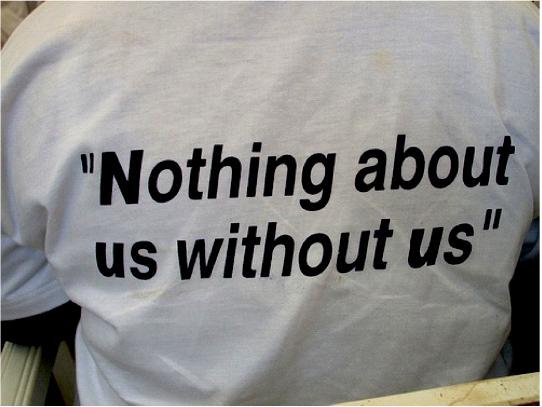
Participant Involvement
Ensures people have a real voice in the creation of programs and policies designed to serve them.
Notes:
Examples of this: having real surveys and mechanisms to invite feedback. Having Peers and clients on committees that develop programs and services in treatment facilities and settings. Asking a team or individuals about changes or improvements in the delivery and kind of services offered. Asking people what they are comfortable with and what they really don’t want. and LISTENING.

Slide 23

Participant Autonomy
Affirms people who use drugs themselves as their own primary agents of change.
Notes:
For a REAL harm reduction program to exist it’s core should be the expertise of the people who use drugs that they serve. Through participant involvement and participant centered services will encourage autonomy of PWUD like self efficacy, that is the individual’s belief in her or her innate ability to achieve goals. People can choose whether or not to participate in harm reduction strategies and programs, they have the ability to voice what helps and what hurts, they can help to develop programs and decide whether or not to participate in them.

Slide 24
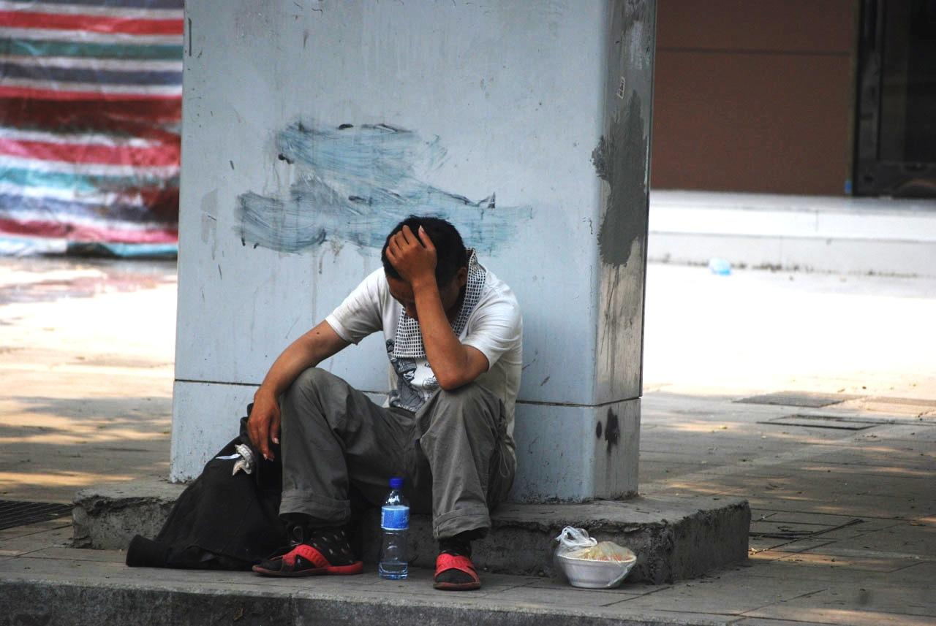
Sociocultural Factors
Recognizes the various social inequalities which affect both people’s vulnerability to and capacity for effectively dealing with potential harm.
Notes:
Examples recognize the effects and limitations of poverty, class, education, racism, social isolation, trauma, sex discrimination, etc

Slide 25
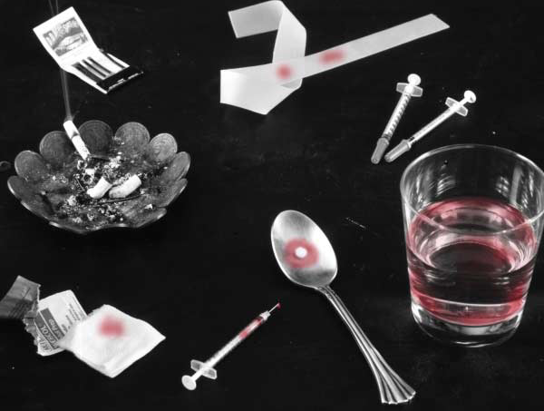
Pragmatism and Realism
Does not attempt to minimize or ignore the real and tragic harm and danger associated with licit and illicit drug use or other risk behaviors.
Notes:
Peers are truth tellers. Although we may be organizing and delivering harm reducing techniques and services, we cannot cover-up, mislead or deny the real and potential dangers and health risks involved with using drugs and other behaviors.

Slide 26
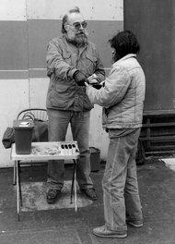
Syringe Access Programs
The Roots of Harm Reduction!
“How does this work?”
“You give me an old one, I give you a sterile one, and it keeps your butt alive.”
Dave Purchase handing out syringes on his own in Tacoma, Wash., in the late 1980s. New York Times, January 27, 2013
Notes:
Dave Purchase handing out syringes on his own in Tacoma, Wash., in the late 1980s. Dave Purchase is thought of as the “godfather” of syringe services. He started the first public syringe exchange in Tacoma, WA in 1988. He also organized the first North American Syringe Exchange Convention (NASEC) in 1990; 7 programs were there. By 1991 there were a few dozen programs and in 1992 amfAR (AMerican Foundation for Aids Research) funded the North American Syringe Exchange Network (NASEN) with Dave at the helm.

Slide 27
Syringe Access:
Reduction in HIV Incidence
Syringe access is the most effective evidence-based HIV prevention tool for people who inject drugs.
Federal agencies for national health such as the CDC and SAMSHA conclude the use of sterile syringes prevent the spread of HIV and other blood-borne infectious diseases.
PWID have reversed the course of the AIDS epidemic by using sterile syringes and harm reduction practices.
Science-based Literature Review on SEPs in the United States 1996-2008. Joanna Berton Martinez

Slide 28
Reduction in Hep C Transmission Risk
Almost 1/3 of PWID (31.8%) report sharing syringes and other equipment in the U.S.*
Many participants of SAPs are referred to Hep B vaccination series and Hep C treatment
Safer injecting equipment education from an SAP assist PWID who do not have Hep C, to stay that way.
*HIV-Associated Behaviors among Injecting Drug Users-
23 Cities, United States, May 2005-Feb 2006
MMWR 2009

Slide 29
Benefits of Syringe Access
Linkage to detox and treatment programs
Medical, dental and mental health services
Bad Date Sheet
Hep A+B Vaccinations
HIV/HEP C services
Housing Services
Safer sex supplies & education
Overdose prevention
Prevention for non-injection drug users
Notes:
People that are currently ingesting or snorting their drugs being able to educate person about harm in progressing to injection drug use or teaching them safer injection practices if/when they decide to start injection use.
Ask who knows what a bad date sheet is???

Slide 30
Humility is not thinking less of yourself; it is thinking of yourself less.”
-C.S. Lewis

Slide 31
Cultural Identity Inventory
Race? County?
Sexuality? Ability?
Class? Gender?
Language? Family of origin?
Culture? Faith?
Ethnicity?
Age?
Education?
Notes:
“Everyone has a cultural identity. Take a few minutes to answer these questions to yourself. The purpose to is examine how your cultural dimensions might include privileges, barriers, biases, assumptions and values.”

Slide 32


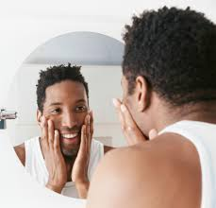
Self Reflection
Notes:
“Does any cultural identity stand out to you as being particularly important to your overall identity? Why?
Are there certain cultural dimensions that you think of more often than others? Why do you think that is?
Were there any dimensions that were harder for you to fill out?
How are these cultural dimensions an asset to you in your work, with your colleagues, and with your community members?
Looking around the room, do you think that everyone t’s values are the same? Each person has their own cultural identity that may or may not work well in different situations and scenarios.
Understanding ourselves is the first step in truly understanding others. As dimensional as we are as individuals, cultural humility allows others to have and experience their own dimensions, as equally diverse and important as our own.”

Slide 33
Cultural Humility Continuum
Cultural Humility
Cultural Sensitivity
Cultural “Blindness” [sic
Cultural Incapacity
Cultural Destructiveness
Notes:
The most negative end of the continuum is represented by attitudes, policies, and practices that are destructive to cultures and consequently to the individuals within the cultures
Incapacity is the lack of capacity of systems and organizations to respond effectively to the needs, interests, and preferences of culturally and linguistically diverse groups
Blindness is an expressed philosophy of viewing and treating all people as the same.
Cultural sensitivity is being aware that cultural differences and similarities between people exist without assigning them a value – positive or negative, better or worse, right or wrong
The ability to maintain an interpersonal stance that is other-oriented (or open to the other) in relation to aspects of cultural identity that are most important to the [person].

Slide 34
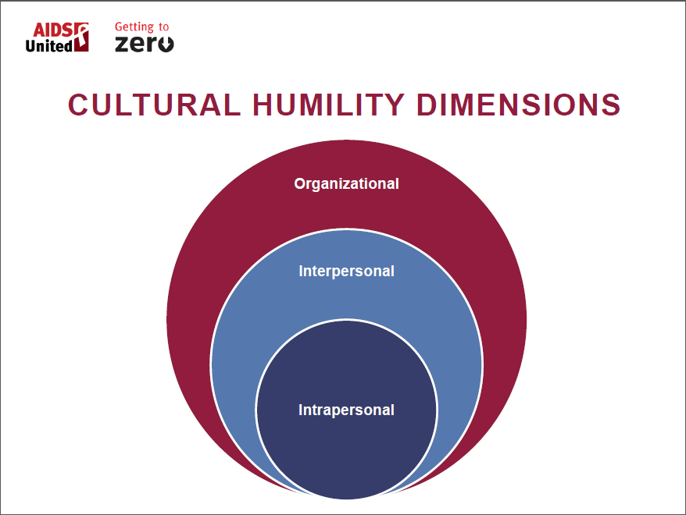
Notes:
“There are 3 dimensions of cultural humility, beginning with our intrapersonal perspective. From that, we impress these qualities of cultural humility in our dealings with others: interpersonal. All together, we make up the culture of our organization: from attitudes and approaches to the services we offer. We can all take on the spirit of there is so much more to learn.”

Slide 35
Cultural Humility
A lifelong learning process which incorporates openness, self-awareness, power-balancing, and critical self-reflection when interacting with diverse individuals to achieve mutually beneficial and respectful partnerships.

Slide 36
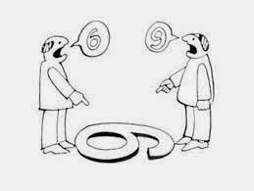
Openness
Notes:
“Cultural humility involves having an open-mind, not just when it is forced open. It is a ready state.”

Slide 37
Self-Awareness
Understanding your own culture
Accepting limitations
Awareness of personal privileges that may be denied others.
Honest assessment of biases
Mindful of what we are carrying with us and what other people are perceiving
Notes:
“Being self-aware fosters a value of humility and compassion towards others.”

Slide 38
Power Balancing
Challenge power imbalances for respectful partnerships
Develop mutually beneficial partnerships with clients and colleagues
Know and own what you don’t know
Notes:
Respect is an attitude we can give everyone at every level of power. Respect is reflected in our ability to listen to the needs and requests of the people we serve with serious consideration, not just shut down because they are a recipient of our services. We can say yes to many things we are conditioned to say no to, like, can my family come with me to this meeting? Could we meet outside today? Can we talk to my partner about my treatment goals? Would you call the Rape Crisis Line with me? Taking requests and situations one at a time, instead of lumping everything in a black or white category, increases the power one has over their own life, choices, recovery. What power do you have over the people you serve? Obvious power? Implied or more subtle power?

Slide 39
Critical Self-Reflection
Acknowledging personal privileges
Knowing your own biases
Commit to lifelong learning process
Notes:
Give yourself permission to change your own mind, to be a better person, to learn more every day about the work you do, how you live, who you are. In giving yourself permission to change from who you were yesterday, you prepare yourself to learn from the varied people and personalities you will encounter in your day. Many of us can benefit from the gratitude of having a home, a bed, clean clothes, our family. Maybe being raised in a healthy family where your physical and emotional needs were met. Perhaps some of us received scholarships or support that permitted us to graduate from school. Others have had strong support networks. Maybe we had none of these things at one time and received the treatment and/or recovery support to have a totally different life. Sometimes that is the luck of the draw, a roll of the genetic dice. Other times that is from poor choices we made or trauma we didn’t choose. Knowing your story and challenges is as unique to you as your fingerprint, may allow you to experience someone else’s without writing the ending or beginning for them by the chapter you walked in on.

Slide 40
For the most part we are already doing it!!!
As people in recovery we work to improve our relationships with ourselves and others everyday.
Intrapersonal- relationship with ourselves
Interpersonal- relationship with others
Organizational- relationship within institutions and society.

Slide 41
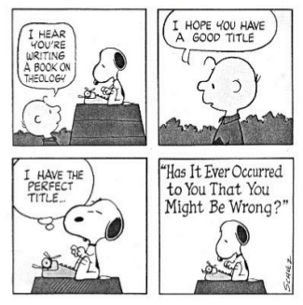

Slide 42
How to practice cultural humility…
Ask questions in a humble, safe manner
Seek self-awareness
Suspend judgment
Express kindness and compassion
Support a safe and welcoming environment

Slide 43
Harm Reduction Peer Work
Giving honest information (don’t sugar coat truth)
Give resources with no pressure or judgement
Teach safe practices
Inform about dangerous situations
Refer to treatment and recovery supports
Help with taking the next right step, today
Identify strengths (everyone has them!)
Protect others from unnecessary harm
Be kind
Encourage testing to be aware of health.
Treasure your own recovery.

Slide 44
Self Care for Peers that work in Harm Reduction
Do say you don’t know when you don’t know.
Do celebrate small wins.
Do roll with the punches.
Do set limits.
Do take care of yourself.

Slide 45
Self Care
Avoid becoming a rescuer.
Avoid taking it personally.
Avoid the assumption you have the same goals as the client.
Avoid trying to do this alone.

Slide 46
“I think harm reduction is not giving up on people, I think it is respecting their timing and assuming even if someone is still using drugs the person deserves the investment of the state in order to have a better and longer life.”
-Dr. Goulao
Notes:
Dr. Goulão is a physician specializing in addiction treatment whose work led Portugal to reform its drug laws in 2000. Such statements, once considered radical, are becoming more appealing to drug officials in other countries

