Slide 1

Happiness On Demand

Slide 2

Happiness Means….

Slide 3
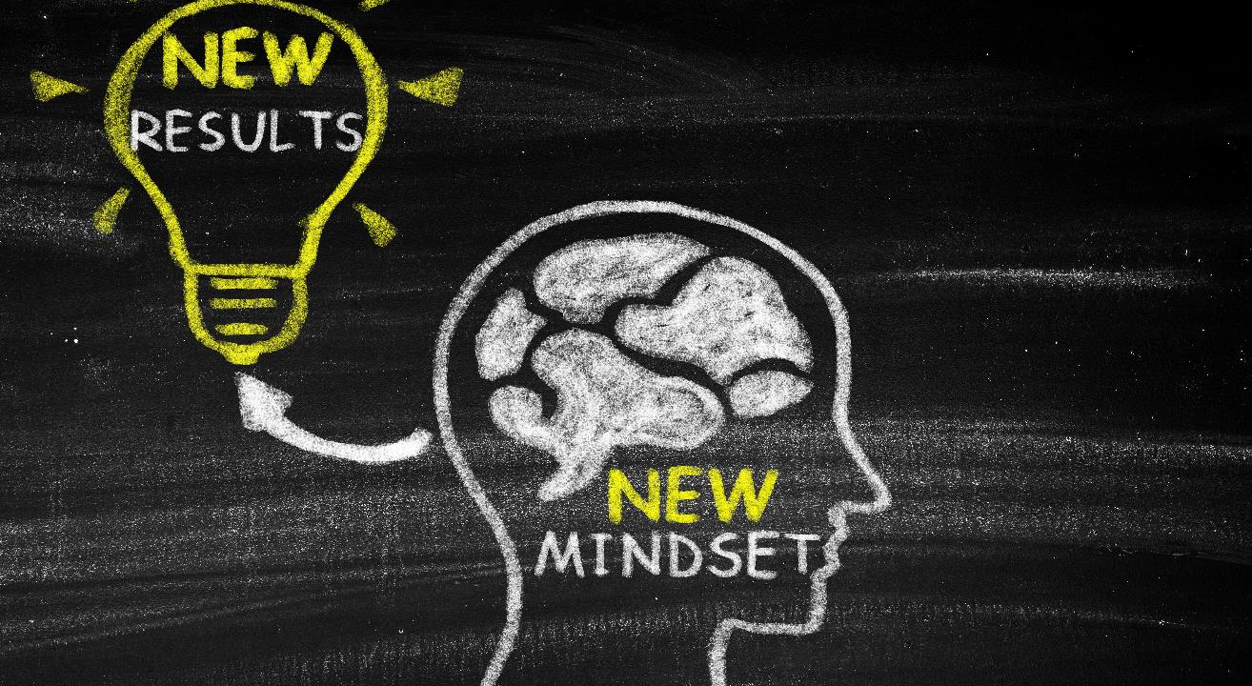
The Language of Happiness

Slide 4

Attitudes And Affirmations
Create YOUR Happiness
      It’s temporary
      Inspirational quotes
I am grateful for….
Redirect the “YES”

Slide 5

THE PRACTICE

Slide 6

Thank You
ARHealthpromotions@gmail.com

