Slide 1
Sexual Health in Recovery
Presented by
Christine Higgins, M.A.
Certified SHIR Trainer
December 1, 2017
PRSS Conference
Linthicum, MD

Slide 2
Ground rules:
Speak one at a time (no talking over someone)
Be respectful of other opinions, values, practices
Try to reserve judgement
Be open to learning something new
Protect confidentiality (what’s said in the room, stays in the room)

Slide 3
Doug Harvey Braun, MFT, CPG Sexual Health in Drug & Alcohol Treatment
Author, Trainer
Developed the SHIR manual later adopted by Prevention and Health Promotion Administration of Baltimore.
Sex is part of our lives from the minute we are born—the way we are held, our experience of touch, the way people around us interact with each other and with us. It’s more than intercourse. It’s a much bigger and more important part of who we are than just what we do with our bodies.

Slide 4
SHIR Program
The goal is to help people in recovery to maintain sobriety by addressing sexual behavior, thoughts feelings and experiences that may be linked to drinking and drugging.

Slide 5
Building New Skills for Talking About Sex
As a PRSS, you have the opportunity to create a relationship of trust so that people can share who
they truly are. The people you engage with will likely feel much more comfortable talking to you about behavior that others may not understand or may
judge as unacceptable.

Slide 6
Why is it so difficult to talk about?

Slide 7
Group Exercise
You’ll see that there are papers around the room with a sexual term written at the top. Grab a colored marker and go to the different posted terms and write other terms you have heard (slang or street talk) that you think mean the same thing.

Slide 8
Now, let’s gather at the filled in sheets and we will all read them aloud.
Then we’ll hear from some participants about what terms are “ok” and what terms are “disrespectful”.
Notes:
De-sensitize.

Slide 9
Where did you first learn about sex?
Was it positive or negative?
Did it affect your substance use?
Did it affect your ability to recover?
Notes:
A word about Harvey Weinstein—shows up what people hold deep inside too ashamed to speak up or speak out—victims who feel somehow it was their fault or their problem that they just went along.
Can substance use be linked to suppressing negative experiences, engaging in acts we want to forget.

Slide 10
Was it part of your own recovery process?
Why or why not?

Slide 11
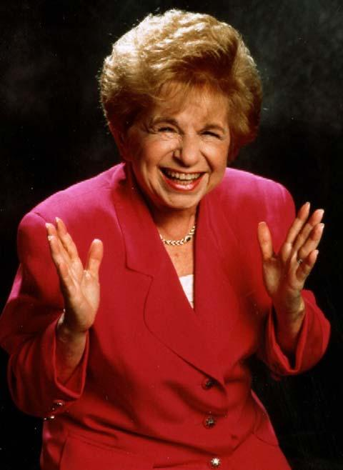
Learn to listen without judgement.
“When it comes to sex, the most important
six inches are the ones between the ears.”
~ Dr. Ruth,
radio talk show host

Slide 12
Cultural “Norms”
Name a rom-com movie where two people fall in love without first consuming alcohol.
Think about the hundreds of times people joke about wine or weed—as a fun time that leads to hilarious situations or a real connection.
If you are gay, transgender, lesbian, questioning how comfortable do you feel talking about sex with professionals who assume something about you? This includes therapists, doctors, nurses, social workers, family, friends, partners.

Slide 13
Sex/Drug Linked Behaviors
To increase the ability to sexually function.
To reduce inhibitions.
To exchange sex for drugs/to exchange
drugs for sex.
To exchange sex for money, shelter, security, safety,
To experience a specific sexual turn-on.
To change the level of sexual interest, desire or arousal.
Notes:
“You have to get all new porn.”

Slide 14
Sexual Health in Recovery
Sexual Health is not just about avoiding relapse, or about avoiding disease, or unintended pregnancies, or getting PAP smears and testicular and prostate exams. It’s also about having sexuality be a safe, consensual, joyful, pleasurable and meaningful part of our lives.

