Slide 1

Expungement 101
Presented by:
The Community Lawyering Initiative
October 2018

Slide 2
Notice/Disclaimer
The legal statutes cited in this presentation are current as of October 1, 2018.
Expungement laws change regularly.
Please consult the Maryland Code and the Courts’ website for the most accurate information.

Slide 3
Expungement is…
The removal of records from PUBLIC inspection.

Slide 4
Why Expunge?
Any arrest is a public record (even without a conviction)
Arrests, charges and convictions will appear on background checks and public court records
Records have major negative impacts on employment opportunities, housing applications and child custody determinations

Slide 5
Expungement Law in Maryland
Relevant statutes: MD Code, Criminal Procedure,§10-105 and§10-110
Maryland charges only
Includes traffic entries where there is a possibility of incarceration
Includes civil charges that are a replacement for criminal charges
i.e. marijuana under 10grams

Slide 6
Pending/Active Case is a Bar
Ask: Do you have a pending criminal case?
being on probation is not a pending case (Robert B. v. State, 193 Md. App. 620)
“drug court” may show as active on case search but is not active for expungement purposes
active incarcerable traffic
Explain: If client receives a new charge after the clinic, Maryland Legal Aid (MLA ) will withdraw the expungement petitions.

Slide 7
Expungeable Dispositions
Nolle Prosequi
Acquittal/Not Guilty
Dismissal
Stet
Probation Before Judgement (PBJ)
Not Criminally Responsible (NCR)
Compromise
Transfer

Slide 8
Expungeable Dispositions
Guilty*
Nolo Contendre (or No contest)
Alford Plea
*Some convictions can be expunged

Slide 9
Immediately Expungeable
Nolle Prosequi, Acquittal/Not Guilty, Dismissals
Waiver required if disposition is less than 3 years old

Slide 10
Stet
3 year waiting period
Subsequent convictions OK

Slide 11
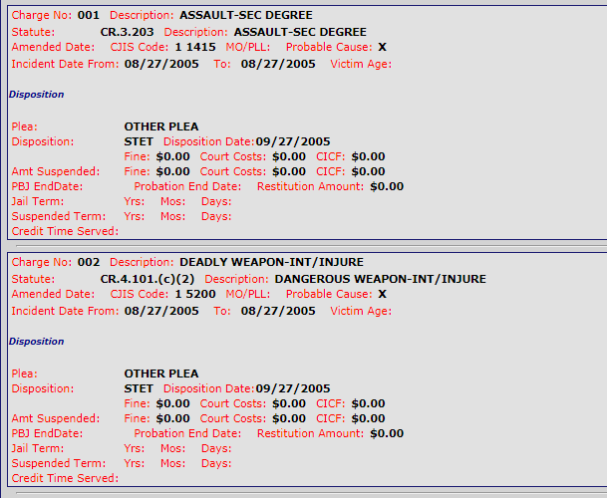
Stet - 3 Year Waiting Period
This stet charge would be expungable on 9/27/2008

Slide 12
Probation Before Judgment
3 year waiting period
If probation is longer than 3 years, must wait until end of probation
This is rare. Probation period is usually 1 year to 18 months.

Slide 13
PBJ - Special Rules
If the client receives a subsequent conviction in the three year period after the PBJ is entered, the PBJ cannot be expunged
Subsequent charges are OK (i.e. dispositions not resulting in guilty)
PBJ dispositions for DUIs/DWIs cannot be expunged

Slide 14
Good Cause
10-105(c)(9)
Sometimes MLA files stets and PBJs early
Requirements:
Only item on record
Successful completion of any probation (PBJ) or community service
Let client know MLA may/may not take this case
A staff attorney will call client in the next week to determine if MLA will staff
Please alert an attorney at the clinic that you have identified a possible good cause case

Slide 15
Not Criminally Responsible (NCR)
Rarely seen
Limited to 3 crimes
Trespass
Disturbing the peace
Telephone Misuse
3 year waiting period
Subsequent convictions OK

Slide 16
Compromise
3 year waiting period
Subsequent convictions OK
Rarely seen

Slide 17
Transferred to Juvenile Court
Charge transferred from adult to juvenile court under 4-202

Slide 18
Pardons
Not automatically expunged
Nonviolent offense
1 criminal offense in lifetime
Expungement must be filed within 10 years of the pardon

Slide 19
Traffic Offenses
Impact of traffic convictions is frequently misunderstood and underestimated by clients
Incarcerable traffic offenses are listed under Md. Code Trans. 27-101
An active incarcerable traffic is a bar to any expungement
A guilty incarcerable traffic may make the client ineligible for otherwise expungeable charges

Slide 20
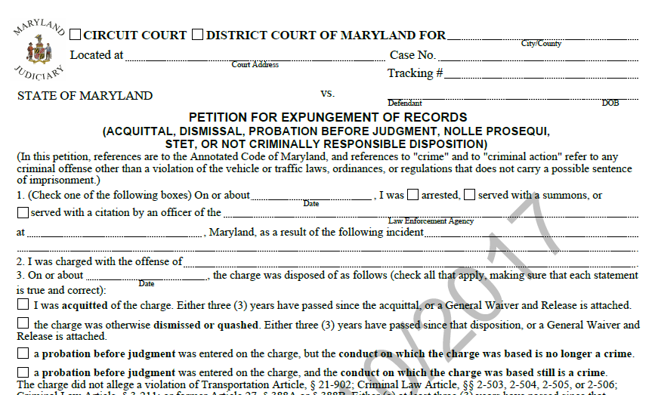
Petition A: Non-Convictions

Slide 21
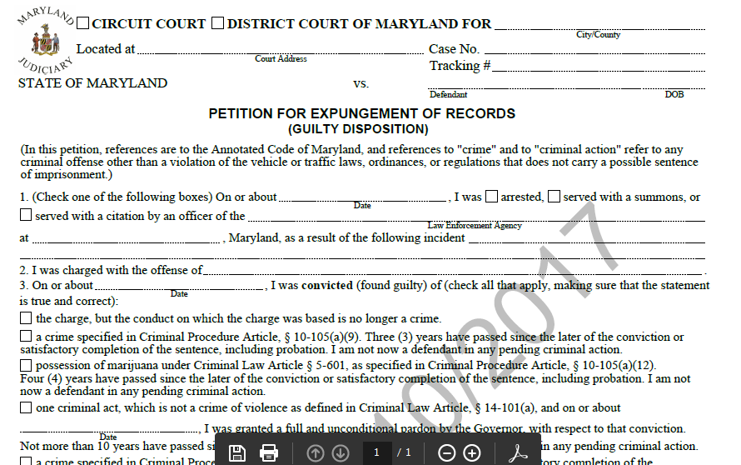
Petition for Convictions

Slide 22
Eligible Convictions
Listed in both 10-105 and 10-110
Include:
Nuisance Crimes
Marijuana Possession and Paraphernalia
Charges that are no longer crimes
Eligible Misdemeanors
Eligible Felonies

Slide 23
Nuisance Crimes: 10-105(a)(9)
Urination in a public place
Riding a transit vehicle without paying the fare
Panhandling
Sleeping in a park
Vagrancy
Loitering
Drinking alcohol in public
Obstructing free passage
Sleeping in public
Crimes enumerated in 7-705 of the Transportation Article

Slide 24
Nuisance Crimes: Time for Filing
Must wait 3 years OR successfully complete probation
Whichever is later
Subsequent convictions OK

Slide 25
No Longer a Crime
Generally:
Marijuana under 10 grams
Marijuana paraphernalia associated with MJ under 10
Certain Traffic Offenses
16-303(h) and (i) are no longer incarcerable

Slide 26
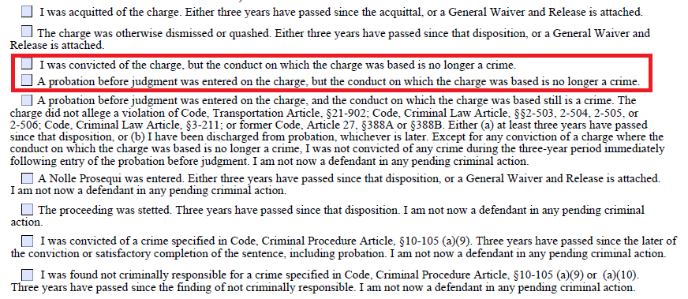
Crimes that are no longer Crimes

Slide 27
Marijuana Convictions
Possession
ALL amounts
Paraphernalia
As associated with use, not distribution
NOT distribution or related charges

Slide 28
Marijuana Convictions: Time for Filing
4 year waiting period
Subsequent Convictions OK

Slide 29
Eligible Misdemeanors
Specific crimes
Listed in Md. Criminal Procedure 10-110
Contact MLA for the cheat sheet

Slide 30
Misdemeanor Convictions: Time for Filing
Generally:
10 years
No subsequent convictions

Slide 31
Misdemeanor Convictions: Time for Filing
TWO eligible misdemeanors have 15 year waiting period
2nd degree assault
Sometimes referred to as common law battery
Domestic Crimes under 6-233
Subsequent convictions NOT okay

Slide 32
Felony Convictions: Now Eligible
Starting October 1, 2018, three felony convictions can be expunged
Theft
Possession with Intent to Distribute
Burglary

Slide 33
Eligible Felonies: Time for Filing
15 year waiting period without subsequent convictions

Slide 34
Convictions: Waiting Period
The 10 or 15 year waiting period begins to run at the completion of the sentence/probation/parole, whichever ends later
If there is no sentence, the waiting period runs from the date of disposition

Slide 35
Convictions: Subsequent Convictions
There cannot be subsequent convictions during the waiting period UNLESS
Those charges are ALSO able to be expunged
Subsequent charges (i.e. not resulting in a guilty) OK

Slide 36
Convictions: Subsequent Convictions Outside Waiting Period
Convictions outside the period may be okay, but requires individual analysis based on interests of justice.
Ask:
what has person been doing with their life since then?
How long since last conviction?
Let client know MLA attorney will need to evaluate their specific case.
Let MLA attorney know about the situation

Slide 37
Convictions
Besides those crimes on the list, can include attempt, conspiracy, or a solicitation of any offense listed
Caution – codes are what the crimes are currently coded as, not 10-30 years ago
Example: The threshold for misdemeanor versus felony theft is now higher

Slide 38
Convictions: Service on Victims
Once petitioner files the petition, the court will have a copy served on the State’s Attorney
The court shall send written notice of the expungement request to each listed victim in the case at the address listed in the court file, advising the victim of the right to offer additional information relevant to the petition
The court shall pass an expungement order after 30 days, unless within the 30 days after service, the State’s Attorney or victim files an objection

Slide 39
Convictions: Objections/Hearings
To expunge the record at the hearing, the court must find:
(1) conviction is eligible
(2) person is eligible
(3) giving due regard to the nature of the crime, the history and the character of the person, and the person’s success at rehabilitation, the person is not a risk to public safety and
(4) expungement would be in the interest of justice

