Slide 1

Empowerment in Aging
Kim Burton & Casey Saylor Mental Health Association of Maryland
Notes:
Need:
Participant information sheet (Casey will make and print)
Evaluation (eval needs room for above fields).
Handouts:
Volunteer Support Program summary
Volunteer job description
Casey’s business card
Guidebook
Guidebook discussion group form
Older Adult brochure
List of talk topics
Informed Decision Making handout

Slide 2

When I say empowerment, what comes to mind?
Notes:
Casey
10 minutes: ask prompt to group, facilitator writes down group’s responses.
Entire Empowerment section = 25 minutes total.

Slide 3



Empowering Older Adults
Environment
Self-Determination
Communication
Notes:
Casey
15 minutes for slides 4-9

Slide 4
Self Determination
Doing with...
Doing for...
Doing to...
Co-Producing
Engaging
Educating
Co-Designing
Consulting
Coercing
Informing
Adapted from content by the new economics forum
Notes:
Casey
Dignity of Risk: self-determination and the right to take reasonable risks are essential for dignity and self esteem, and should not be impeded by overly cautious caregivers. Definition from Michelle Murphy and John Raffaele.
Doing for and Doing to tend to represent typical treatment models.
You won’t know someone’s story in chapters 1-39, even if they try to tell you. But when you come in in chapter 40, you can assess their needs today and empower them to get them met.
Citation: Obtained from 12/17/19 NCAPPS webinar Finding the Balance: Person Centered Supports that Honor Both Safety & Dignity of Risk

Slide 5
Self Determination
Let them set the pace.
Reinforce strengths and empower them to make their own decisions.
Ask questions to help them identify their own needs.
Facilitate Informed Decision-Making (handout)
Notes:
Casey
You won’t know someone’s story in chapters 1-39, even if they try to tell you. But when you come in in chapter 40, you can assess their needs today and empower them to get them met.

Slide 6
Environment
Enable autonomy.
accessible entrances and public areas
avoid scheduling after dark
Need:
privacy
stimulation
comfort
Combat Ageism
policies & procedures
recovery planning
Notes:
Casey

Slide 7
Communication
Avoid elderspeak: intentionally or unintentionally demeaning communication similar to baby talk.
Not confrontation, but education. Focus on what can be gained, not lost.
Slow your pace and repeat yourself if necessary. Ask them to repeat the material back to you to make sure they understand.
Honey
Dear
Sweetie
Darling
Sugar
Notes:
Casey
You’re an OA: how do you want to be spoken to? / treated. Follow with communication tips.

Slide 8
Communication
Use learning aids to accommodate impairment (i.e. large print on presentations and handouts). Identify how the person you’re working with learns best.
Avoid slang or jargon specific to behavioral health. Re-word ideas in familiar language (i.e. stressors instead of triggers, feeling well instead of recovery, etc).
Reframe behavioral health as a health issue.
Pay attention to the language they may use to indicate behavioral health problems: i.e.) nervous breakdown, baby blues.
Do they have the tools necessary for communication?
Notes:
Casey
5 minutes for 35 and 36
You’re an OA: how do you want to be spoken to? / treated. Follow with communication tips.

Slide 9
Dimensions of Recovery
Health: overcoming or managing one’s disease(s) or symptoms and making informed, healthy choices that support physical and emotional well-being.
Home: having a stable and safe place to live.
Purpose: conducting meaningful daily activities and having the independence, income, and resources to participate in society.
Community: having relationships and social networks that provide support, friendship, love, and hope.
Hope: the belief that these challenges and conditions can be overcome, is the foundation of recovery.
Notes:
Casey
15 minutes for Dimensions/ challenges to recovery slides 10-11
From SAMHSA
All of these dimensions are threatened by normal aging.

Slide 10

Rethinking the Rehab Model
The typical rehab model measures gains. Older adults’ goals may be completely different than a younger person’s in the following areas:
Work
Social engagement/ relationships
Education
Living arrangements
Health management
Mental wellbeing
In the current model, “aging in place” is not well supported.
Notes:
Casey
15 minutes for Dimensions/ challenges to recovery

Slide 11

Theory of Compounded Vulnerabilities:
At a time of many risk factors, addressing one risk factor can open the door to another.
Solutions to one problem can cause another
It has been estimated that 20 percent of Medicare beneficiaries have five or more chronic conditions and 50 percent receive five or more medications
Notes:
Kim
5 minutes
more than 80% of older americans have 1 chronic health problem. More than 50% have 2 or more.

Slide 12

Notes:
Problem: Ear infection
RX: Amoxicillin

Slide 13
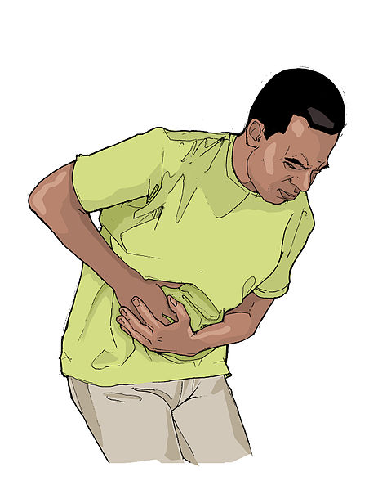
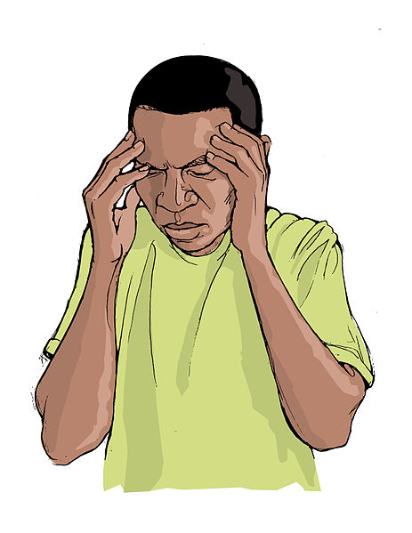
Notes:
Among the more common side effects for amoxicillin (Amoxil, Trimox) are:
• diarrhea.
• stomach upset.
• headache.
• abnormal taste sense.
• skin rash.
• vaginal yeast infection

Slide 14



Possible side effects of Kaopectate:
Anxiety
any loss of hearing
confusion
constipation (severe)
diarrhea (severe or continuing)
difficulty in speaking or slurred speech
dizziness or lightheadedness
drowsiness (severe)
fast or deep breathing
headache (severe or continuing)
increased sweating
increased thirst
mental depression
muscle spasms/ muscle weakness
nausea or vomiting (severe or continuing)
ringing or buzzing in ears (continuing)
stomach pain (severe or continuing)
trembling
uncontrollable body movements (especially in elderly patients)
vision problems
Common Advil side effects may include:
upset stomach,
mild heartburn,
nausea or vomiting;
bloating, gas, diarrhea, constipation;
dizziness,
headache,
nervousness;
mild itching or rash; or.
ringing in your ears.
Common side effects of Unisom:
Sleepiness.
Dizziness
Headache.
Dry eyes
Dry mouth,
Dry throat.
Blurry vision or double vision.
Problems with balance.
Trouble urinating
Constipation.
Sweating.
Having a hard time ejaculating or getting an erection.

Slide 15

Brainstorming Risk Factors
7 minutes
Guidebook pp. 15-23
Notes:
Kim
20 minutes for entire section
7 minute group work brainstorming
10 minutes reporting out
3 minute pain example of intersection
Small group activity: Brainstorm changes in social/physical/ emotional realms
Review Risk factors as a group
Risk Factors & Long term recovery:
Age-related challenges can:
introduce new stressors that require new coping skills.
cause symptoms of a previous behavioral health problem to return.
cause a new behavioral health problem.

Slide 16
Chronic Pain
Mental
Frustration, sadness, lack of confidence, lack of motivation, exhaustion, fear, feel like no one understands
Social
Isolation,fear of appearing weak, don’t want to be a burden or “bring others down,” dwindling support network
Physical
Difficulty moving, worsens other conditions, pain management medication, lack of energy
Notes:
Kim
3 minutes
High likelihood of multiple risk factors, and they tend to bunch quickly.
Possible Follow up question: how can medication side effects impact this?

Slide 17
Variance of Onset
Long lived experience: Individuals who first experienced behavioral health conditions during childhood or early adulthood.
Late onset: Individuals who first experienced behavioral health conditions during later life, age 50+.
Late identification: Individuals who may have experienced behavioral health conditions earlier in life but did not recognize them until later life.
Notes:
Casey
13 minutes
Everyone in this room has had a behavioral health experience of some kind. You are a person with long lived experience who will be 80 years old someday.
We’ve broken experienced down into these 3 areas, but in real life it’s messy because we don’t always get to know.
Many people experience their first BH problem after turning 65. Most common = anxiety & depression

Slide 18
Year of birth
1980
1970
1960
1950
1940
1930
1920
Age this year
40
50
60
70
80
90
100
Generation X: 1965-1980
Age 39-54
Baby Boomers generation: 1946-1964
Age 55-73
Traditionalist generation: 1900-1945
Age 74-100+
Notes:
Casey
Allow time for group to ask questions on generational info we present in slide 17 since some may not know what the influential events are. If we appear to have participants from these generations present, may be worth asking them if/ how they feel different from the other generations on the slide.
To add some context, consider the years that individuals in each age group were born.
Traditionalist generation was influenced by: WWII, Korean War, Great Depression, New Deal, Rise on Corporations, Space Age. The Hoover Dam was new technology. Raised by parents who had just survived Great Depression. Experienced hard times growing up that were followed by times of prosperity.
Baby Boomer generation were raised by the Traditionalist Generation and promised “The American Dream” was as children. Influenced by: Civil rights, Vietnam War, Sexual Revolution, Cold War, Space travel. The microwave was new technology. Have experienced the highest rates of divorce and 2nd marriages in history.
Generation X were raised by the Baby Boomer generation and were the first generation of latchkey kids. Influenced by: Watergate, energy crisis, dual income families and single parents, activism, corporate downsizing, end of Cold War, increased divorce rate. First generation that will not do as well financially as their parents. The cell phone and handheld PDAs were new technology.

Slide 19
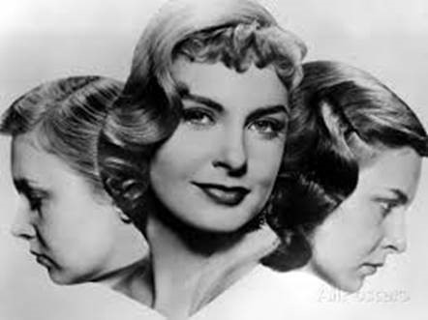
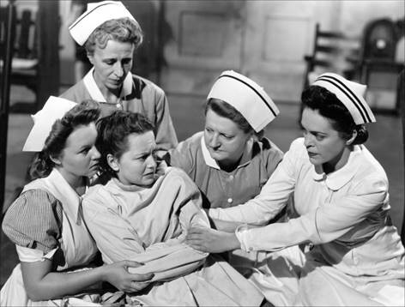
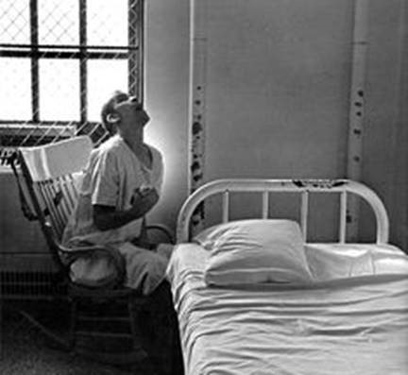
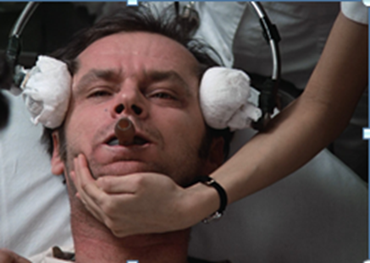
Year of birth
1980
1970
1960
1950
1940
1930
1920
Age this year
40
50
60
70
80
90
100
Notes:
Kim speak on knowledge of/ stigma around/ interpretation of behavioral health in past decades.
Generational interpretation of behavioral health

Slide 20

Aging is a normal process-
we are aging from the moment of birth.
Notes:
Kim
15 minutes for Normal/ Healthy Aging

Slide 21

Common Changes in the Body
Sensory changes; hearing, vision, taste, touch and sense of thirst .
Metabolism slows down; affected by medications and lack of activity.
Sleep patterns change.
Skin and hair changes can be dramatic
Muscle weakness and joint stiffness are common and can cause pain
Notes:
Kim
15 minutes for Normal/ Healthy Aging

Slide 22

Normal Changes in the Brain
Committing new information to memory might require reinforcement
Recall of data / names / numbers can take longer
Multi-tasking can slow processes
Brain shrinks raising risk for brain injury
Metabolism slows raising risk for toxicity
Notes:
Kim
15 minutes for Normal/ Healthy Aging

Slide 23

Regardless of age, healthy brains...
Learn new information
Create and remember memories
Adapt to changes and challenges
Communicate who you are as a person through your personality, behaviors, and beliefs.
Notes:
Kim
15 minutes for Normal/ Healthy Aging

Slide 24

Priorities...
Notes:
Kim
15 minutes for Normal/ Healthy Aging

Slide 25
Practical Skills
Let them lead; maximize choice. (Mental Health Advance Directive)
Be supportive but not patronizing.
Treat an older person with dignity and respect.
Appreciate that they have goals, aspirations, talents and strengths and remind them of this.
Support dimensions of recovery: Health, Home, Purpose, Community, & Hope.
Provide education; Avoid jargon; frame mental health as a health benefit.
Remember that the world today is VERY different from the world they grew up in.
Notes:
Kim

Slide 26
Upcoming opportunities
Free guidebooks for everyone!
Order more materials at mdaging.org
Guidebook discussion groups
Baltimore County Volunteer Support Program
Leave your information on the evaluation or contact Casey
See handout for details
Coming in 2020: Behavioral Health and Aging, an 8-hour training course for CPRS or anyone who provides peer support.
Sign up for updates on this course and training dates.
Community presentations on behavioral health and aging
We come to you!
Choose the topics you need.
Notes:
Casey

Slide 27
Thank you!
Kim Burton
Director of Older Adult Programs
Mental Health Association of Maryland
kburton@mhamd.org
443-901-1550 x210
Casey Saylor
Older Adult Project Manager
Baltimore County PEERS Program
Mental Health Association of Maryland
csaylor@mhamd.org
443-901-1550 x213

