Slide 1
Recovery Coaches in Emergency Departments
It’s not just important that you serve, it’s equally important, how you serve.
Serve Well!
Introduction to CCAR’s Recovery Coaching in an Emergency Department

Slide 2
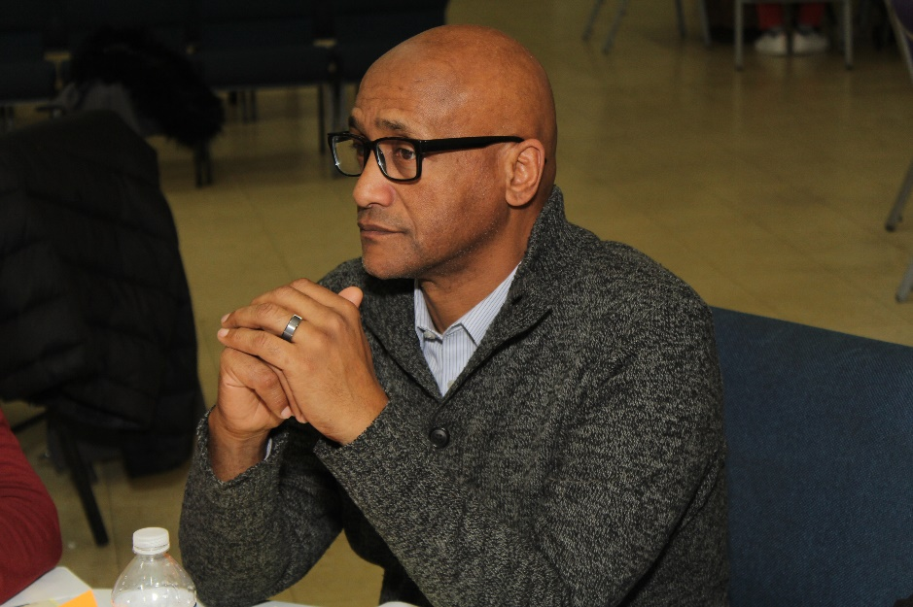
Hillena Beyene, CPRS, RPS
Tyrell D. Moyd, RPS, RCP

Slide 3
Today, we will:
Discuss Recovery Coaches growing presence in Emergency Departments
Review a few roles of Recovery Coaches in Emergency Departments
Explore staying in your lane when serving in Emergency Departments
CCAR’s ED Introduction

Slide 4
2 year Data (3-1-17 to 2-28-19) 3,615 Individuals Seen at 13 ED’s
Gender
Male= 2,493 (70%)
Female= 1,122 (30%)
Overdose (?)
No= 4,220 (93%)
Yes= 297 (7%)
4,517 calls to 13 ED’s for 3,615 individuals
Alcohol & Alcohol OS= 65%
Heroin OS= 23%
OS = Other Substances
*CCAR data used with permission
CCAR’s ED Introduction

Slide 5
2 year Data (3-1-17 to 2-28-19)
Level of Care (from ED)
Detox- 2193
Community Supports- 1185
Inpatient- 354
MAT- 150
IOP- 129
Outpatient- 138
Total= 4149 of 4517 calls
92%
Assertive Linkage to Care!!!!
4,517 calls to ED’s for 3,615 individuals
Hospitals (13)
Manchester - 435
Windham- 521
L&M (New London) - 614
Backus (Norwich)- 589
Mid State (Meriden) - 304
St. Francis (Hartford) - 658
Danbury- 219
Day Kimball (Putnam)- 118
Hartford- 627
Charlotte Hungerford - 218
Hospital of Central CT- 173
Johnson & Memorial (Stafford Springs)- 22
St. Mary’s (Waterbury)- 19
*CCAR data used with permission
CCAR’s ED Introduction

Slide 6
A few RC roles that are common in an ED:
Advocate
Role Model & Mentor
Resource Broker
Problem Solver
Truth Teller
CCAR’s ED Introduction

Slide 7
Advocate
What are you advocating for?
Who are you advocating to?
Accountability
CCAR’s ED Introduction

Slide 8
Role Model & Mentor
Role Model – a person looked to by others as an example to be imitated
Mentor – an experienced and trusted advisor
Accountability
CCAR’s ED Introduction

Slide 9
Resource Broker
Share some examples of how a Recovery Coach may be a Resource Broker in an Emergency Department
Creative ways to maintain resources in this setting
CCAR’s ED Introduction

Slide 10
Problem Solver
Scenario
CCAR’s ED Introduction

Slide 11
Truth Teller
Say what you mean, but don’t say it mean
Patient
Family member/friends
Hospital Staff
CCAR’s ED Introduction

Slide 12
Staying In Your Lane
Doctor/Nurse
Social Worker
Security
Attorney
CCAR’s ED Introduction

Slide 13
?
Questions & Comments
?
?
?
?
Thank You!
?
?
?

Slide 14
Thank You!

