Slide 1
Delivering Hope:
How Motivational Interviewing Can Support Your Role as Peer Recovery Support Specialists
Fifth Annual Peer Summit
Thursday, May 16, 2019
Presenter: Christine Higgins, M.A., Member of MINT

Slide 2

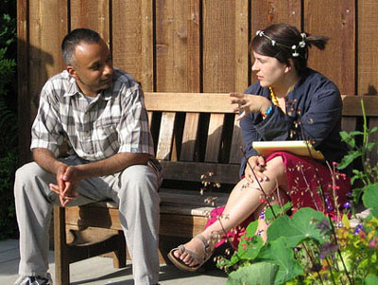


What is unique about your role?

Slide 3

You are uniquely qualified to deliver A message of HOPE, Belief, perseverance
This Photo by Unknown Author is licensed under CC BY-NC

Slide 4
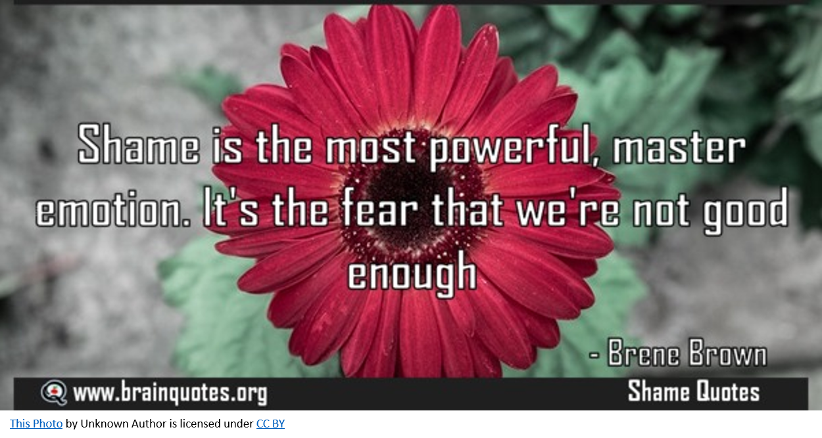

Slide 5
MI Concepts
MI Spirit that conveys belief
Affirmations that convey support
Reflections the convey empathy
Rolling with disagreement/discord

Slide 6
Carl Rogers, American Psychologist
Influenced the development of MI
Rogerian Theory of person-centered counseling

Slide 7
Rogers’ famous requirements …
1. Congruence —genuineness, honesty with the individual.
2. Empathy —the ability to feel what the individual feels.
3. Respect —acceptance, unconditional positive

Slide 8
Advantages of MI
It’s more than a counseling technique, it’s a way of being.
We refer to MI as a dance. Moving with the individual as the individual moves, rather than creating an opposing force.
It’s nicely tailored to a brief discussion.
MI is being used by pastoral counselors, nutritionists, ER docs, probation officers, physical therapists, peer recovery support.
.

Slide 9
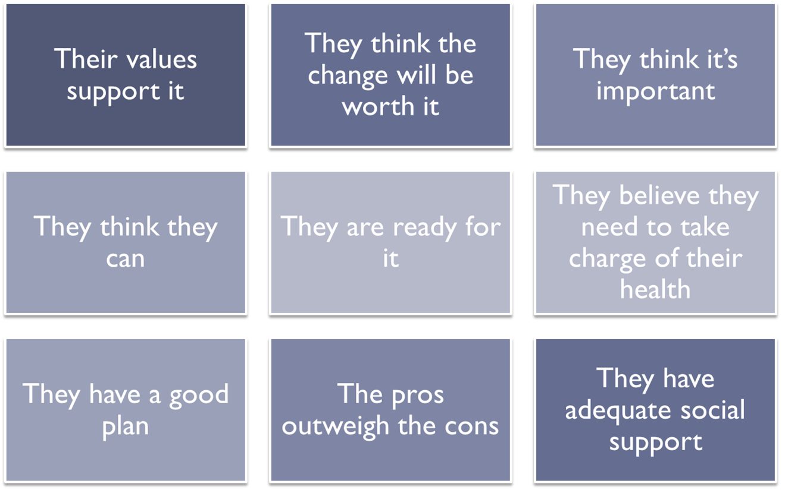
How Do People Change?

Slide 10
MI Spirit
Need a few volunteers to respond to this open-ended question:
“What is your relationship to recovery?”

Slide 11
MI Spirit!
It’s not this:
And it’s not this:
Notes:
I’m going to show you how to do it. I going to beat it out of you. You will submit!

Slide 12
MI is not this kind of cheerleading
“I know you can do it.”
“I’m proud of you.”
“I have faith in you.”
Notes:
You can do it! I believe in you! Cheerleading! We want an open and honest relationship about recurrence,

Slide 13
Four Processes in MI
Engaging – Establish helpful connection & working relationship
Focusing – Particular agenda the individual came to discuss
Evoking – individual’s own motivation for change
Planning – Developing commitment to change, forming specific plan of action

Slide 14
MI supports self-efficacy
MI can offer a new way of fulfilling key roles like cheerleader, advocate, confidante, truth-teller, resource broker.

Slide 15

We want individuals to take affirmations away with them, like putting something in their pocket for safe keeping. We want Affirmations to be lasting.
You set a goal and you achieved it.
It takes a lot of courage to be honest about this.
Controlling your temper is a sign of maturity.
You are taking responsibility.
Emphasize: Talent, ability, strength

Slide 16
Affirmations
Acknowledge
Acknowledge the individual
Recognize
Recognize the individual’s effort or small steps
Reinforce and validate
Positively reinforce and validate the individual
Foster
Foster the belief that there is hope

Slide 17

Quick Affirmation exercise
Think of a person you worked with recently.
Share with us an affirmation you could have given to that person.
Notes:
Frequent flyer, not in compliance, resistant, manipulative, big talker

Slide 18
Let’s hear some affirmations…
An individual completes a necessary form.
An individual has sought out help for mental health or substance use disorder.
An individual opens up and tells you something personal.
A individual loses her job, but soon after finds a new one.

Slide 19
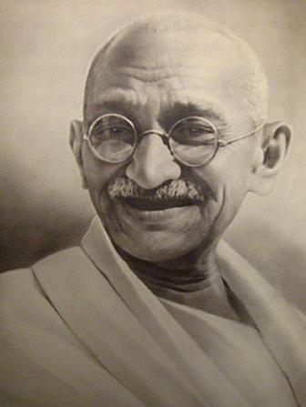
Is It Rejection of you?
“A 'No' uttered from the deepest conviction is better than a 'Yes' merely uttered to please, or worse, to avoid trouble.” ~Mahatma Gandhi

Slide 20

Reflections
Backbone of MI
Helps to ensure accurate understanding
Communicates interest and acceptance
Allows individuals to hear their thoughts
in another person’s words
This Photo by Unknown Author is licensed under CC BY-SA
Notes:
Resistance is a sign to change course
You want to generate change talk

Slide 21
Reflections
Ask the person next to you, “What is your favorite food and why?
Then repeat the answer back to the person.
It’s responding with active listening.
Try to practice responding to statements with re-statements rather than another question.

Slide 22
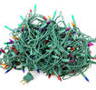
summary
As you work with an individual offering
a variety of resources and problem solving
together, it’s good to offer a summary
to keep on track, to offer a hopeful
future.

Slide 23
MI is a Stress Reducer
So, a new of looking at problem solving. Instead of being the authority on recovery we work to establish collaboration. We get input from the individual—the real expert in their own recovery!

Slide 24
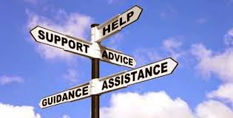
Recovery is possible!
Thank you for your dedication, your hard work, your patience, your steadfast belief in recovery.

