Slide 1
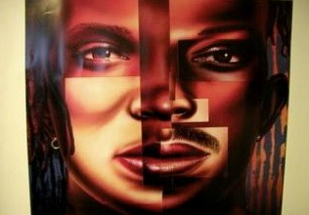
Cultural Competence in Peer Recovery: More than meets the eye

Slide 2
Goals and Objectives
Following this session participants will be able to:
Define Cultural Competence
Describe why delivering culturally competent peer recovery support is important
Understand being culturally competent is a continual process
Use culturally competent practices to engage in peer recovery supportive services

Slide 3
What is Cultural Competency?
"Cultural Competency is the ability of individuals and systems to respond respectfully and effectively to people of all cultures, classes, races, ethnic backgrounds, sexual orientations and religions in a manner that recognizes, affirms, and values the cultural differences and similarities and the worth of individuals, families, and communities and protects and preserves the dignity of each."

Slide 4
Each person is representative of a mixture of “cultures and experiences”…
Every aspect of a person’s life is influenced by that person’s culture.

Slide 5
In other words…………
Respect this fact when engaging in peer recovery services
Treat all people with respect!

Slide 6

What is Culture?
Culture includes but is not limited to:

Slide 7
A broader look at culture
Culture is “the collective mixture of differences and similarities that includes for example, individual and family, and community characteristics, values, beliefs, experiences, backgrounds, preferences, and behaviors.”

Slide 8
A broader look at culture
Culture includes behaviors, beliefs, values, and symbols that they accept, generally without thinking about them, and that are passed along by communication and imitation from one generation to the next.

Slide 9
So how can we increase our cultural competence as peer recovery specialist?

Slide 10
Understanding Cultural Differences
We need to examine our own cultural values and evaluate their interpersonal strengths and weaknesses.
We also need to recognize that differences in language, age, culture, socio economic status, political and religious beliefs, sexual orientation, and life experience add challenging dimensions to the dynamics of cross cultural interactions.

Slide 11
Consider this…..
Have you ever been the subject of a negative reaction based only on your membership in a group?
How about a positive reaction for the same reason?
Why do people have negative stereotypes about others?

Slide 12
Stereotypes and Prejudgments
Are like icebergs…..
Just as 90% of an iceberg is out of sight, very little can be determined about a person based on their appearance. Stereotypes are opinions based on their appearance.

Slide 13
More than meets the eye

Slide 14
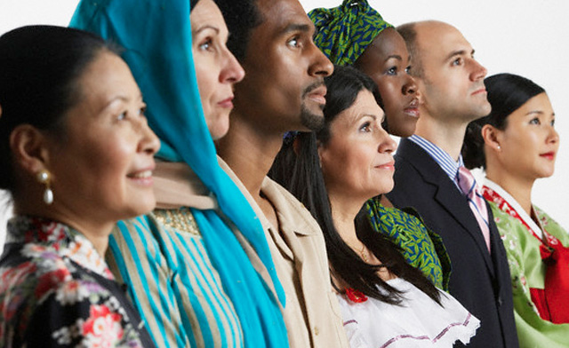
What is Diversity?
Diversity refers to all the ways that individuals are unique and differ from one another.
Diversity can’t be narrowly defined. It’s simply embracing and celebrating the differences we all embody.

Slide 15
Diversity Involves:
Recognizing our unique differences
Attracting people of all backgrounds
Recognizing how attitudes affect us all
Creating an environment where all can succeed
Acting to promote diversity

Slide 16
Elements of Diversity
Age
Gender
Ethnicity
Race
Physical Ability
Sexual Orientation
Physical Characteristics
Income
Education
Marital Status
Religious Beliefs
Geographic Location
Parental Status
Personality Type

Slide 17
Dimensions of Diversity
Primary dimensions are aspects of ourselves that we cannot change. They are things people know about us before we even open our mouths, because they are physically visible (except sexual orientation). When people feel they are being stereotyped based on primary dimension, they can be very sensitive about it.
Gender
Eye Color
Hair Color
Race
Birth Defects

Slide 18
Dimensions of Diversity
Secondary dimensions are elements we have some power to change. People are less sensitive about secondary dimensions. We also have the choice of whether to disclose this information or not; we can conceal these characteristics.
Religion
Educational Level
Parental Status
Geographic Location
Socioeconomic Status
Sexual Identity

Slide 19
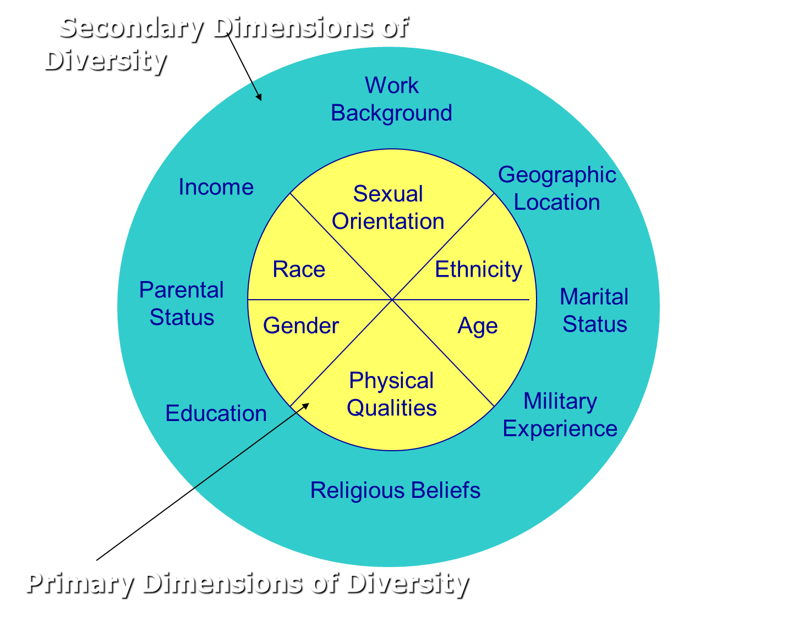
Dimensions of Diversity

Slide 20
Labeling = Stereotype, Prejudice, & Discrimination
Categorizing can be dangerous. Labels can become too rigid and when there is no room for growth the label becomes stifling, both for the individuals who are labeled and for the category itself.
This leads to stereotypes, prejudice, & discrimination.
SAMHSA, Office of Minority Health, and Health Resources and Administration, Quality Health Services for Hispanics: The Cultural Competency Component, 2001.

Slide 21
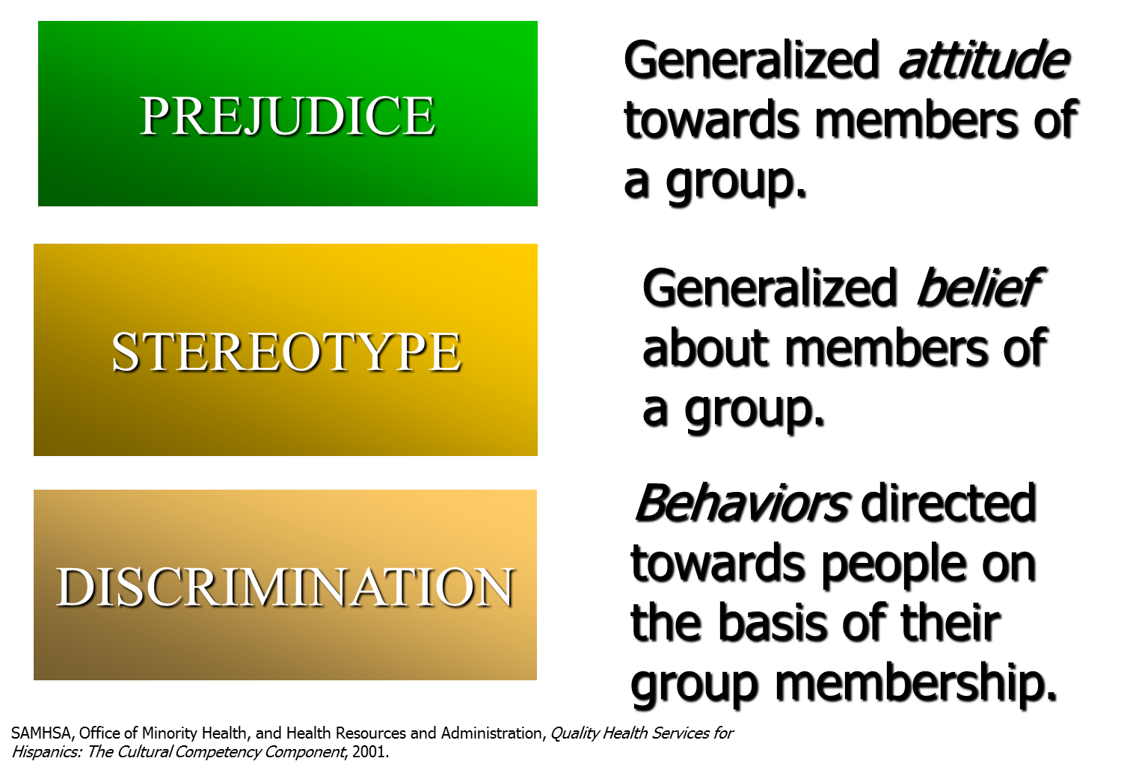
Dissecting Labels

Slide 22
Prejudice, Stereotype, & Discrimination
Negative prejudices stem from:
  Social learning
  Threats
Is being prejudiced against one group the same as being prejudiced against another group?
  E.g., Do people who have prejudices against women and homosexuals have those prejudices for the same reason?
SAMHSA, Office of Minority Health, and Health Resources and Administration, Quality Health Services for Hispanics: The Cultural Competency Component, 2001.

Slide 23
Prejudice, Stereotype, & Discrimination
Prejudice is learned.
If we become prejudiced against groups because they threaten us, perhaps groups that trigger certain threats will also trigger certain prejudices and certain reactions.

Slide 24
Questions to consider…..
What can we do to reduce the existence or expression of prejudice, stereotyping, and discrimination?
How can we move toward the development of increased cultural competence?

Slide 25
Individual’s Path to Cultural Competency
Learning is like a journey, in that, it is a path that we follow.
A model developed by David Hoopes (1979), gives us a model to cultural competency.
His outline illustrates the development of cultural competency in every one of us.
Competency implies having the capacity to function effectively.

Slide 26
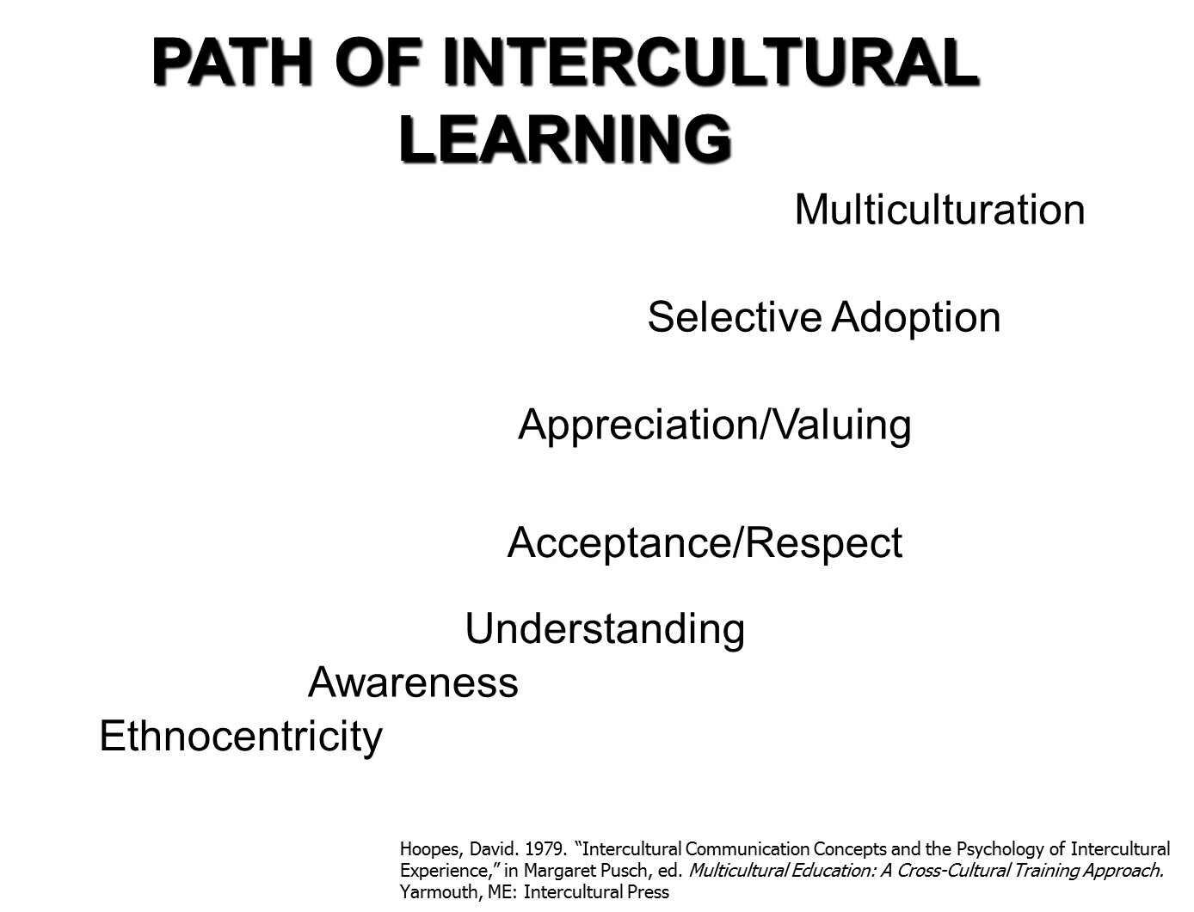
Developing Cultural Competence

Slide 27
CULTURAL SENSITIVITY
The ability to be open to learning about and accepting of different cultural groups.
“If we are aware of our biases, we can correct them—as when driving a car that drifts to the right, we steer left to go where we intend."
-- Mahzarin Banaji
U.S. Department of Health and Human Services, OPHS: National Standards for Culturally and Linguistically Appropriate Services in Health Care, March 2001

Slide 28
Cultural Humility
Cultural humility is one construct for understanding and developing a process-oriented approach to competency.
Hook, Davis, Owen, Worthington and Utsey (2013) conceptualize cultural humility as the “ability to maintain an interpersonal stance that is other-oriented (or open to the other) in relation to aspects of cultural identity that are most important to the [person]” (p. 2).
Notes:
https://www.youtube.com/watch?v=_Mbu8bvKb_U

Slide 29
Guiding Principles of Cultural Humility
lifelong commitment to self-evaluation and self-critique (Tervalon & Murray-Garcia, 1998).
Underlying this piece is the knowledge that we are never finished — we never arrive at a point where we are done learning. Therefore, we must be humble and flexible, bold enough to look at ourselves critically and desire to learn more.
When we do not know something, are we able to say that we do not know? Willingness to act on the acknowledgement that we have not and will not arrive at a finish line is integral to this aspect of cultural humility as well. Understanding is only as powerful as the action that follows.

Slide 30
Guiding Principles of Cultural Humility
A desire to fix power imbalances where none ought to exist (Tervalon & Murray-Garcia, 1998).
Recognizing that each person brings something different to the proverbial table of life helps us see the value of each person.
When practitioners interview clients, the client is the expert on his or her own life, symptoms and strengths. The practitioner holds a body of knowledge that the client does not; however, the client also has understanding outside the scope of the practitioner. Both people must collaborate and learn from each other for the best outcomes. One holds power in scientific knowledge, the other holds power in personal history and preferences.

Slide 31
Guiding Principles of Cultural Humility
Aspire to develop partnerships with people and groups who advocate for others (Tervalon & Murray-Garcia, 1998).
Though individuals can create positive change, communities and groups can also have a profound impact on systems.
We cannot individually commit to self-evaluation and fixing power imbalances without advocating within the larger organizations in which we participate.
Notes:
Cultural humility, by definition, is larger than our individual selves — we must advocate for it systemically.

Slide 32
Why be Culturally Competent?
Many cultures populate our country
  Vast array of customs, beliefs, practices
Important to understand impact of different backgrounds on behavioral health service delivery
  Ethnic
  Religious
  Cultural

Slide 34
Cultural Competence Definitions
Cultural Destructiveness: forced assimilation, subjugation, rights and privileges for dominant groups only
Cultural Incapacity: racism, maintain stereotypes, unfair hiring practices
Cultural Blindness: differences ignored, “treat everyone the same”, only meet needs of dominant groups

Slide 35
How can we respond to cultural differences in the workplace?
Positively – I’ll embrace this challenge!
Negatively – I’ll resist this. (No one can force me!)
Indifferently – Whatever! No skin off my nose either way… I treat everyone the same.
Proactively – I need to learn about this before I encounter it firsthand.
Reactively – Uh oh! What should I do?

Slide 36
Acquiring Cultural Competence
Starts with Awareness
Grows with Knowledge
Enhanced with Specific Skills
Polished through Cross-Cultural Encounters

Slide 37
Keys to Working Well w/ Others
Communicating openly
Listening
Establishing respect and understanding
Discussing issues as they arise

Slide 38
Adapt existing approaches (MI Skills)
Express empathy
Work with ambivalence
Avoid argumentation
Roll with resistance
Support self-efficacy

Slide 39
Express empathy
Remember you are an ally to the client
Client should feel heard- “They are the expert on their life”
Create a safe atmosphere through acceptance to explore alternatives
Skillful reflective listening is fundamental

Slide 40

Understanding Ambivalence
Working with ambivalence is key
Ambivalence is normal, acceptable, understandable
Attachment to the behavior is part of ambivalence
Ambivalence tips back and forth

Slide 41
Avoid Argumentation (keep the door open)
Giving advice, making suggestions or providing solutions
Persuading with logic, arguing or lecturing
Disagreeing, judging or diagnosing
Withdrawing, distracting, humoring or changing the subject

Slide 42
Roll with Resistance
Roll, rather than confront resistance. Let client know resistance is OK.
Explore the resistance with client.

Slide 43
Support Self-Efficacy
Self beliefs are important
People gain self-efficacy by seeing others succeed.
Participant can borrow self-efficacy from counselors or others

Slide 44
Essential Elements of Cultural Competence
Elements that contribute to a system’s capacity to become culturally competent
    Valuing diversity
    Possessing capacity for cultural self-assessment
    Being conscious of dynamics inherent in interactions between cultures
    Having institutionalized cultural knowledge
    Developing adaptations of service delivery reflecting an understanding of cultural diversity

Slide 45
Culturally competent service providers
Are aware of how their own cultural backgrounds, experiences, attitudes, values and biases influence psychological processes.
Have a clear and explicit knowledge and understanding of general characteristics of cultures they work with.
Respect client’s religious and/or spiritual beliefs, and values, because they affect how they see the WORLD, psychosocial functioning and expressions of distress.

Slide 46
In the end……
Not only can’t we judge a book by its cover, we must recognize that some books have had their covers torn off, some are written in a foreign language, and some might contain ideas with which we don’t agree.
Recognize, accommodate, and value ALL of your co-workers/clients for what they represent and what they have to offer. Be positive and proactive in this endeavor.

