Slide 1
Maryland certified community behavioral health clinic (CCBHC) Cost Report Training

Slide 2
agenda
Overview of the CCBHC Prospective Payment System (PPS) Rate.
Overview of Terms and Documentation.
Overview of CCBHC Cost Report Process.
Guidance on Next Steps.

Slide 3
Background of CCBHC

Slide 4
Protecting Access to Medicare Act (PAMA) of 2014, Effective April 1, 2014 (P.L. 113-93, Section 223)
Established criteria that states will use to certify community behavioral health clinics that will participate in two-year demonstration programs to improve community behavioral health services.
Provided guidance on the development of a Prospective Payment System (PPS).
Awarded grants to states for planning purposes and developing proposals to participate in demonstration program.
Selected eight states to participate in the demonstration program.
Paid states that are participating in the demonstration federal matching funds equivalent to the standard Children’s Health Insurance Program (CHIP) matching rate for services, with some exceptions.
Evaluated the project and prepared annual reports to Congress.

Slide 5
Bipartisan safer communities act (bsca) of 2022
Since 2015, over $1.1 billion appropriated to develop and expand CCBHCs through:
    Direct grants to eligible providers: Expansion, Planning, Development, and Implementation; and Improvement and Advancement.
    Planning grants to states.
    State Medicaid demonstration.
  2022 BSCA:
    Extends the existing CCBHC Medicaid demonstration through September 30, 2025.
    Expands the CCBHC Medicaid demonstration to an additional 10 states every two years. New states have a four-year demonstration period.

Slide 6
CCBHC required services
Services
Crisis mental health services, including 24-hour mobile crisis teams, emergency crisis intervention services and crisis stabilization
Screening, assessment and diagnosis, including risk assessment
Patient-centered treatment planning
Outpatient mental health and substance use services
Outpatient clinic primary care screening and monitoring of key health indicators and health risk
Targeted case-management
Psychiatric rehabilitation services
Peer support, counseling services, and family support services
Intensive, community-based mental health care for members of the armed forces and veterans, particularly in rural areas; care consistent with minimum clinical health VA guideline
CCBHCs must deliver 51% or more of encounters across all services (excluding crisis services) directly, rather than through a Designated Collaborating Organization (DCO).

Slide 7
CCBHC reimbursement elements

Slide 8
CCBHC Prospective Payment System (PPS) Rate Elements
Rate Element | Description | CCBHC Cost Report
CC PPS-1 Base Rate | Daily Rate - Uniform payment per day, regardless of the intensity of services or individual needs of clinic users | Utilized to calculate the PPS base rate To be completed by CCBHCs Format developed by CMS
Base Rate Update Factor | Medicare Economic Index adjustment or rebasing | Rates will be adjusted with MEI or rebased.
Quality Bonus Payment (QBP) | Optional bonus payment for CCBHCs that meet quality measures | N/A

Slide 9
CCBHC PPS-1 Rate Calculation
Single Rate Calculation
Direct Costs
(Trial Balance Tab)
Indirect Costs
(Indirect Cost Tab)
MEI
Daily Visits
(Daily Visits Tab)

Slide 10
Terms and documents to know

Slide 11
Terms to know
Cost/Expense – amounts that are paid to purchase or obtain something.
Revenue – income for the facility either through regularly provided services or other means. Includes standard patient care revenue, donations/grants, and miscellaneous revenue.
Visit – an instance of providing an allowed service to a patient.
Fixed Assets – assets which are purchased for long-term use and are not likely to be converted quickly into cash, such as land, buildings, and major equipment.
Anticipated Costs – costs that are not currently being incurred by a provider in their current facility certification; however, will need to be incurred to operate as a CCBHC.

Slide 12
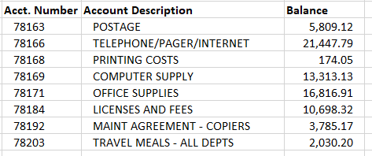
Documents to know – trial balance
A trial balance is a report/document that generates the balances for all income, expense, and asset accounts.
The trial balance includes account number, name, and balance.

Slide 13
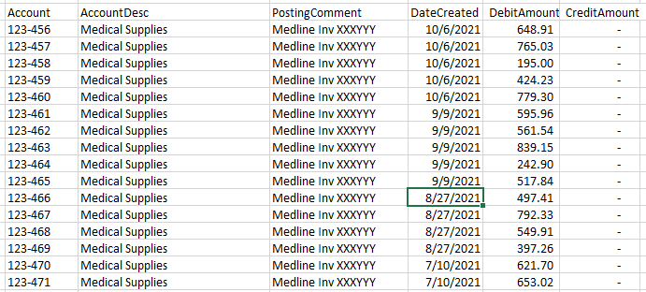
Documents to know – general ledger detail
General ledger (GL) detail is a report that shows the individual journal entries for every account listed on the trial balance.
GLs include individual entries that make up the account balance (entry date, description, amount).

Slide 14
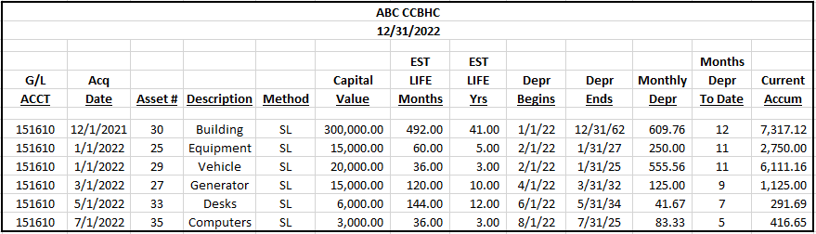
Documents to know – depreciation schedule
A depreciation schedule is a listing of fixed assets at the facility.
Depreciation schedules include asset descriptions, place in service date, estimated useful life, depreciation method, and depreciation expense for the year.

Slide 15
What is included on a cost report?

Slide 16
Data on a cost report
Costs
  Direct
      Indirect
      Non-Allowable
      Anticipated
      Visits
      General Provider Information

Slide 17
Direct costs
What is a direct cost?
  A cost that has a direct health care impact to a patient.
    Patient-facing costs.
    Not administrative or overhead.
    Examples:
      Nursing salaries.
      Medical supplies.

Slide 18
Direct care costs
This section only applies if a facility plans to provide services other than CCBHC approved services.
Directly Related to Patient Care
Directly Related to CCBHC
Direct
Non-CCBHC
Direct costs related to ALL services provided (CCBHC and non-CCBHC).
Nurse salaries providing services to all patients.
Direct costs ONLY related to CCBHC approved services.
Salaries for staff providing ONLY CCBHC services.
Direct costs related to providing non-CCBHC services.

Slide 19
Indirect costs
Costs incurred by a facility that are not directly related to providing patient care. Typically, indirect costs are for the overall operation of the facility.
Also known as overhead or administrative costs.
Examples:
  Business office salaries.
  Maintenance.
  Utilities.
  Insurance.

Slide 20
Allowable costs
Per CMS Pub 15-1: 2102.2:
  These include all necessary and proper costs which are appropriate and helpful in developing and maintaining the operation of patient care facilities and activities. Necessary and proper costs related to patient care are usually costs which are common and accepted occurrences in the field of the provider’s activity. They include personnel costs, administrative costs, costs of employee pension plans, normal standby costs, and others.

Slide 21
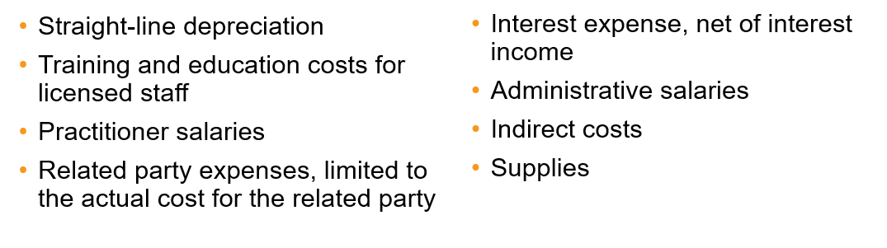
What is an allowable cost?
2 CFR 200 Subpart E Cost Principles
All payments to providers of services must be based on the reasonable cost of services covered under Medicare and related to the care of beneficiaries.
Reasonable cost includes all necessary and proper costs incurred in furnishing the services, subject to principles relating to specific items of revenue and cost.
Including but not limited to:

Slide 22
Non-Allowable costs
Per CMS Pub 15-1: 2102.3 Costs Not Related to Patient Care:
  Costs not related to patient care are costs which are not appropriate or necessary and proper in developing and maintaining the operation of patient care facilities and activities. Costs which are not necessary include costs which usually are not common or accepted occurrences in the field of the provider’s activity.

Slide 23
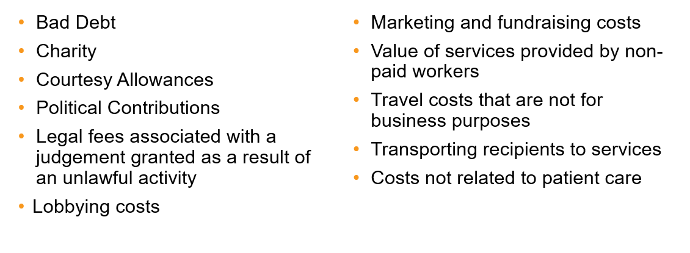
What is not an allowable cost?
2 CFR 200 Subpart E Cost Principles
Included but not limited to:

Slide 24
Anticipated costs
What are anticipated costs?
  Costs that not currently being incurred that a provider anticipated needing to incur during the cost report period to provide CCBHC services or bring facility up to CCBHC standards.
  Examples:
    New staff.
    New medical equipment.
    Electronic health record (EHR) costs.
    Anticipated costs COULD be ANY costs that will be incurred as a CCBHC that is not currently being incurred.

Slide 25
CCBHC Cost report

Slide 26
CCBHC Cost Report Regulations
CCBHC Cost Report & Instructions:
https://www.medicaid.gov/media/173116
www.medicaid.gov/medicaid/financial-management/downloads/ccbhc-cost-rpt-instr.pdf
When reporting costs, the CCBHC must adhere to:
  45 Code of Federal Regulations (CFR) §75 Uniform Administrative Requirements, Cost Principles, and Audit Requirements for the U.S. Department of Health and Human Services (HHS) Awards
  2 CFR §200 Uniform Administrative Requirements, Cost Principles, and Audit Requirements for Federal Awards

Slide 27
Cost Report Walkthrough
Cost report must be prepared on the accrual basis of accounting.
All requested information in the tabs must be provided.
Round all amounts to the nearest whole dollar.

Slide 28
Cost Report Steps/Schedules (Recommended Order)
Provider Information
Trial Balance
Trial Balance Reclassifications
Trial Balance Adjustments
Anticipated Costs
Daily Visits
Services Provided
Comments (as needed)
CC PPS-1 Rate
Certification
Allocation Descriptions (as needed)
Indirect Cost Allocation

Slide 29
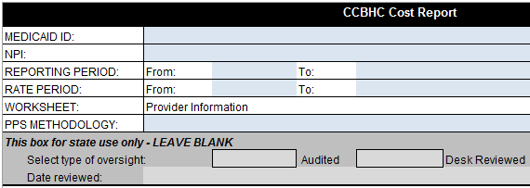

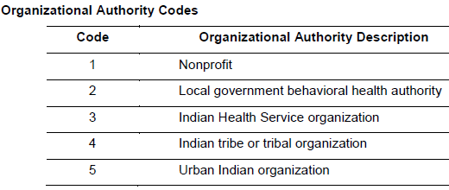
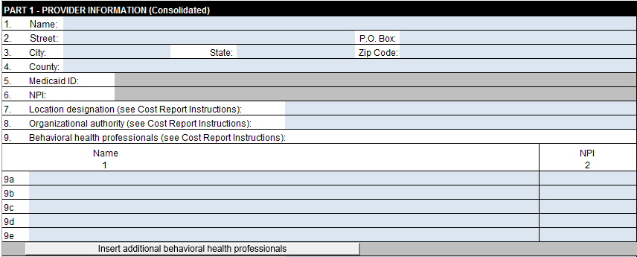
Provider Information – Part 1
Use the Provider Information tab (Parts 1 and 2) to report CCBHC-identifying information for all of the CCBHC’s primary and satellite center locations.
Part I is for single sites or central office information.
PPS-1

Slide 30
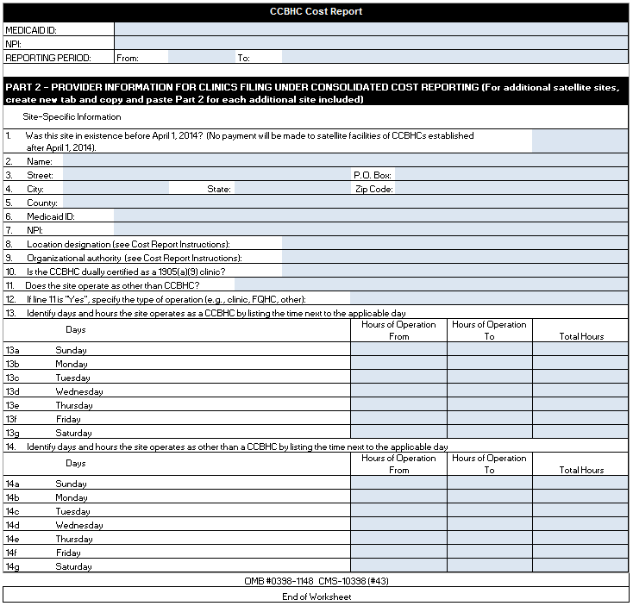
Provider Information – Part 2
Part II is used if the entity is filing a consolidated report and should be completed for every additional clinic site.
The tab should be copied for each location.

Slide 31
Steps to creating a crosswalk & mapping
Step 1
List all Trial Balance Accounts.
Should include all CCBHC allowable services and visits, regardless of payer.
Step 2
Identify the Appropriate Cost Report Line and Description beside each TB Account (See Cost Report Instructions).
Step 3
Summarize Costs by Cost Report Cost Line.

Slide 32
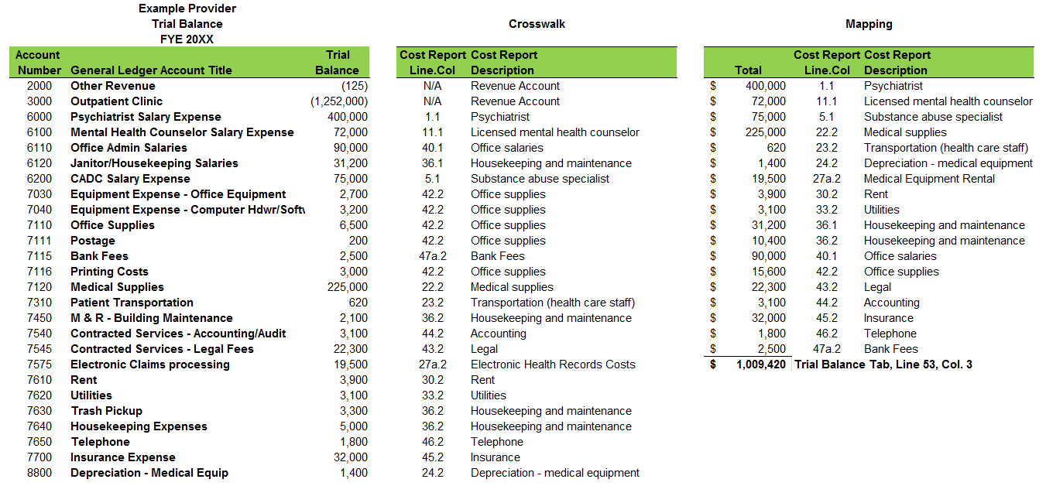
Trial Balance
Trial Balance/Crosswalk/Mapping
Step 1
Step 2
Step 3

Slide 33
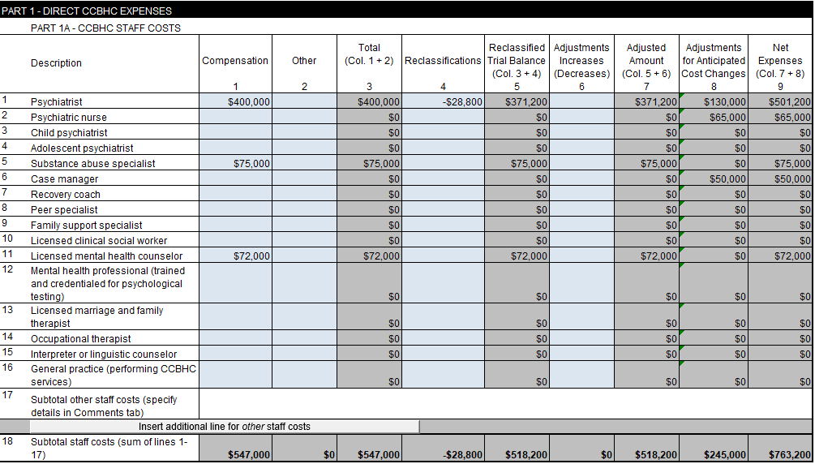
Trial Balance Part 1A
CCBHC STAFF COSTS
This information must correspond with the Mapping of Trial Balance Costs.
This information must correspond with the Trial Balance Reclassifications/Adjustments Tab(s).
This section is used to report CCBHC Staff Costs and also shows:
Staff Reclassifications.
Adjustments.
Adjustments for Anticipated Cost Changes.
This information must correspond with the Anticipated Costs Tab.

Slide 34
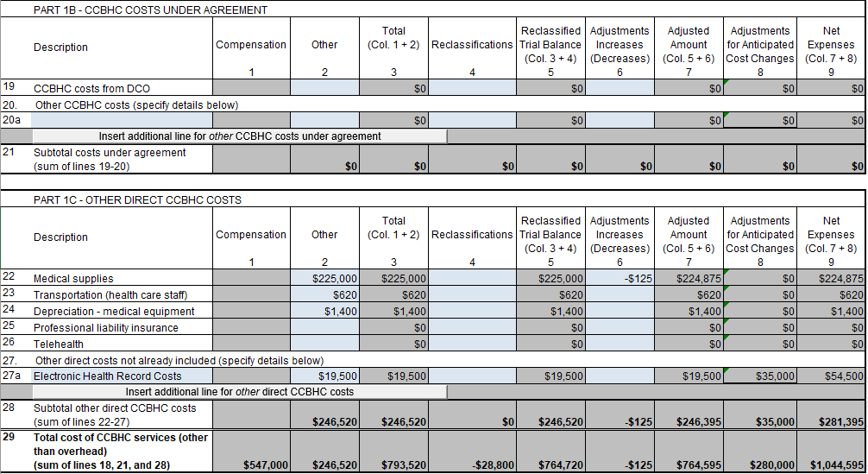
Trial Balance
Trial Balance Part 1B
CCBHC COSTS UNDER AGREEMENT
This information must correspond with your Mapping of Trial Balance Costs.
This information must correspond with the Trial Balance Reclassifications/Adjustments Tab(s).
This information must correspond with the Anticipated Costs Tab.

Slide 35
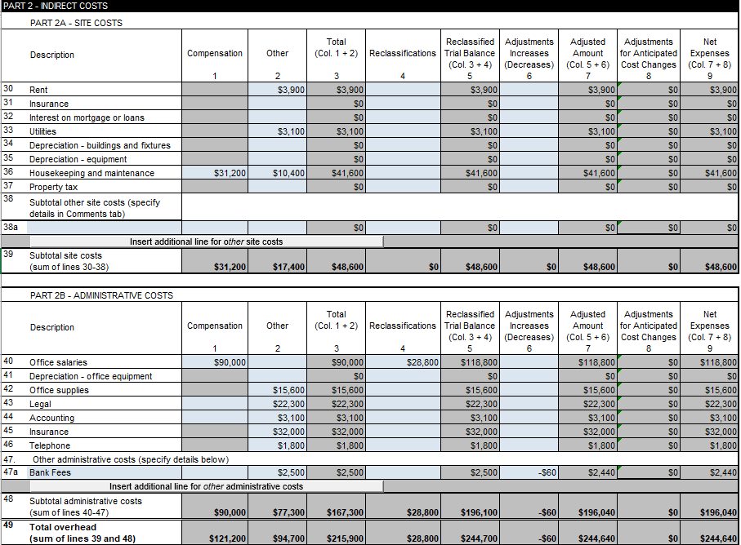
Trial Balance
Trial Balance Part 2A/2B
INDIRECT SITE COSTS
This information must correspond with your Mapping of Trial Balance Costs.
This information must correspond with the Trial Balance Reclassifications/Adjustments Tab(s).
Indirect Costs – Costs incurred to support the providing of a service:
  Rental costs.
  Utility costs.
  Administrative personnel costs.
This information must correspond with the Anticipated Costs Tab.

Slide 36
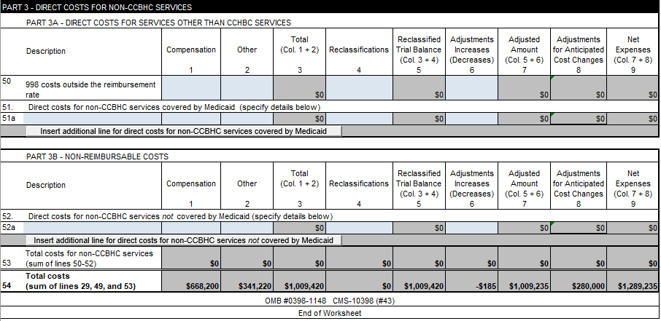
Trial Balance Part 3A/3B
DIRECT COSTS FOR NON-CCBHC SERVICES
This section is used to report direct costs for non-CCBHC services both covered & non-reimbursable by Medicaid.
This total must correspond with total costs on your Mapping of Trial Balance Costs.

Slide 37
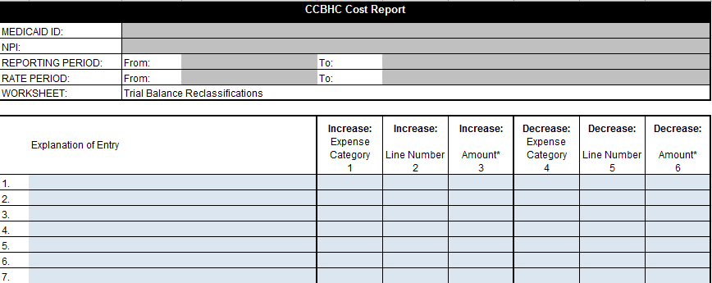

Trial Balance Reclassifications
Used to reclassify the expenses listed on the Trial Balance tab.
Reclassify costs where expenses are applicable to more than one expense category.
Example

Slide 38
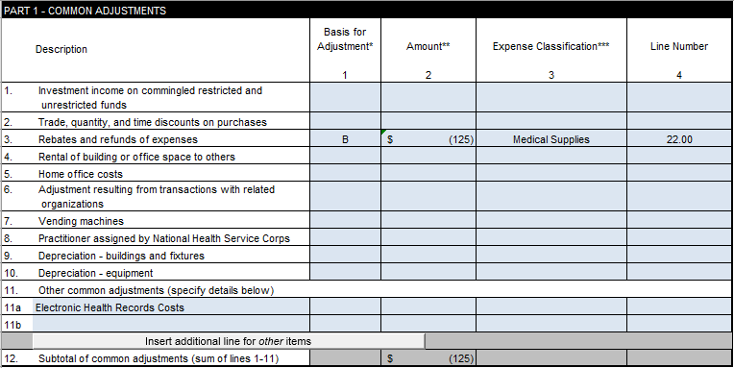
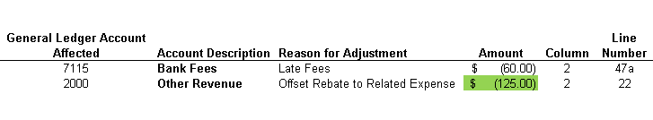
Trial Balance Adjustments
Use to adjust the expenses listed on Trial Balance tab
Example
45 CFR 75.406 Applicable Credits - Applicable credits refer to those receipts or reduction-of-expenditure-type transactions that offset or reduce expense items allocable to the Federal award as direct or indirect F&A costs.
Examples of such transactions are: purchase discounts, rebates, or allowances; recoveries or indemnities on losses; insurance refunds or rebates and; adjustments of overpayments or erroneous charges.

Slide 39
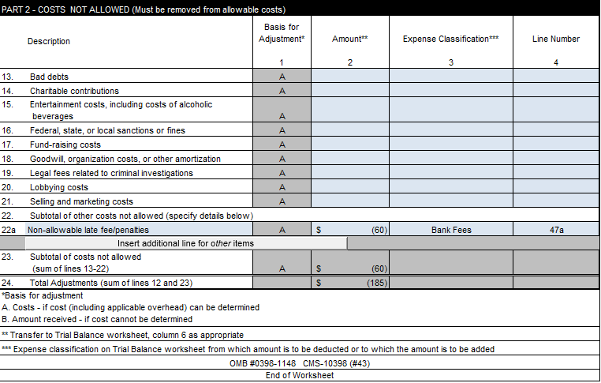
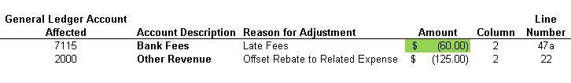
Trial Balance Adjustments cont.

Slide 40
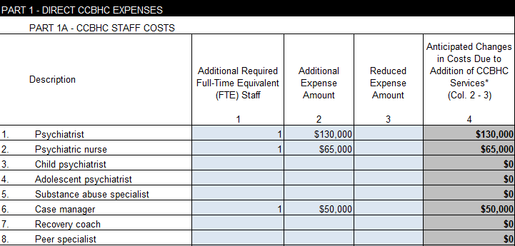
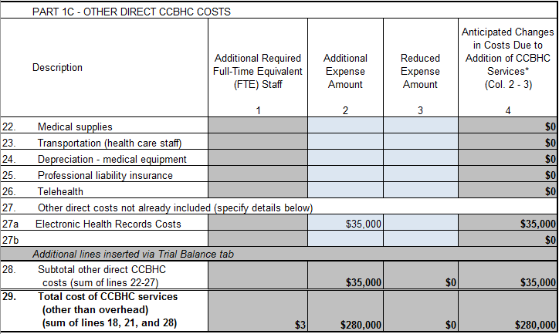
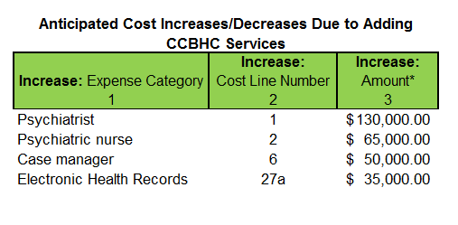
Anticipated Costs
Used to add or change the expenses listed on Trial Balance tab to allow for services not previously offered but required as a CCBHC.
Estimate changes in cost and FTEs providing CCBHC services.

Slide 41
Anticipated cost documentation
Description of costs.
Reason that cost is not included in the reporting year.
Support for any estimates/allocations utilized to determine the costs.

Slide 42
Anticipated costs examples
Adding costs for Psychiatry services & related FTE staffing needs.
Adding FTE SA Counselors/Licensed Clinical Social Worker/Intake/Case Managers.
Estimating a cost of new vehicle, divided by four years (AHA Useful Life), necessary to provide Mobile Crisis Response.
Anticipated Increase in Leased Space.
Upgrades made to EHR system.

Slide 43
Other Guidelines for anticipated costs/visits
Costs must be justified by the organization’s community needs assessment.
Documentation for anticipated staffing hires must be accompanied by support showing the requested hires can be hired before/during the rate period.
Other anticipated costs (i.e., non-staffing) will be considered on a case-by-case basis.
Anticipated visits should be determined based on historic usage of similar clinicians.
  This can be done by calculating a historic visit per FTE ratio of direct CCBHC clinicians by type or in total

Slide 44
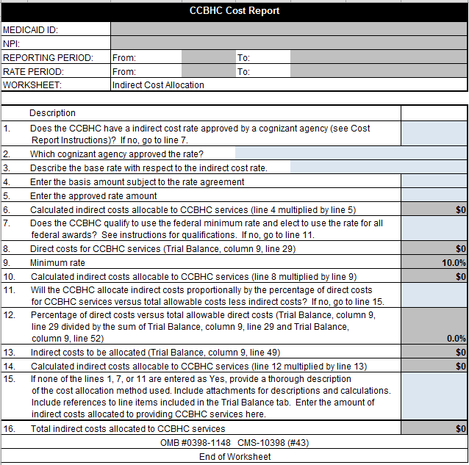
Indirect Cost Allocation
Use to identify the method used for calculating allocable indirect costs to CCBHC services.
The worksheet can be used for the following methods of allocation:
  Federally approved indirect cost rate (FIR) by a cognizant agency. Should be used if one is assigned. Costs are required to be classified on the cost report in the same manner as they were for the FIR calculation.
  *Minimum rate for qualifying entities (10%)
  Proportionate allocation by percentage of direct costs
  Other, where the entity must provide a description and justification of the allocation method
* Eff. 10/1/2024, the de minimis rate increased from 10% to 15%.

Slide 45
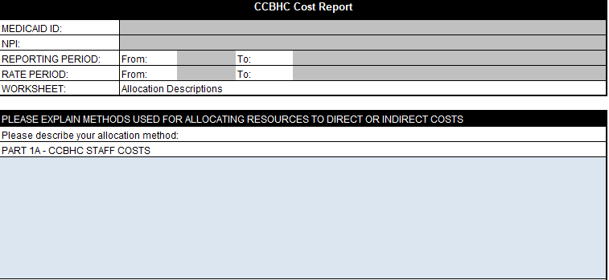
Allocation Descriptions
The purpose of this tab is to expedite cost report review and to limit the questioning of costs.
This tab allows the clinic to describe, in detail, the calculations and methods to support the allocation of direct and indirect costs.
Data reported in this tab should support allocations in the Trial Balance, Reclassifications, and Adjustments tabs.
Additional anticipated daily visit calculations/estimations should be included on this tab.

Slide 46
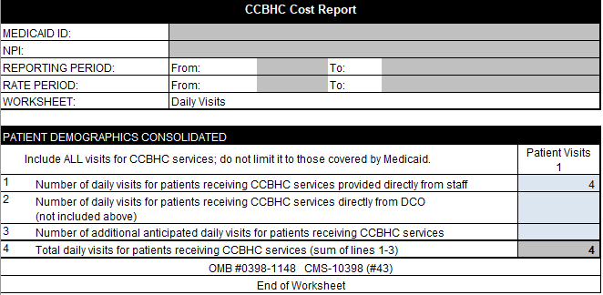
Daily Visits
Use this tab to report the total annual number of daily CCBHC visits delivered to all clinic users that receive demonstration services; include daily visits of DCOs* and services delivered to non- Medicaid beneficiaries.
* A DCO is an entity that is not under the direct supervision of the CCBHC but is engaged in a formal relationship with the CCBHC and delivers services under the same requirements as the CCBHC.

Slide 47
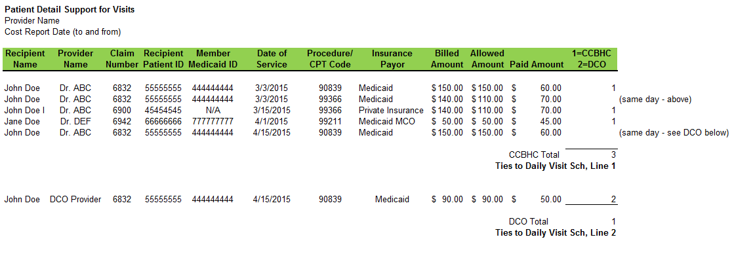
Detailed visit report (example)
1
4

Slide 48
VISIT enumeration
A visit may only be enumerated when at least one of the statutorily-required services as specified at section 223 (a)(2)(D) is provided in accordance with federal guidelines at a certified CCBHC service delivery site.
  These refer to the 9 required services listed on slide 9 and then, specifically, the Maryland-allowable CCBHC procedure codes.
  The totals on the Patient Daily Visit Report should tie to lines 1 and 2 of the Daily Visits schedule of the CCBHC cost report. Line 3 (additional anticipated daily visits) should be explained in the “Allocation Descriptions” tab.

Slide 49
VISIT Documentation
SAMHSA requires a CCBHC to establish or maintain a health information system that includes, but is not limited to, electronic health records
All activities that trigger an enumerated visit must be documented in the clinic user’s medical record
The DCO must provide all data to the CCBHC required for the CCBHC to bill for demonstration services

Slide 50
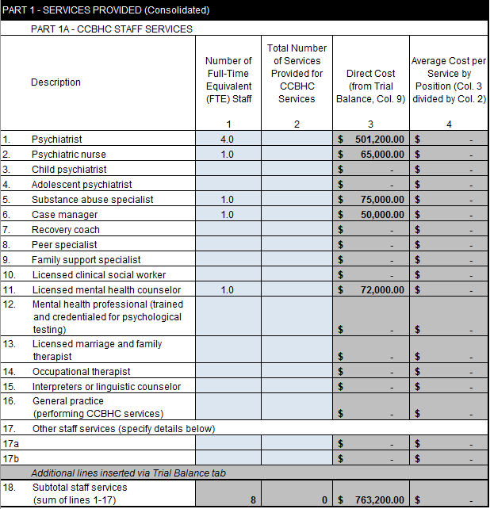
Services Provided
  Use the Services Provided tab to report the number of FTEs and the number of services provided for CCBHC services for each type of practitioner.
  Number of Services Provided should reflect the amount of CCBHC services provided. If multiple procedure codes can be billed, then multiple services should be counted.

Slide 51
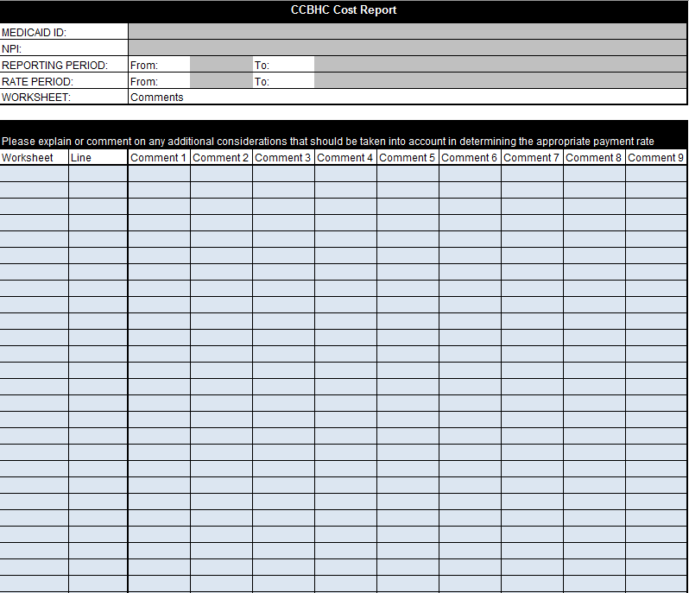
Comments
  Use the Comments tab to explain any cost anomalies, entries in “Other (specify)” lines in Trial Balance, Trial Balance Adjustments, Services Provided, or any other considerations the state should make regarding the expenses used to determine the payment rate

Slide 52
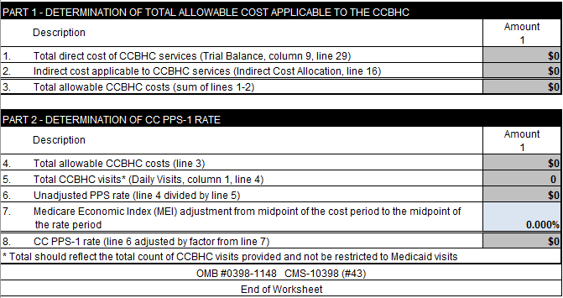
CC PPS-1 Rate
Used to determine the all-inclusive CCBHC payment rate per daily visit for the reporting period for states selecting the CC PPS-1 rate method.
    Determination of Total Allowable Cost Applicable to CCBHC.
    Determination of CC PPS-1 Rate.
    Requires input of MEI to trend data.

Slide 53
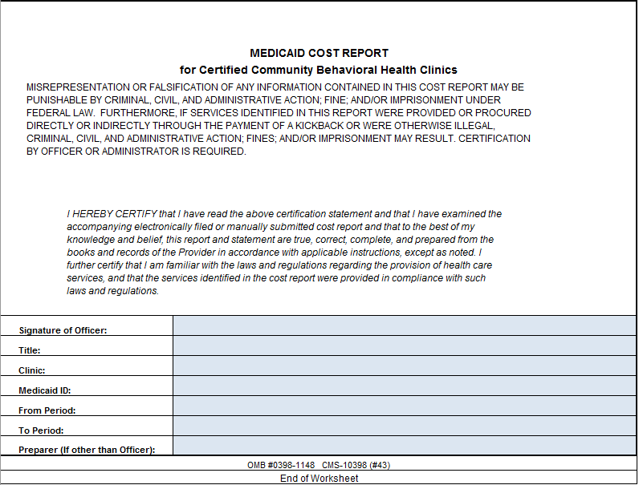
Certification
  Cost reports must include certification from the CEO, CFO or an authorized delegate.
  Cost reports will be rejected and returned for re-submission if not completed properly.

Slide 54
CCBHC Cost Report Documents
Cost Report Submission
Complete CCBHC Cost Report Submission includes:
CCBHC Cost Report
Accompanying Support:
  Detailed Trial Balance.
    Crosswalk/Mapping between the Trial Balance and the Cost Report by Cost Center (should include a reconciliation of TB and Cost Report Differences).
    Daily visits supporting documentation.
    Federal indirect rate support, if applicable.
    Certification by Officer or Administrator of the cost report with original signature.
    Explanations, calculations, and supporting documentation for allocations, reclassifications, adjustments, and anticipated costs.
    Explanation and calculation details for estimated Designated Collaborating Organizations (DCO)s.
    Separate summary of and identification and support for costs and visits due to providing primary care services (please note, primary care screening and monitoring costs and visits should not be included in these separate costs identified).
    Detailed support on FTE and number of services provided per staff description.
    Listing of all sites with one of the following designations (CCBHC, Non-CCBHC, Combination of CCBHC & Non-CCBHC).

Slide 55
Next steps: items to come
Cost report request letter with a full list of required support.
Cost report technical assistance (upon request).
Cost report submissions will be due April 24, 2026

Slide 56
Ccbhc pps resources
Medicaid.gov:
  https://www.medicaid.gov/medicaid/financial-management/section-223-demonstration-program-improve-community-mental-health-services/index.html
SAMSHA.gov:
  https://www.samhsa.gov/section-223/certification-resource-guides/state-certification-guide
The National Council:
    https://www.thenationalcouncil.org/ccbhc-success-center/

Slide 57
Questions?
Questions regarding the cost report can be submitted to:
James Wright, JWright@mslc.com
Matt Lee, MLee@mslc.com
888-749-5799

