Slide 1

10 Tips for Building Resilience and Preventing Burnout
Michelle Pearce, PhD
Professor and Clinical Psychologist
Graduate School, University of Maryland, Baltimore
BHA/MedChi Behavioral Health Webinar Series:
Helping the Helpers and Those They Serve

Slide 2

Overview/Objectives
Describe burnout and what puts us at risk as health care providers.
Define resilience.
Learn and apply 10 tips for building resilience and preventing burnout.
Q & A

Slide 3
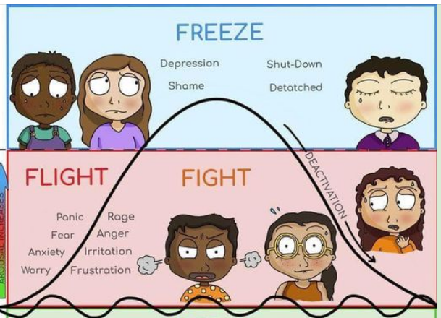
Burnout and The Stress Response

Slide 4

Why COVID-19 Increased the Risk of Burnout
Front line workers
Threat of COVID-19 for self and family
Patients very sick/Many witnessed patients die
Increased feelings of hopelessness and despair
Longer hours
Little or no time off
Changing work protocols
Isolation/lack of community
Those outside health care had different experience
Less time for self-care

Slide 5

Resilience: Fill Your Cup

Slide 6

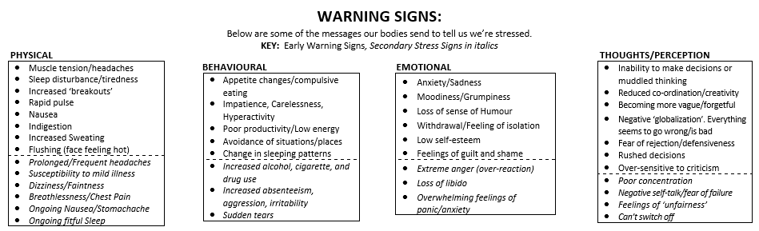
1. Know Your Warning Signs
Chronic Stress Response

Slide 7


2. Move Your Body
Resources
Work Out at Home Ideas
Yoga With Adriene YouTube Channel
There’s an app for that! Check your app store for free/low-cost fitness apps and trackers (e.g., The 7 Minute Workout App)

Slide 8

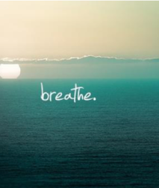
3. Take a Breath and a Mental Break
Resources
Mindfulness TED Talk: All it Takes is 10 Mindful Minutes
How to Meditate
Free Guided Meditations UCLA
More Free Guided Meditations and Guided Imagery

Slide 9
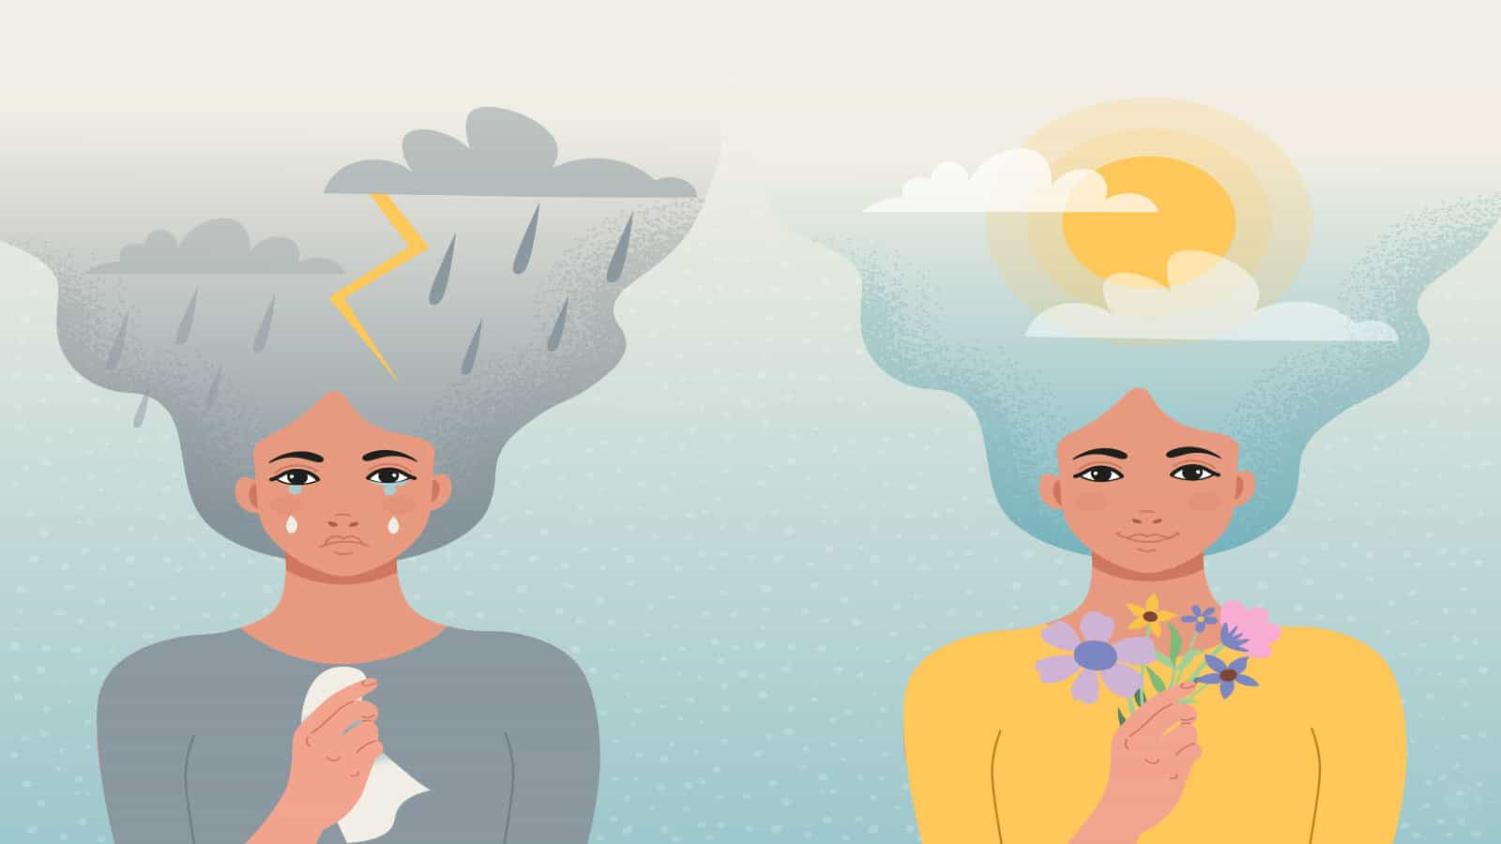
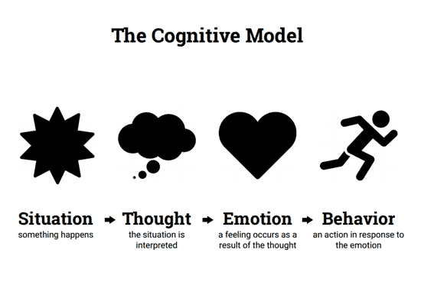
4. Challenge Your Thoughts
2 Questions to Ask Yourself:
Is it true?
Is it helpful?
How does Cognitive Behavioral Therapy Work?
More about Challenging Thoughts
20 Questions to Ask Yourself

Slide 10
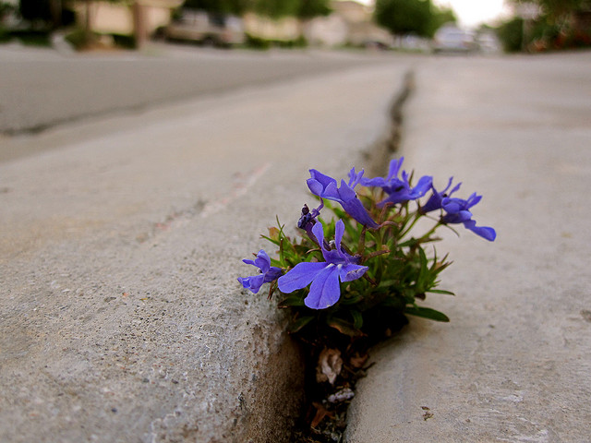

5. Consider a New Perspective
Beyond Resilience: How to Bloom in the Dark
5 ways to Change Your Perspective

Slide 11


6. Protect and Prioritize Your Personal Time
How to Fiercely Protect Your Time
No One Will Protect Your Time for You

Slide 12


7. Connect
Meetup.com
CitySocializer.com

Slide 13

8. Nurture Your Spirit
The 5 Minute Journal to Build Gratitude and Happiness
8 Step Guide to Tap into Your Spiritual Side

Slide 14


9. Give Grace/Be Kind
Resources
What it Really Means to ‘Give Yourself Grace’
Self-Compassion Resources and Meditation

Slide 15

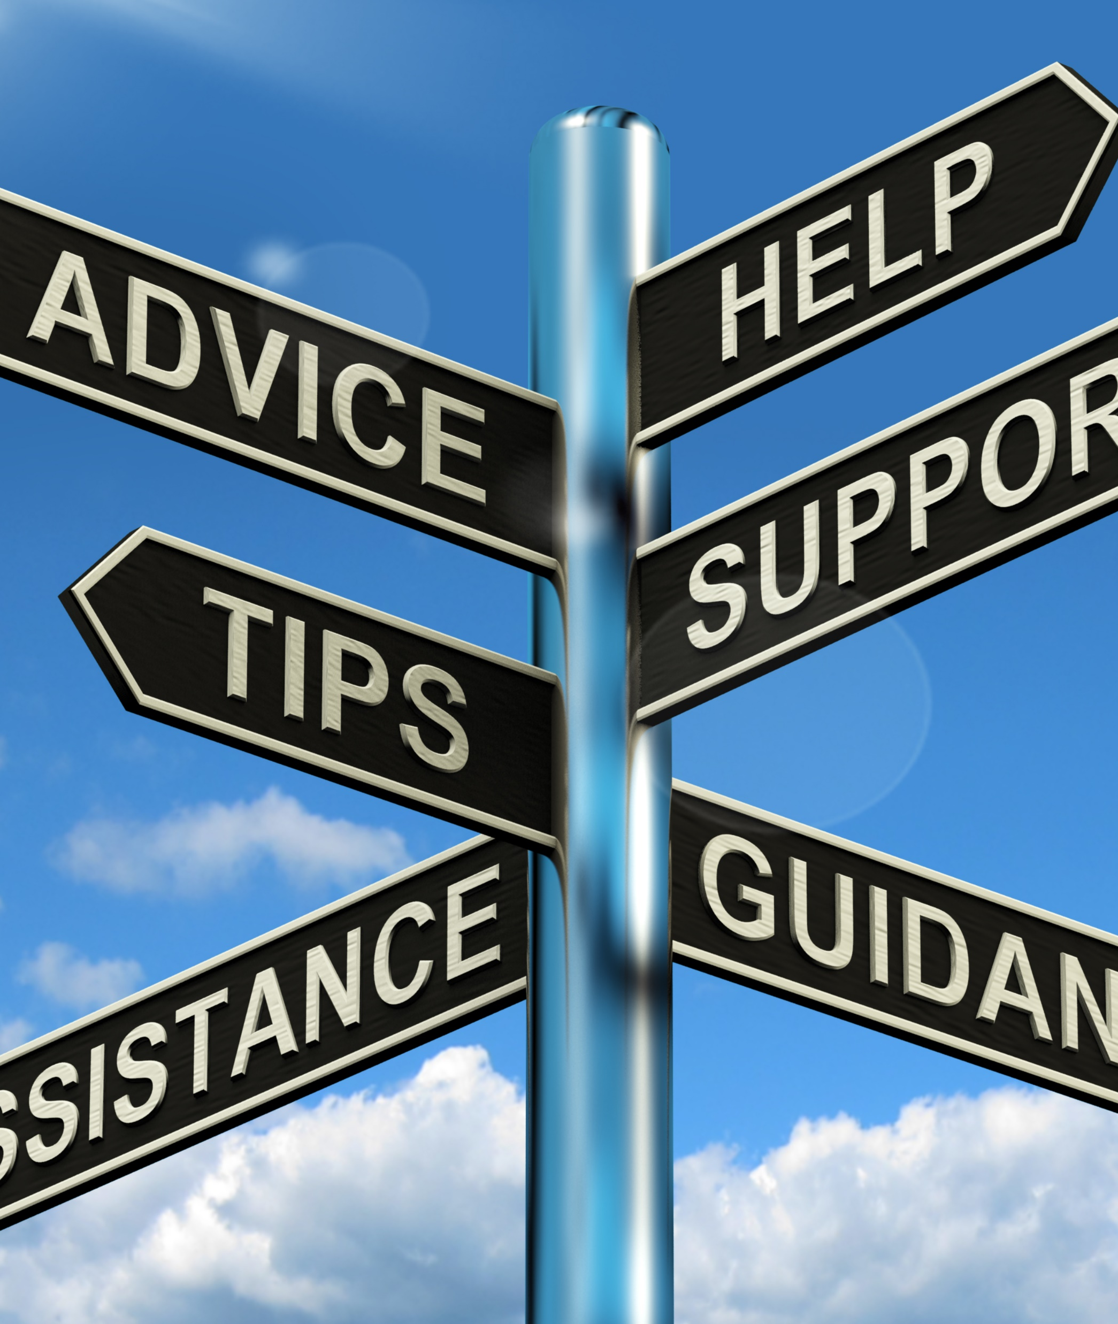
10. Know Your Limits and Ask for Help
Resources
BetterHelp.com
“Find a Therapist” on Psychology Today
Professional Life Coaching (www.drmichellepearce.com)
Other ways to find a coach

Slide 16

Thank you! Q & A
Michelle Pearce, PhD
Email: Michelle.Pearce@umaryland.edu
Website: www.DrMichellePearce.com
IG: @bloomwithdrmichelle

Slide 17
References
Hall, D., Millstein, R., Luberto, C., et al. (2020). Responding to COVID-19 stress: Disseminating mind-body resiliency approaches. Global Advances in Health and Medicine, 9. https://doi.org/10.1177/2164956120976554
Hall, DL, Luberto, CM, Philpotts, LL, et al. Mind-body interventions for fear of cancer recurrence: a systematic review and meta-analysis. Psycho-Oncology. 2018; 27(11):2546–2558.
Luberto, CM, Shinday, N, Song, R, et al. A systematic review and meta-analysis of the effects of meditation on empathy, compassion, and prosocial behaviors. Mindfulness. 2018; 9(3):708–724.
National Academies of Sciences, Engineering, and Medicine. Taking Action Against Clinician Burnout: A Systems Approach to Professional Well-Being. Washington, DC: The National Academies Press; 2019.
Park, ER, Perez, GK, Millstein, RA, et al. A virtual resiliency intervention promoting resiliency for parents of children with learning and attentional disabilities: a randomized pilot trial. Matern Child Health J. 2020; 24(1):39–53.
Shanafelt, TD, Noseworthy, JH. Executive leadership and physician well-being: nine organizational strategies to promote engagement and reduce burnout. Mayo Clin Proc. 2017; 92(1):129–146.

Slide 18
COVID-19 Resource Page
BHA COVID-19 Response webpage found at https://bha.health.maryland.gov/Pages/bha-covid-19.aspx

Slide 19


CME Accreditation and Designation
This activity has been planned and implemented in accordance with the Essential Areas and policies of the Accreditation Council for Continuing Medical Education (ACCME) through the joint providership of MedChi, The Maryland State Medical Society and the Behavioral Health Administration of the Maryland Department of Health. MedChi is accredited by the ACCME to provide continuing medical education for physicians. CMEs will be available at no cost, as will Participant Certificates, which for other disciplines may qualify for CEUs or other continuing education credit, although these are not approved for CEUs by the Maryland Board of Social Work Examiners. Participants should check with their certifying organizations to see how these would apply.
MedChi designates this webinar educational activity for a maximum of 1 AMA PRA Category 1 Credits™. Physicians should claim only the credit commensurate with the extent of their participation in the activity, as should other disciplines who claim credit for Participant Certificates. For CME/Participant Certificate questions please contact Sherrie Noonan at sherrie.noonan@maryland.gov.
Webinars jointly sponsored by the Behavioral Health Administration and MedChi

Slide 20
CME Disclosures
Presenters and Planners: Aliya Jones, MD and Steve Whitefield, MD have reported no relevant financial relationships to disclose. Michelle Pearce, PhD receives royalties from sales from her books; she has no other financial relationships to disclose.
MedChi CME Reviewers: The reviewers from the MedChi Committee On Scientific Activities (COSA) for this activity have reported no relevant financial relationships to disclose.
Webinars jointly sponsored by the Behavioral Health Administration and MedChi

