Slide 1

Cultivating
Compassion and Resilience
for Yourself and Those in Your Care
Beth Terrence, MS, CPRS
BHA/MedChi Behavioral Health Webinar Series
January 13, 2022
Founder and Facilitator, Holistic Recovery Pathways, LLC

Slide 2


Slide 3


Welcome Everyone!
I’m Beth Terrence, MS, CPRS,
founder and lead facilitator of
Holistic Recovery Pathways, LLC.
A few of my hats include…
  Holistic Health Practitioner
  Trained Shaman
  Restorative Practices Facilitator & Trainer
  Certified Peer Recovery Specialist
  May Is For Metta: 31 Days of Lovingkindness Program Creator & Facilitator
  Certified SHINE Mindfulness Facilitator

Slide 4




Learning Objectives:
Define Compassion, Self-Compassion, and their components
Describe how Compassion training and practices build resilience
Discuss the effects of Self-Compassion on work-related and overall wellbeing
Examine types of Compassion practice to support yourself and those in your care
Discuss how to integrate Compassion into a self-care and resilience plan

Slide 5
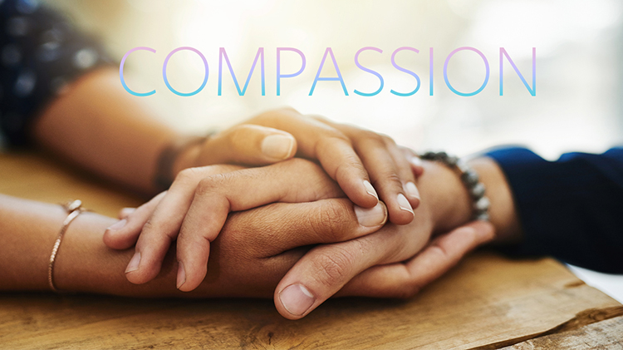

Slide 6
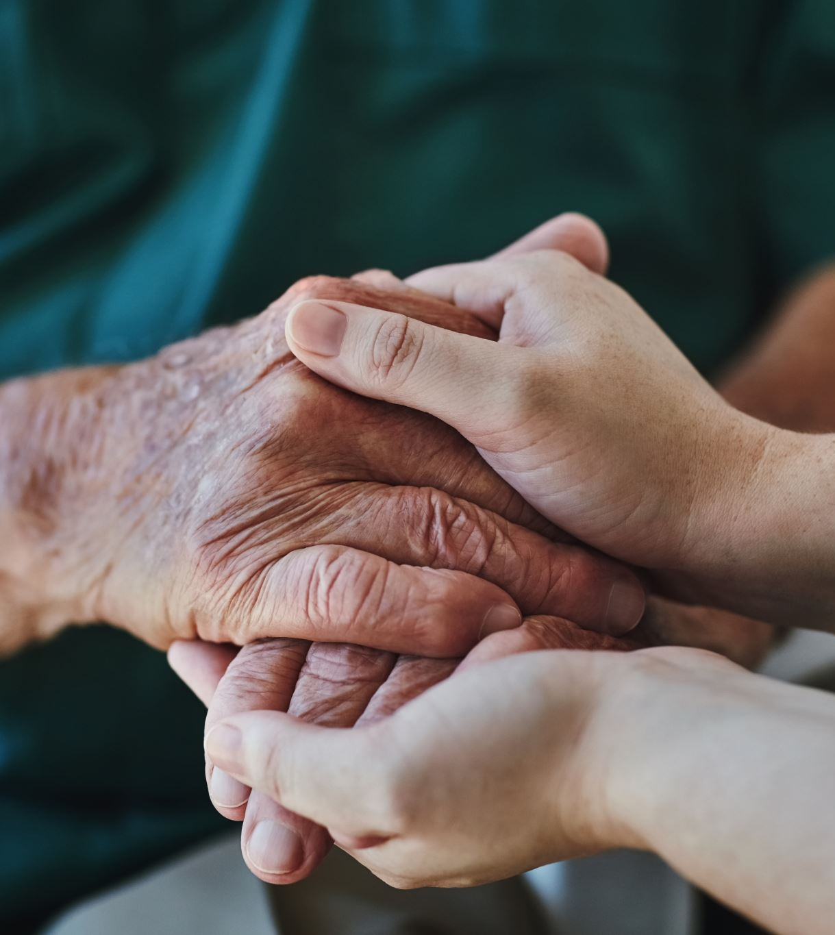
Defining Compassion
“to suffer together.” (greatergood.berkeley.edu)
“to recognize the suffering of others and then take action to help. Compassion embodies a tangible expression of love for those who are suffering.” (Compassion.com)
"sympathetic consciousness of others' distress together with a desire to alleviate it.” (Merriam Webster Dictionary)
“the feeling that arises when you are confronted with another’s suffering and feel motivated to relieve that suffering.” (Strauss et al., 2016)
“concern for the wellbeing of others.” (Cosley, McCoy, & Saslow, 2010)

Slide 7

Image Source: grandsecretsofspiritualmysteries.com

Slide 8

Spiritual Roots of Compassion
Compassion and compassion practices have been at the heart of many spiritual and religious traditions for thousands of years.
In the Buddhist tradition compassion is defined as ”the heart that trembles in the face of suffering”. It is considered the noblest quality of the human heart, the motivation underlying all meditative paths of healing and liberation. The Dalai Lama once said, “if you want to know what compassion is, look into the eyes of a mother or father as they cradle their sick and fevered child”.
The Tao Te Ching, a fundamental text of Taoist philosophy, states, “Compassionate towards yourself, you reconcile all beings in the world.”
Compassion in Judaism is one of the central attributes of the divine; and is considered to be one of the core obligations of humanity.
In Christianity, the parable of the Good Samaritan is probably the most concrete example of compassion, presenting a model of how we should not only help someone in need, but
make an attempt to ensure their future.

Slide 9
Science of Compassion
“If we say, oh, the practice of compassion is something holy, nobody will listen. If we say, warm-heartedness really reduces your blood pressure, your anxiety, your stress and improves your health, then people pay attention.”
~ H.H Dalai Lama
Research by expert well-being psychologists Ed Diener and Martin Seligman indicates that social connectedness is a predictor of longer life, faster recovery from disease, higher levels of happiness and well-being, and a greater sense of purpose and meaning.
One large-scale study showed that lack of social connectedness predicts vulnerability to disease and death above and beyond traditional risk factors such as smoking, blood pressure, obesity and lack of physical activity.
Chuck Raison and colleagues at Emory University have demonstrated that a regular compassion meditation practice reduces negative neuroendocrine, inflammatory and behavioral responses to psychosocial stress.
Stephanie Brown, professor at SUNY Stony Brook University and the University of Michigan, has shown that the act of experiencing compassion and helping others actually leads to tremendous mental and physical well-being for us as well.
Steve Cole from UCLA, a social neuro-genetics scientist, has shown that loneliness leads to a less healthy immune stress profile at the level of the gene -- their gene expression makes them more vulnerable to inflammatory processes which have been shown to have negative effects on health. One particularly telling survey showed that 25% of Americans have no one that they feel close enough with to share a problem.
Source: Doty, J.R. (2012)

Slide 10
Defining Self-Compassion
“Self-compassion is the ongoing practice of relating to yourself kindly and fairly. It is especially helpful during times of stress and suffering. Self-compassion is not kicking yourself when you’re down, which prolongs stress reactions, creates more suffering, and delays your ability to get back up. Instead, self-compassion is about treating yourself as you would treat a good friend in distress. It is about responding with caring support.” ~ Whitlock, et al. (2021)
“Self-compassion is the practice in which we learn to be a good friend to ourselves
when we need it most – to become an inner ally rather than an inner enemy.” ~
Neff & Germer (2018)

Slide 11
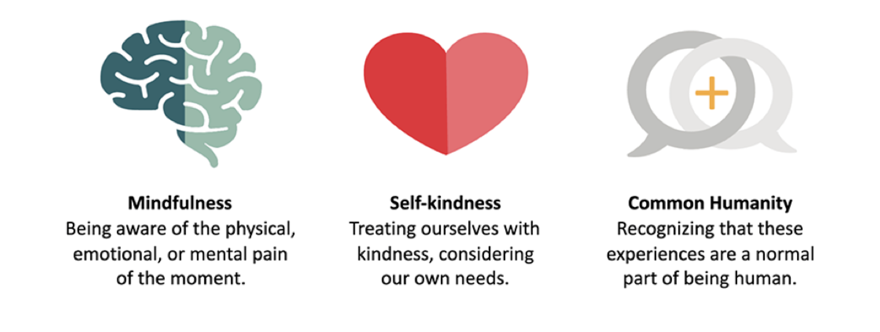
Three Elements of Self-Compassion
Image source: @THEU; Content Source: Neff & Germer (2018)

Slide 12
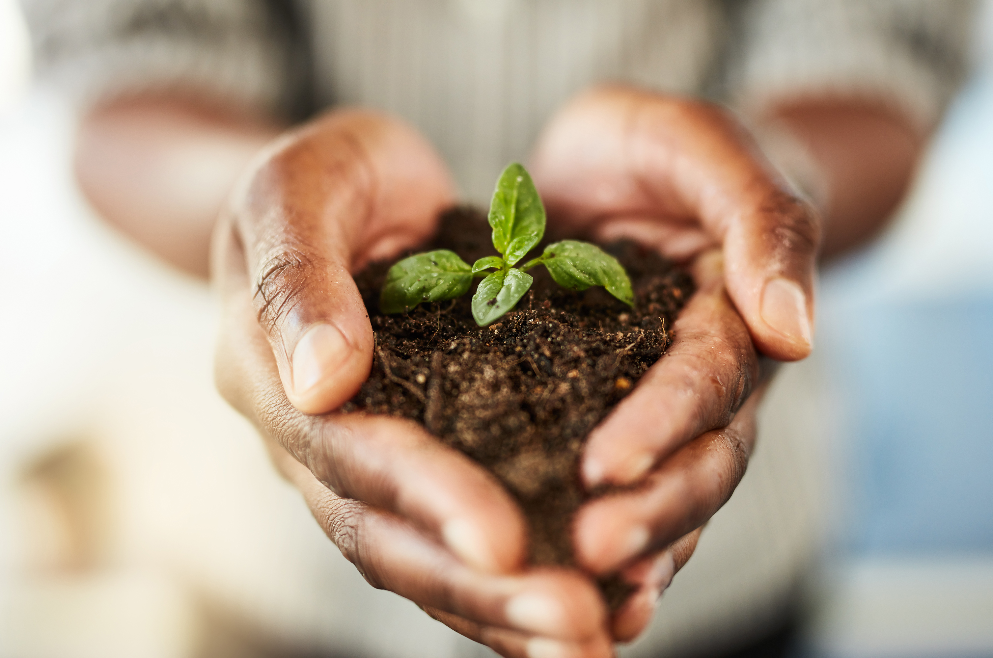
Resilience
is defined as the ability to…
recover and continue on in the face of adversity without being overwhelmed or act in dysfunctional/unhealthy ways
become strong, healthy and successful again after something difficult or challenging happens.
recover from setbacks and adapt well to change and crisis.

Slide 13
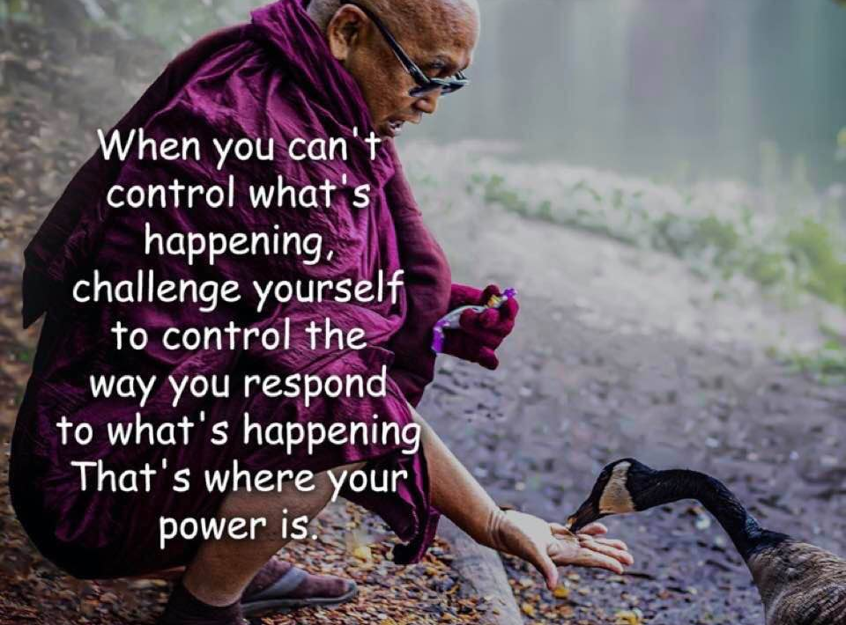
~ H.H. Dalai Lama

Slide 14
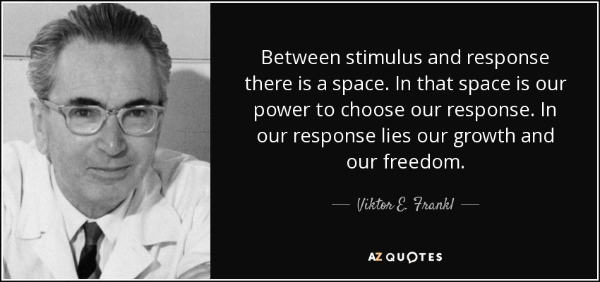

Slide 15

Effects of Self-Compassion Practice for Providers and Those in Your Care
  Research shows that self-compassion:
Increases well-being and resilience
Decreases stress, secondary trauma and burnout
Supports practicing healthy behaviors and minimizing unhealthy behaviors (like more exercise and less substance use)
Improves confidence in providing compassionate care to others
Strengthens pro-social or supportive relationship behaviors
Improves self-care
Decreases anxiety and depression
Increases non-reactivity and perspective taking, and decreases self-judgement
Source: Kotera & Van Gordon (2021)

Slide 16
Types of Compassion Practices for You & Those in Your Care
Lovingkindness Meditation
Gratitude
Connection
Be Your Own Best Friend
Journaling
Self-Care
Mindfulness

Slide 17






“Self-care is never a selfish act—it is simply good stewardship of the only gift I have, the gift I was put on earth to offer to others.”
~ Parker Palmer

Slide 18
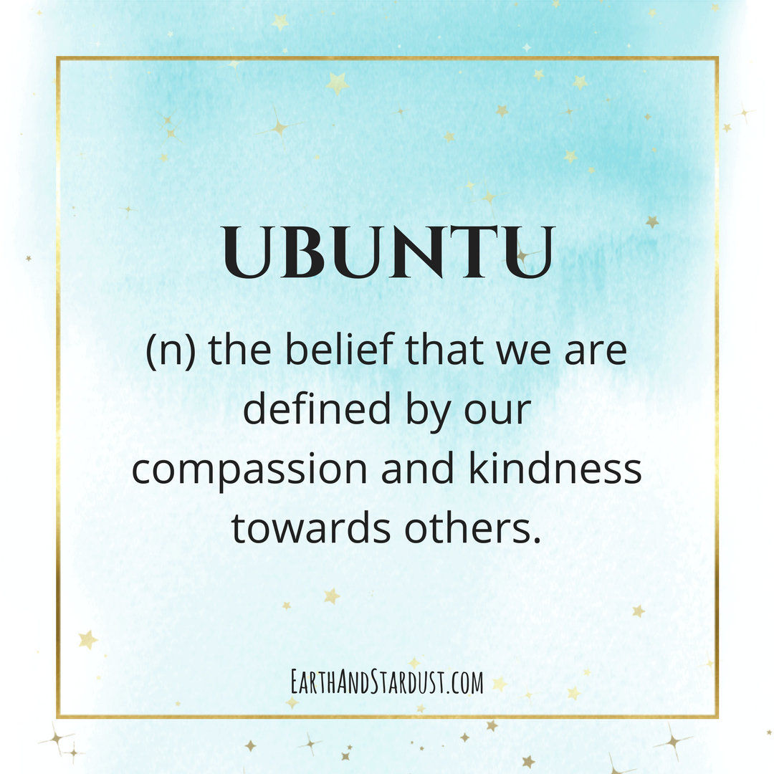
3 Types of Compassion Practice
“We think of ourselves far too frequently as just individuals, separated from one another, whereas you are connected and what you do affects the whole world. When you do well, it spreads out; it is for the whole of humanity.”
~ Archbishop Desmond Tutu
Lovingkindness Meditation (LKM)
Gratitude
Connection

Slide 19

Lovingkindness Meditation (LKM)
Benefits include…
Increasing positive emotions
Growing overall experience wellbeing
Enhancing emotional processes
Increasing empathy
Improving social connection
Reducing self-criticism
Increasing compassion towards oneself and others
Easing PTSD symptoms, depression and other traumas
Decreasing chronic pain and migraines
Slows biological aging
Supporting physical health by decreasing inflammation and improving immune function
Source: Seppala, E. (2014).

Slide 20
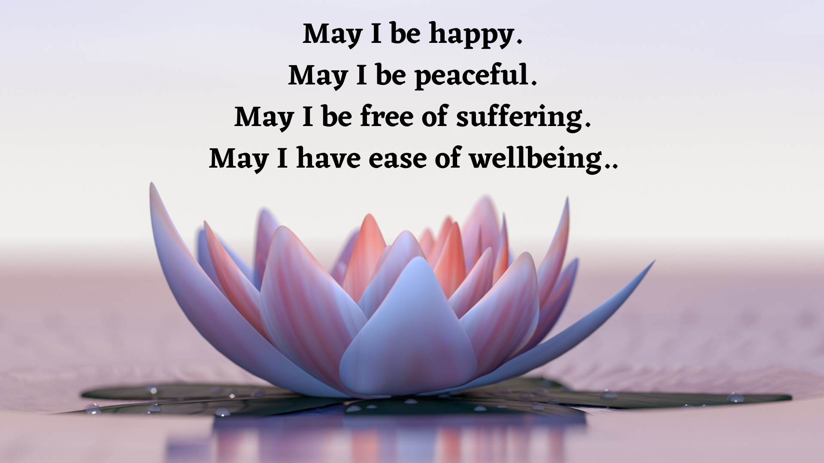

Slide 21
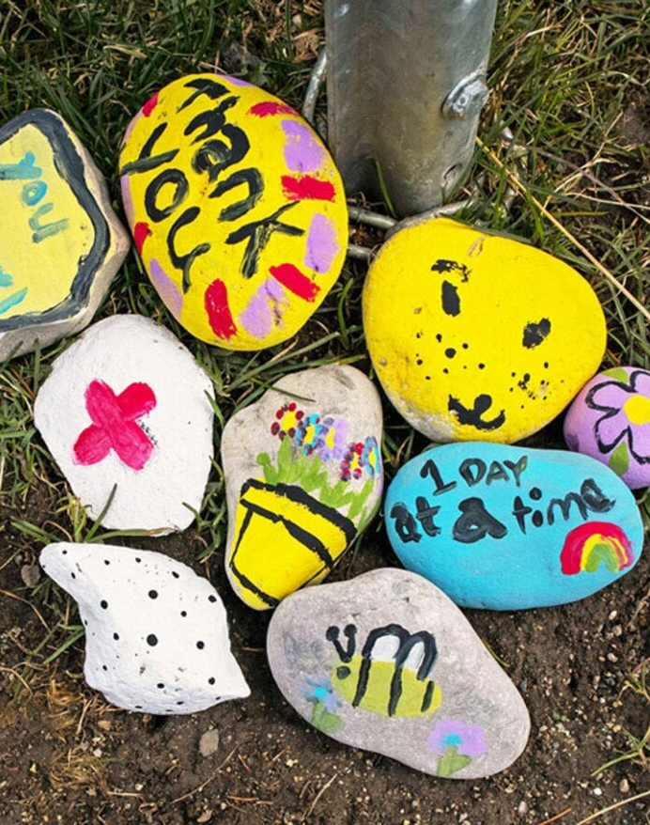
Gratitude
Benefits of Gratitude Practice include:
Feeling happier and more optimistic
Reduced anxiety and depression
Having healthier behaviors and better health maintenance
Getting more regular exercise and eating healthier foods
Improved mental alertness
Facilitating better sleep
Improved overall physical and psychological health
Better self-care of physically and mentally
Coping better with overall stress and life/work challenges
Reducing suicidal thoughts and attempts
Improved work-related mental health and reduce stress
Feeling a greater sense of connection to self, others and the world
Source: Ackerman, C. (2021)
PHOTO Source BY F:NALINFRAME,

Slide 22



Ways To Practice Gratitude:
Meditation
Journaling
Reflection
Sharing With Friends & Family
Gratitude Sharing Circle
On The Spot

Slide 23

Connection
Connection is vital to our personal experience of well-being, as well as our ability to serve and support others. As we cultivate practices that help us to feel connected, we become better able to access support when we ourselves need it, both inwardly and outwardly.

Slide 24

Cultivating Connection
Spiritual practices such as prayer, meditation, or contemplation
Participating in community – local, social, hobbies, spiritual, co-visioning
Spending time with family and friends
Accessing peer support or mentorship
Connecting with self through meditation, journaling, and self-reflection
Spending time in nature
Creativity activities or hobbies
Listening to or playing music
Journaling or letter writing to self or others

Slide 25


Slide 26
Integrating Compassion into Self-Care & Resilience Planning
Choose Compassion Specific Practices in Your Wellness Planning
Be Gentle and Loving with Yourself and Others
Be proactive and responsive
Be consistent
Know your triggers and signs of depletion
Build your own Compassion Toolbox or Compassion RX

Slide 27
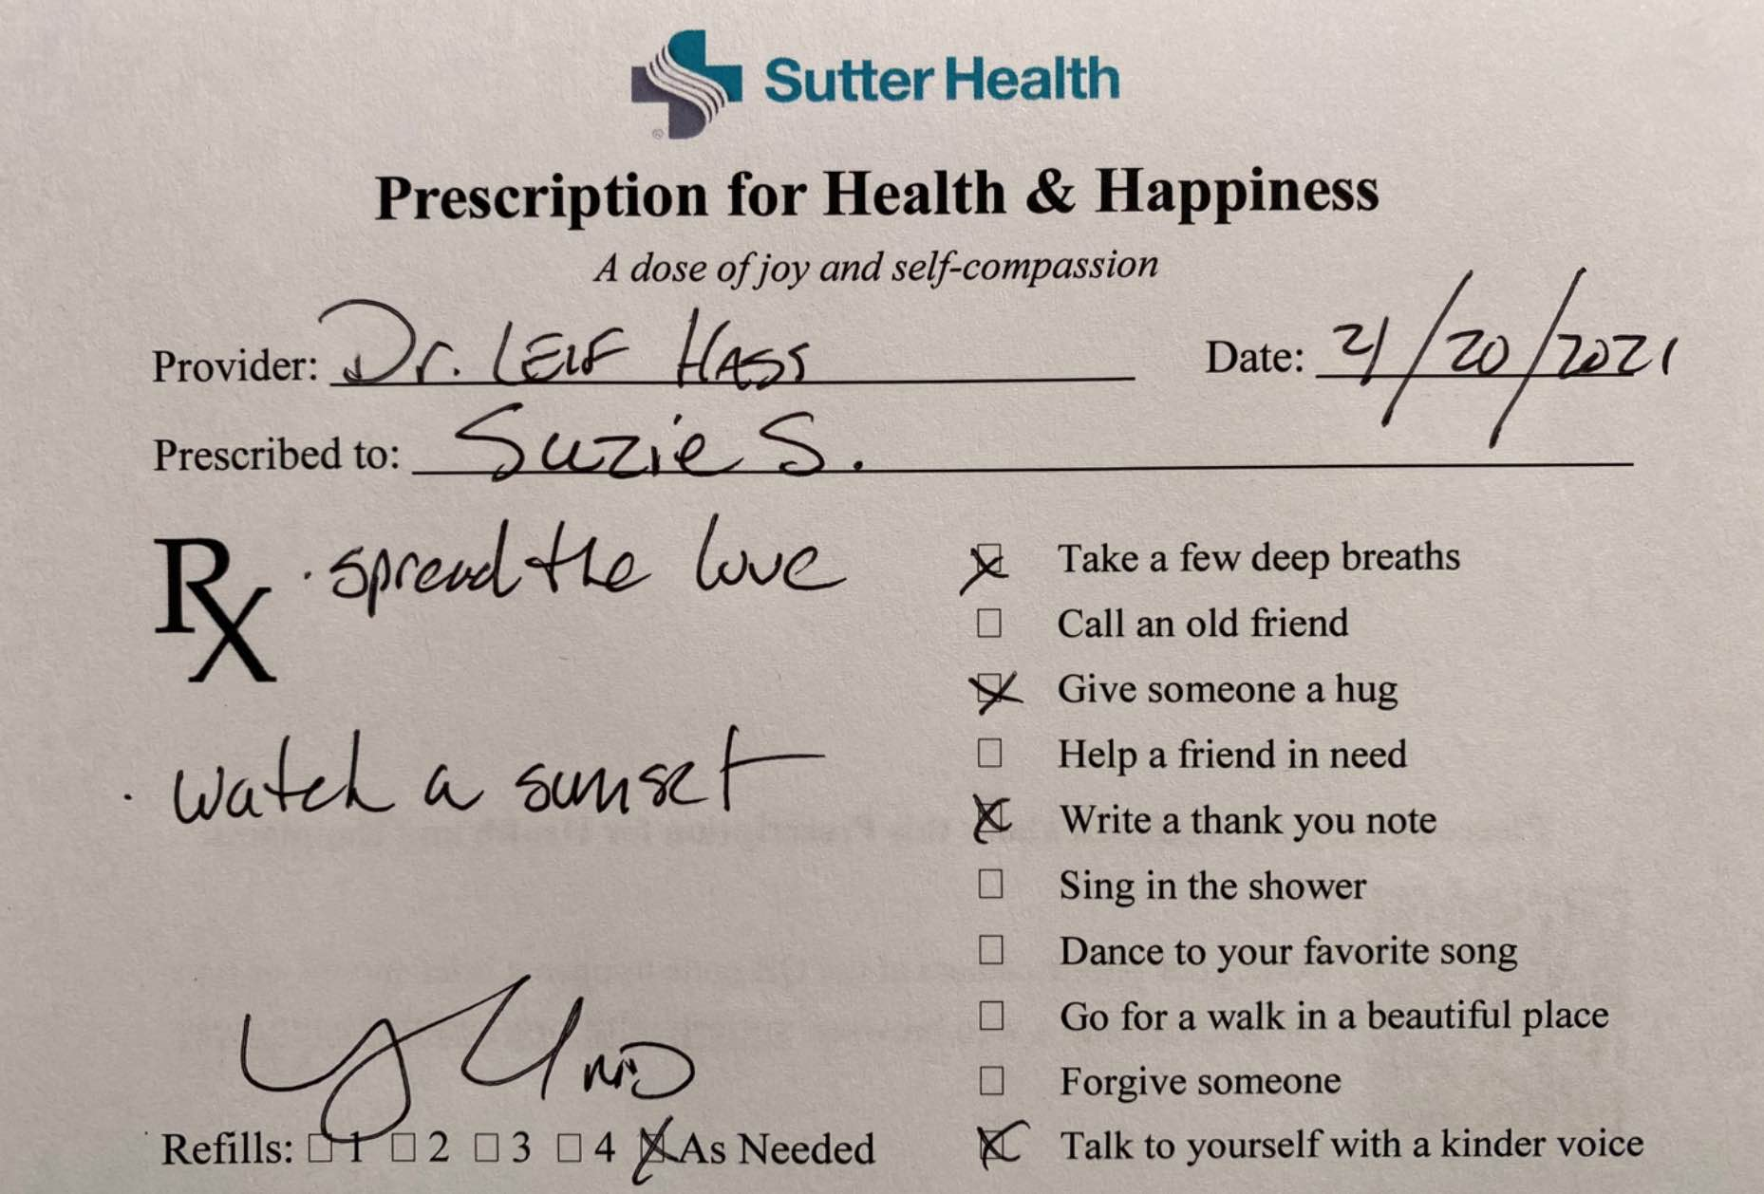

One Doctor’s Compassion RX

Slide 28
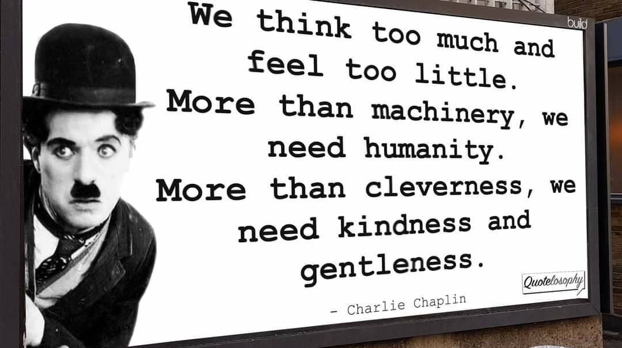

Slide 29
Carry These with You…
Three Elements of Self-Compassion
Image source: @THEU; Content Source: Neff & Germer (2018)
.

Slide 30
Resources
Greater Good In Action ~ https://greatergood.com.
Happiness & Wellness/Karen Salmansohn ~ notsalmon.com.
Science of Health & Happiness/Dr. Emma Seppala ~ https://emmaseppala.com.
Self-Compassion/Dr. Kristen Neff ~https://self-compassion.org/category/exercises.
The Center for Compassion and Altruism Research and Education/Stanford Medicine ~
http://ccare.stanford.edu.
May Is For Metta (Lovingkindness Meditation) Audios ~ https://bethterrence.com/resources.
12 Best Compassion Training Exercises & Activities/ Houston, E., PositivePsychology.com ~
https://positivepsychology.com/compassion-training/.
.

Slide 31
References
Ackerman, C. (2021). 28 Benefits of Gratitude & Most Significant Research Findings.
https://positivepsychology.com/benefits-gratitude-research-questions/.
Doty, J. (2012). The Science of Compassion. https://www.huffpost.com/entry/science-of-compassion_b_1578284.
Eckman, E. (2019). Five Ways to Protect Your Well-Being as a Health Care Professional. https://greatergood.berkeley.edu/article/item/five_ways_to_protect_your_wellbeing_as_a_health_care_professional.
Greater Good Magazine. (2021). Keys to Wellbeing: Compassion. https://greatergood.berkeley.edu/topic/compassion.
Hass, L. (2021). 10 Happiness Practices a Doctor Prescribes to His Patients. https://greatergood.berkeley.edu/article/item/10_happiness_practices_a_doctor_prescribes_to_his_patients.
Kotera, Y. & Van Gordon, W. (2021). Effects of Self-Compassion Training on Work-Related Well-Being: A Systematic Review. Frontiers in Psychology. https://doi.org/10.3389/fpsyg.2021.630798.
Neff, K. & Germer C. (2018). The Mindful Self-Compassion Workbook. Guilford Press.
Seppala, E. (2014). Scientific Benefits of Self-Compassion Infographic. https://emmaseppala.com/scientific-benefits-self-compassion-infographic/.
Seppala, E. (2014). 18 Science-Backed Reasons to Try Loving-Kindness Meditation. https://www.psychologytoday.com/us/blog/feeling-it/201409/18-science-backed-reasons-try-loving-kindness-meditation.
Strauss et al. (2016). What is compassion and how can we measure it? A review of definitions and measures. https://www.sciencedirect.com/science/article/pii/S0272735816300216.
Whitlock et al. (2021). How to Practice Self-compassion for Resilience and Well-being. https://accelerate.uofuhealth.utah.edu/resilience/how-to-practice-self-compassion-for-resilience-and-well-being.

Slide 32




Presenter Info
Beth Terrence is the founder and lead facilitator of Holistic Recovery Pathways, LLC. She is a trained shaman, holistic practitioner, and restorative facilitator. She is a certified peer recovery specialist (CPRS) in Maryland and nationally (NCPRSS). She recently completed her Master of Science degree in Restorative Practices through the International Institute of Restorative Practices (IIRP).
Beth’s vision is to help create a healthier and more nurturing world by supporting individuals, families, and communities in finding hope, healing, and a deeper sense of connection and belonging. She is known for her engaging and experiential programming, which includes holistic workshops, wellness retreats and trainings. She is strongly committed to supporting organizations and systems in building cultures of health, well-being, and inclusivity.
Beth Terrence ~ Holistic Recovery Pathways
Email: beth@bethterrence.com
Websites:
http://holisticrecoverypathways.com
https://bethterrence.com

Slide 33


CME Accreditation and Designation
This activity has been planned and implemented in accordance with the Essential Areas and policies of the Accreditation Council for Continuing Medical Education (ACCME) through the joint providership of MedChi, The Maryland State Medical Society and the Behavioral Health Administration of the Maryland Department of Health. MedChi is accredited by the ACCME to provide continuing medical education for physicians. CMEs will be available at no cost, as will Participant Certificates, which for other disciplines may qualify for CEUs or other continuing education credit, although these are not approved for CEUs by the Maryland Board of Social Work Examiners. Participants should check with their certifying organizations to see how these would apply.
MedChi designates this webinar educational activity for a maximum of 1 AMA PRA Category 1 Credits™. Physicians should claim only the credit commensurate with the extent of their participation in the activity, as should other disciplines who claim credit for Participant Certificates. For questions please contact Steve Whitefield at steven.whitefield@maryland.gov.
Webinars jointly sponsored by the Behavioral Health Administration and MedChi

Slide 34
CME Disclosures
Presenters and Planners: Aliya Jones, MD and Steve Whitefield, MD have reported no relevant financial relationships to disclose. Beth Terrence, MS and Jennifer Greenspun, LCSW-C have reported no relevant financial relationships to disclose.
MedChi CME Reviewers: The reviewers from the MedChi Committee On Scientific Activities (COSA) for this activity have reported no relevant financial relationships to disclose.

