Slide 1
SHINELLE OGLESBY, MS, LCPC, NCC OWNER/THERAPIST
Spirituality and Self-Care
for
Health Care Workers
BHA/MedChi Behavioral Health Webinar Series: Helping the Helpers and Those They Serve.
PRESENTER:

Slide 2


CME Accreditation and Designation
This activity has been planned and implemented in accordance with the Essential Areas and policies of the Accreditation Council for Continuing Medical Education (ACCME) through the joint providership of MedChi, The Maryland State Medical Society and the Behavioral Health Administration of the Maryland Department of Health. MedChi is accredited by the ACCME to provide continuing medical education for physicians. CMEs will be available at no cost, as will Participant Certificates, which for other disciplines may qualify for CEUs or other continuing education credit, although these are not approved for CEUs by the Maryland Board of Social Work Examiners. Participants should check with their certifying organizations to see how these would apply.
MedChi designates this webinar educational activity for a maximum of 1 AMA PRA Category 1 Credits™. Physicians should claim only the credit commensurate with the extent of their participation in the activity, as should other disciplines who claim credit for Participant Certificates. For CME/Participant Certificate questions please contact Sherrie Noonan at sherrie.noonan@maryland.gov.
Webinars jointly sponsored by the Behavioral Health Administration and MedChi

Slide 3
CME Disclosures
Presenters and Planners: Aliya Jones, MD and Steve Whitefield, MD have reported no relevant financial relationships to disclose. Shinelle Oglesby, MS, LCPC and Dennis DuPont have reported no relevant financial relationships to disclose.
MedChi CME Reviewers: The reviewers from the MedChi Committee On Scientific Activities (COSA) for this activity have reported no relevant financial relationships to disclose.
Webinars jointly sponsored by the Behavioral Health Administration and MedChi

Slide 4
Learning Objectives
The participant will be able to recognize the existence of spiritual trauma and how it may disorient and negatively affect a person’s well-being, creating traumatic stress.
The participant will identify individualized ways to use meaning making to engage in re-orienting and re-framing traumatic events, from one’s own spiritual perspective to reduce distress.
The participant will examine the impacts that the COVID-19 pandemic, current social justice issues, and other stressors can potentially have on their ability to deliver quality care to the people they serve.
The participate will discuss the importance of integrating meaning making and spirituality into their daily lives, in an attempt, to reduce psychological, emotional and physical distress.
Given a set of self-care techniques, participants will identify ways to incorporate their own spirituality to personalize their attempts to be more self-focused and self-reflective. as a method of Self-Care.
Participants will discuss ways that Self-care, using meaning making and spirituality, can be applied to the care providers deliver to the people they serve.

Slide 5

Mental Health is Four Dimensional
Psychological/Mental
Physical
Social/Emotional
Spiritual

Slide 6
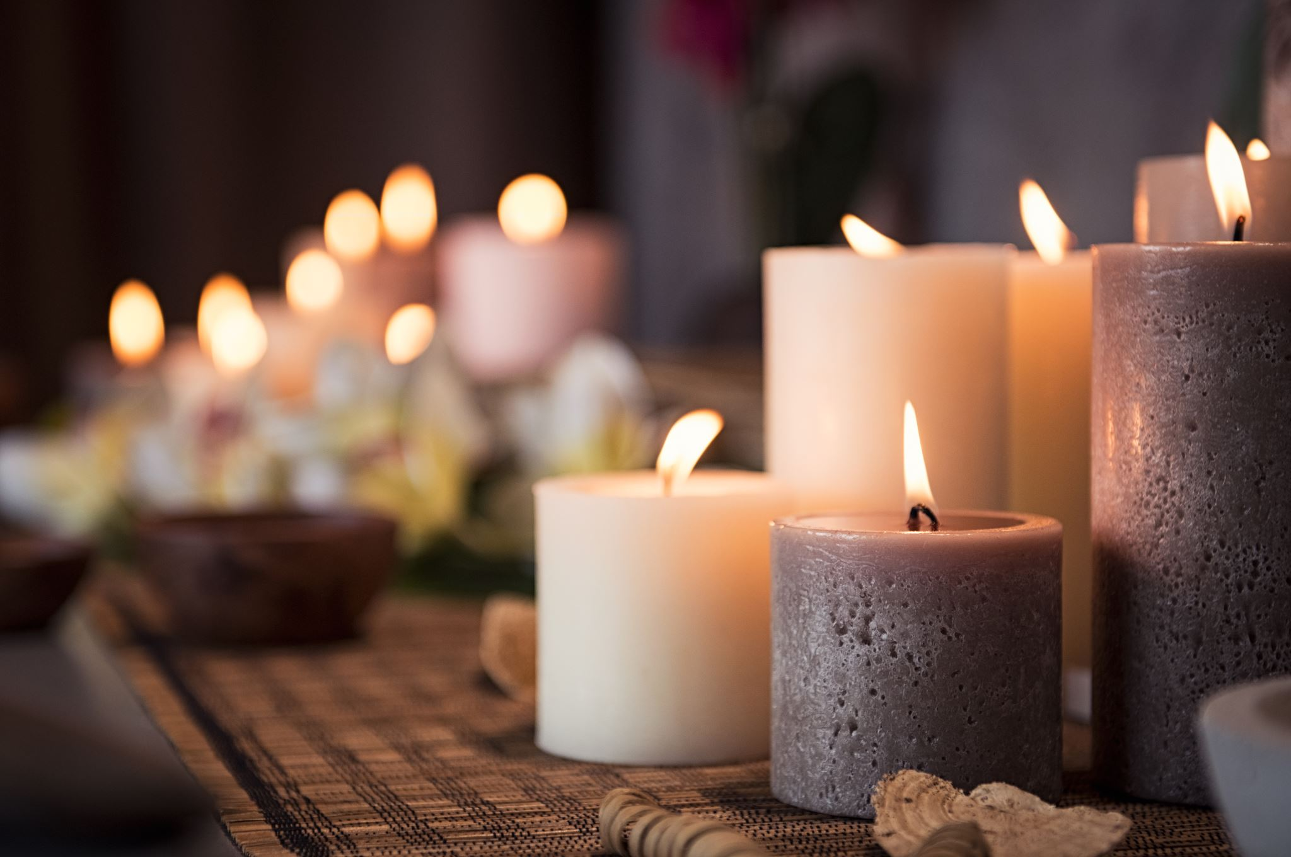
Self-Care Mitigates the Negative Effects of Traumatic Stress
Our exposure to Trauma affects us on a Spiritual Level that often goes unnoticed and disorients our being in a profound manner.

Slide 7
How we and and the people we serve are traumatized
Vicariously
Directly

Slide 8
Vicarious Trauma
Vicarious trauma can occur when we are exposed to difficult or disturbing images and stories second-hand.
This can occur by viewing graphic news reports, gruesome or frightening television shows and various other media, hearing a detailed traumatic story from another person, viewing crime scene evidence, attending a debriefing or a conference where disturbing images are described or shown, and many other ways in which we can be indirectly affected by the content or visuals of some other living creature’s suffering.

Slide 9
Direct Trauma
direct personal experience of an event that involves actual or threatened death or serious injury, or other threat to one’s physical integrity;
or witnessing an event that involves death, injury, or a threat to the physical integrity of another person; or learning about unexpected or violent death, serious harm, or threat of death or injury experienced by a family member or other close associate.

Slide 10
Symptoms of Traumatic Stress
Behavioral: agitation, irritability, hostility, hypervigilance, self-destructive behavior, or social isolation
Psychological: flashback, fear, severe anxiety, or mistrust
Mood: loss of interest or pleasure in activities, guilt, or loneliness
Sleep: insomnia or nightmares
Also common: emotional detachment or unwanted thoughts

Slide 11

Let’s have a quick overview of Spiritual Trauma

Slide 12

Spiritual Trauma and the Need for Healing
Traumatic Events: Deeds, Insults, Actions, Assaults don’t just affect our Physical and Mental health. They often times cause spiritual violation
As Kenneth Pargament(2011), states, they could feel like desecrations to a person’s soul. Even if a person is not religious or have ever thought of themselves as being spiritual. Traumatic evens could break or disorient you in a profoundly spiritual way.
These desecrations may leave a person feeling polluted, unloveable, and unworthy.
In order for someone to feel worthy of participating in self-care they must first nurture and tend to their spiritual needs, allow for healing and new meaning making - thus allowing healing from the inside out.

Slide 13
What is Spirituality
Spirituality has many definitions, but at its core spirituality helps to give your life context. It's not necessarily connected to a specific belief system or even religious worship. Instead, it arises from your connection with yourself and with others, the development of your personal value system, and your search for meaning in life.
For many, spirituality takes the form of religious observance, prayer, meditation or a belief in a higher power. For others, it can be found in nature, music, art or a secular community. Spirituality is different for everyone.
Notes:
Taking the path less traveled by exploring your spirituality can lead to a clearer life purpose, better personal relationships and enhanced stress management skills.
By Mayo Clinic Staff
Some stress relief tools are very tangible: exercising more, eating healthy foods and talking with friends. A less tangible — but no less useful — way to find stress relief is through spirituality.
What is spirituality?
Spirituality has many definitions, but at its core spirituality helps to give your life context. It's not necessarily connected to a specific belief system or even religious worship. Instead, it arises from your connection with yourself and with others, the development of your personal value system, and your search for meaning in life.
For many, spirituality takes the form of religious observance, prayer, meditation or a belief in a higher power. For others, it can be found in nature, music, art or a secular community. Spirituality is different for everyone.

Slide 14
How to Discover Your Spirituality
Uncovering your spirituality may take some self-discovery. Here are some questions to ask yourself to discover what experiences and values define you:
What are your important relationships?
What do you value most in your life?
What people give you a sense of community?
What inspires you and gives you hope?
What brings you joy?
What are your proudest achievements?
Notes:
The answers to such questions can help you identify the most important people and experiences in your life. With this information, you can focus your search for spirituality on the relationships and activities in life that have helped define you as a person and those that continue to inspire your personal growth.

Slide 15

Ways to Connect Spiritually
Nurturing
Nurturing your relationships
Spirituality is nurtured by your relationships with others. Realizing this, it's essential to foster relationships with the people who are important to you. This can lead to a deepened sense of your place in life and in the greater good.
Make relationships with friends and family a priority. Give more than you receive.
See the good in people and in yourself. Accept others as they are, without judgment.
Contribute to your community by volunteering.
Pursuing
Pursuing a spiritual life
Staying connected to your inner spirit and the lives of those around you can enhance your quality of life, both mentally and physically. Your personal concept of spirituality may change with your age and life experiences, but it always forms the basis of your well-being, helps you cope with stressors large and small, and affirms your purpose in life.
Cultivating
Cultivating your spirituality
Self-reflection: focus on inner self; Prayer, mindfulness and relaxation techniques focus your thoughts and find peace of mind
Keep a journal to help you express your feelings and record your progress.
Seek out a trusted adviser or friend who can help you discover what's important to you in life and gain insights
Read inspirational stories or essays and watch videos to help you evaluate different philosophies of life.
Talk to others whose spiritual lives you admire. Ask questions to learn how they found their way to a fulfilling spiritual life.

Slide 16

Meaning Making
Where Your Faith and Spirituality Intersect Your Resiliency

Slide 17

What is Meaning Making
The ability to explore patterns and significance in both great and minor life events
The process of finding clarity through events and situations
It is unique and depends on life experiences, circumstances, viewpoints, culture, states of being, value systems, etc.
More focused on perception and understanding
vs.
fact based
A sense that one is apart of something greater than itself
Restatement or Renewed View of a Painful Event

Slide 18

Quotes that Reflect Meaning Making
“When we are no longer able to change a situation, we are challenged to change ourselves.” ― Viktor E. Frankl, Man's Search for Meaning
“Everything can be taken from a man but one thing: the last of the human freedoms—to choose one’s attitude in any given set of circumstances, to choose one’s own way.” ― Viktor E. Frankl, Man's Search for Meaning
“An abnormal reaction to an abnormal situation is normal behavior.” ― Victor Frankl, Man's Search for Meaning
“But there was no need to be ashamed of tears, for tears bore witness that a man had the greatest of courage, the courage to suffer.” (vulnerability) ― Viktor E. Frankl, Man's Search for Meaning

Slide 19
Self-Care and Stress Reduction

Slide 20

Spirituality and Meaning Making Mitigates the negative and disorienting affects that Traumatic Stressors cause to our Spiritual Parts.
The need for Self-Care care towards our spiritual parts is often unnoticed and underserved.

Slide 21
Connection of Spirituality and Stress Reduction
Action | Stress Relief Response
Feel a sense of purpose | Cultivating your spirituality may help uncover what's most meaningful in your life. By clarifying what's most important, you can focus less on the unimportant things and eliminate stress.
Connect to the world | The more you feel you have a purpose in the world, the less solitary you may feel — even when you're alone. This can lead to a valuable inner peace during difficult times.
Release Control | When you feel part of a greater whole, you may realize that you aren't responsible for everything that happens in life. You can share the burden of tough times as well as the joys of life's blessings with those around you
Spirituality has many benefits for stress relief and overall mental health.

Slide 22
Connection of Spirituality and Stress Reduction (Cont.)
Expand your support network | Whether you find spirituality in a church, mosque or synagogue, in your family, or in nature walks with a friend, this sharing of spiritual expression can help build relationships.
Lead a healthier life | People who consider themselves spiritual may be better able to cope with stress and may experience health benefits.

Slide 23

Meaning Making Reduces Suffering
Become so full of good thoughts, deeds, gratitude, affirmations, goals, and activities, so that when suffering comes, there is only a small amount of space left for it to consume.
(Shinelle Oglesby)

Slide 24

Spiritual Meaning Making
In the process of Spiritual Meaning Making, traumatic events are reappraised and often placed in a more benevolent context, context made up of symbols, myths, and exemplary figures that offers hope for oneself and others.

Slide 25
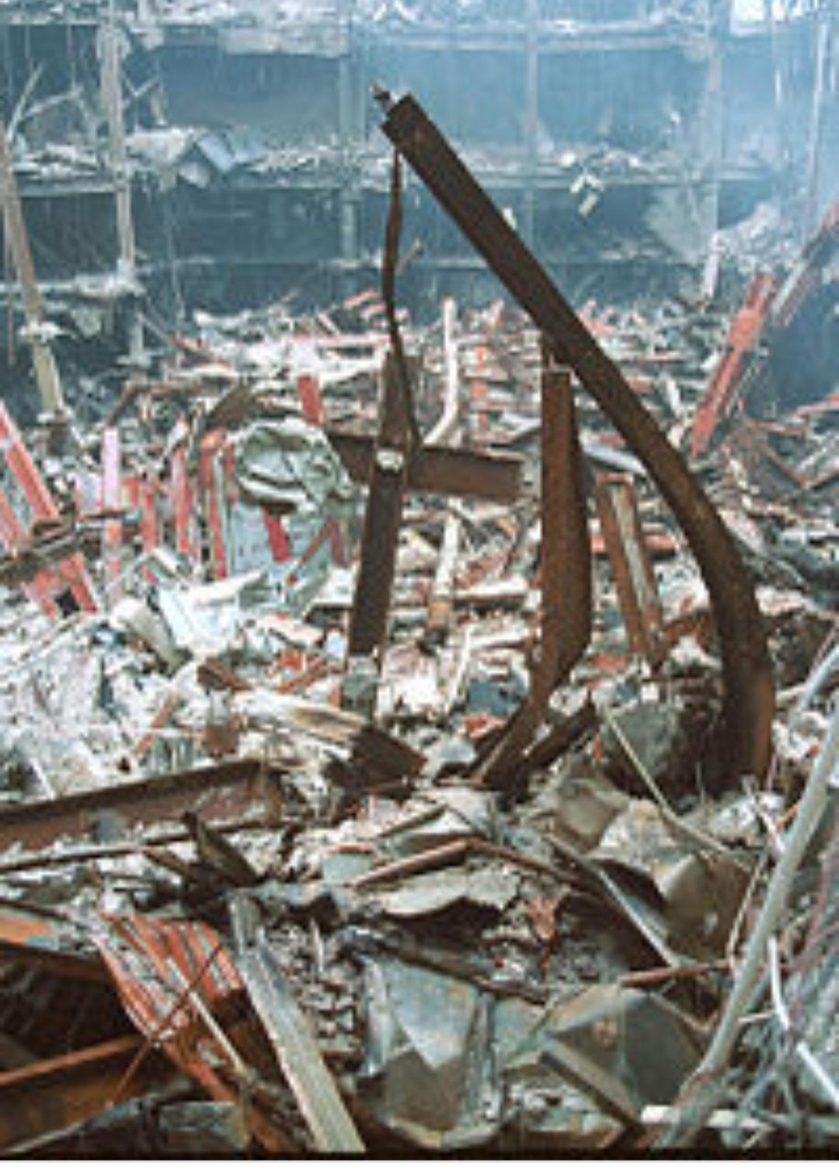
Examples of Positive Reappraisals of Negative Events
A survivor of the September 11 attacks visited the remains of the World Trade Center and Noticed a set of steel beams shaped like a cross. For her this crucifix-like beams were an example of hope and reminded her of the possibilities of resurrection and rebirth in the midst of painful circumstances.

Slide 26
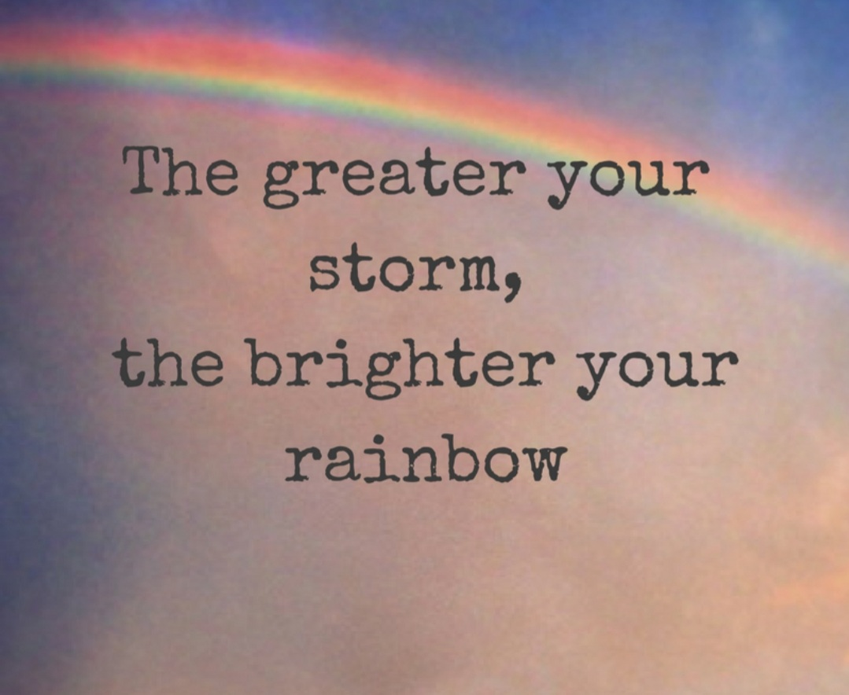
Examples of Positive Reappraisals of Negative Events
People may experience happiness, feelings of togetherness, hope, and good fortune to see a rainbow at the end of a storm, symbolizes God’s divine protection, mercy and grace even in the midst of corruption.

Slide 27

THANK YOU

Slide 28
Discussion Questions/Comments

Slide 29
Sources
Mayo Clinic, Spirituality and stress relief: Make the connection, https://www.mayoclinic.org/healthy-lifestyle/stress-management/in-depth/stress-relief/art-20044464, March 15, 2019, retrieved May 20, 2021
Paragment, K.I.,( 2007). Spiritually Integrated Psychotherapy: Understanding the Sacred. The Guilford Press

