Slide 1
Maryland Situation Update on Coronavirus Disease (COVID-19) for BHA
Maryland Department of Health
Infectious Disease Epidemiology and Outbreak Response Bureau
September 3rd, 2021

Slide 2

Call Agenda
mAB Post Exposure Prophylaxis
Epi summary
Q and A
https://covidlink.maryland.gov/content/vaccine/govax/

Slide 3
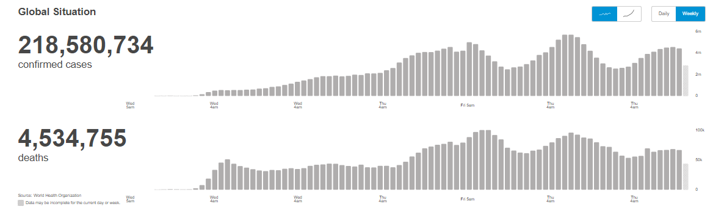
Worldwide: COVID-19
Source: https://covid19.who.int/ accessed 9/3/21

Slide 4
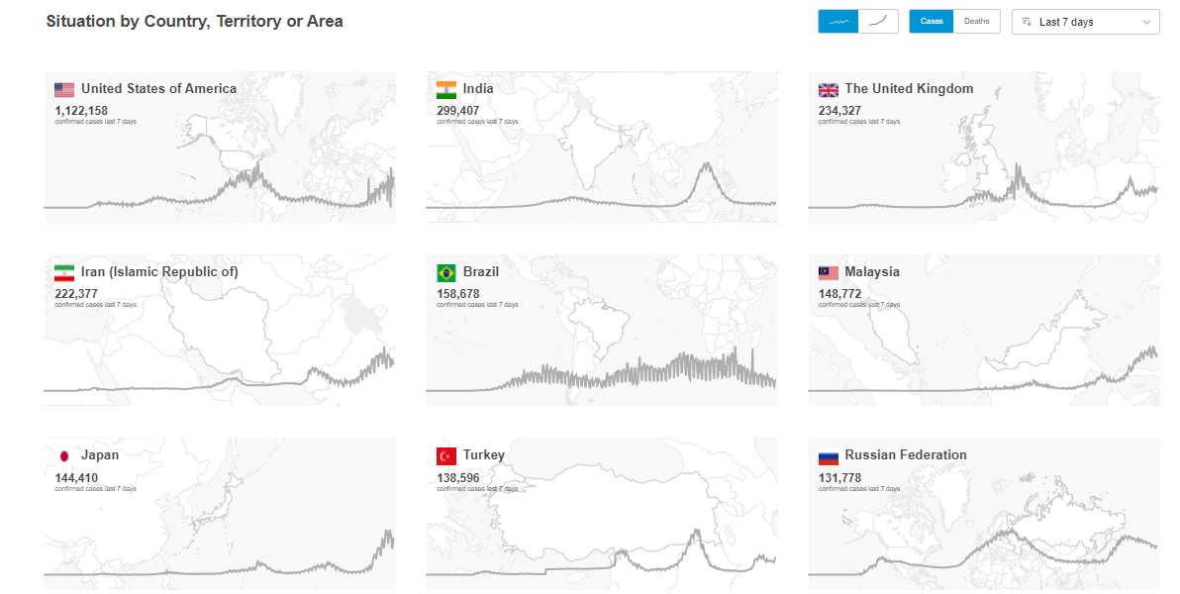
Worldwide: COVID-19
Source: https://covid19.who.int/ accessed 9/3/21

Slide 5
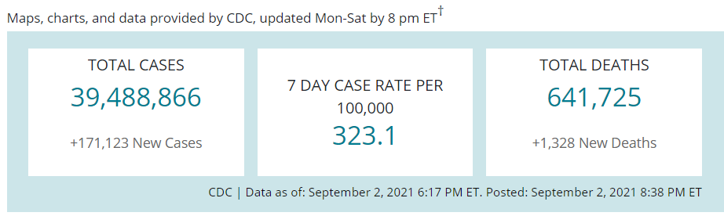
US Case Counts and Rates
https://www.cdc.gov/coronavirus/2019-ncov/cases-updates/cases-in-us.html 9/3/2021

Slide 6
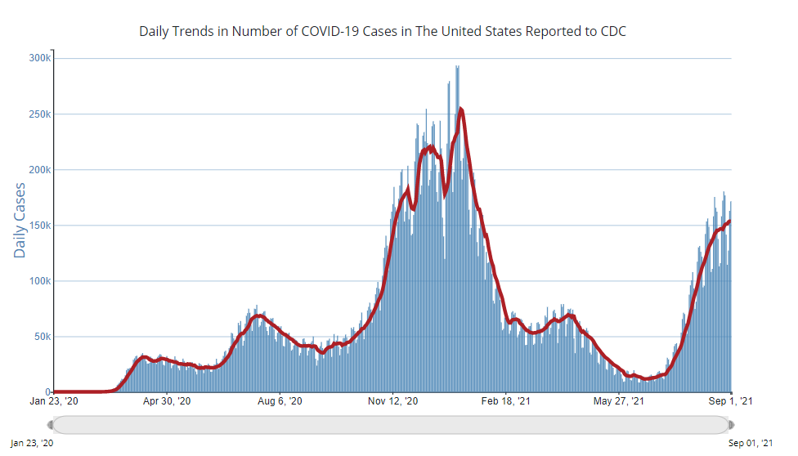
Number of Cases Reported in the USA, by Day
https://covid.cdc.gov/covid-data-tracker/#trends_dailytrendscases Updated 9/3/2021

Slide 7
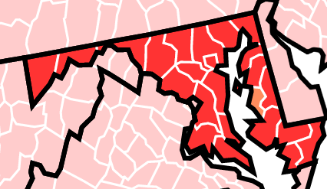

Community Transmission
https://covid.cdc.gov/covid-data-tracker/#county-view 9/3/21

Slide 8
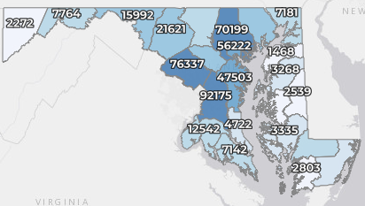
Maryland: COVID-19 Cases
http://health.maryland.gov/coronavirus
Data current as of 9/3/2021
Cases: 501,035
1,387 new
Deaths: 9,827
10 new
Hospitalizations: 46,337
Current: 812 (up 13)
Case rate: 20.1 per 100,000
Percent Positivity: 4.40%

Slide 9
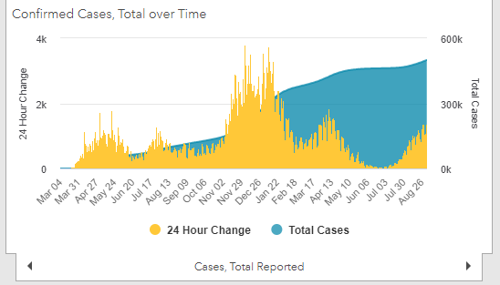
Maryland: COVID-19
Source: https://coronavirus.maryland.gov/, accessed 9/3/21

Slide 10
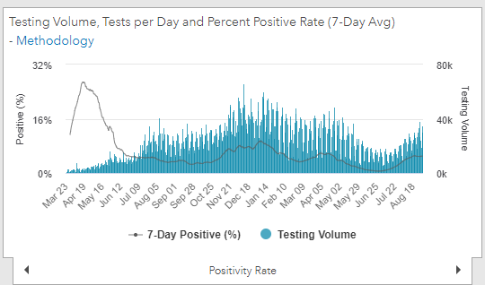
Maryland: COVID-19
Source: https://coronavirus.maryland.gov/, accessed 9/3/21

Slide 11
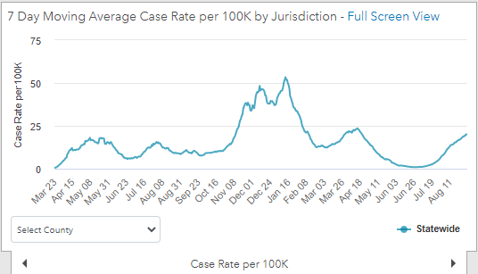
Maryland: COVID-19
9/3/21: 20.1 per 100k
Low: 6/24/21 at 0.90 per 100K
High: 1/12/21 at 53.39 per 100k
Source: https://coronavirus.maryland.gov/, accessed 9/3/21

Slide 12
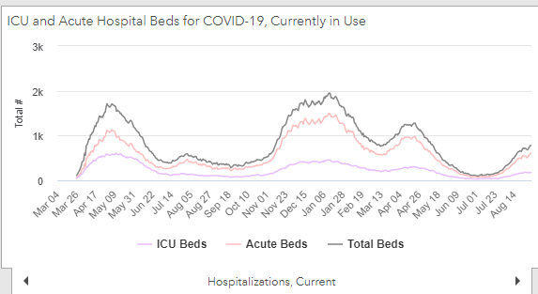
Maryland: COVID-19
Source: https://coronavirus.maryland.gov/, accessed 9/3/21

Slide 13
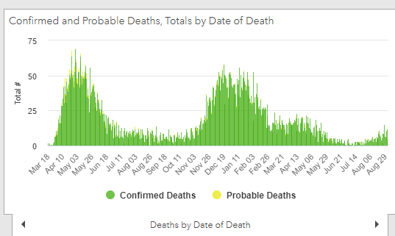
Maryland: COVID-19
Source: https://coronavirus.maryland.gov/, accessed 9/3/21

Slide 14
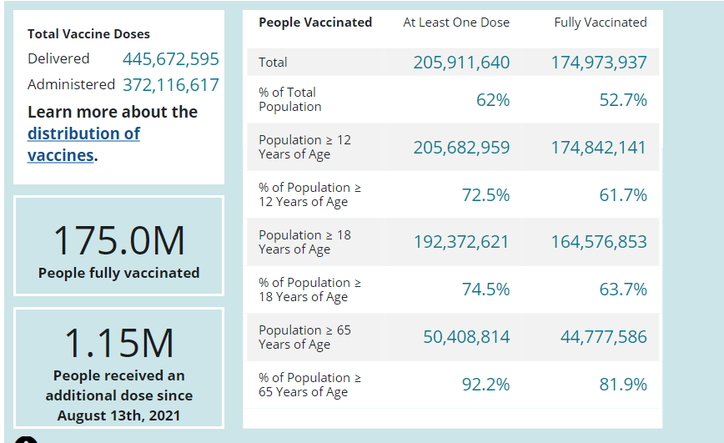
US: COVID-19 Vaccinations
Source: https://covid.cdc.gov/covid-data-tracker/#vaccinations accessed 9/3/21

Slide 15
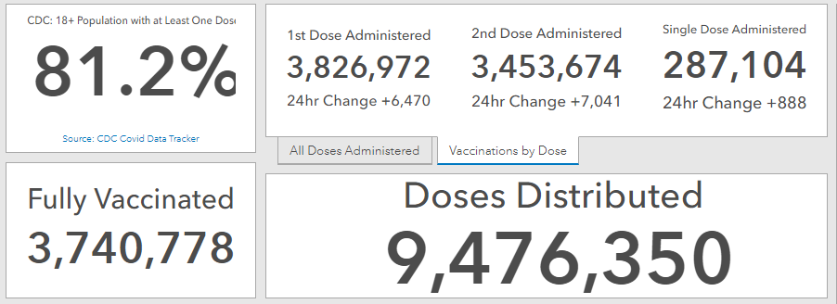
Maryland Vaccine Dashboard
https://coronavirus.maryland.gov/#Vaccine accessed 9/3/2021

Slide 16
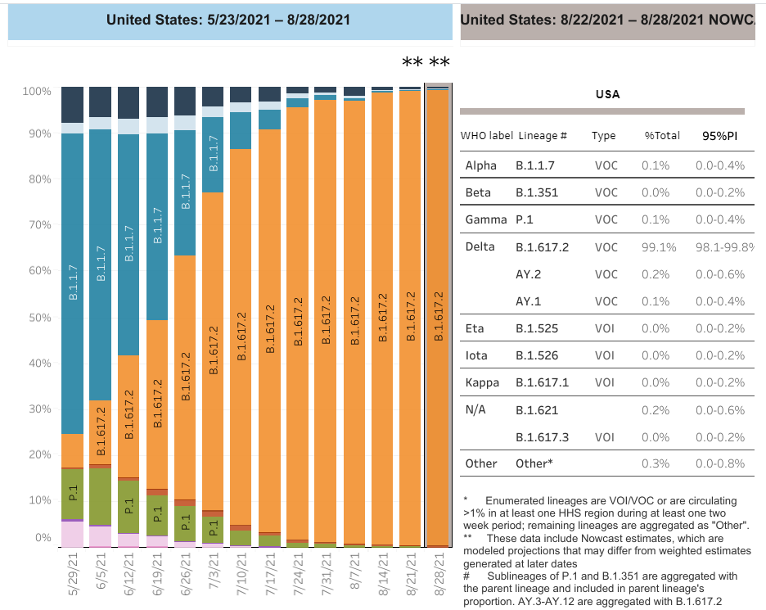

US: Delta Variant
https://covid.cdc.gov/covid-data-tracker/#variant-proportions Accessed 9/3/21
Delta 99.4%
99.1% B.1.617.2 + 0.2% A2 + 0.1% AY.1

Slide 17
Questions?
mdh.ipcovid@maryland.gov

