Slide 1
Maryland Situation Update on
Coronavirus Disease (COVID-19) for BHA
Maryland Department of Health
Infectious Disease Epidemiology and Outbreak Response Bureau
September 17, 2021

Slide 2

Call Agenda
Epi summary
Mu Variant
Updated Healthcare Infection Control Guidance
Q and A
https://covidlink.maryland.gov/content/vaccine/govax/

Slide 3
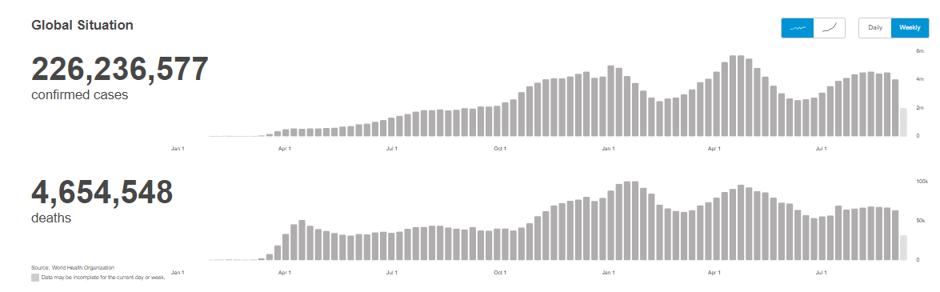
Worldwide: COVID-19
Source: https://covid19.who.int/ accessed 9/17/21

Slide 4
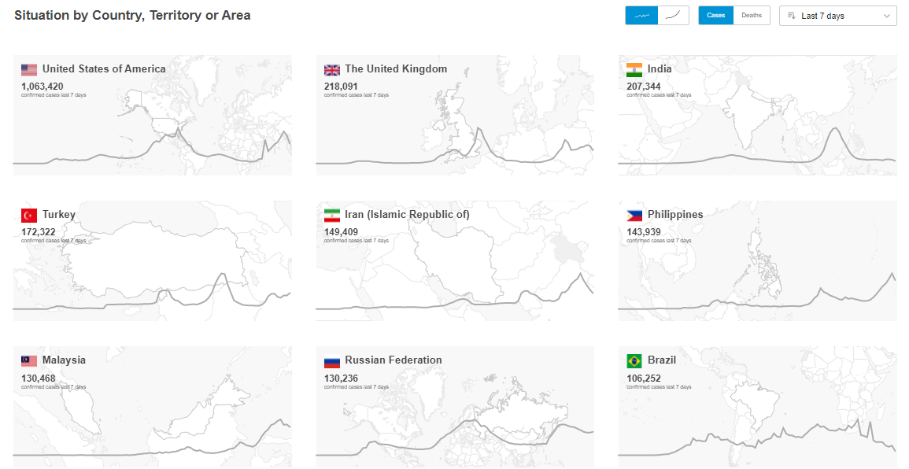
Worldwide: COVID-19
Source: https://covid19.who.int/ accessed 9/3/21

Slide 5
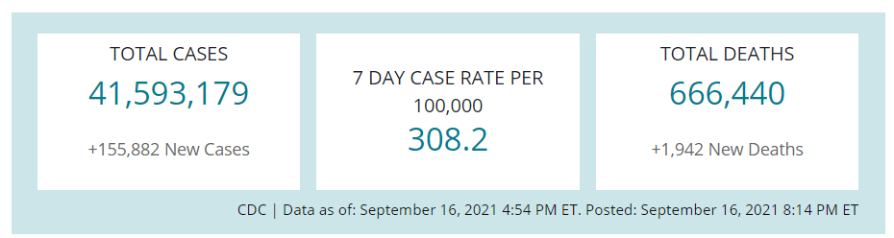
US Case Counts and Rates
https://www.cdc.gov/coronavirus/2019-ncov/cases-updates/cases-in-us.html 9/17/2021

Slide 6
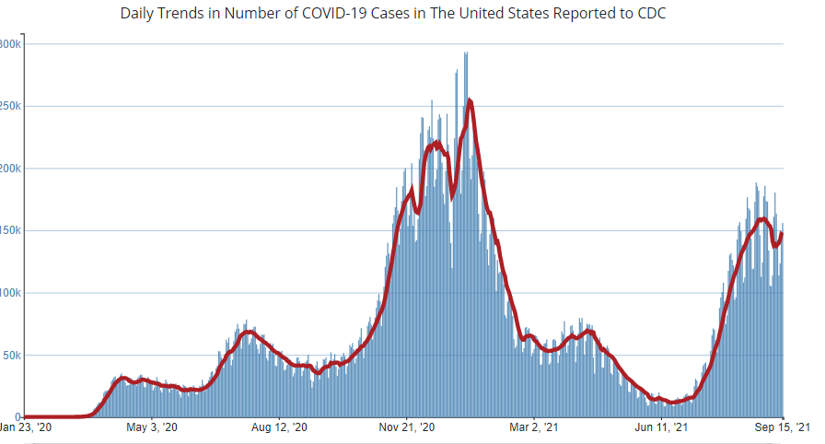
Number of Cases Reported in the USA, by Day
https://covid.cdc.gov/covid-data-tracker/#trends_dailytrendscases Updated 9/17/2021

Slide 7


Community Transmission
https://covid.cdc.gov/covid-data-tracker/#county-view 9/17/21

Slide 8
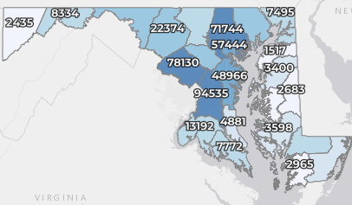
Maryland: COVID-19 Cases
http://health.maryland.gov/coronavirus
Data current as of 9/17/2021
Cases: 516,784
  1,525 new
Deaths: 10,023
  12 new
Hospitalizations: 46,337
  Current: 792 (down 12)
Case rate: 20.7 per 100,000
Percent Positivity: 4.23%

Slide 9
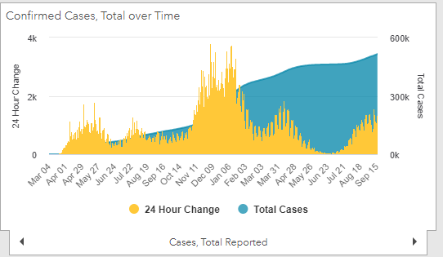
Maryland: COVID-19
Source: https://coronavirus.maryland.gov/, accessed 9/17/21

Slide 10
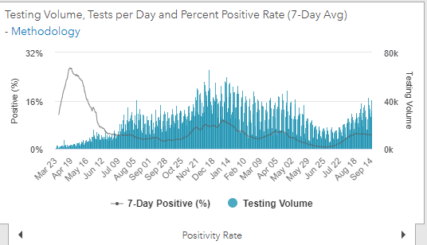
Maryland: COVID-19
Source: https://coronavirus.maryland.gov/, accessed 9/17/21

Slide 11
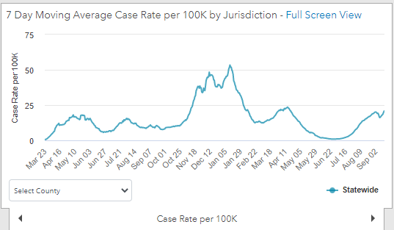
Maryland: COVID-19
9/17/21: 20.7 per 100k
Low: 6/24/21 at 0.90 per 100K
High: 1/12/21 at 53.39 per 100k
Source: https://coronavirus.maryland.gov/, accessed 9/3/21

Slide 12
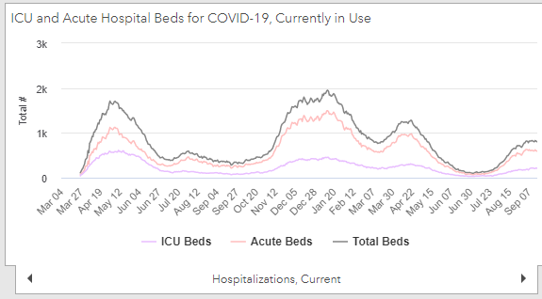
Maryland: COVID-19
Source: https://coronavirus.maryland.gov/, accessed 9/17/21

Slide 13
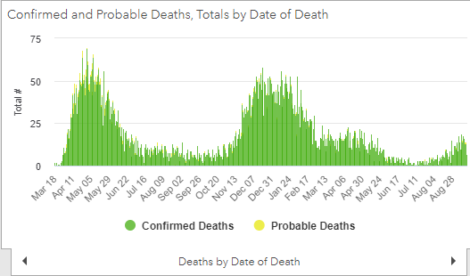
Maryland: COVID-19
Source: https://coronavirus.maryland.gov/, accessed 9/17/21

Slide 14
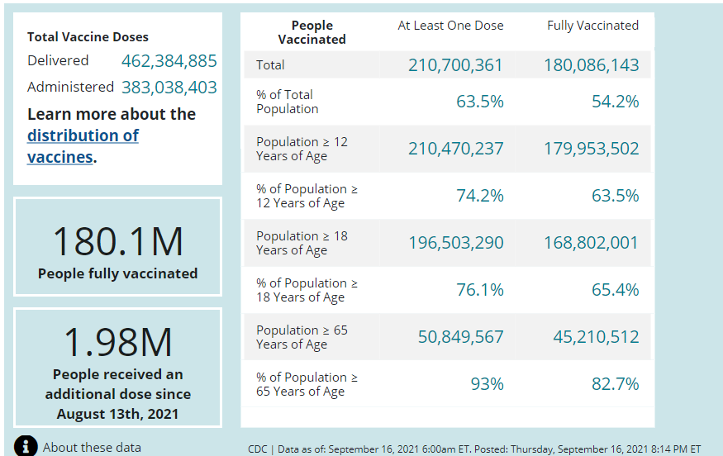
US: COVID-19 Vaccinations
Source: https://covid.cdc.gov/covid-data-tracker/#vaccinations accessed 9/17/21

Slide 15
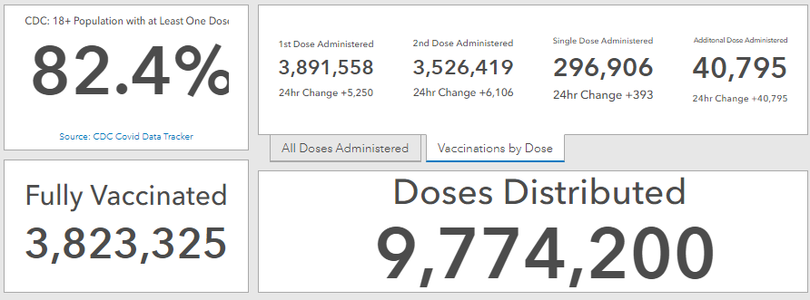
Maryland Vaccine Dashboard
https://coronavirus.maryland.gov/#Vaccine accessed 9/17/2021

Slide 16
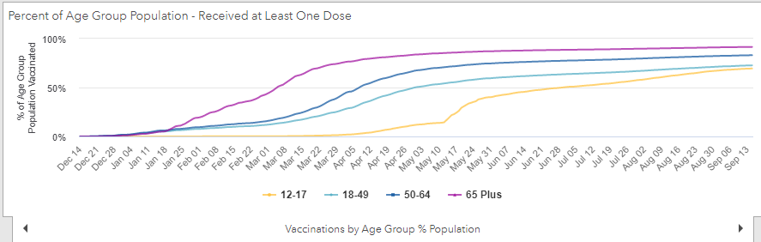
Percent of age groups with at least one dose

Slide 17
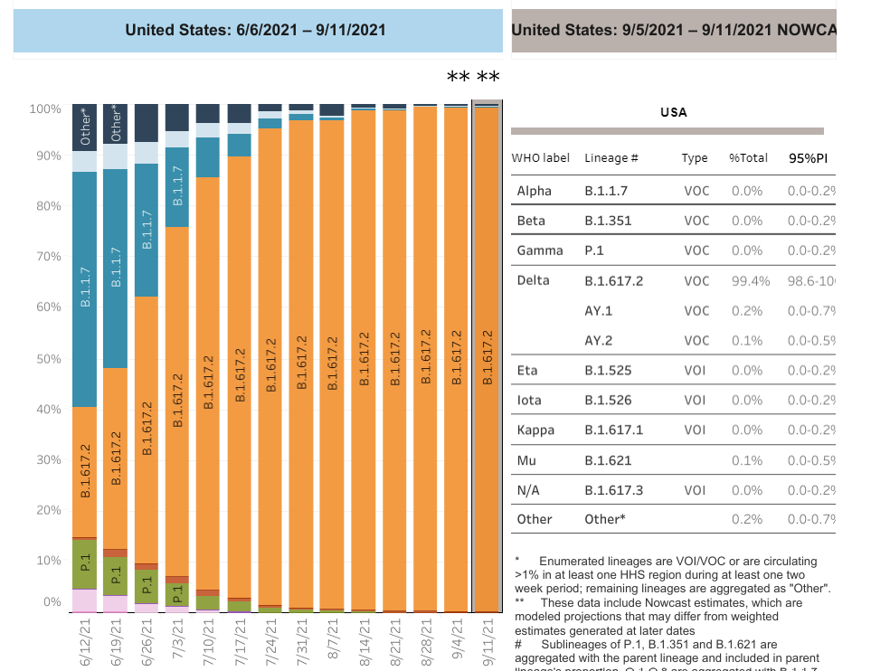

US: Delta Variant
https://covid.cdc.gov/covid-data-tracker/#variant-proportions Accessed 9/7/21
Delta 99.7%
99.4% B.1.617.2 + 0.2% A2 + 0.1% AY.1

Slide 18
Mu Variant (B.1.621)
Classified as a Variant of Interest by WHO 8/31/21
Constellation of mutations that indicate potential properties of immune escape.
Preliminary data show a reduction in neutralization capacity of convalescent and vaccinee sera similar to that seen for the Beta variant
First identification in Colombia in January 2021
As of 29 August, over 4500 sequences have been uploaded to GISAID from 39 countries
Although the global prevalence of the Mu variant among sequenced cases has declined and is currently below 0.1%, the prevalence in Colombia (39%) and Ecuador (13%) has consistently increased.
https://www.who.int/publications/m/item/weekly-epidemiological-update-on-covid-19---31-august-2021

Slide 19
CDC Healthcare Guidance Updates

Slide 20
CDC Guidance Updates
On 9/10/21, CDC updated the following pages:
  Interim Infection Prevention and Control Recommendations for Healthcare Personnel During the Coronavirus Disease 2019 (COVID-19) Pandemic
    https://www.cdc.gov/coronavirus/2019-ncov/hcp/infection-control-recommendations.html
  Interim Guidance for Managing Healthcare Personnel with SARS-CoV-2 Infection or Exposure to SARS-CoV-2
    https://www.cdc.gov/coronavirus/2019-ncov/hcp/guidance-risk-assesment-hcp.html
  Interim Infection Prevention and Control Recommendations to Prevent SARS-CoV-2 Spread in Nursing Homes
    https://www.cdc.gov/coronavirus/2019-ncov/hcp/long-term-care.html

Slide 21
CDC Guidance Updates
IP&C Recommendations for HCP Updated 9/10/21
Continue: a process to identify healthcare personnel, patients, and visitors with symptoms or exposure to SARS-CoV-2 prior to entering a facility.
Continue: source control for everyone in a healthcare setting.
Updated: source control recommendations for healthcare personnel, patients, and visitors now better align with community guidance. This includes a few limited circumstances where fully vaccinated individuals in counties with low to moderate community transmission could choose not to wear source control.
https://www.cdc.gov/coronavirus/2019-ncov/hcp/infection-control-recommendations.html

Slide 22
CDC Guidance Updates
IP&C Recommendations for HCP Updated 9/10/21
Continue: recommended PPE for the care of patients with suspected or confirmed SARS-CoV-2 infection
Updated: Quarantine is no longer recommended for fully vaccinated patients with exposure to SARS-CoV-2 or those patients who have had SARS-CoV-2 infection in the prior 90 days.
Updated: Clarified timing of SARS-CoV-2 testing after higher-risk exposure for healthcare personnel and close contact for patients. "Test Immediately" means no earlier than 2 days after last exposure.
https://www.cdc.gov/coronavirus/2019-ncov/hcp/infection-control-recommendations.html

Slide 23
CDC Guidance Updates
Managing Healthcare Personnel with SARS-CoV-2 Infection or Exposure Updated 9/10/21
No change: managing healthcare personnel with SARS-CoV-2 infection (return to work guidance)
No change: managing HCP exposure to SARS-CoV-2 (risk assessment guidance), including the definition of “higher-risk exposure”
Special considerations for fully vaccinated HCP after high-risk exposures (next slide)
    https://www.cdc.gov/coronavirus/2019-ncov/hcp/guidance-risk-assesment-hcp.html

Slide 24
CDC Guidance Updates
Managing Healthcare Personnel with SARS-CoV-2 Infection or Exposure Updated 9/10/21
Following a high-risk exposure, work restriction may be recommended for fully vaccinated HCP as follows:
  HCP who are moderately to severely immunocompromised OR
  When directed by public health authorities (e.g., during an outbreak where SARS-CoV-2 infections are identified among fully vaccinated HCP)
    In the event of ongoing transmission within a facility that is not controlled with initial interventions, strong consideration should be given to use of work restriction of fully vaccinated HCP with higher-risk exposures. In addition, there might be other circumstances for which the jurisdiction’s public health authority recommends these and additional precautions.
    https://www.cdc.gov/coronavirus/2019-ncov/hcp/guidance-risk-assesment-hcp.html

Slide 25
CDC Guidance Updates
Interim Infection Prevention and Control Recommendations to Prevent SARS-CoV-2 Spread in Nursing Homes Updated 9/10/21
Updated: Perform contact tracing to identify any HCP who have had a higher-risk exposure or residents who may have had close contact with the individual with SARS-CoV-2 infection
  All HCP who have had a higher-risk exposure and residents who have had close contacts, regardless of vaccination status, should be tested immediately
  If testing of close contacts reveals additional HCP or residents with SARS-CoV-2 infection, contact tracing should be continued to identify residents with close contact or HCP with higher-risk exposures to the newly identified individual(s) with SARS-CoV-2 infection.
https://www.cdc.gov/coronavirus/2019-ncov/hcp/long-term-care.html

Slide 26
Questions?
mdh.ipcovid@maryland.gov

