Slide 1
Maryland Situation Update on
Coronavirus Disease (COVID-19) for BHA
Maryland Department of Health
Infectious Disease Epidemiology and Outbreak Response Bureau
August 6, 2021

Slide 2

Call Agenda
Epi summary
CDC Updates
Maryland Updates
Vaccine Effectiveness
Q and A
https://covidlink.maryland.gov/content/vaccine/govax/

Slide 3
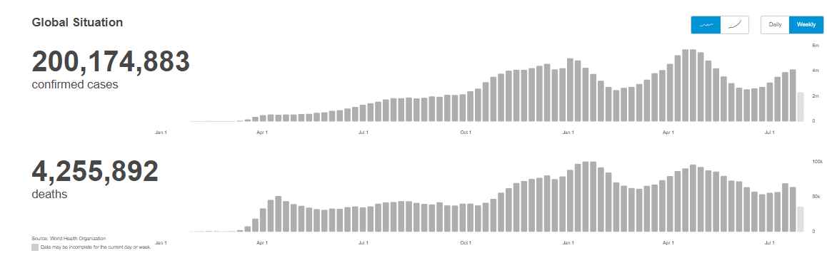
Worldwide: COVID-19
Source: https://covid19.who.int/ accessed 8/6/21

Slide 4
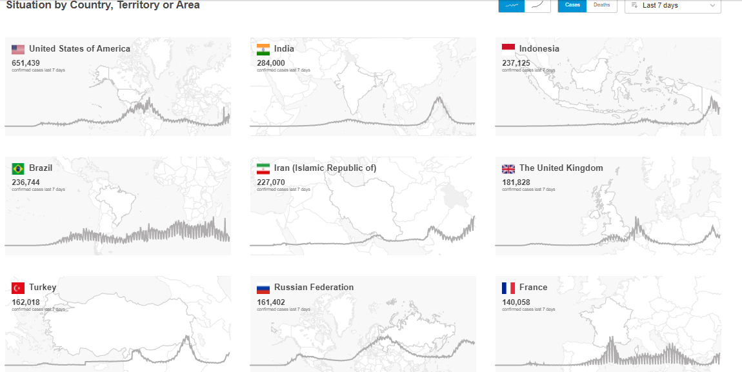
Worldwide: COVID-19
Source: https://covid19.who.int/ accessed 8/6/21

Slide 5
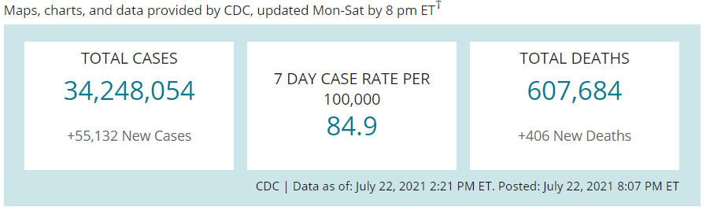
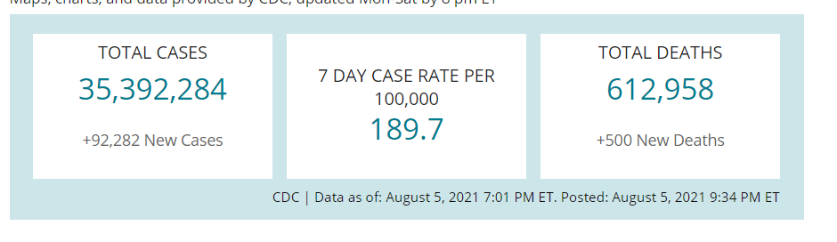
US Case Counts and Rates
https://www.cdc.gov/coronavirus/2019-ncov/cases-updates/cases-in-us.html 7/23/2021 and 8/6/21

Slide 6
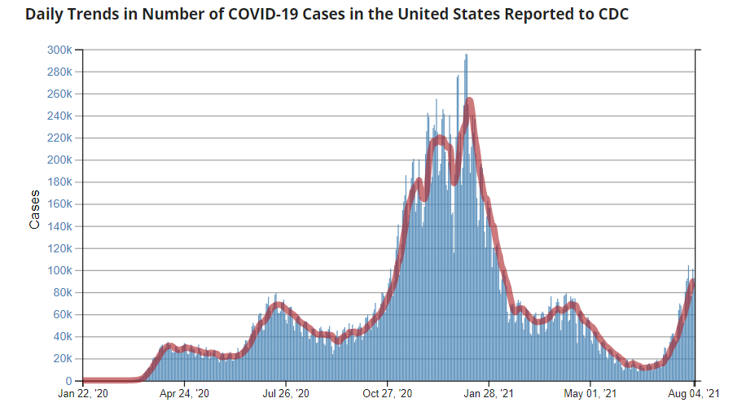
Number of Cases Reported in the USA, by Day
https://covid.cdc.gov/covid-data-tracker/#trends_dailytrendscases Updated 8/6/2021

Slide 7
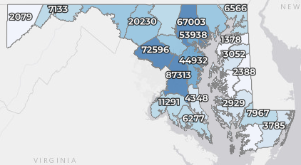
Maryland: COVID-19 Cases
http://health.maryland.gov/coronavirus
Data current as of 8/6/2021
Cases: 472,224
  890 new
Deaths: 9,626
  4 new
Hospitalizations: 43,978
  Current: 345 (up 8)
Case rate: 10.1 per 100,000
Percent Positivity: 3.90%

Slide 8
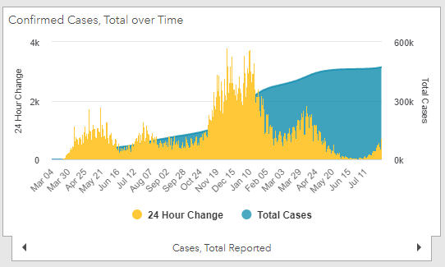
Maryland: COVID-19
Source: https://coronavirus.maryland.gov/, accessed 8/6/21

Slide 9
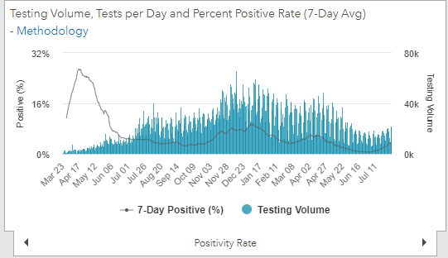
Maryland: COVID-19
Source: https://coronavirus.maryland.gov/, accessed 8/6/21

Slide 10
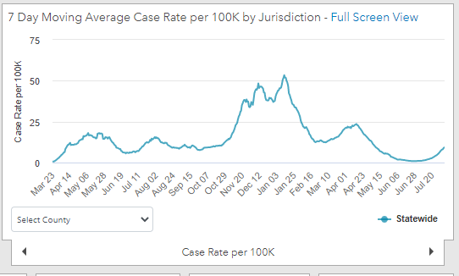
Maryland: COVID-19
8/6/21: 10.1 per 100k
Low: 6/24/21 at 0.90 per 100K
High: 1/12/21 at 53.39 per 100k
Source: https://coronavirus.maryland.gov/, accessed 8/6/21

Slide 11
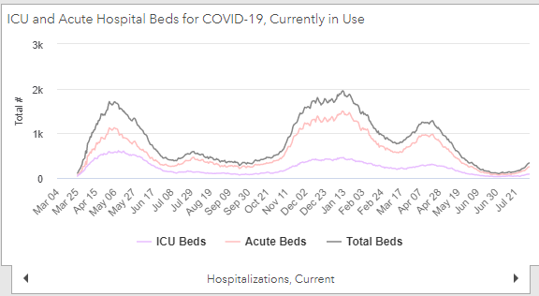
Maryland: COVID-19
Source: https://coronavirus.maryland.gov/, accessed 8/6/21

Slide 12
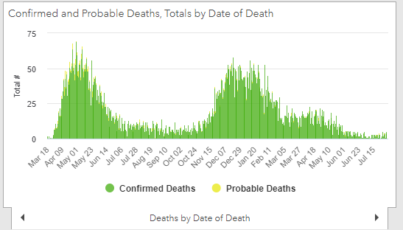
Maryland: COVID-19
Source: https://coronavirus.maryland.gov/, accessed 8/6/21

Slide 13
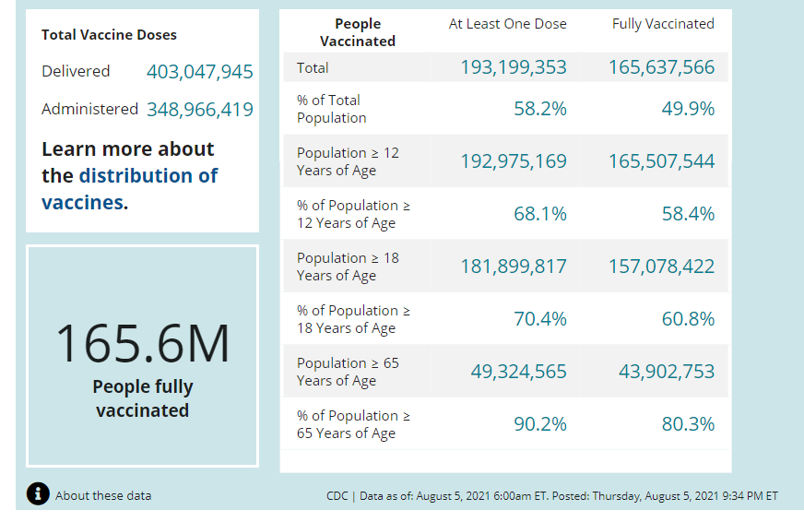
US: COVID-19 Vaccinations
Source: https://covid.cdc.gov/covid-data-tracker/#vaccinations accessed 8/6/21

Slide 14
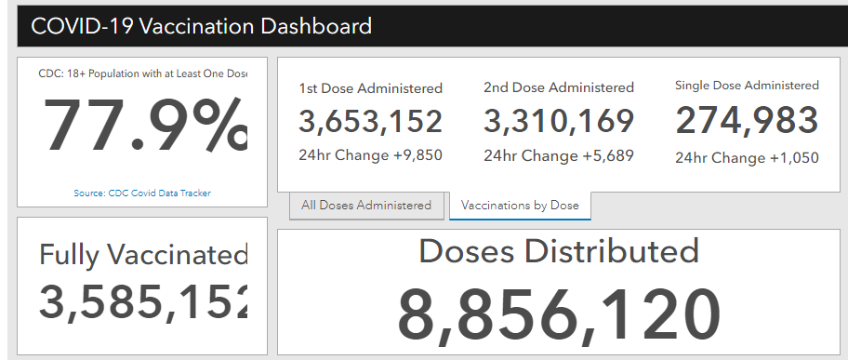
Maryland Vaccine Dashboard
https://coronavirus.maryland.gov/#Vaccine accessed 8/6/2021

Slide 15
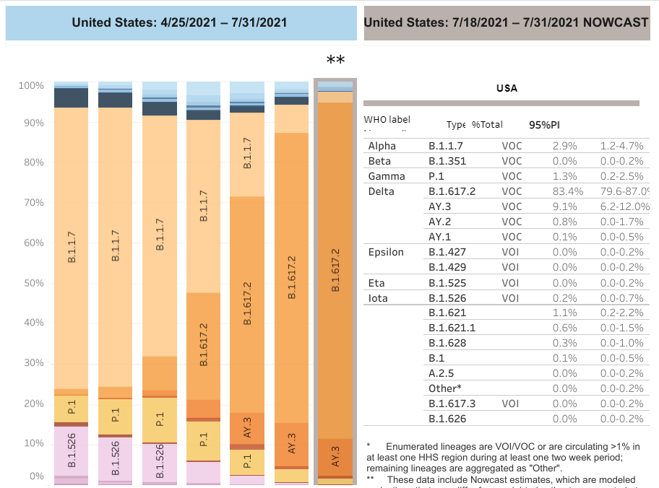

US: Delta Variant
https://covid.cdc.gov/covid-data-tracker/#variant-proportions Accessed 8/6/21
61.7%
as of 7/3/21
83.4% as of 8/6/21

Slide 16
CDC Science Update
7/27/21: Data were added from studies published since the last update that demonstrate currently authorized mRNA vaccines provide protection against variants of concern, including the Delta strain that is now predominant in the United States.
Vaccine effectiveness against hospitalization and death is high for all current SARS-CoV-2 variants; emerging data suggest lower effectiveness against confirmed infection and symptomatic disease caused by the Beta, Gamma, and Delta variants compared with the ancestral strain and the Alpha variant.
https://www.cdc.gov/coronavirus/2019-ncov/science/science-briefs/fully-vaccinated-people.html
https://www.cdc.gov/library/covid19/07302021_covidupdate.html

Slide 17
CDC: Interim Public Health Recommendations for Fully Vaccinated People
Updated July 28, 2021
The following recommendations apply to non-healthcare settings. For related information for healthcare settings, visit Updated Healthcare Infection Prevention and Control Recommendations in Response to COVID-19 Vaccination (last updated 4/27/21)
https://www.cdc.gov/coronavirus/2019-ncov/vaccines/fully-vaccinated-guidance.html

Slide 18
CDC: Interim Public Health Recommendations for Fully Vaccinated People
Updated July 28, 2021
Updated information for fully vaccinated people given new evidence on the B.1.617.2 (Delta) variant currently circulating in the United States.
Added a recommendation for fully vaccinated people to wear a mask in public indoor settings in areas of substantial or high transmission.
Added information that fully vaccinated people might choose to wear a mask regardless of the level of transmission, particularly if they are immunocompromised or at increased risk for severe disease from COVID-19, or if they have someone in their household who is immunocompromised, at increased risk of severe disease or not fully vaccinated.
https://www.cdc.gov/coronavirus/2019-ncov/vaccines/fully-vaccinated-guidance.html

Slide 19
CDC: Interim Public Health Recommendations for Fully Vaccinated People
Updated July 28, 2021
Added a recommendation for fully vaccinated people who have a known exposure to someone with suspected or confirmed COVID-19 to be tested 3-5 days after exposure, and to wear a mask in public indoor settings for 14 days or until they receive a negative test result.
CDC recommends universal indoor masking for all teachers, staff, students, and visitors to schools, regardless of vaccination status.
https://www.cdc.gov/coronavirus/2019-ncov/vaccines/fully-vaccinated-guidance.html

Slide 20
Updated MDH Order: Vaccination Matters

Slide 21
Vaccination Requirements
All staff of the facilities listed are required to show proof of first dose or single dose of COVID-19 vaccination by Wednesday, September 1, 2021.
Staff includes, but is not limited to, regular and contractual employees, contractual staff, volunteers, and other state employees performing any duties at the facility.
All staff are required to complete the full shot regimen, including any booster shot, as clinically indicated in order to satisfy this requirement.

Slide 22
Facilities this applies to:
i. All residential facilities operated by the Maryland Department of Health or any local health department;
ii. All state correctional facilities under the direction of the Secretary of the Department of Public Safety and Correctional Services in the Correctional Services Article;
iii. All state facilities operated by the Department of Juvenile Services under Title 9 of the Human Services Article;
iv. The Home maintained by the Department of Veterans Affairs under Title 9, Subtitle 9 of the State Government Article; and
v. Other state congregant living facilities as identified by the Secretary of the Department of Health.

Slide 23
Staff who remain unvaccinated
Staff that fail to show proof of full vaccination shall be subject to mandatory minimum of COVID-19 testing once a week and will be required to wear appropriate personal protective equipment, as determined by each facility’s management, in consultation with the relevant federal and state guidance, while on the facility’s premises.

Slide 24
Reasonable Accommodation Requests:
A staff individual may request an accommodation by providing appropriate and sufficient documentation for bona fide medical or religious reasons. This request for an accommodation shall be made to and reviewed and documented by the requesting staff's agency Equal Employment Opportunity/Fair Practices office.

Slide 25
Maryland COVID-19 Post-Vaccination Infections
Dr. David Blythe
Maryland Department of Health
August 4, 2021

Slide 26
Definition of Post-Vaccination Infections
“Post-vaccine infections” (aka “vaccine breakthrough cases” are defined as cases where the first positive detection of COVID-19 occurs 14 or more days after being fully vaccinated (ie, 14 or more days after the 2nd dose of Pfizer or Moderna vaccine or a dose of Johnson & Johnson vaccine)

Slide 27
Post-Vaccination Infections
All COVID-19 vaccines currently authorized in the United States are effective against COVID-19 – particularly against:
  severe disease
  hospitalization
  death
Even with highly effective vaccines, post-vaccination infections are expected
Asymptomatic as well as symptomatic infections will occur among vaccinated people

Slide 28
Factors that Affect Post-Vaccination Infection Numbers
Percentage of the population vaccinated
Effectiveness of the vaccine, which can vary by:
  Vaccine product
  Underlying factors in population vaccinated (eg, immunosuppression)
  Variant of virus causing infection
Time since vaccination (“waning immunity”)

Slide 29
Factors that Affect Post-Vaccination Infection Numbers
Percentage of the population vaccinated
Effectiveness of the vaccine, which can vary by:
  Vaccine product
  Underlying factors in population vaccinated (eg, immunosuppression)
  Variant of virus causing infection
Time since vaccination (“waning immunity”)
Vary over time

Slide 30
Vaccine Effectiveness – Delta
Lower than against other variants
  Studies from England and Scotland found that compared to alpha, effectiveness was 79% for PCR+ infection and 88% for symptomatic infection
  Two surveys completed in England recently demonstrated effectiveness of ~72% and ~73%, respectively
  Report from Israel suggested effectiveness against infection and symptomatic infection was 64%
Effectiveness at preventing hospitalization and death still high
Varies by vaccine type/dosing regimen
https://www.cdc.gov/coronavirus/2019-ncov/science/science-briefs/fully-vaccinated-people.html

Slide 31
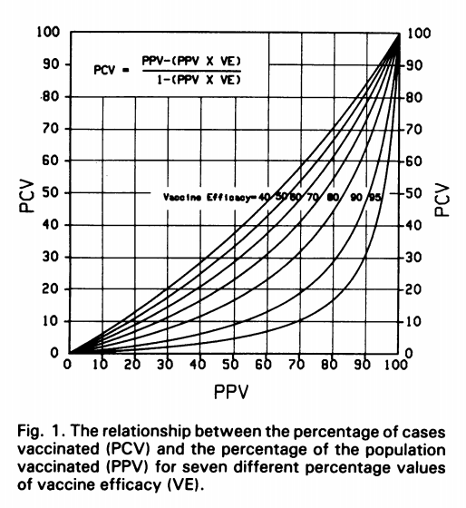
Post-Vaccination Infections
Orenstein et al, Bulletin of the World Health Organization, 63 (6): 1055-1068 (1985)

Slide 32
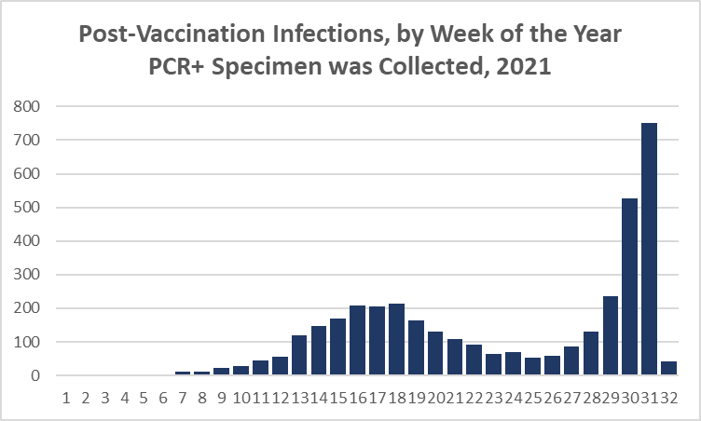
Post-Vaccination Infections, Maryland 2021
As of August 2, 2021
Current week – not complete
Week of the Year

Slide 33
Questions?
mdh.ipcovid@maryland.gov

