Slide 1
Maryland Situation Update on
Coronavirus Disease (COVID-19) for BHA
Maryland Department of Health
Infectious Disease Epidemiology and Outbreak Response Bureau
August 28th, 2020

Slide 2
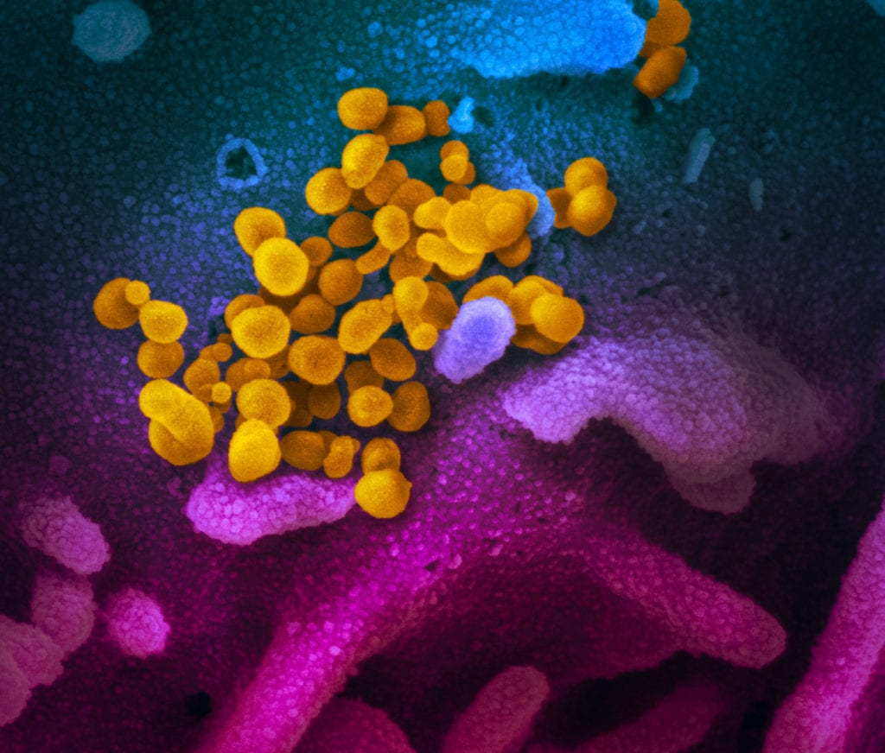
Call Agenda
Picture Courtesy of NIAID-RML
Review current situation of COVID-19
CDC Updates
CovidConnect
Questions and Answers

Slide 3
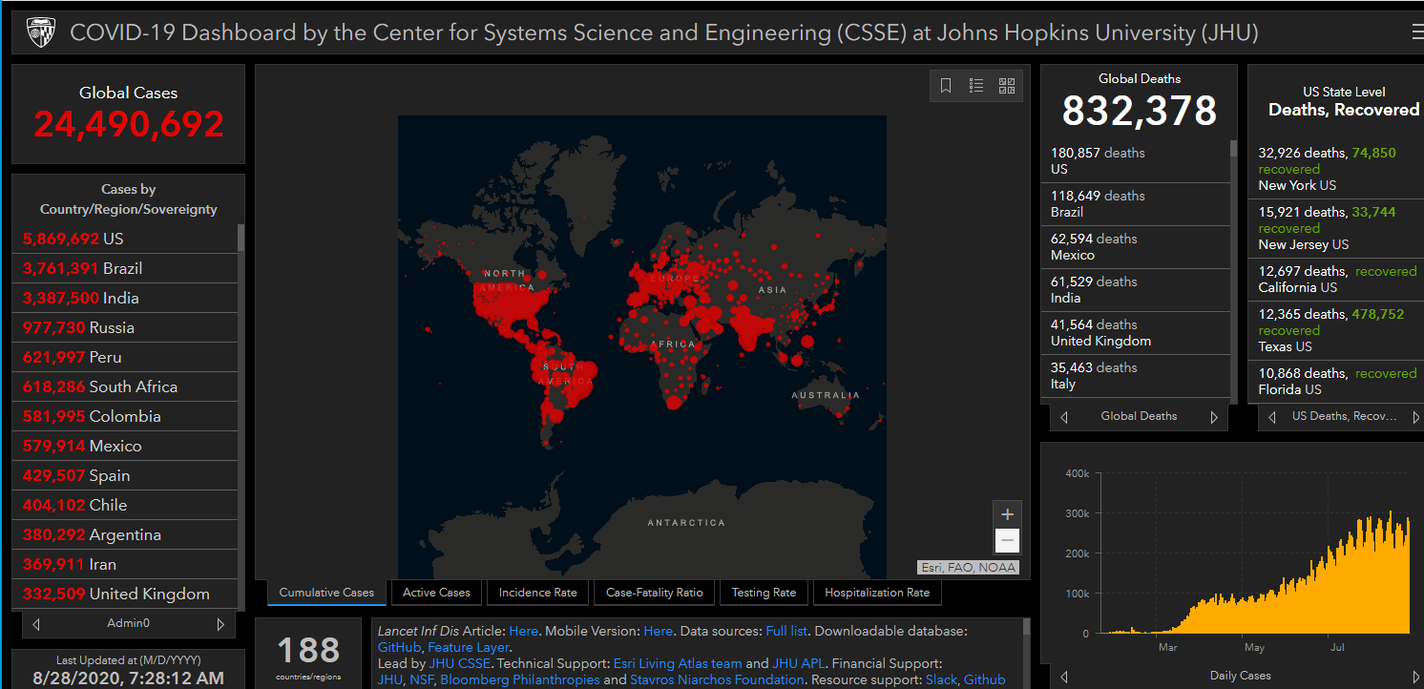
COVID-19 Global Situation Summary

Slide 4
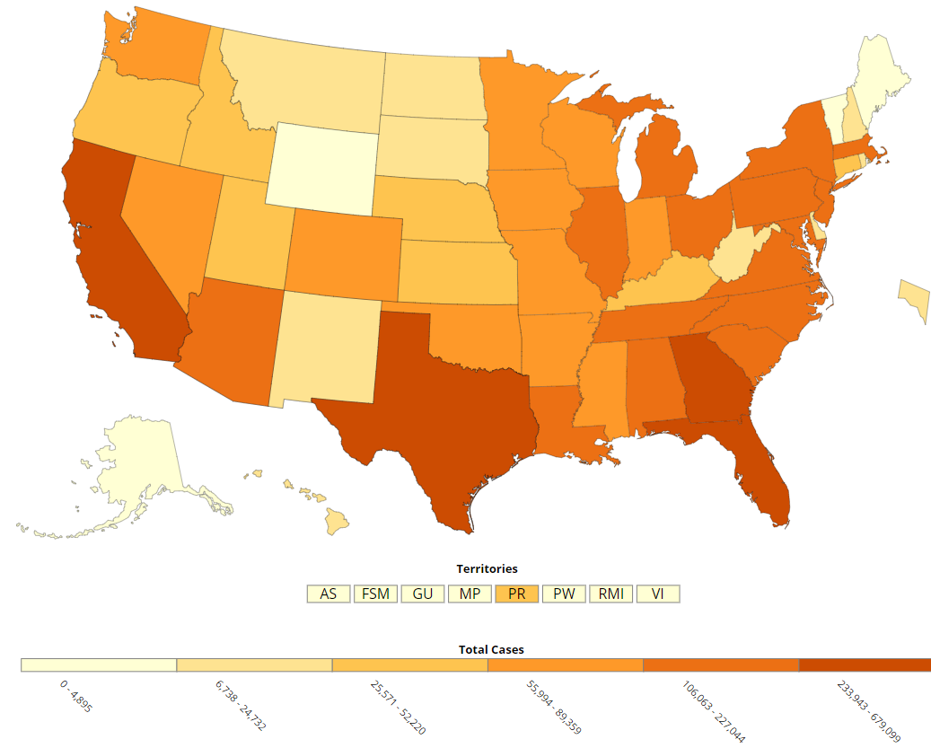
U.S.: COVID-19 Cases
5,799,046 Confirmed Cases
  46,393 new in 24 hours
  292,117 new in the past 7 days
178,998 total deaths
  1,239 new
https://www.cdc.gov/coronavirus/2019-ncov/cases-updates/cases-in-us.html
Accessed 8/28/2020

Slide 5
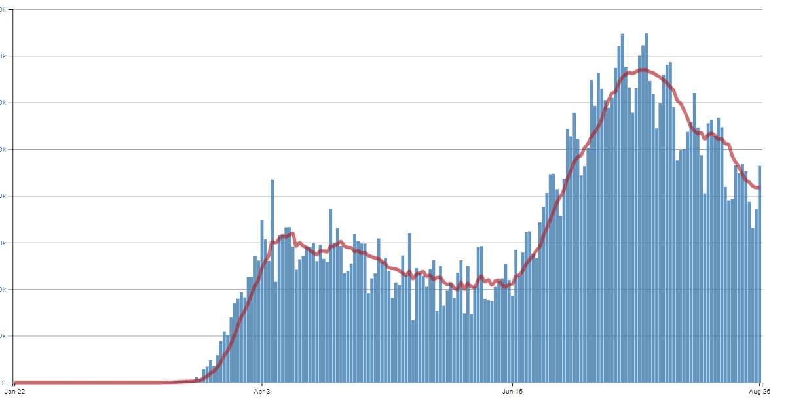
Number of Cases Reported in the USA, by Day

Slide 6
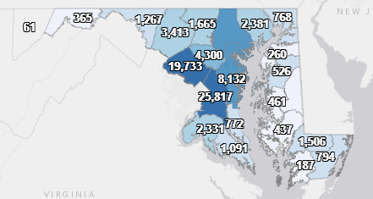
Maryland: COVID-19 Cases
http://health.maryland.gov/coronavirus
Data current as of 8/28/2020
Cases: 106,664
  601 new
Deaths: 3,593
  13 new
Hospitalizations: 14,184
  Current: 412
  43 new
Total tests 1,868,927

Slide 7
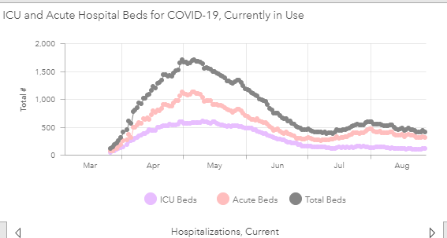

Slide 8
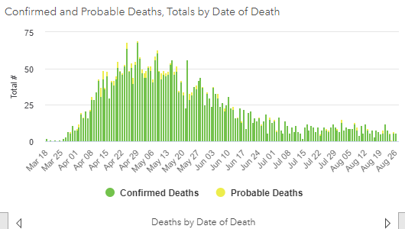

Slide 9
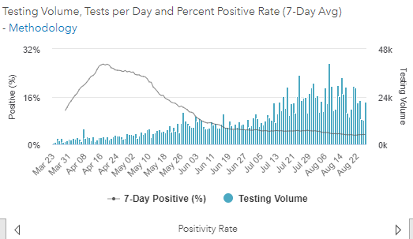
Testing Volume and % Positivity

Slide 10
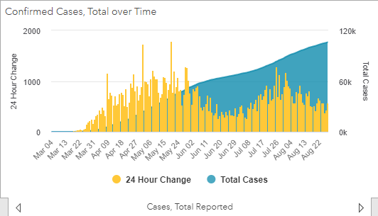

Slide 11
CDC Testing Recommendations
Symptomatic people
People who have been in close contact with a known or suspect case
  If you test negative, you should continue to quarantine for 14 days after the last known exposure
Screening tests for certain settings
  Staff and residents of long term care
  Corrections facilities

Slide 12
Definitions
Diagnostic Testing
  To identify current infection in individuals
  Performed when a person has signs or symptoms consistent with COVID-19, or when a person is asymptomatic but has recent known or suspected exposure to SARS-CoV-2.
Screening Testing
  To identify infected persons who are asymptomatic and without known or suspected exposure to SARS-CoV-2.
  Ex: testing in congregate settings, such as a LTCF or a correctional facility, a workplace testing its employees, or a school testing its students, faculty, and staff.
Surveillance Testing
  To monitor for a community- or population-level infection and disease, or to characterize the incidence and prevalence of disease.
  Performed on de-identified specimens; results are not linked to individuals.

Slide 13
The Recent Changes
On 8/24, CDC guidance modified to say close contacts “May not need to be tested”
Lots of concerns expressed over the risk of undetected cases and asymptomatic transmission- ~40% of cases are asymptomatic
On 8/27, CDC director Robert Redfield clarified that “Testing may be considered for all exposed contacts of confirmed or probable cases”
Maryland guidance has not changed, and people with known exposures should still be prioritized for testing

Slide 14
Maryland CovidCONNECT
Carrie Durham, JD
August 27, 2020

Slide 15
CovidCONNECT Overview
Purpose: create a resource specific to Maryland residents who have been affected by COVID-19
Current website features:
  Information about plasma donation opportunities and clinical trials
  Recovery stories
  Resources on such topics as self-care and overcoming stigma after illness
Upcoming features:
  Virtual support groups moderated by behavioral health experts and peers
  More webinars

Slide 16
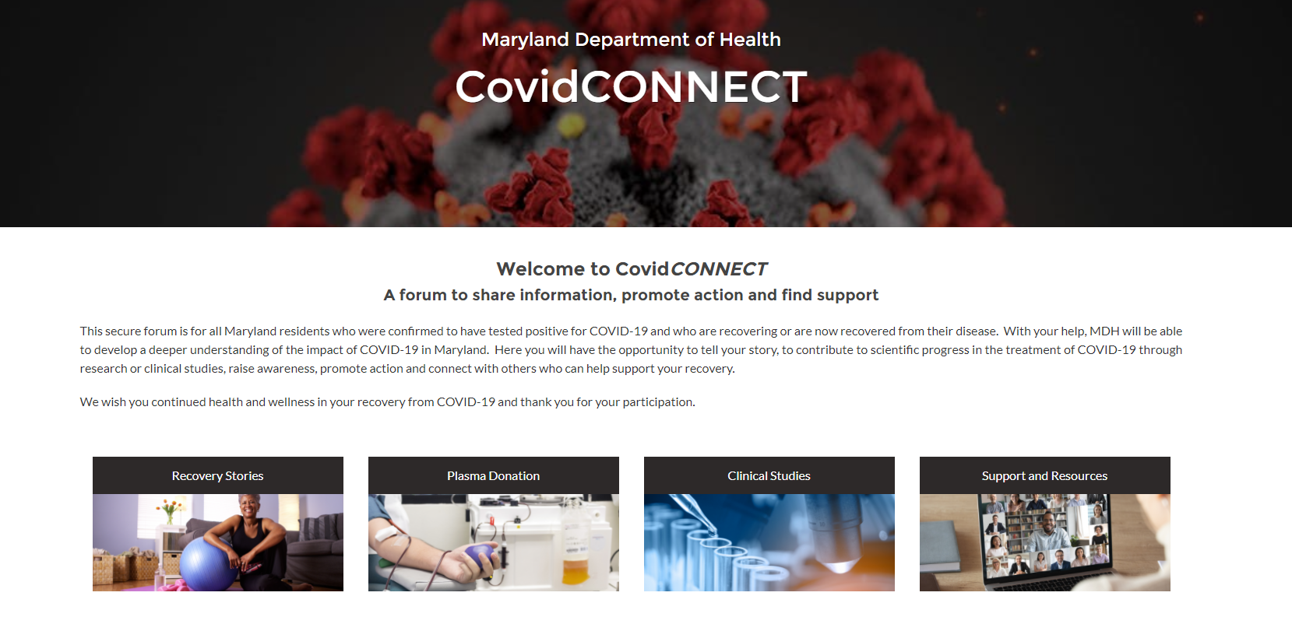

Slide 17
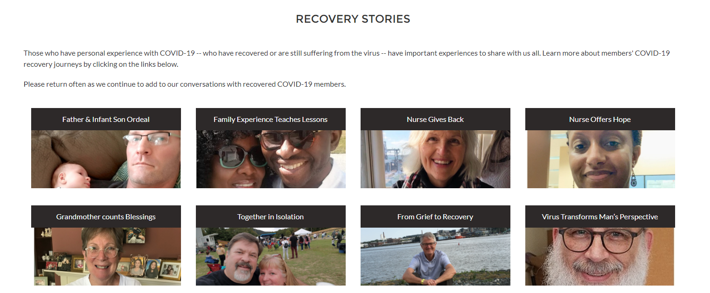

Slide 18
CovidCONNECT Highlights
April 10, 2020 - CovidCONNECT registry opened
May 11, 2020 - CovidCONNECT website went live
Today: > 2,300 registrants
Interviewed and published 14 recovery stories
Webinars:
  Hosted 9 clinical study presentations
  Held 6 behavioral health-related discussions

Slide 19
To Join
Register at:
https://health.maryland.gov/covidconnect/Pages/Home.aspx
OR
Find our registry link on:
https://coronavirus.maryland.gov/
Notes:
Discuss that some of the clinical trials have short time frames and some are interested in nursing home and assisted living residents especially for convelsant plasma. Also-encoorage them to sign up.

Slide 20
Resources
MDH Novel Coronavirus: http://health.maryland.gov/coronavirus
MDH Laboratory Coronavirus: https://health.maryland.gov/laboratories/Pages/Novel-Coronavirus.aspx
COVID-19 People at risk https://www.cdc.gov/coronavirus/2019-ncov/specific-groups/high-risk-complications.html
CDC Guidance for Infection Control https://www.cdc.gov/coronavirus/2019-nCoV/infection-control.html
Behavioral Health https://www.cdc.gov/coronavirus/2019-ncov/hcp/infection-control-faq.html?CDC_AA_refVal=https%3A%2F%2Fwww.cdc.gov%2Fcoronavirus%2F2019-ncov%2Finfection-control%2Finfection-prevention-control-faq.html
Memory Care https://www.cdc.gov/coronavirus/2019-ncov/hcp/memory-care.html

Slide 21
Questions?
Email : mdh.ipcovid@Maryland.gov

