Slide 1
Maryland Situation Update on
Coronavirus Disease (COVID-19) for BHA
Maryland Department of Health
Infectious Disease Epidemiology and Outbreak Response Bureau
August 20, 2021

Slide 2

Call Agenda
Epi summary
mAB Post Exposure Prophylaxis
Q and A
https://covidlink.maryland.gov/content/vaccine/govax/

Slide 3
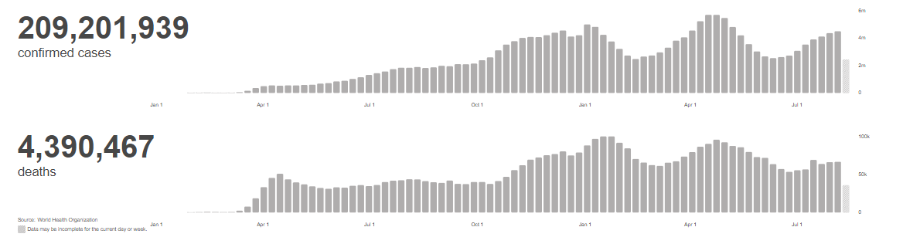
Worldwide: COVID-19
Source: https://covid19.who.int/ accessed 8/20/21

Slide 4
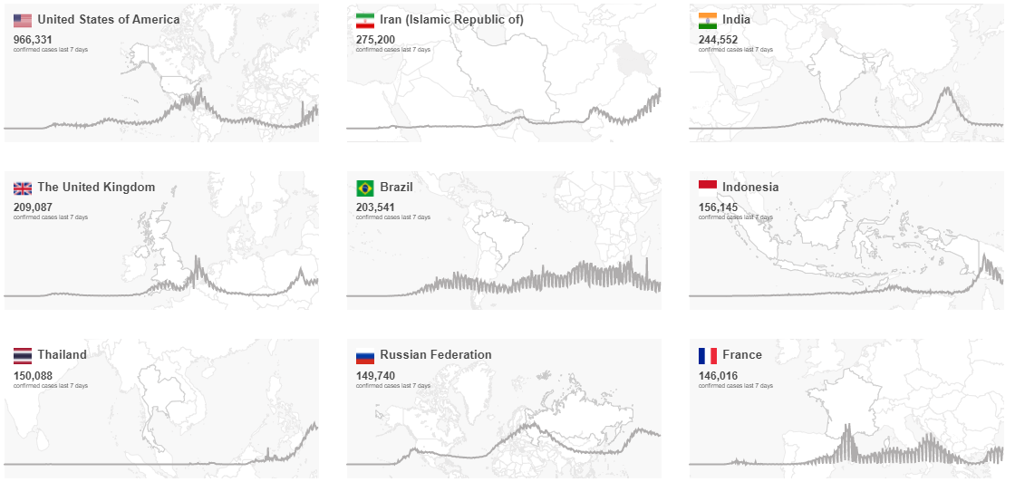
Worldwide: COVID-19
Source: https://covid19.who.int/ accessed 8/20/21

Slide 5
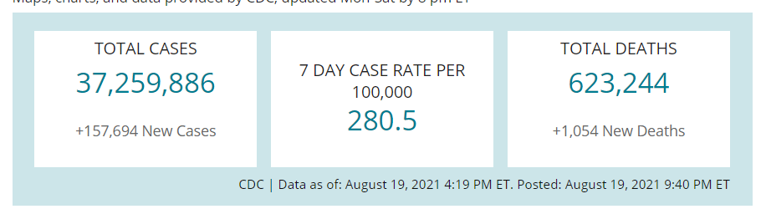
US Case Counts and Rates
https://www.cdc.gov/coronavirus/2019-ncov/cases-updates/cases-in-us.html 8/20/2021

Slide 6
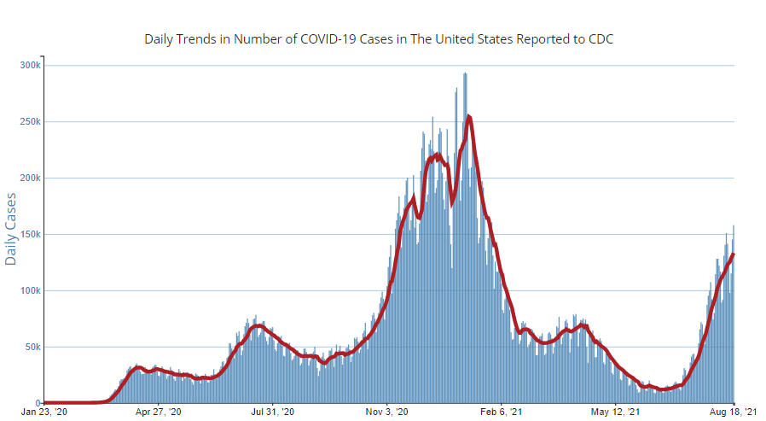
Number of Cases Reported in the USA, by Day
https://covid.cdc.gov/covid-data-tracker/#trends_dailytrendscases Updated 8/20/2021

Slide 7


Community Transmission
https://covid.cdc.gov/covid-data-tracker/#county-view 8/20/21

Slide 8
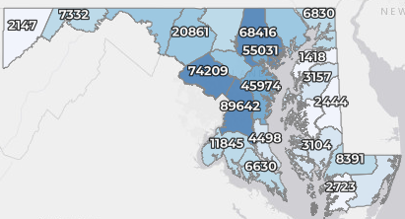
Maryland: COVID-19 Cases
http://health.maryland.gov/coronavirus
Data current as of 8/20/2021
Cases: 484,847
  1,206 new
Deaths: 9,701
  6 new
Hospitalizations: 45,235
  Current: 656 (up 13)
Case rate: 15.4 per 100,000
Percent Positivity: 5.06%

Slide 9
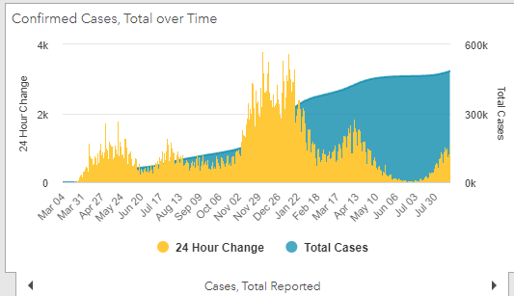
Maryland: COVID-19
Source: https://coronavirus.maryland.gov/, accessed 8/20/21

Slide 10
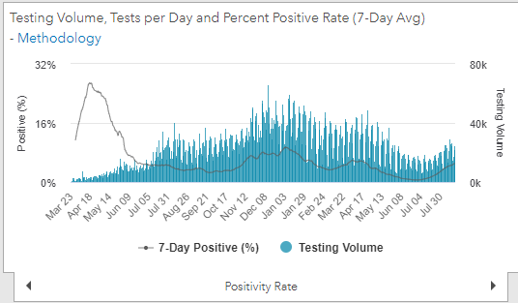
Maryland: COVID-19
Source: https://coronavirus.maryland.gov/, accessed 8/20/21

Slide 11
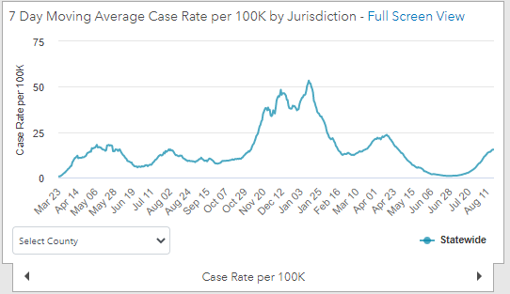
Maryland: COVID-19
8/20/21: 15.4 per 100k
Low: 6/24/21 at 0.90 per 100K
High: 1/12/21 at 53.39 per 100k
Source: https://coronavirus.maryland.gov/, accessed 8/20/21

Slide 12
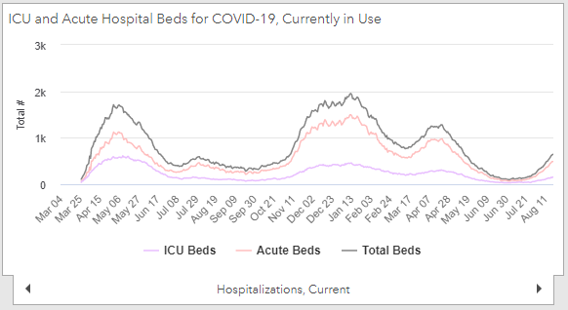
Maryland: COVID-19
Source: https://coronavirus.maryland.gov/, accessed 8/20/21

Slide 13
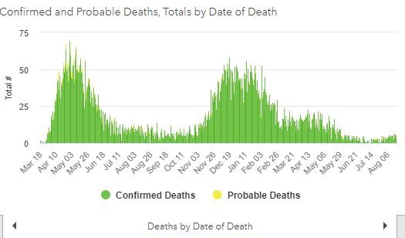
Maryland: COVID-19
Source: https://coronavirus.maryland.gov/, accessed 8/20/21

Slide 14
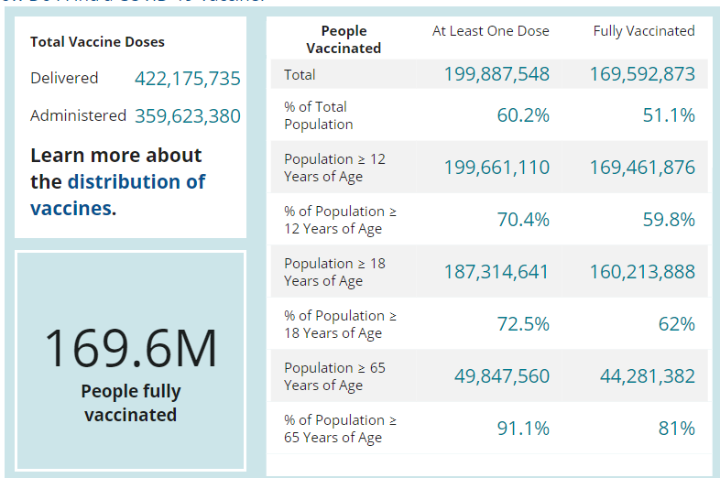
US: COVID-19 Vaccinations
Source: https://covid.cdc.gov/covid-data-tracker/#vaccinations accessed 8/20/21

Slide 15
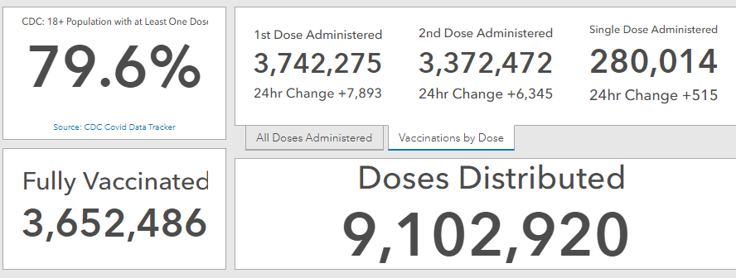
Maryland Vaccine Dashboard
59.1% total population, using 2020 census data (6,177,224 MD residents)
https://coronavirus.maryland.gov/#Vaccine accessed 8/6/2021

Slide 16
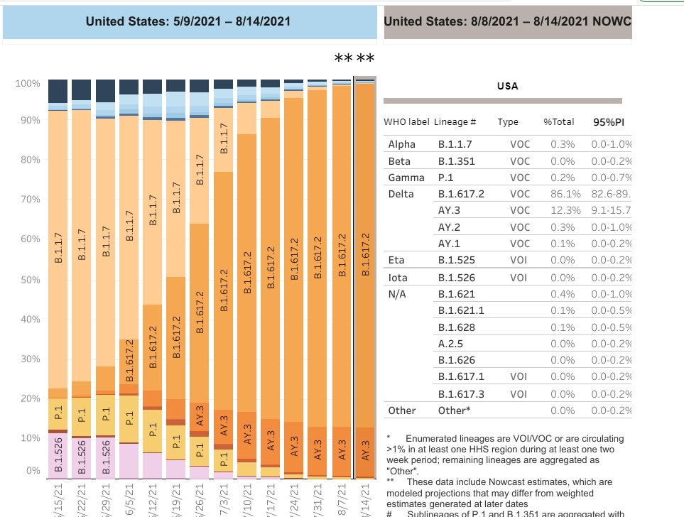

US: Delta Variant
https://covid.cdc.gov/covid-data-tracker/#variant-proportions Accessed 8/20/21
61.7%
as of 7/3/21
86.1% as of 8/20/21

Slide 17
Updates of Interest

Slide 18
CDC and ACIP: 3rd Dose Approved for Immunocompromised People
CDC recommends people who are moderately to severely immunocompromised should receive an additional dose of mRNA COVID-19 vaccine after the initial 2 doses.
Third dose should be administered at least 28 days after the second dose.
CDC does not recommend additional doses or booster shots for any other population at this time.
https://www.cdc.gov/coronavirus/2019-ncov/vaccines/recommendations/immuno.html

Slide 19
Who Needs an Additional COVID-19 Vaccine?
Been receiving active cancer treatment for tumors or cancers of the blood
Received an organ transplant and are taking medicine to suppress the immune system
Received a stem cell transplant within the last 2 years or are taking medicine to suppress the immune system
Moderate or severe primary immunodeficiency (such as DiGeorge syndrome, Wiskott-Aldrich syndrome)
Advanced or untreated HIV infection
Active treatment with high-dose corticosteroids or other drugs that may suppress your immune response

Slide 20
Booster Doses: HHS Statement
We have developed a plan to begin offering these booster shots this fall subject to FDA conducting an independent evaluation and determination of the safety and effectiveness of a third dose of the Pfizer and Moderna mRNA vaccines and CDC’s Advisory Committee on Immunization Practices (ACIP) issuing booster dose recommendations based on a thorough review of the evidence.
We are prepared to offer booster shots for all Americans beginning the week of September 20 and starting 8 months after an individual’s second dose.
https://www.cdc.gov/media/releases/2021/s0818-covid-19-booster-shots.html

Slide 21
Coadministration of COVID-19 vaccines
COVID-19 vaccines and other vaccines may now be administered without regard to timing.
This includes simultaneous administration of COVID-19 vaccine and other vaccines on the same day, as well as coadministration within 14 days.
Best practices for multiple injections include:
  Label each syringe with the name and the dosage (amount) of the vaccine, lot number, the initials of the preparer, and the exact beyond-use time, if applicable.
  Separate injection sites by 1 inch or more, if possible.
  Administer the COVID-19 vaccines and vaccines that may be more likely to cause a local reaction (e.g., tetanus-toxoid-containing and adjuvanted vaccines) in different limbs, if possible.
https://www.cdc.gov/vaccines/covid-19/clinical-considerations/covid-19-vaccines-us.html

Slide 22
Questions?
mdh.ipcovid@maryland.gov

