Slide 1
Maryland Situation Update on Coronavirus Disease (COVID-19) for BHA
Maryland Department of Health
Infectious Disease Epidemiology and Outbreak Response Bureau
July 31, 2020

Slide 2
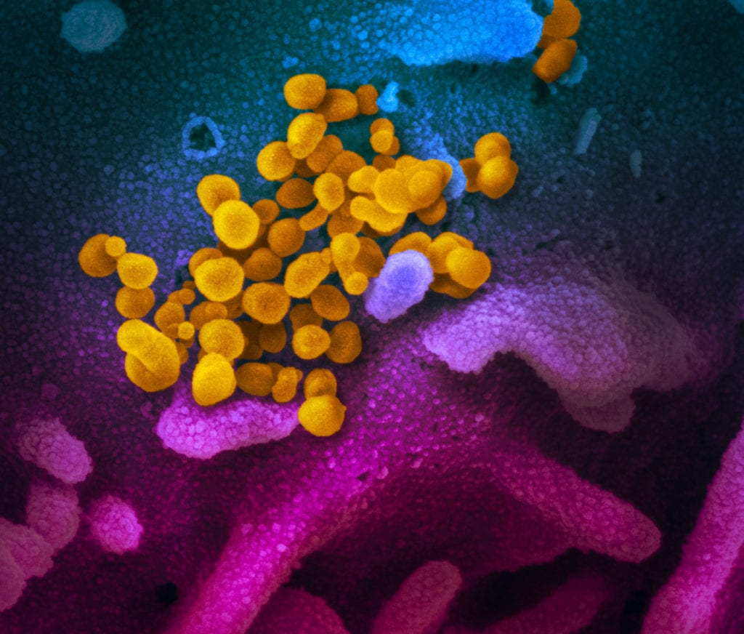
Call Agenda
Picture Courtesy of NIAID-RML
Review current situation of COVID-19
School and Childcare guidance
Questions and Answers

Slide 3
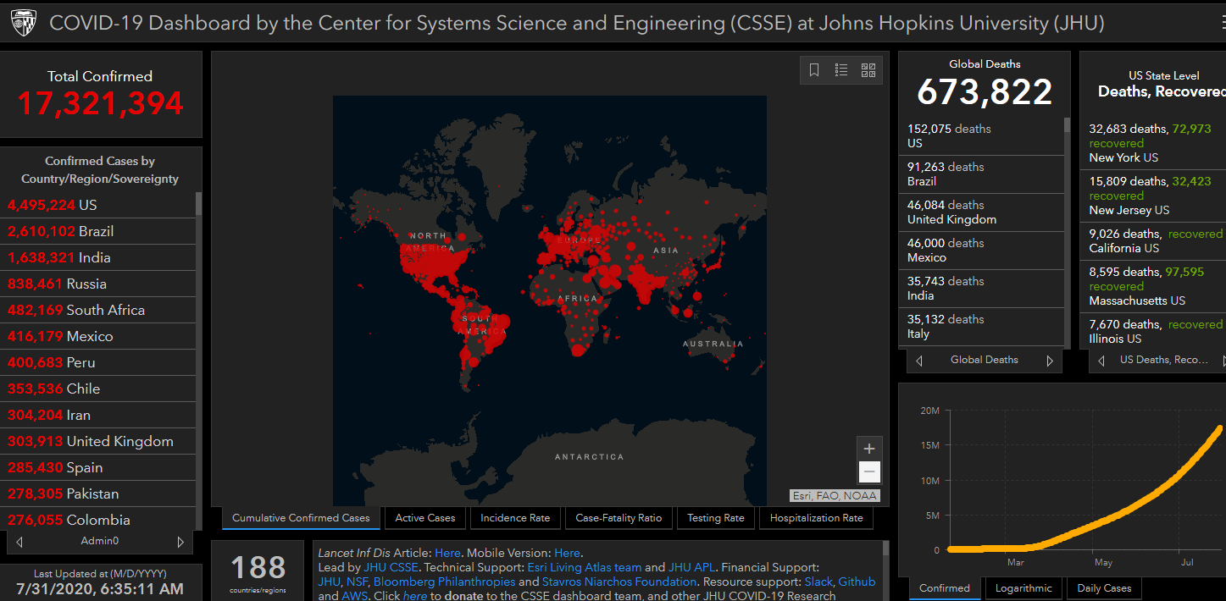
COVID-19 Global Situation Summary

Slide 4
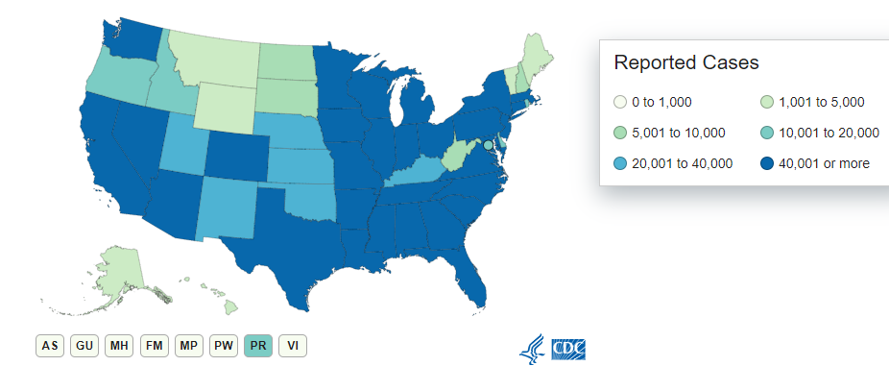
U.S.: COVID-19 Cases
4,405,932 Confirmed Cases
65,935 new
150,283 total deaths
1,417 new
https://www.cdc.gov/coronavirus/2019-ncov/cases-updates/us-cases-deaths.html
Accessed 7/31/2020

Slide 5
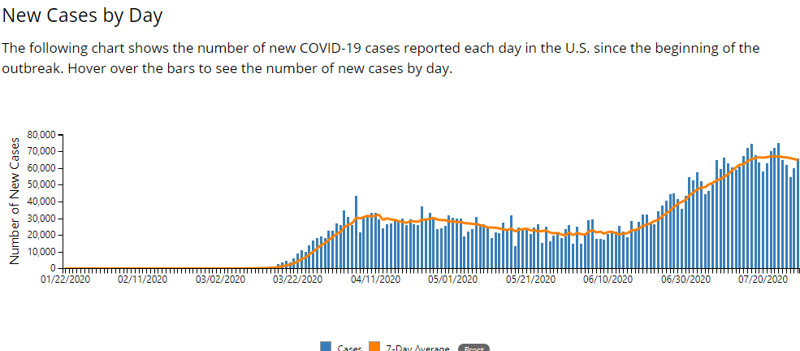

Slide 6
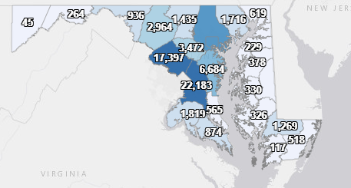
Maryland: COVID-19 Cases
http://health.maryland.gov/coronavirus
Data current as of 7/31/2020
Cases: 88,348
1,169 new
Deaths: 3,362
5 new
Hospitalizations: 12,593
Current: 590
93 new
Total tests 1,214,764

Slide 7
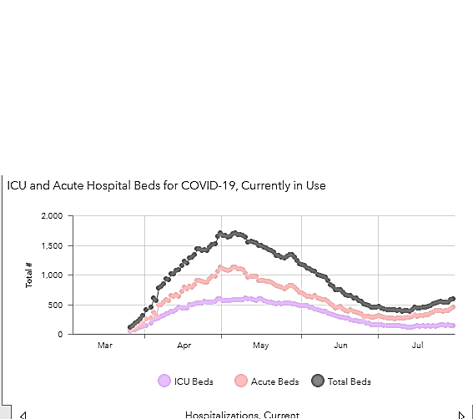

Slide 8
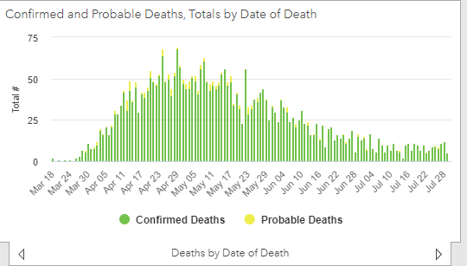

Slide 9
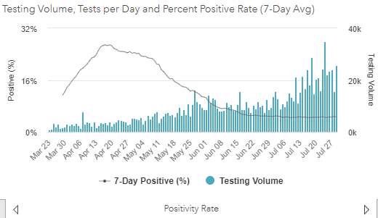
Testing Volume and % Positivity

Slide 10
Guidance Update: Response to COVID-19 and COVID-19-like Illness in School and Child Care
Jamie Perry, MD, MPH

Slide 11
Decision Aid
“Decision Aid: Exclusion and Return for Laboratory Confirmed COVID-19 Cases and Persons with COVID-19-like Illness in School, Child Care Programs, and Youth Camps”

Slide 12
COVID-19-like Illness
For the purposes of this decision aid, COVID-19-like illness is defined as: New onset cough or shortness of breath OR At least 2 of the following: fever of 100.4º or higher, chills, shivering, muscle pain, sore throat, headache, loss of sense of taste or smell, and gastrointestinal symptoms (nausea, vomiting or diarrhea).
NOTE: This definition was adapted from the clinical criteria in the CDC case definition of a probable case of COVID-19.

Slide 13
Decision Aid: Ill Persons without COVID-19-like Illness
Exclude person and allow return when symptoms have improved and criteria in the Communicable Diseases Summary have been met as applicable. If person develops symptoms of COVID-19-like illness, follow processes below for person with COVID-19-like illness.
Person (child, care provider, educator, other staff) with ONE NEW symptom not meeting the definition of COVID-19-like illness.

Slide 14
Person with COVID-19-like Illness: Positive Test or Not Tested
Person (child, care provider, educator, other staff) with COVID-19-like illness.
Exclude person and recommend that they talk to their health care provider about testing for COVID-19 or whether there is another specific diagnosis.
The person should isolate pending test results or evaluation by their health care provider.
Close contacts of the ill person should quarantine per CDC guidelines.
Close contacts should stay home for 14 days from the date of last exposure even if they have no symptoms or they have a negative COVID-19 test done during quarantine.
Person has positive test for COVID-19.
The ill person should stay home at least 10 days since symptoms first appeared AND until no fever for at least 24 hours without medication AND improvement of other symptoms.
Person does not receive a laboratory test or another specific diagnosis by their health care provider.

Slide 15
Person with COVID-19-like Illness: Negative Test or Another Specific Diagnosis
Person (child, care provider, educator, other staff) with COVID-19-like illness.
Exclude person and recommend that they talk to their health care provider about testing for COVID-19 or whether there is another specific diagnosis.
The person should isolate pending test results or evaluation by their health care provider.
Close contacts of the ill person should quarantine per CDC guidelines.
The ill person should stay home until symptoms have improved and criteria in the Communicable Diseases Summary have been met as applicable.
The person should consider being tested/retested for COVID-19 if symptoms do not improve.
Person has negative test for COVID-19.
Close contacts DO NOT need to stay home as long as they remain asymptomatic.
Health care provider documents that the person has another specific diagnosis (e.g. influenza, strep throat, otitis) or health care provider documents that symptoms are related to a pre-existing condition.

Slide 16
Decision Aid: Asymptomatic Person Testing Positive
Close contacts should stay home for 14 days from the date of last exposure even if they have no symptoms or they have a negative COVID-19 test done during quarantine.
An asymptomatic person (child, care provider, educator, other staff) tests positive for COVID-19.
The asymptomatic person should stay home for 10 days from positive test.

Slide 17
Application of Guidance in Child Care
Quarantine of close contacts of persons with COVID-19 or COVID-19-like illness in child care centers typically leads to partial (classroom) or full (entire site) closure of the program depending on program operations and degree of cohorting
Local health department and MSDE Licensing Specialist assessment is required to identify close contacts and make quarantine and closure decisions
Quarantine of close contacts of persons with COVID-19 or COVID-19-like illness in family child care homes should result in full closure of the site

Slide 18
Application of Guidance in Schools
Local schools and local health departments should work together to
Identify close contacts of persons with COVID-19 or COVID-19-like illness in school who need to quarantine
Determine whether closure of a classroom or more extensive closure is indicated based on assessment of the exposure risk

Slide 19
MDH Updates

Slide 20
Out of State Travel 7/29
Strongly recommends quarantine for people who have traveled to states with higher than 10% test positivity
Strongly recommends that Marylanders refrain from nonessential travel outside of Maryland
Does not include Virginia and Washington DC
Essential workers, including healthcare personnel, are exempt from quarantine recommendation
Recommend testing for returning travelers
https://www.cdc.gov/covid-data-tracker/index.html#testing

Slide 21
Universal Masking Order 7/29
All persons over the age of 5 must wear masks:
In or on public transportation
Indoors at any location where members of the public are generally permitted
Outdoors and unable to consistently maintain at least 6 feet of space
Obtaining healthcare services
Engaged in work where
Interaction with others is likely
Food is prepared or packaged

Slide 22
CDC Updates

Slide 23
CDC Updates and Resources
Toolkit for Retirement Communities (July 21) https://www.cdc.gov/coronavirus/2019-ncov/communication/toolkits/retirement-communities.html
New “Rural Communities” page (July 21) https://www.cdc.gov/coronavirus/2019-ncov/need-extra-precautions/other-at-risk-populations/rural-communities.html
Toolkit for People with Disabilities (July 24) https://www.cdc.gov/coronavirus/2019-ncov/communication/toolkits/people-with-disabilities.html

Slide 24
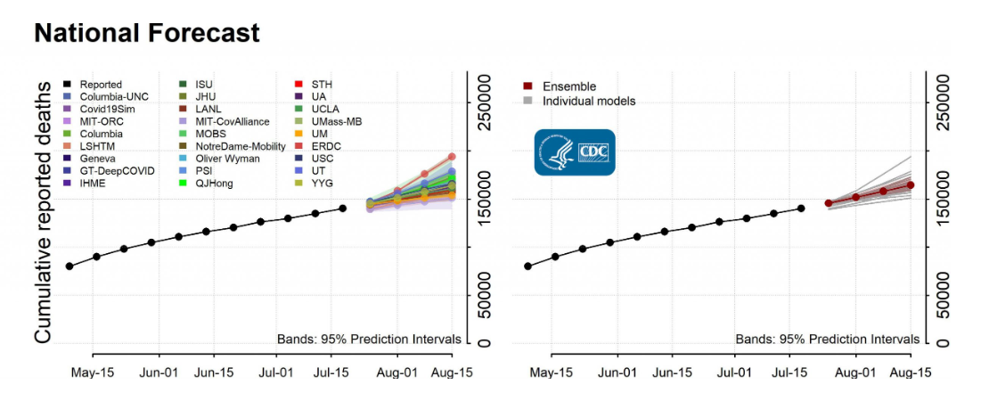
CDC: Cumulative Death Forecasts
Predicts 160,000 - 175,000 total reported COVID-19 deaths by August 15th.
Number of new deaths over the next 4 weeks will likely exceed the number reported over the last 4 weeks for the US overall
Source: https://www.cdc.gov/coronavirus/2019-ncov/covid-data/forecasting-us.html

Slide 25
Prolonged Symptoms
Multistate telephone survey of symptomatic adults who had a positive outpatient test result for SARS-CoV-2 infection
35% had not returned to their usual state of health when interviewed 2–3 weeks after testing.
Tenforde MW, Kim SS, Lindsell CJ, et al. Symptom Duration and Risk Factors for Delayed Return to Usual Health Among Outpatients with COVID-19 in a Multistate Health Care Systems Network — United States, March–June 2020. MMWR Morb Mortal Wkly Rep. ePub: 24 July 2020. DOI: http://dx.doi.org/10.15585/mmwr.mm6930e

Slide 26
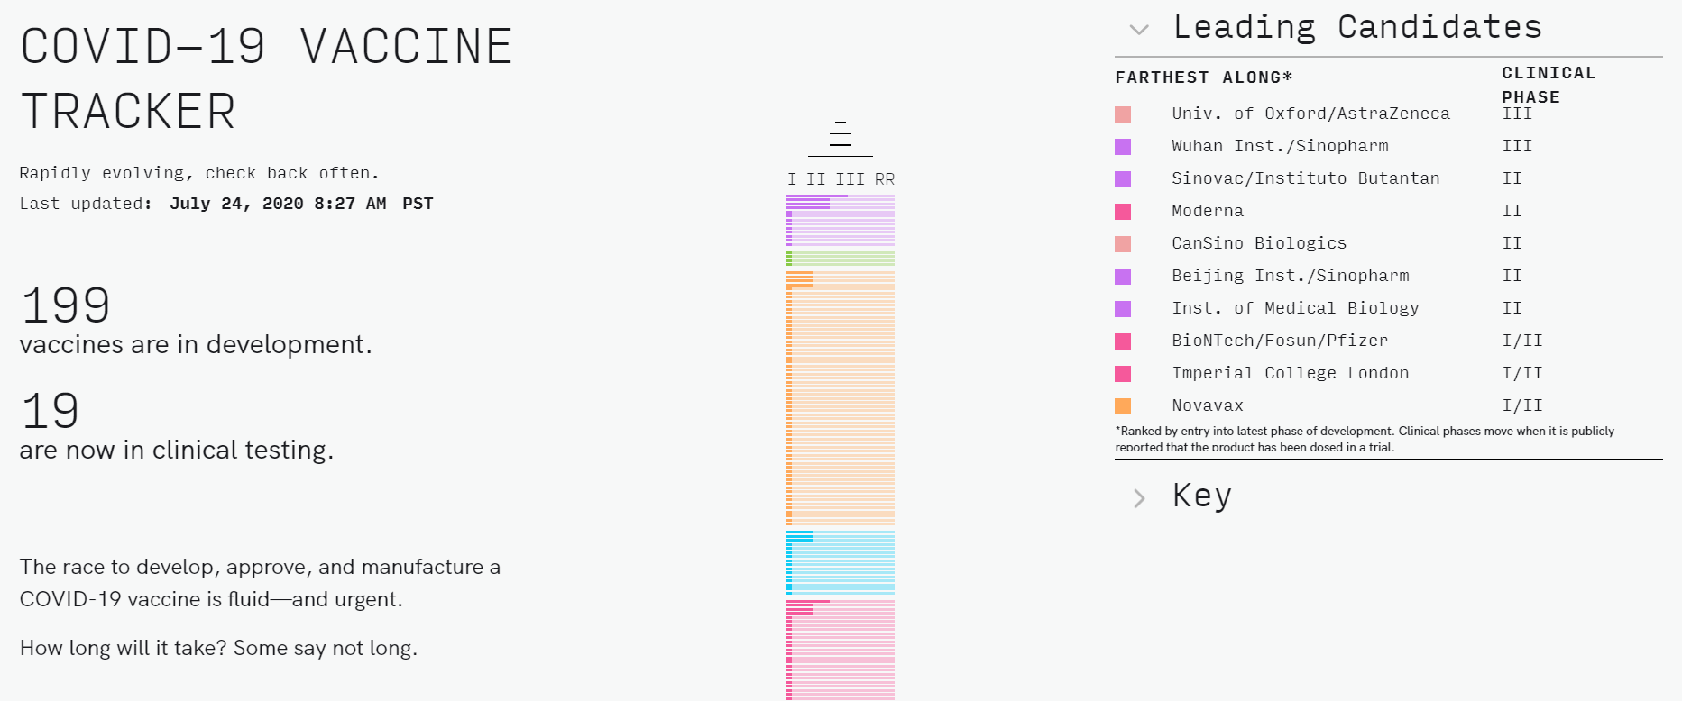
COVID-19 Vaccine Progress
Source: https://www.covid-19vaccinetracker.org/

Slide 27
NIH Press Release (July 27)
A Phase 3 clinical trial designed to evaluate if an investigational vaccine (mRNA-1273) can prevent symptomatic COVID-19 in adults has begun
Developed by Moderna, Inc. and NIAID
Will enroll ~30,000 adult volunteers
https://www.nih.gov/news-events/news-releases/phase-3-clinical-trial-investigational-vaccine-covid-19-begins

Slide 28
Resources
MDH Novel Coronavirus: http://health.maryland.gov/coronavirus
MDH Laboratory Coronavirus: https://health.maryland.gov/laboratories/Pages/Novel-Coronavirus.aspx
COVID-19 People at risk https://www.cdc.gov/coronavirus/2019-ncov/specific-groups/high-risk-complications.html
CDC Guidance for Infection Control https://www.cdc.gov/coronavirus/2019-nCoV/infection-control.html
Behavioral Health https://www.cdc.gov/coronavirus/2019-ncov/hcp/infection-control-faq.html?CDC_AA_refVal=https%3A%2F%2Fwww.cdc.gov%2Fcoronavirus%2F2019-ncov%2Finfection-control%2Finfection-prevention-control-faq.html
Memory Care https://www.cdc.gov/coronavirus/2019-ncov/hcp/memory-care.html

Slide 29
Questions?
Email : mdh.ipcovid@Maryland.gov

