Slide 1
Maryland Situation Update on
Coronavirus Disease (COVID-19) for BHA
Maryland Department of Health
Infectious Disease Epidemiology and Outbreak Response Bureau
July 23, 2021

Slide 2

Call Agenda
Epi summary
Delta Variant
FDA Updates
American Academy of Pediatrics Statement
Respiratory Syncytial Virus
Q and A
https://covidlink.maryland.gov/content/vaccine/govax/

Slide 3
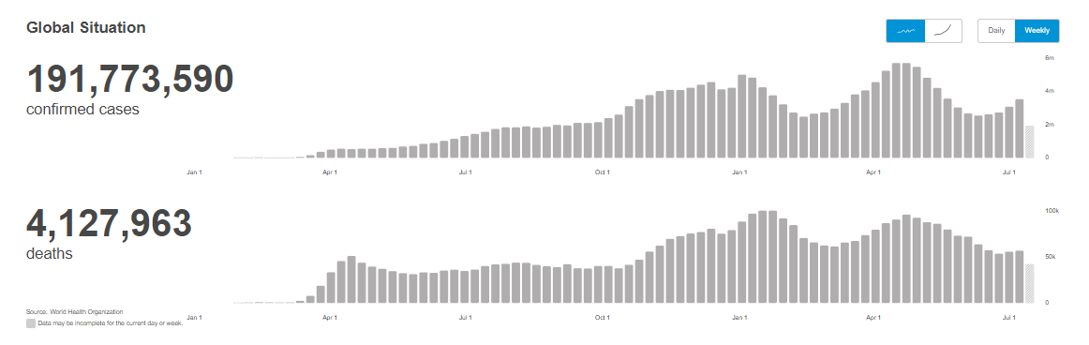
Worldwide: COVID-19
Source: https://covid19.who.int/ accessed 7/23/21

Slide 4
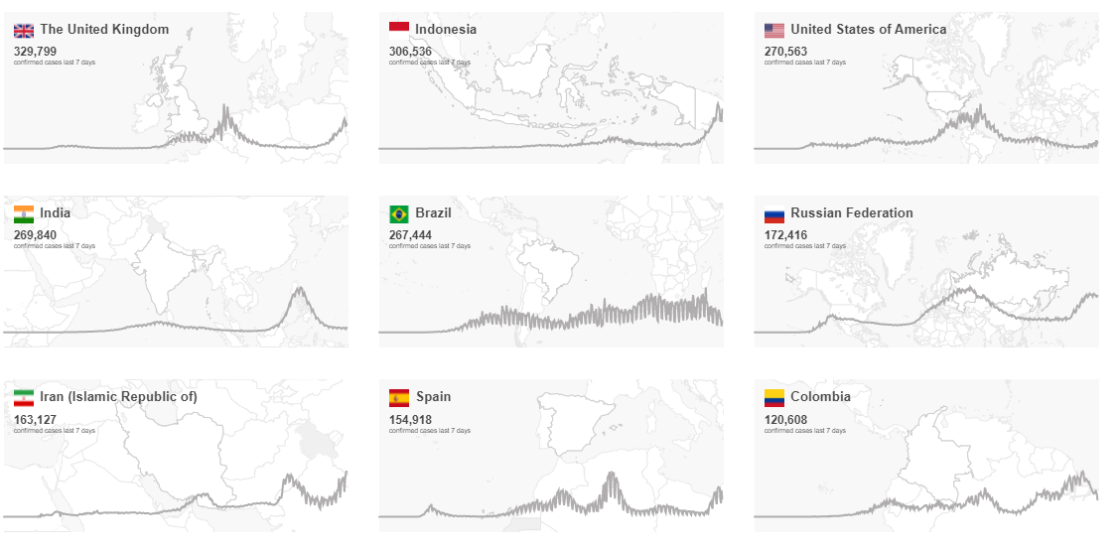
Worldwide: COVID-19
Source: https://covid19.who.int/ accessed 7/23/21

Slide 5
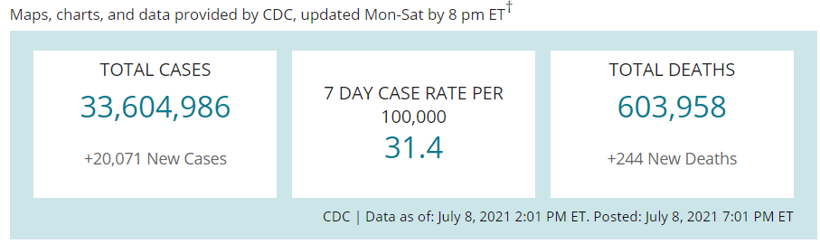
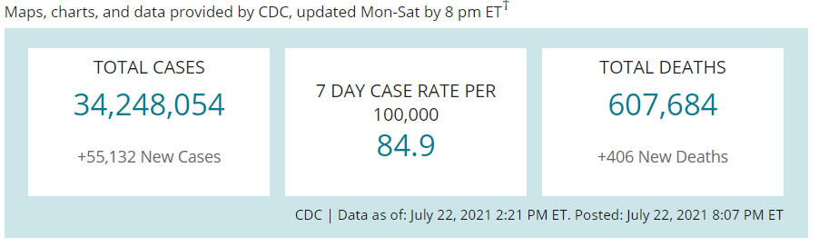
US Case Counts and Rates
https://www.cdc.gov/coronavirus/2019-ncov/cases-updates/cases-in-us.html Accessed7/92021 and 7/23/2021

Slide 6
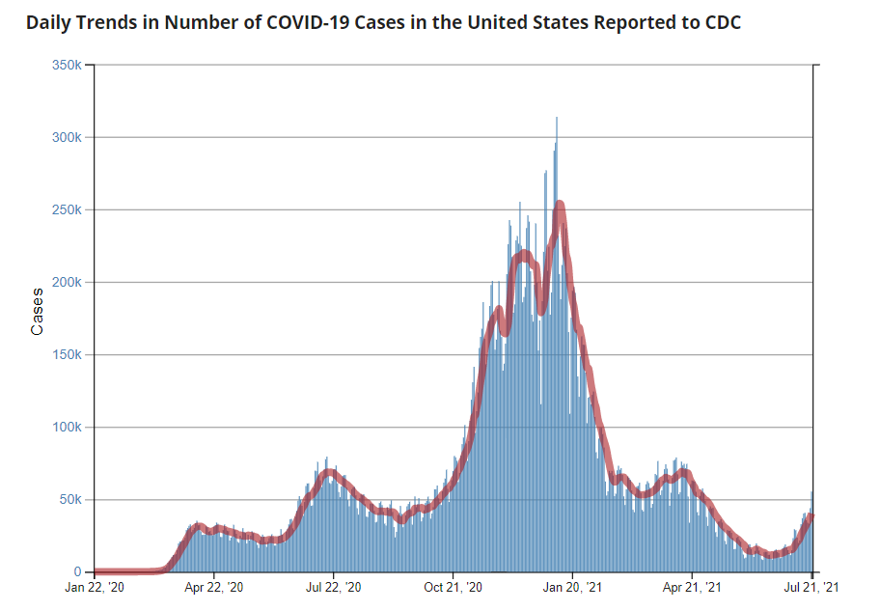
Number of Cases Reported in the USA, by Day
https://covid.cdc.gov/covid-data-tracker/#trends_dailytrendscases Updated 7/23/2021

Slide 7
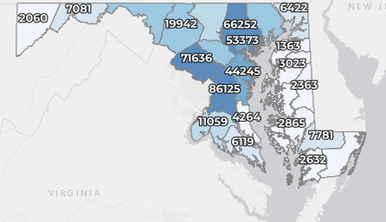
Maryland: COVID-19 Cases
http://health.maryland.gov/coronavirus
Data current as of 7/23/2021
Cases: 465,326
  288 new
Deaths: 9,582
  3 new
Hospitalizations: 43,978
  Current: 163 (up 11)
Case rate: 3.5 per 100,000
Percent Positivity: 1.79%

Slide 8
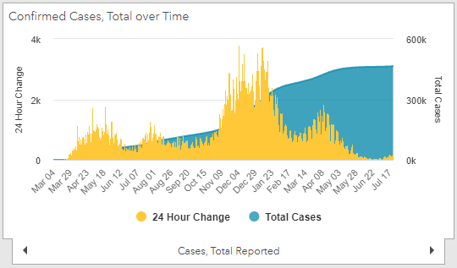
Maryland: COVID-19
Source: https://coronavirus.maryland.gov/, accessed 7/23/21

Slide 9
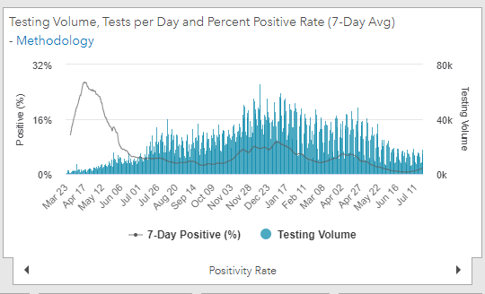
Maryland: COVID-19
Source: https://coronavirus.maryland.gov/, accessed 7/23/21

Slide 10
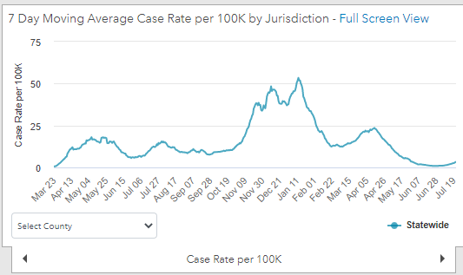
Maryland: COVID-19
7/23/21: 3.5 per 100k
Low: 6/24/21 at 0.90 per 100K
High: 1/12/21 at 53.39 per 100k
Source: https://coronavirus.maryland.gov/, accessed 7/23/21

Slide 11
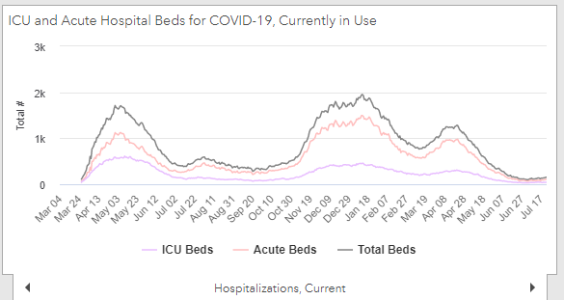
Maryland: COVID-19
Source: https://coronavirus.maryland.gov/, accessed 7/23/21

Slide 12
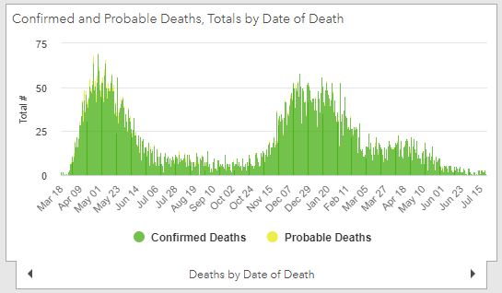
Maryland: COVID-19
Source: https://coronavirus.maryland.gov/, accessed 7/23/21

Slide 13
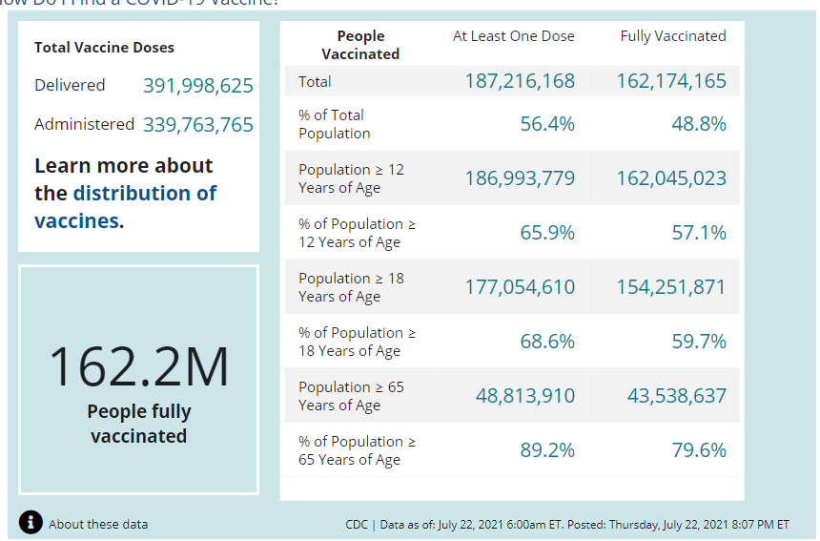
US: COVID-19 Vaccinations
Source: https://covid.cdc.gov/covid-data-tracker/#vaccinations accessed 7/23/21

Slide 14
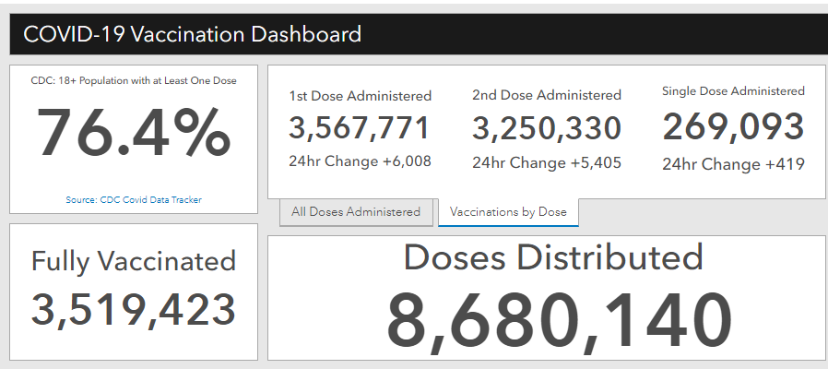
Maryland Vaccine Dashboard
https://coronavirus.maryland.gov/#Vaccine accessed 7/23/2021

Slide 15
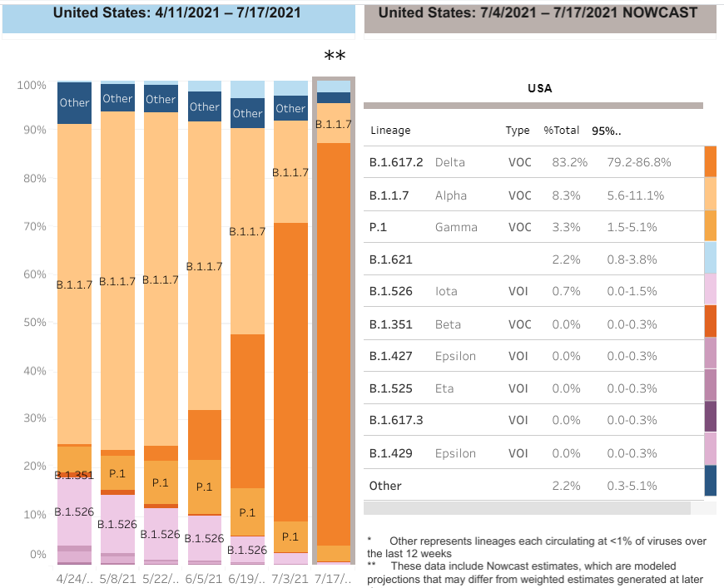

US: Delta Variant
https://covid.cdc.gov/covid-data-tracker/#variant-proportions Accessed 7/23/21
61.7%
as of 7/3/21
83.2% as of 7/17/21

Slide 16
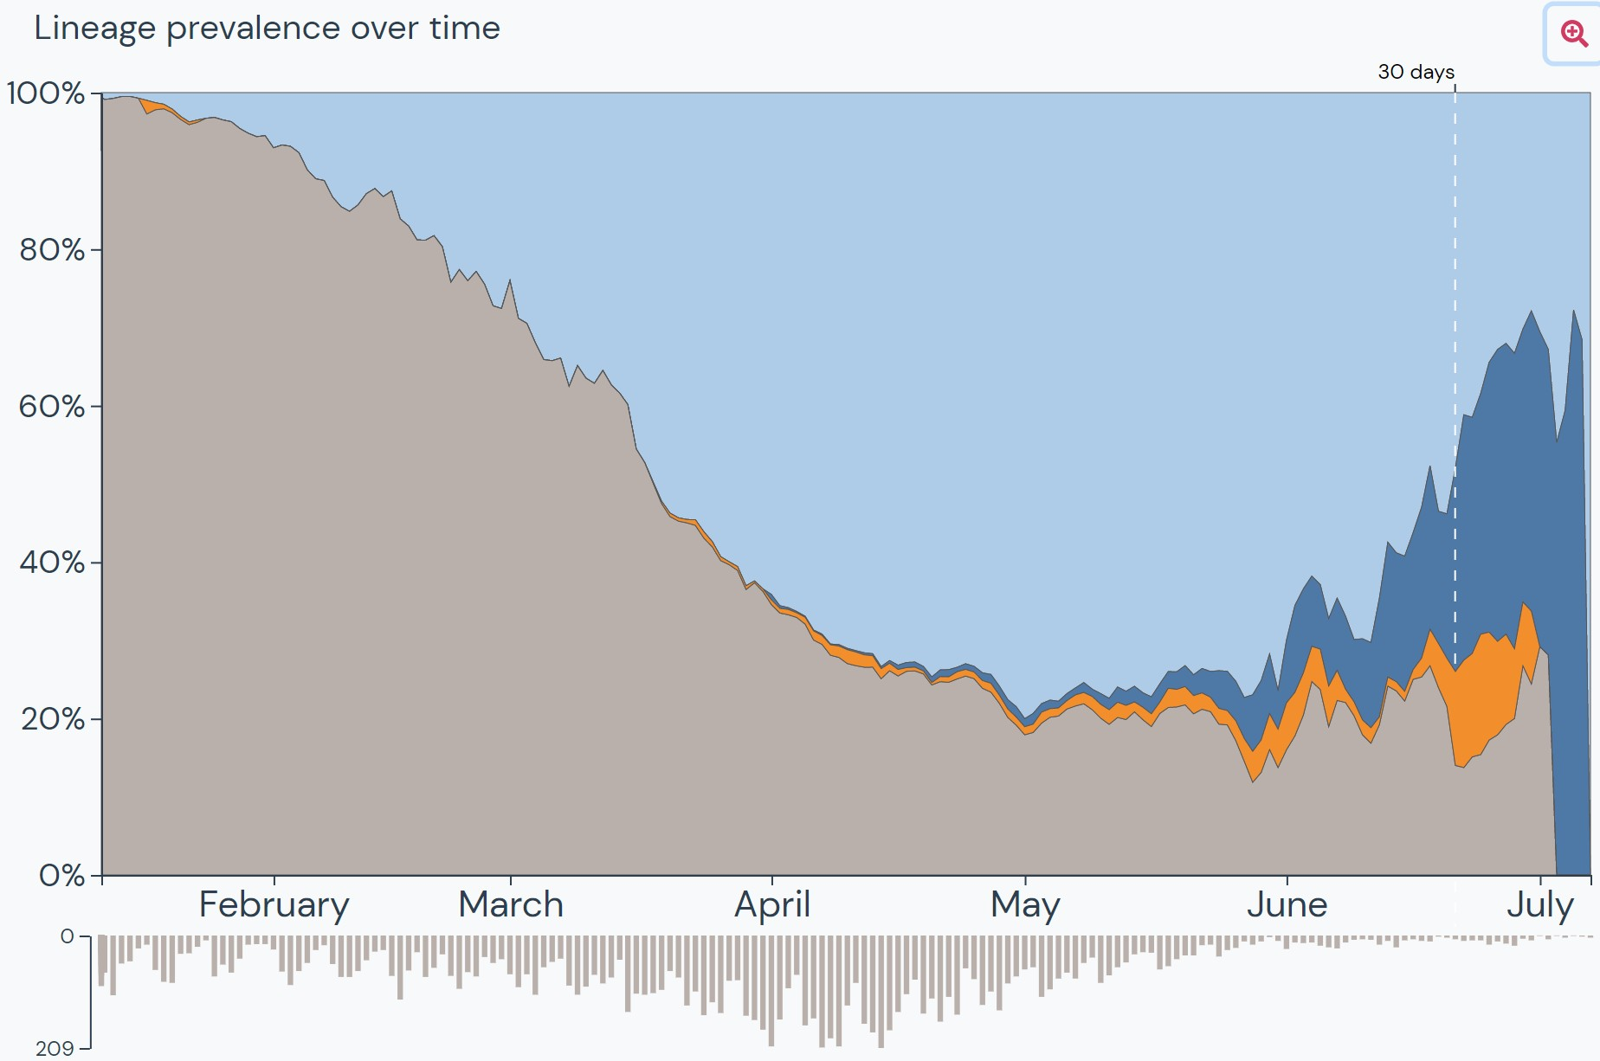
US: Delta Variant
https://outbreak.info/location-reports?loc=USA_US-MD accessed 7/20/21

Slide 17
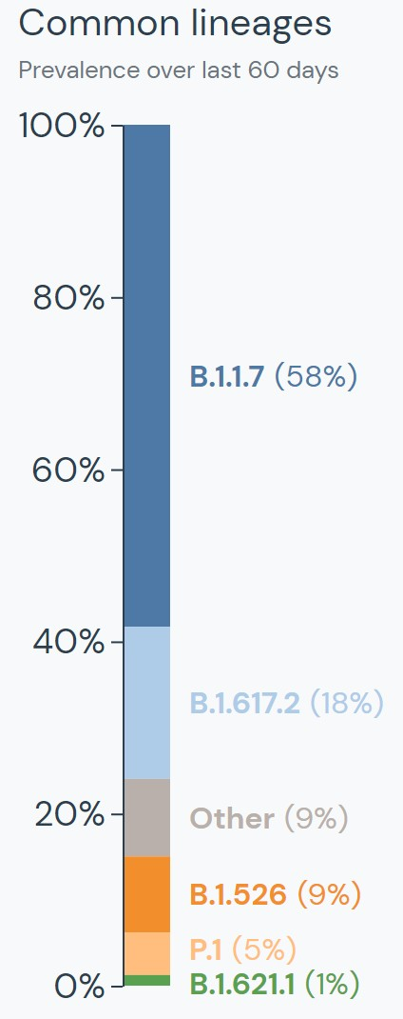
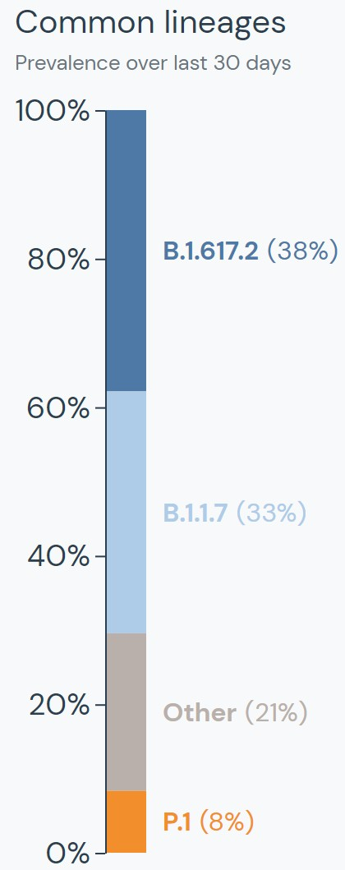
Maryland: Delta Variant
25
https://outbreak.info/location-reports?loc=USA_US-MD accessed 7/20/21

Slide 18
FDA Johnson & Johnson Factsheets Updated
Released July 8, 2021
On July 8, the FDA and CDC updated the Johnson and Johnson EUA Fact Sheets for Healthcare Providers and Fact Sheets for Vaccine Recipients to include the warning for risk of developing the nervous system disorder, Guillain-Barré syndrome (GBS).
31

Slide 19
FDA J&J Warning –EUA Fact Sheet for Vaccine Recipients
Guillain Barré syndrome (a neurological disorder in which
the body’s immune system damages nerve cells, causing muscle weakness and sometimes paralysis) has occurred in some people who have received the Janssen COVID-19 Vaccine.
In most of these people, symptoms began within 42 days following receipt of the Janssen COVID-19 Vaccine.
The chance of having this occur is very low.
https://www.fda.gov/media/146305/download

Slide 20
FDA J&J Warning –EUA Fact Sheet for Vaccine Recipients
Recipients are advised to seek medical attention right away if they develop any of the following symptoms after receiving the Janssen COVID-19 Vaccine:
Weakness or tingling sensations, especially in the legs or arms
that is worsening and spreading to other parts of the body
Difficulty walking
Difficulty with facial movements, including speaking, chewing, or
swallowing
Double vision or inability to move eyes
Difficulty with bladder control or bowel function
https://www.fda.gov/media/146305/download

Slide 21

Return to School Guidance- AAP
American Academy of Pediatrics (AAP) Updated Recommendations for Opening Schools in Fall 2021. Issued 7/19/21
Strongly recommends in-person learning
Urges all who are eligible to be vaccinated against COVID-19
Recommends everyone older than age 2 wear masks, regardless of vaccination status
“Combining layers of protection that include vaccinations, masking and clean hands will make in-person learning safe and possible for everyone.”- Sonja O’Leary, MD, FAAP, chair of the AAP Council on School Health
https://services.aap.org/en/news-room/news-releases/aap/2021/american-academy- of-pediatrics-updates-recommendations-for-opening-schools-in-fall-2021/

Slide 22
Respiratory Syncytial Virus
Common childhood illness
Annual outbreaks in all ages
Most often seen in fall, winter and spring
One of many viruses that causes the common cold
May also cause pneumonia and lower respiratory disease in infants and young children, and may lead to hospitalization
https://www.cdc.gov/rsv/clinical/index.html

Slide 23
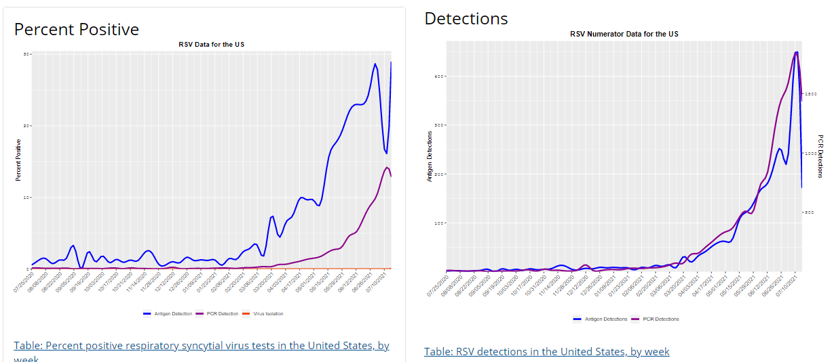
https://www.cdc.gov/surveillance/nrevss/rsv/natl-trend.html

Slide 24
2020 – 2021 season
October 2020 – May 2021 = 28 cases
  17 children / 11 adults
  4 ICU admissions, 2 pregnant women
June 2021 – Present = 76 cases
  61 children / 15 adults
  13 ICU admissions , 3 pregnant women
No deaths reported during Oct – May season or during summer months

Slide 25
Questions?
mdh.ipcovid@maryland.gov

