Slide 1
Maryland Situation Update on
Coronavirus Disease (COVID-19) for BHA
Maryland Department of Health
Infectious Disease Epidemiology and Outbreak Response Bureau
July 10, 2020

Slide 2
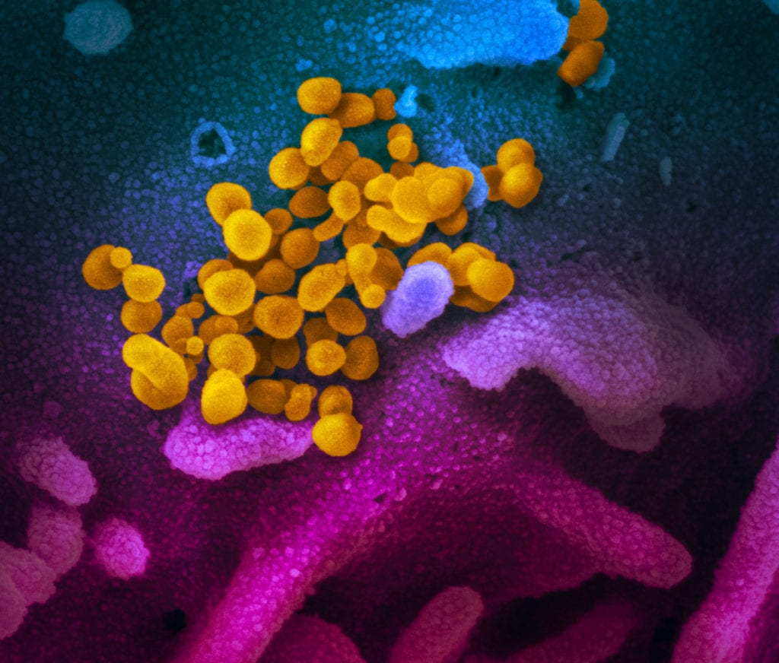
Call Agenda
Picture Courtesy of NIAID-RML
Contact Tracing
Review current situation of COVID-19
Questions and Answers

Slide 3
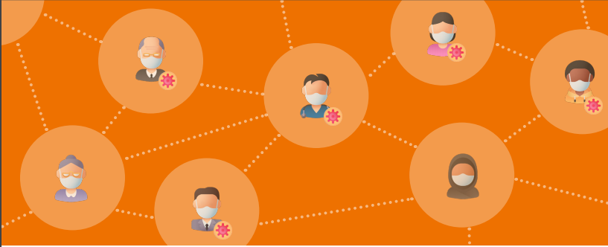
Contact Tracing
Katherine Feldman, DVM, MPH
Chief Public Health Scientist

Slide 4

What is Contact Tracing?
Contact tracing involves identifying people who have an infectious disease (cases) and people with whom they came in contact (contacts)
To prevent further spread of disease
  Cases are asked to isolate at home, and
  Contacts are asked to stay home and monitor themselves for signs and symptoms of COVID-19
Notes:
and working with them to interrupt disease spread. This includes asking people with COVID-19 to isolate and their contacts to quarantine at home voluntarily.
To prevent the further spread of disease, people who had contact with someone with COVID-19 are encouraged to stay home and maintain social distance (at least 6 feet) from others until 14 days after their last exposure to a person with COVID-19. Contacts should monitor themselves by checking their temperature twice daily and watching for symptoms of COVID-19.

Slide 5
Contact Tracing – An Essential Tool
An essential public health tool used for decades by public health practitioners to slow or stop the spread of infectious disease
  Sexually transmitted infections
  Ebola in Africa
Effective use of contact tracing is a critical step in decreasing the number of COVID-19 cases

Slide 6
Contact Tracing Involves
Interviewing people with COVID-19 to identify everyone they had close contact with during the time they may have been infectious
Notifying contacts of their potential exposure
Referring contacts for testing
Monitoring contacts for signs and symptoms of COVID-19
Connecting contacts with services they might need during the self-quarantine period

Slide 7
Isolation and Quarantine
Individuals monitored by text, secure web survey or telephone
Contacts referred for testing if symptoms develop
Cases released from isolation when meet recovery definition
  >10 days since symptom onset
  >3 days have passed since
    Resolution of fever without use of fever-reducing meds
    Improvement in COVID-19 symptoms

Slide 8
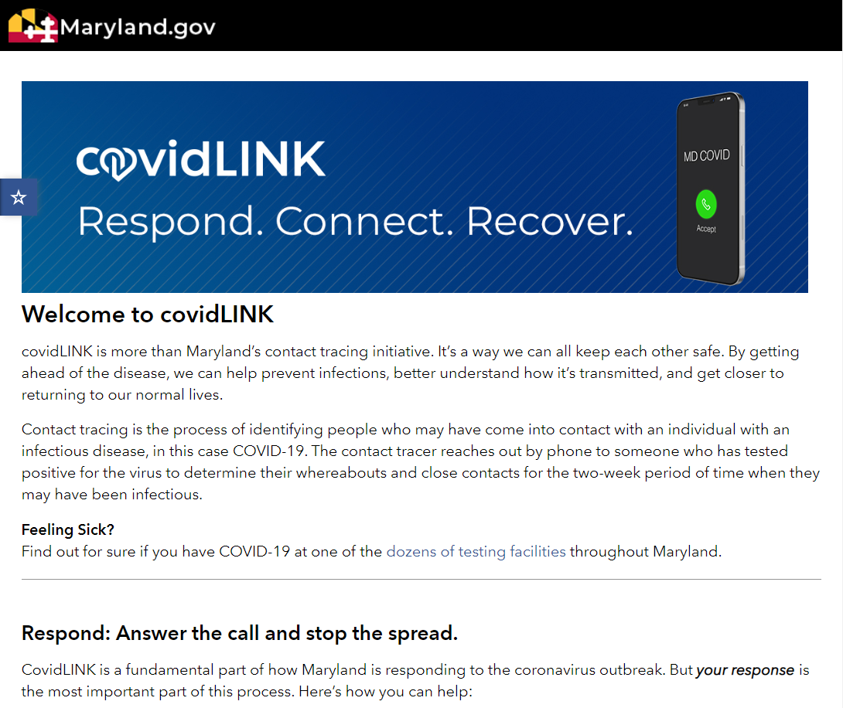

Slide 9
Contact Tracing in Maryland
Conducted by Maryland’s 24 local health departments and the National Opinion Research Center at the University of Chicago
1,350 contact tracers conduct interviews with cases and contacts
  Cases are asked about their health, whereabouts during incubation period (14 days before symptom onset) and infectious period (2 days before symptom onset until current time for cases) and close contacts
  Contacts are asked about their health, whereabouts
  For both cases and contacts, guidance provided for isolation/quarantine including access to resources

Slide 10
Automated
COVID-19
Contact
Tracing (CT)
Communications

Slide 12
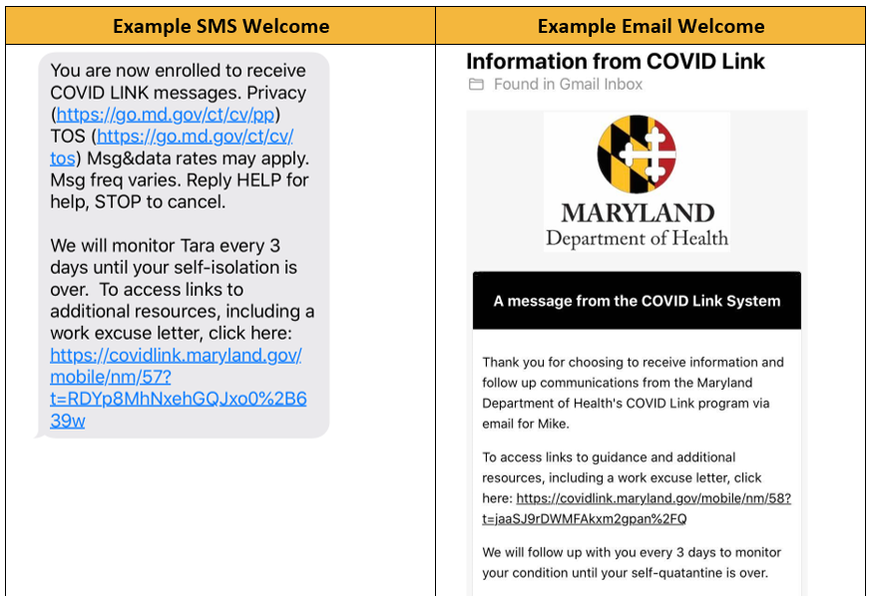

Slide 13
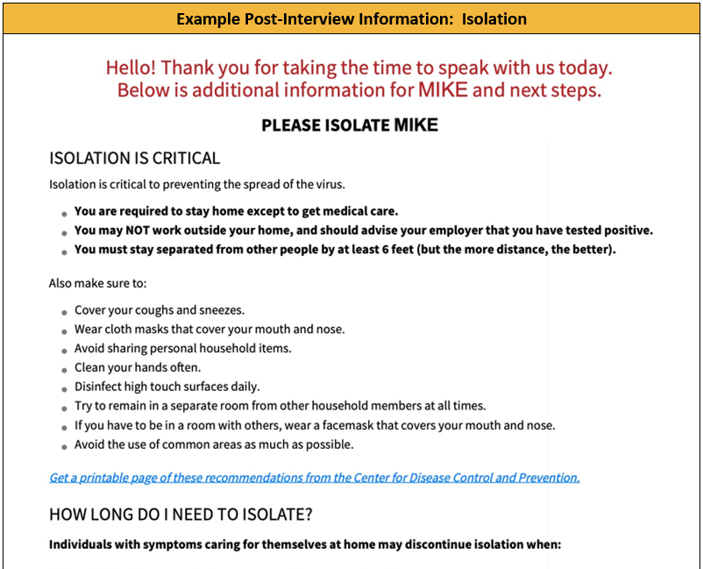

Slide 14
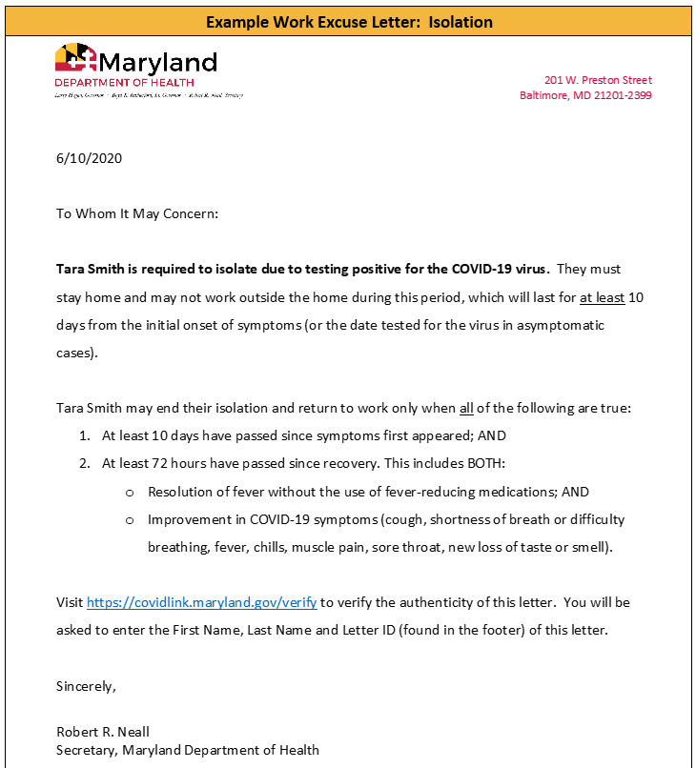
The authenticity of letters generated by the COVID Link system can be verified. Employers, schools, or other groups that need to verify that a Work Excuse or Work Clearance letter is authentic can go to https://covidlink.maryland.gov/verify to confirm the letter was generated by the system. They will need to enter the first name, last name, and letter ID printed on the letter.

Slide 16
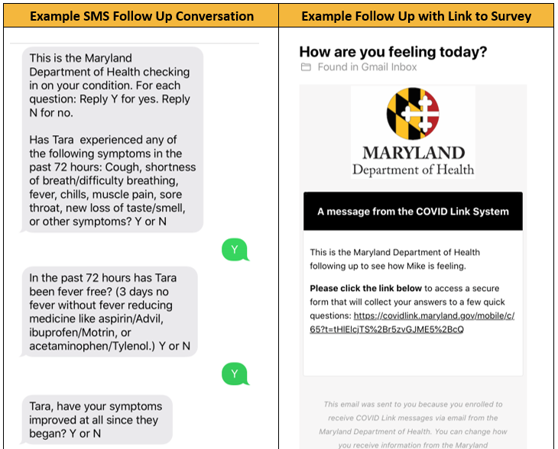

Slide 18
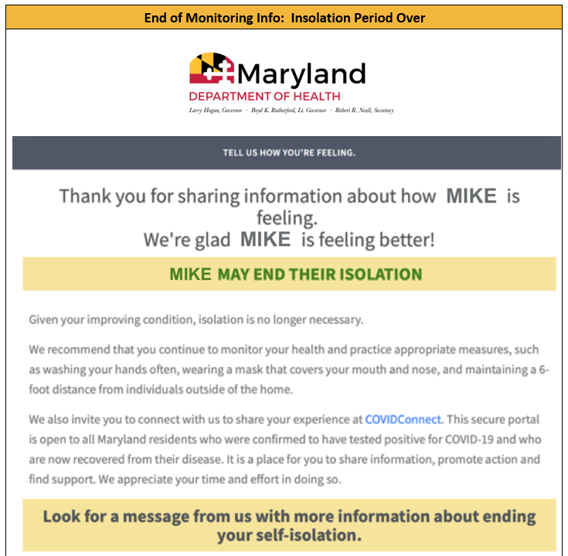

Slide 19
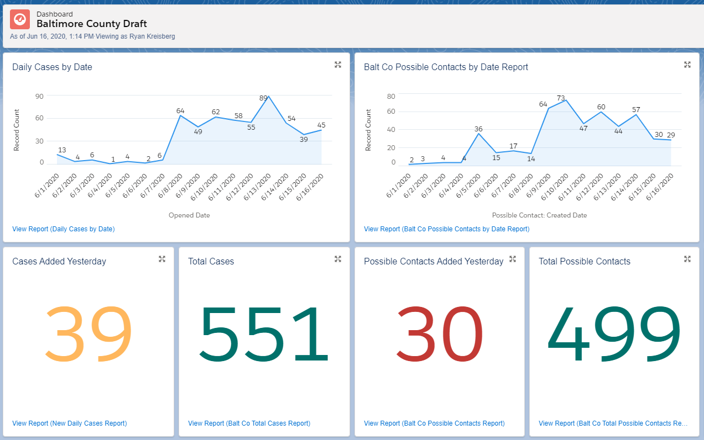
Contact Tracing Dashboard

Slide 20
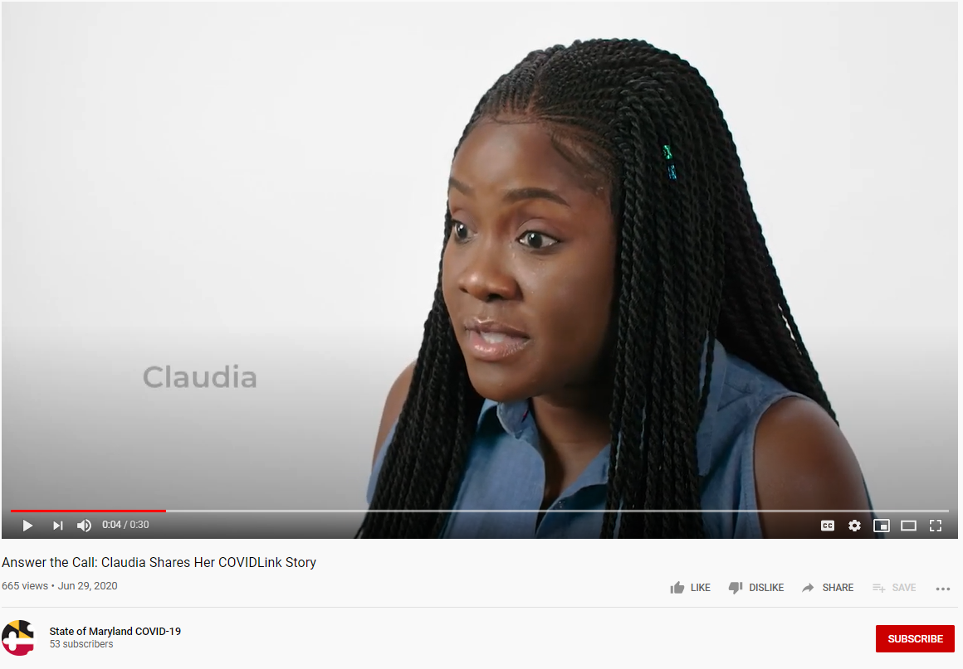

Slide 21
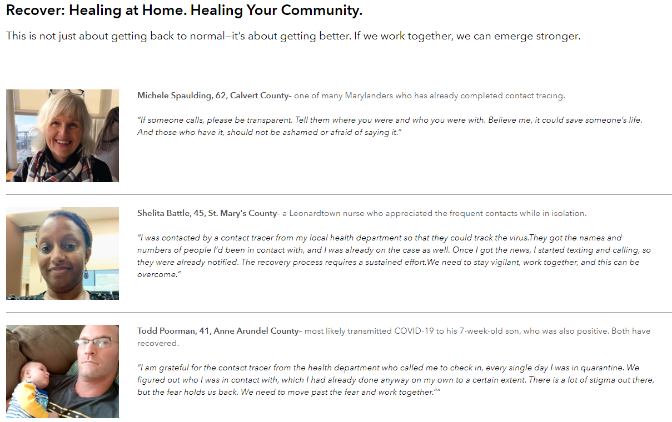

Slide 22
How Is Contact Tracing Going?
During June 15 - July 5
  7,242 cases entered into covidLINK
  4,084 cases completed interview
  Median time to interview: 18 hours
  8,693 contacts entered into covidLINK
  3,873 contacts completed interview
  Median time to interview: 16 hours

Slide 23
Resources
MDH Contact Tracing https://coronavirus.maryland.gov/pages/contact-tracing
CDC Contact Tracing https://www.cdc.gov/coronavirus/2019-ncov/php/open-america/contact-tracing-resources.html
Johns Hopkins Contact Tracing resources, including a free course https://coronavirus.jhu.edu/contact-tracing
ASTHO training https://www.astho.org/COVID-19/Contact-Tracing-and-Disease-Intervention/

Slide 24
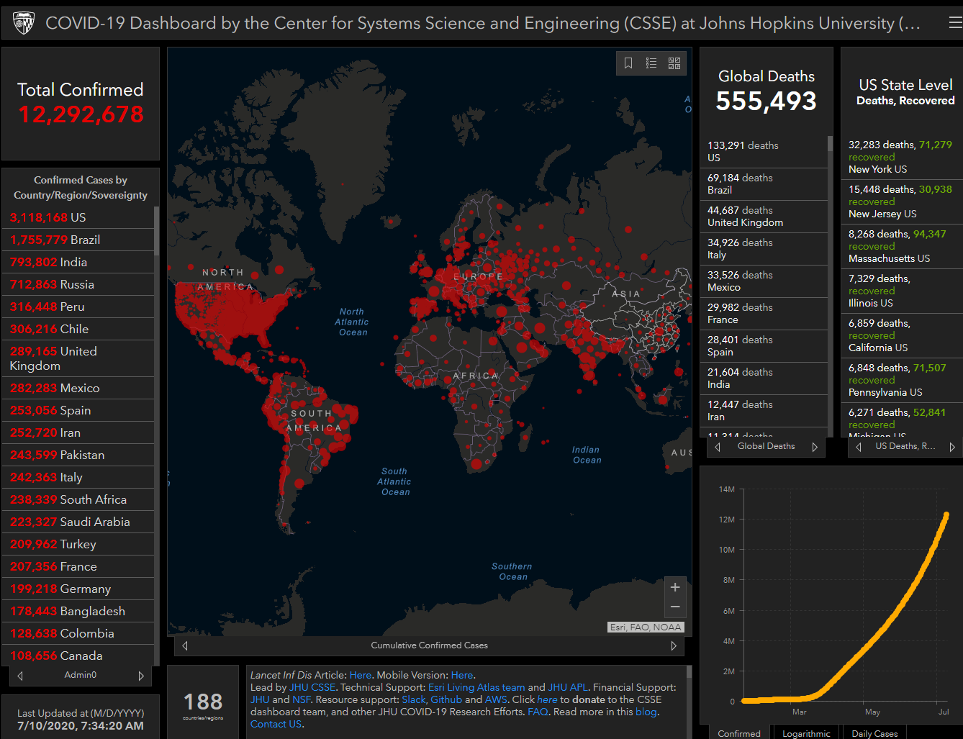
COVID-19 Global Situation Summary
Notes:
Over 1 million new cases this week

Slide 25
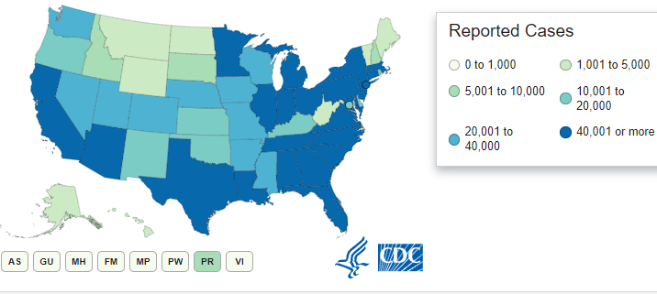
U.S.: COVID-19 Cases
3,047,671 Confirmed Cases
  64,771 new
132,056 total deaths
  991new
US states and territories with no cases:
  American Samoa
  Marshall Islands
  Micronesia
  Palau
Source: www.cdc.gov, accessed July 10, 2020
Notes:
2155572 last week

Slide 26
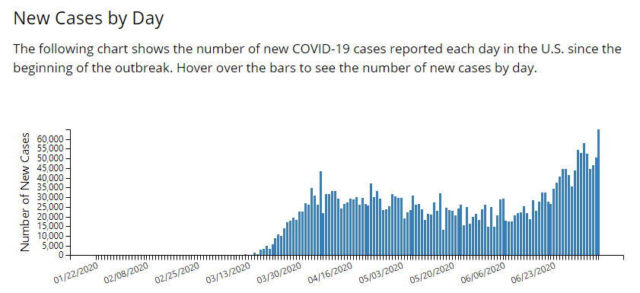

Slide 27
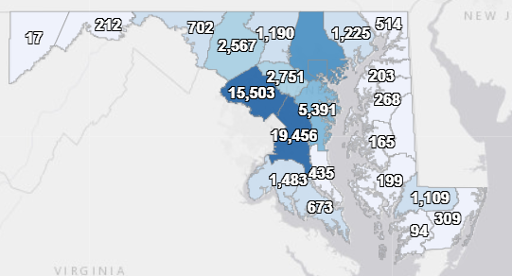
Maryland: COVID-19 Cases
http://health.maryland.gov/coronavirus
Data current as of 7/10/2020
Cases: 71,910
  463 new
Deaths: 3,172
  12 new
Hospitalizations: 10,725
  42 new
Total tests 613,513

Slide 28
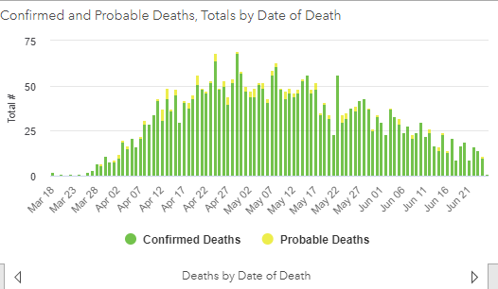

Slide 29
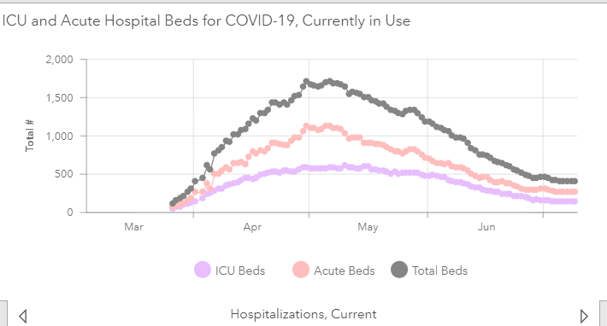

Slide 30
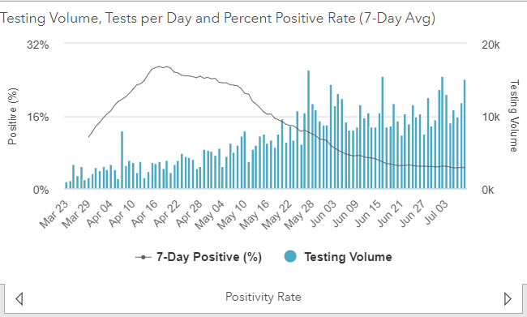
Testing Volume and % Positivity

Slide 31
MDH Updates

Slide 32
Amended Directive and Order Regarding Various Healthcare Matters (July 1)
Healthcare providers shall order a COVID-19 test for any individual who believes it necessary, regardless of symptoms.
https://coronavirus.maryland.gov/pages/cdc-resources

Slide 33
Amended Directive and Order Regarding Various Healthcare Matters (July 1)
Any individual who is in one of the following categories should contact their healthcare provider to arrange to be tested:
i. Any symptomatic individual; and
ii. Asymptomatic individuals where COVID-19 exposure may be possible, including:
  a. Contacts of confirmed COVID-19 cases
  b. Residents and staff of congregate living settings and long-term care facilities
  c. Healthcare workers and first responders
  d. Patients, especially high-risk unstable patients, whose care would be altered by a diagnosis of COVID-19;
  e. Individuals employed in close contact settings
  f. Individuals previously in a large gathering
iii. Individuals who have traveled to or returned to Maryland from out-of-state travel.
https://coronavirus.maryland.gov/pages/cdc-resources

Slide 34
CDC Updates

Slide 35
CDC Resources (NEW)
Visiting Beaches and Pools
https://www.cdc.gov/coronavirus/2019-ncov/daily-life-coping/beaches-pools.html
Playing Youth Sports
https://www.cdc.gov/coronavirus/2019-ncov/daily-life-coping/youth-sports.html
Sick Parents and Caregivers
https://www.cdc.gov/coronavirus/2019-ncov/if-you-are-sick/parents-caregivers.html
Visiting friends and family with higher risk for severe illness (video)
https://www.youtube.com/watch?v=Nnxk5OGW8PA

Slide 36
CDC Interim Considerations (NEW)
Interim Considerations for Health Departments for SARS-CoV-2 Testing in Homeless Shelters and Encampments
https://www.cdc.gov/coronavirus/2019-ncov/community/homeless-shelters/testing.html
Interim Considerations for Institutions of Higher Education Administrators for SARS-CoV-2 Testing
https://www.cdc.gov/coronavirus/2019-ncov/community/colleges-universities/ihe-testing.html
Interim Considerations for K-12 School Administrators for SARS-CoV-2 Testing
https://www.cdc.gov/coronavirus/2019-ncov/community/schools-childcare/k-12-testing.html

Slide 37
Resources
MDH Novel Coronavirus: http://health.maryland.gov/coronavirus
MDH Laboratory Coronavirus: https://health.maryland.gov/laboratories/Pages/Novel-Coronavirus.aspx
COVID-19 People at risk https://www.cdc.gov/coronavirus/2019-ncov/specific-groups/high-risk-complications.html
CDC Guidance for Infection Control https://www.cdc.gov/coronavirus/2019-nCoV/infection-control.html
Behavioral Health https://www.cdc.gov/coronavirus/2019-ncov/hcp/infection-control-faq.html?CDC_AA_refVal=https%3A%2F%2Fwww.cdc.gov%2Fcoronavirus%2F2019-ncov%2Finfection-control%2Finfection-prevention-control-faq.html
Memory Care https://www.cdc.gov/coronavirus/2019-ncov/hcp/memory-care.html

Slide 38
Questions?
Email : mdh.ipcovid@Maryland.gov
https://www.cdc.gov/coronavirus/2019-ncov/hcp/guidance-risk-assesment-hcp.html

