Slide 1
Maryland Situation Update on Coronavirus Disease (COVID-19) for BHA
Maryland Department of Health
Infectious Disease Epidemiology and Outbreak Response Bureau
June 5, 2020

Slide 2
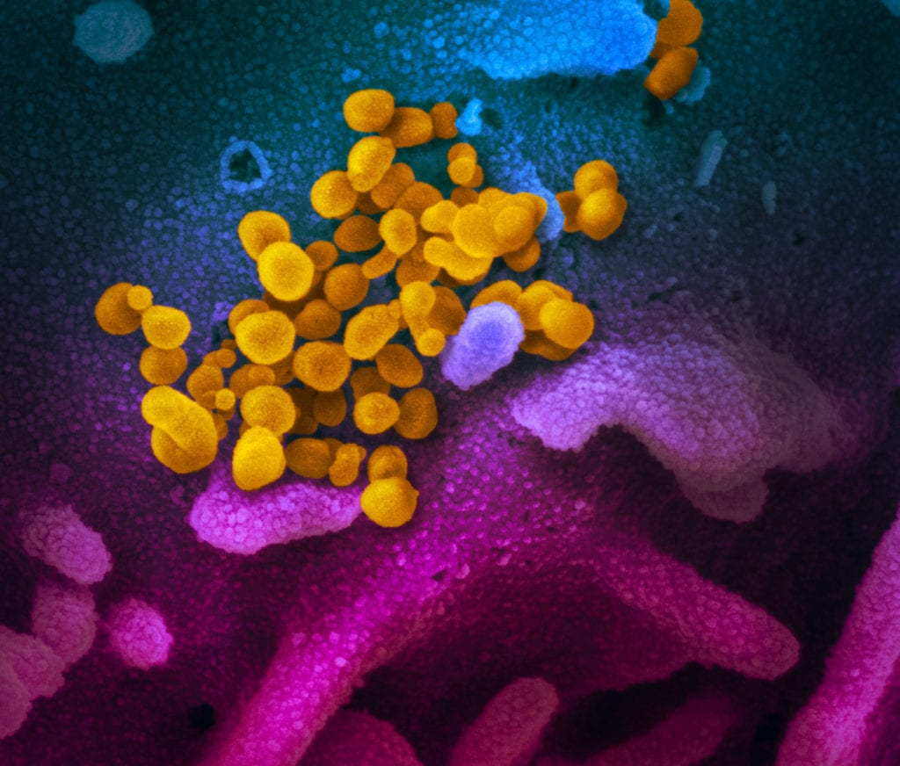
Call Agenda
Picture Courtesy of NIAID-RML
Review current situation of COVID-19
CDC Updates
Re-opening guidance
Questions and Answers

Slide 3

COVID-19 Global Situation Summary

Slide 4
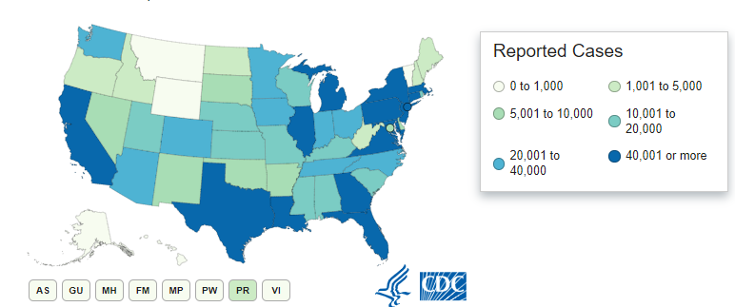
U.S.: COVID-19 Cases
1,842,101 Confirmed Cases
14,676 new
107,029 total deaths
827 new
55 states and territories reporting
Source: www.cdc.gov, accessed June 5, 2020

Slide 5
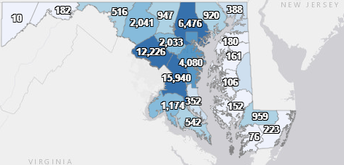
Maryland: COVID-19 Cases
http://health.maryland.gov/coronavirus
Data current as of 6/5/2020
Cases: 56,770
912 new
Deaths: 2,580
34 new
Hospitalizations: 9,346
129 new
Negative tests 405,414

Slide 6
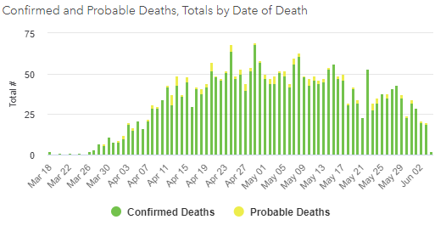

Slide 7
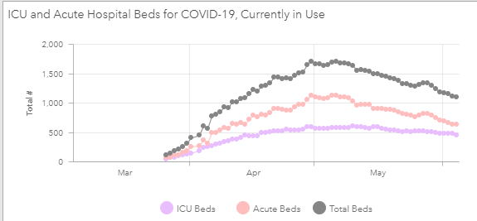

Slide 8
Safer Groups
Continue to physically distance- 6 or more feet between people
Limit group size 10 or fewer, or 50% room capacity based on fire codes, whichever is smaller
Find a larger room to meet, or meet outdoors (if possible with privacy concerns)
Masks are still important as source control for everyone
No singing, shouting, spitting, etc.
Screen group attendees prior to allowing them into the room- anyone with any should go home, and get tested

Slide 9

Service and Therapy Animals
Reports of some animals infected with COVID-19
Mostly dogs and cats ( and mink)
When possible, animals should stay 6 feet away from other people
If an animal gets sick, call a veterinarian, and don’t go into public
Avoid bringing service and therapy animals to places where humans are infected with COVID-19
Frequently clean and disinfect collars, service vests, leashes, harnesses, other supplies
Do not put a mask on animals
https://en.wikipedia.org/wiki/Mink
https://www.cdc.gov/coronavirus/2019-ncov/animals/service-therapy-animals.html

Slide 10
CMS Reopening Nursing Home Guidance

Slide 11
CMS- Reopening Nursing Homes
Applies to Medicare/Medicaid-certified long term care facilities
Allows for individualized reopening plans by facility, area (e.g. zip/county/region), or whole state
Encourages use of various factors at the levels of facility, community, and state
https://www.cms.gov/files/document/nursing-home-reopening-recommendations-state-and-local-officials.pdf - Dated May 18, 2020

Slide 12
CMS Reopening Nursing Homes - Metrics
Case status in community
Decreasing cases, hospitalizations, deaths
Case status in the nursing home(s)
Absence of any new nursing home–onset cases (resident or staff)*
Adequate staffing
No staffing shortages and not under a contingency staffing plan
*Excludes cases among newly admitted residents w/ COVID-19 or who become COVID-19–positive in first 14 days after admission. But if a resident (or staff??) contracts COVID-19 w/in the NH w/o prior hospitalization w/in the last 14 days, facility should “go back to the highest level of mitigation and start the phases over.”

Slide 13
CMS Reopening Nursing Homes – Metrics (con.)
Universal source control
Residents and visitors (once allowed) – cloth face covering or facemask; restrict if unable/unwilling
Staff wear facemasks (cloth covering okay for administrative staff)
All should maintain social distancing and perform HH
Access to adequate PPE* for staff
Contingency capacity strategy is allowable
Crisis capacity strategy is NOT allowable
Local hospital capacity – hospitals can accept transfers from NHs
*https://www.cdc.gov/coronavirus/2019-ncov/hcp/ppe-strategy/index.html
Notes:
Crisis capacity examples that would NOT be allowed:
- Re-use of cloth isolation gowns without laundering between patients, including for the care of multiple patients with suspected or confirmed COVID-19
- Extended use of isolation gowns, i.e. when the same gown is worn by the same HCP when interacting with more than one patient known to be infected with the same infectious disease when these patients are housed in the same location
- Use of facemasks beyond the manufacturer-designated shelf life
- Limited re-use of facemasks, i.e. the practice of using the same facemask by one HCP for multiple encounters with different patients but removing it after each encounter
- Limited re-use of N95 respirators, i.e. the practice of using the same N95 by one HCP for multiple encounters with different patients but removing it after each encounter

Slide 14
Reopening Nursing Homes - Testing
Facility should have a testing plan in place
At a MINIMUM:
Capacity for all residents and staff (anyone in facility on ≥weekly basis) to receive single baseline test
Capacity for all residents to be tested upon identification of individual w/ COVID-19 sx or positive staff member
Capacity for weekly re-testing of all residents until all test negative
Capacity for weekly re-testing of all staff (may be adjusted by state/local leaders based on community rates)

Slide 15
Reopening Nursing Homes – Testing (con.)
At a MINIMUM (con.):
Written screening protocols for all staff (each shift), each resident (daily), and all persons entering facility
An arrangement with laboratories to process tests
Specifies need to detect SARS-CoV-2 via PCR w/ >95% sensitivity, >90% specificity w/in 48 hours
Specifies that antibody tests should not be used for dx
Procedure to address residents/staff that decline or are unable to be tested

Slide 16
Additional Guidance
Opening Up America Guidance for communities includes visitation guidance for “senior care facilities.” → refers to a broader set of facilities and not specific to CMS-certified LTCFs (nursing homes)
States should survey nursing homes that experienced a “significant” COVID-19 outbreak prior to reopening
NHs should remain in current state of highest mitigation while community is in Phase 1 of OUAA → should lag behind community by at least 14 days

Slide 17
Phase 1 - Reopening Nursing Homes
Visitation still prohibited except for compassionate care situations
Limited communal dining, e.g. for COVID-19–negative
Limited group activities w/ social distancing and use of facemasks in place
100% screening of all staff/residents still in place
Universal source control still in place
All staff tested weekly; all residents tested if new suspect or confirmed case ID’ed
Cohorting plan still in place

Slide 18
Phase 2 – Reopening Nursing Homes
Requires no new NH-onset cases in last 14 days, no staff shortages, adequate PPE and testing
Visitation still prohibited except for compassionate care situations
Allows limited entry of non-essential HCP/contractors
Limited group activities, including outings w/ no more than 10 people and social distancing, masking
Ongoing screening, testing, cohorting, universal source control as in Phase 1

Slide 19
Phase 3 – Reopening Nursing Homes
Requires no new NH-onset cases in last 28 days, no staff shortages, adequate testing and PPE
Visitation allowed with screening and enforced social distancing, HH, and source control
Group activities, including outings, allowed with “no more than the # of people where social distancing among residents can be maintained”
Volunteers allowed entry w/ screening, etc.
Continued screening, testing, cohorting, universal source control as in Phases 1-2

Slide 20
Additional Recommendations
NH should spend minimum of 14 days in each phase w/ no new cases before advancing to next phase
Re-emphasizes that facilities may be in various phases relative to one another and community and that facility STARTS OVER again if new NH-onset case ID’ed
States may choose to have a longer waiting period before relaxing restrictions for NHs that have had outbreaks, staffing issues, etc.

Slide 21
Reporting COVID-19 to Local Health Departments
Reminder: Nursing home, assisted living, group home, and residential treatment facilities must report one or more confirmed case of COVID-19 in a resident or staff member to their local health department.
All cases of COVID-19 identified through universal screening must be reported to the local health department.

Slide 22
Allowing Residents to Go Outside
Per OHCQ – Residents may go outside one at a time with their masks, while maintaining 6 feet of distance from others
Residents on observation or suspected or confirmed with COVID-19 must remain in their room with the door shut
At this time OHCQ is not aware of any guidance or regulations that prohibit this practice
MDH guidance is coming soon

Slide 23
Resources
MDH Novel Coronavirus: http://health.maryland.gov/coronavirus
MDH Laboratory Coronavirus: https://health.maryland.gov/laboratories/Pages/Novel-Coronavirus.aspx
COVID-19 People at risk https://www.cdc.gov/coronavirus/2019-ncov/specific-groups/high-risk-complications.html
CDC Guidance for Infection Control https://www.cdc.gov/coronavirus/2019-nCoV/infection-control.html
Behavioral Health https://www.cdc.gov/coronavirus/2019-ncov/hcp/infection-control-faq.html?CDC_AA_refVal=https%3A%2F%2Fwww.cdc.gov%2Fcoronavirus%2F2019-ncov%2Finfection-control%2Finfection-prevention-control-faq.html
Memory Care https://www.cdc.gov/coronavirus/2019-ncov/hcp/memory-care.html

Slide 24
Questions?
Email : mdh.ipcovid@Maryland.gov

