Slide 1
Maryland Situation Update on Coronavirus Disease (COVID-19) for BHA
Maryland Department of Health
Infectious Disease Epidemiology and Outbreak Response Bureau
June 4th, 2021

Slide 2
Call Agenda
Review current situation of COVID-19
https://covidlink.maryland.gov/content/vaccine/govax/

Slide 3
COVID-19 Global Situation Summary
https://covid19.who.int/ accessed 6/4/2021

Slide 4
Highest Case Count Last 7 Days
https://covid19.who.int/ accessed 6/4/2021

Slide 5
US Case Counts and Rates
https://www.cdc.gov/coronavirus/2019-ncov/cases-updates/cases-in-us.html Accessed 6/4/2021

Slide 6
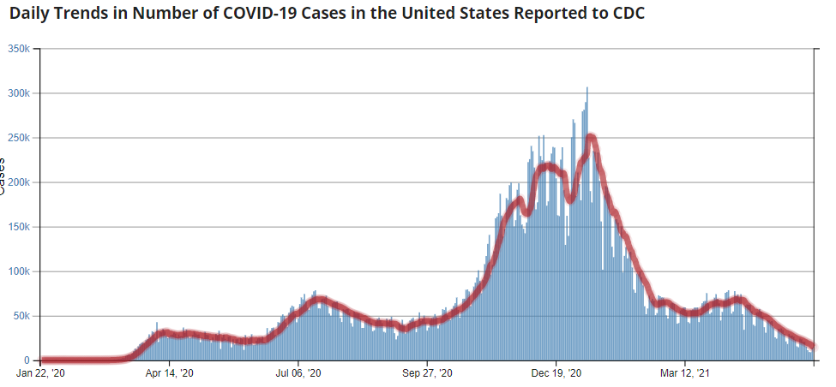
Number of Cases Reported in the USA, by Day
https://covid.cdc.gov/covid-data-tracker/#trends_dailytrendscases Updated 6/4/2021

Slide 7
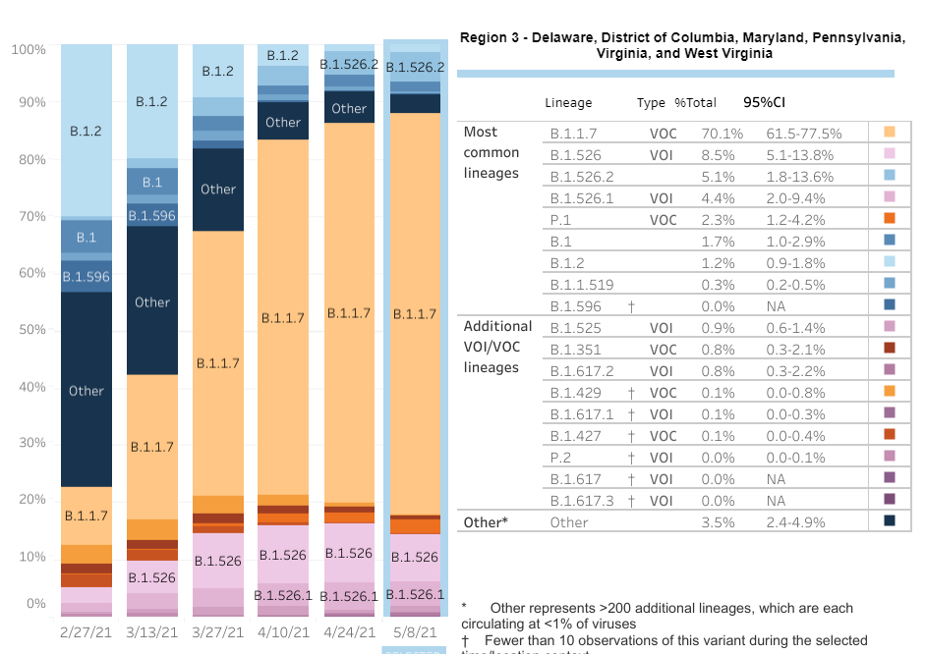
US: SARS-CoV-2 Variants
https://www.cdc.gov/coronavirus/2019-ncov/cases-updates/variant-proportions.html accessed 6/4/21

Slide 8
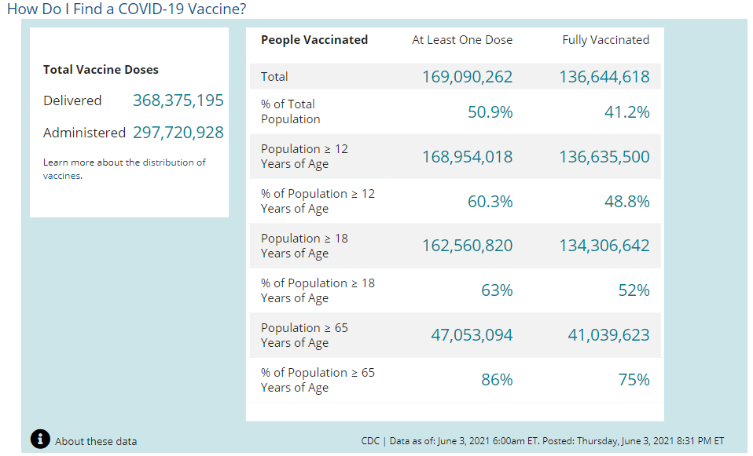
COVID-19 Vaccinations in the United States
https://covid.cdc.gov/covid-data-tracker/#vaccinations accessed 6/4/2021

Slide 9
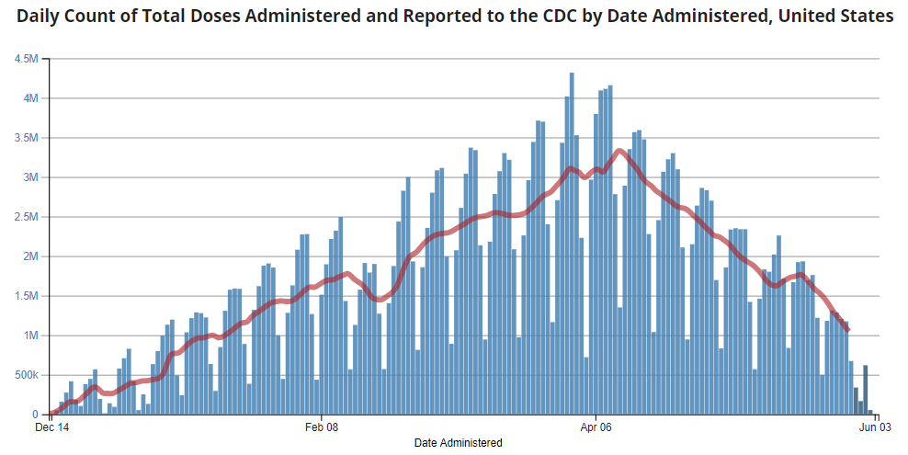
https://covid.cdc.gov/covid-data-tracker/#vaccination-demographics-trends 6/4/2021

Slide 10
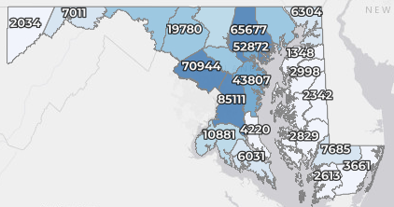
Maryland: COVID-19 Cases
http://health.maryland.gov/coronavirus
Data current as of 6/4/2021
Cases: 460,339
145 new
Deaths: 9,417
3 new
Hospitalizations: 43,373
Current: 318 (down 29)
Total tests: 10,468,298
Case rate: 2.4 per 100,000
Percent Positivity: 1.37%

Slide 11
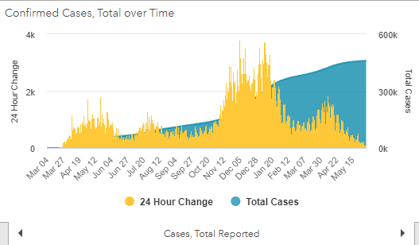
https://coronavirus.maryland.gov/ 6/4/2021

Slide 12
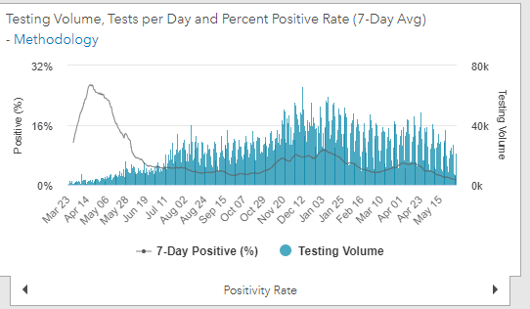
Testing Volume and % Positivity
https://coronavirus.maryland.gov/ 6/4/2021

Slide 13
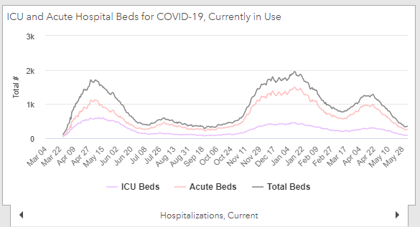
https://coronavirus.maryland.gov/ 6/4/2021

Slide 14
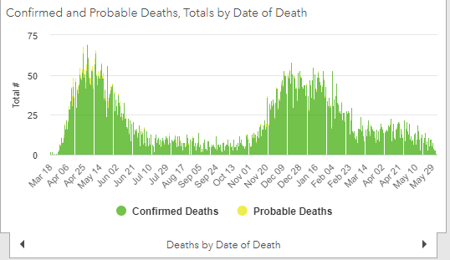
https://coronavirus.maryland.gov/ 6/4/2021

Slide 15
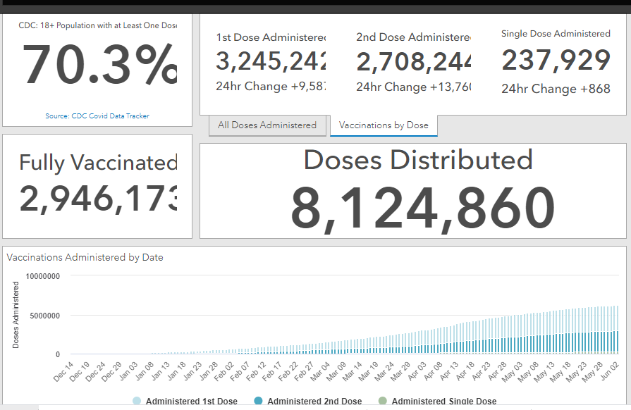
Maryland Vaccine Dashboard
https://coronavirus.maryland.gov/#Vaccine accessed 6/4/2021

Slide 16
Myocarditis and Pericarditis following mRNA COVID vaccination
Since April 2021, there have been increased reports to VAERS of cases of inflammation of the heart happening after mRNA COVID-19 vaccination
These reports are rare, given the number of vaccine doses administered
Cases reported to VAERS have occurred:
Mostly in male adolescents and young adults age 16 years or older
More often after getting the second dose of one of these two COVID-19 vaccines than after the first dose
Typically within several days after COVID-19 vaccination
Most patients who received care responded well to medicine and rest and quickly felt better
CDC and its partners are actively monitoring these reports, by reviewing data and medical records, to learn more about what happened and to see if there is any relationship to COVID-19 vaccination
https://www.cdc.gov/coronavirus/2019-ncov/vaccines/safety/myocarditis.html

Slide 17
Questions?
mdh.ipcovid@maryland.gov

