Slide 1
Maryland Situation Update on Coronavirus Disease (COVID-19) for BHA
Maryland Department of Health
Infectious Disease Epidemiology and Outbreak Response Bureau
June 26, 2020

Slide 2
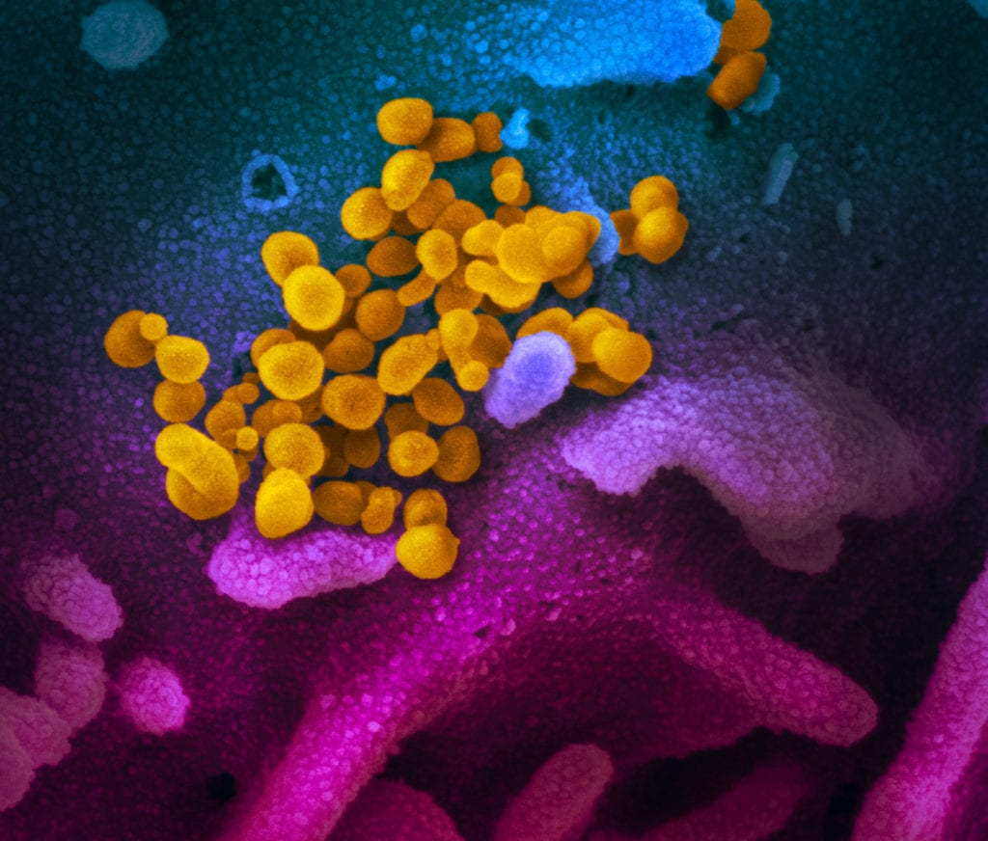
Call Agenda
Picture Courtesy of NIAID-RML
Review current situation of COVID-19
Re-opening guidance
Questions and Answers

Slide 3
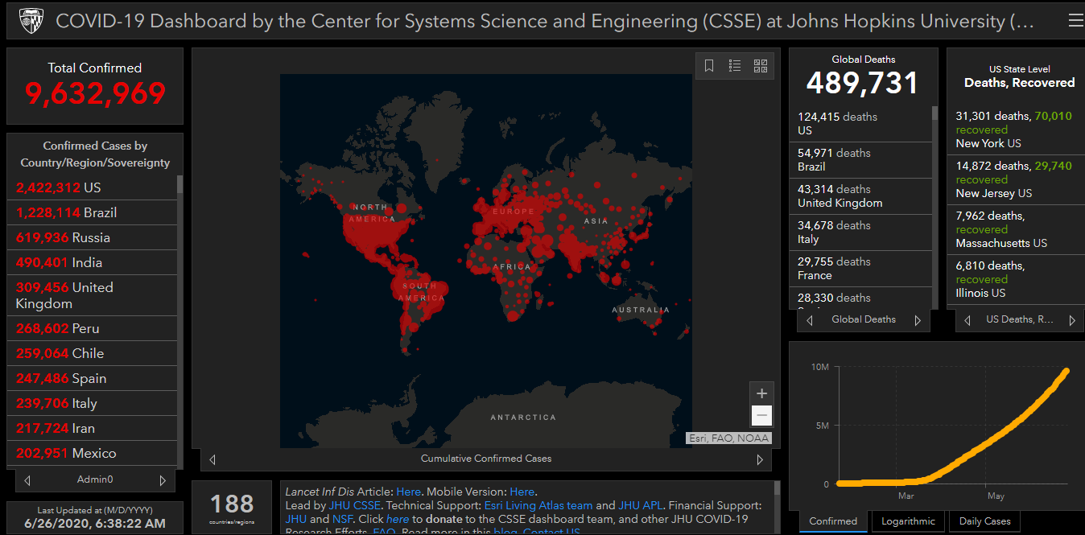
COVID-19 Global Situation Summary
Notes:
Over 1 million new cases this week

Slide 4
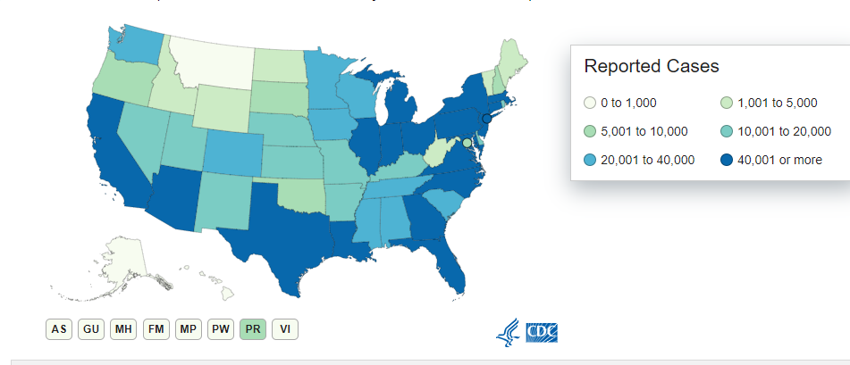
U.S.: COVID-19 Cases
2,374,282 Confirmed Cases
22,834 new
1212,809 total deaths
692 new
US states and territories with no cases:
American Samoa
Marshall Islands
Micronesia
Palau
Source: www.cdc.gov, accessed June 26, 2020
Notes:
2155572 last week

Slide 5
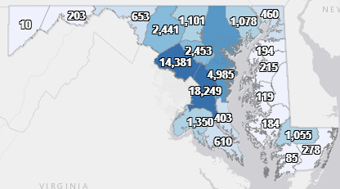
Maryland: COVID-19 Cases
http://health.maryland.gov/coronavirus
Data current as of 6/26/2020
Cases: 66,115
338 new
Deaths: 3015
14 new
Hospitalizations: 10,725
42 new
Total tests 613,513

Slide 6
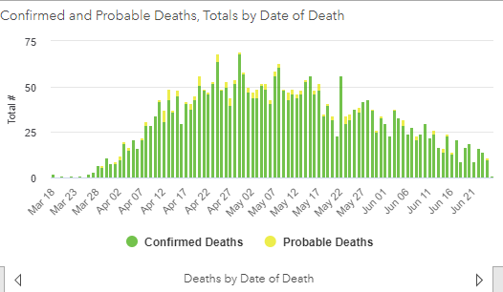

Slide 7
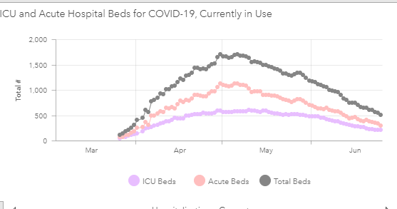

Slide 8
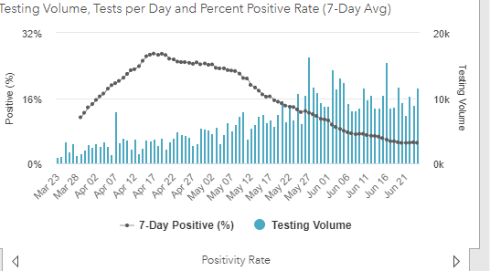
Testing Volume and % Positivity

Slide 9
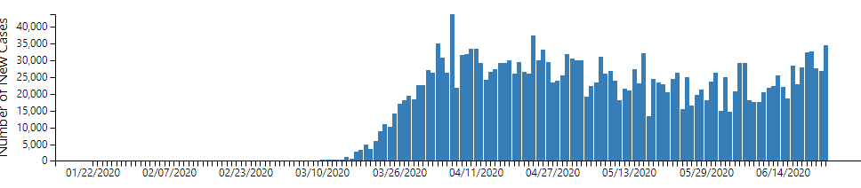
Why are cases going up again in other states?

Slide 10
How to stop transmission: short term
Prevent contact between infectious individuals and susceptible individuals
Physical distancing
Really good universal masking
Hand hygiene
Cover your cough
If the virus is still present, and there are still enough susceptible individuals transmission will resume when restrictions are lifted

Slide 11
How to stop transmission- longer lasting
Reduce the number of susceptible individuals
Effective vaccine that enough people get
Infection that leaves immunity, and enough of the population has been infected
Eliminate the virus
Smallpox
Unknown factors
SARS-1

Slide 12
Quarantine for travelers
Quarantine for out of state travelers is not a state mandate
Facility specific policies can vary

Slide 13
Limited size of gatherings
As per the Governor's executive order from 6/3
Gatherings larger than 10 persons prohibited
As per the Governor's executive order from 6/10
50% maximum occupancy at indoor gatherings are not prohibited
If necessary and reasonable, additional restrictions may be left in place

Slide 14
Signs and Symptoms
Fever or chills
Cough
Shortness of breath or difficulty breathing
Fatigue
Muscle or body aches
Headache
New loss of taste or smell
Sore throat
Congestion/runny nose
Nausea or vomiting
Diarrhea

Slide 15
Increased risk of severe outcomes
Chronic kidney disease
COPD (chronic obstructive pulmonary disease)
Immunocompromised state (weakened immune system) from solid organ transplant
Obesity (body mass index [BMI] of 30 or higher)
Serious heart conditions, such as heart failure, coronary artery disease, or cardiomyopathies
Sickle cell disease
Type 2 diabetes mellitus

Slide 16
Might increase risk for severe outcomes
Asthma (moderate-to-severe)
Cerebrovascular disease (affects blood vessels and blood supply to the brain)
Cystic fibrosis
Hypertension or high blood pressure
Immunocompromised state
Neurologic conditions, such as dementia
Liver disease
Pregnancy
Pulmonary fibrosis (having damaged or scarred lung tissues)
Smoking
Thalassemia (a type of blood disorder)
Type 1 diabetes mellitus

Slide 17
Resources
MDH Novel Coronavirus: http://health.maryland.gov/coronavirus
MDH Laboratory Coronavirus: https://health.maryland.gov/laboratories/Pages/Novel-Coronavirus.aspx
COVID-19 People at risk https://www.cdc.gov/coronavirus/2019-ncov/specific-groups/high-risk-complications.html
CDC Guidance for Infection Control https://www.cdc.gov/coronavirus/2019-nCoV/infection-control.html
Behavioral Health https://www.cdc.gov/coronavirus/2019-ncov/hcp/infection-control-faq.html?CDC_AA_refVal=https%3A%2F%2Fwww.cdc.gov%2Fcoronavirus%2F2019-ncov%2Finfection-control%2Finfection-prevention-control-faq.html
Memory Care https://www.cdc.gov/coronavirus/2019-ncov/hcp/memory-care.html

Slide 18
Questions?
Email : mdh.ipcovid@Maryland.gov
https://www.cdc.gov/coronavirus/2019-ncov/hcp/guidance-risk-assesment-hcp.html

