Slide 1
Maryland Situation Update on
Coronavirus Disease (COVID-19) for BHA
Maryland Department of Health
Infectious Disease Epidemiology and Outbreak Response Bureau
June 25th, 2021

Slide 2

Call Agenda
Epi summary
State and Federal Guidance Updates
Post-COVID Conditions
Q and A
https://covidlink.maryland.gov/content/vaccine/govax/

Slide 3
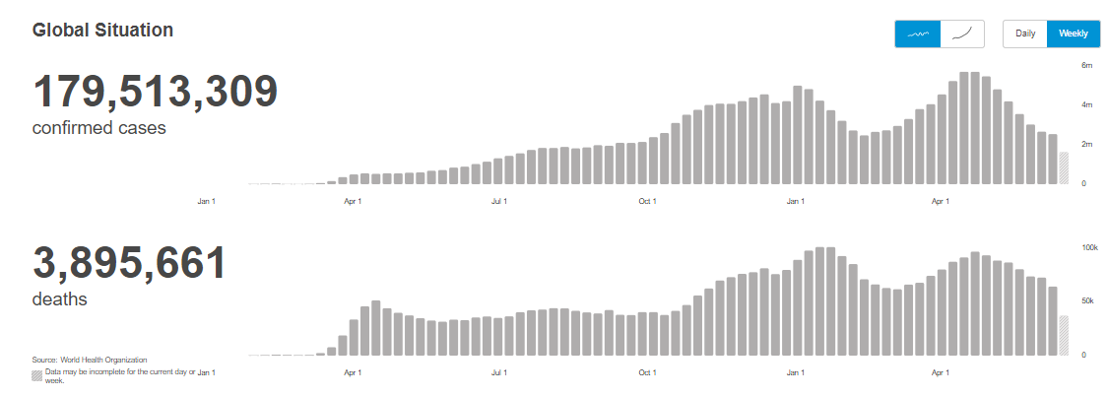
Worldwide: COVID-19
Source: https://covid19.who.int/ accessed 6/25/21

Slide 4
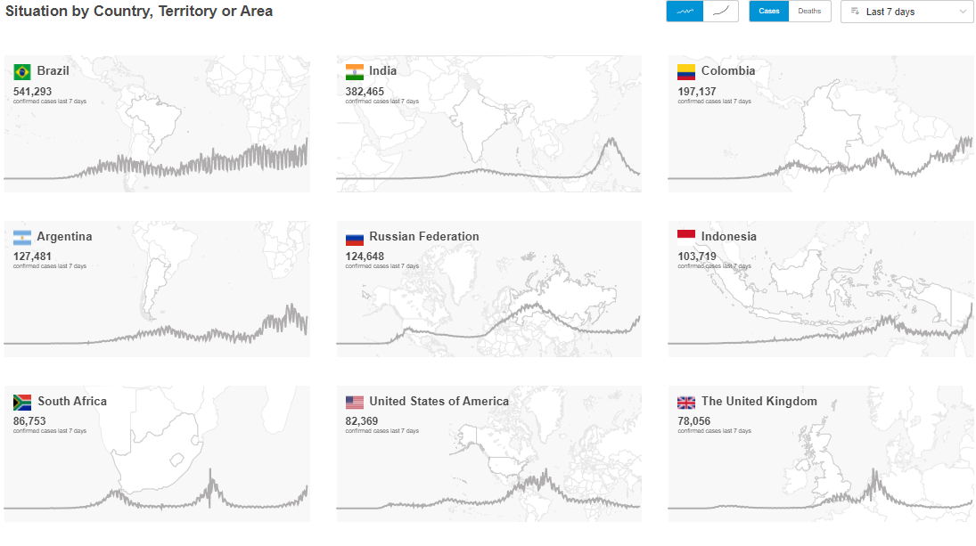
Worldwide: COVID-19
Source: https://covid19.who.int/ accessed 6/25/21

Slide 5
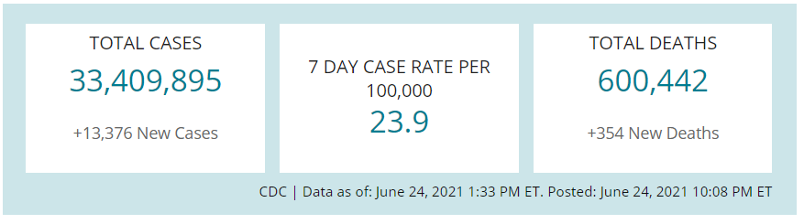
US Case Counts and Rates
https://www.cdc.gov/coronavirus/2019-ncov/cases-updates/cases-in-us.html Accessed 6/25/2021

Slide 6
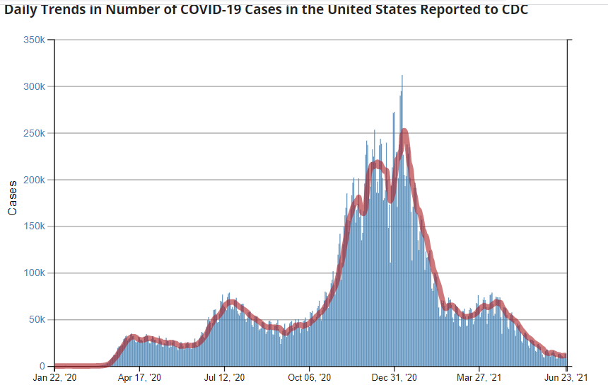
Number of Cases Reported in the USA, by Day
https://covid.cdc.gov/covid-data-tracker/#trends_dailytrendscases Updated 6/25/2021

Slide 7
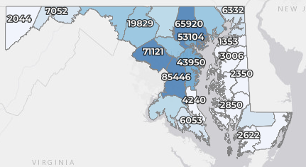
Maryland: COVID-19 Cases
http://health.maryland.gov/coronavirus
Data current as of 6/25/2021
Cases: 462,017
  64 new
Deaths: 9,513
  1 new
Hospitalizations: 43,662
  Current: 115 (down 4)
Total tests: 10,786,503
Case rate: 0.9 per 100,000
Percent Positivity: 0.45%

Slide 8
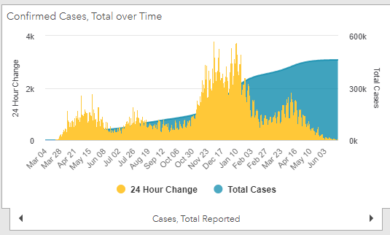
Maryland: COVID-19
Source: https://coronavirus.maryland.gov/, accessed 6/25/21

Slide 9
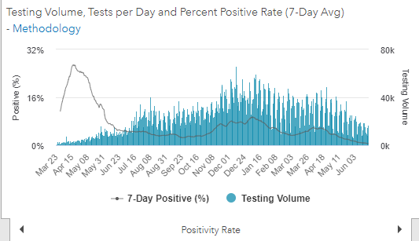
Maryland: COVID-19
Source: https://coronavirus.maryland.gov/, accessed 6/25/21

Slide 10
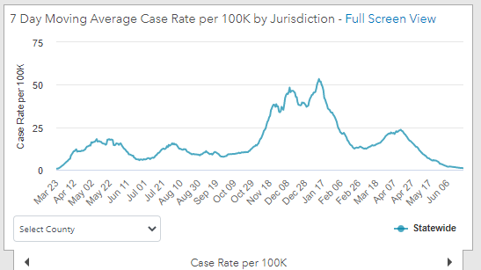
Maryland: COVID-19
6/24/21: 0.9 per 100k
High: 1/12/21 at 53.39 per 100k
Source: https://coronavirus.maryland.gov/, accessed 6/25/21

Slide 11
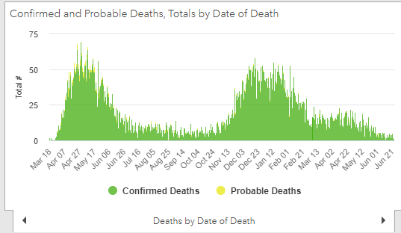
Maryland: COVID-19
Source: https://coronavirus.maryland.gov/, accessed 6/25/21

Slide 12
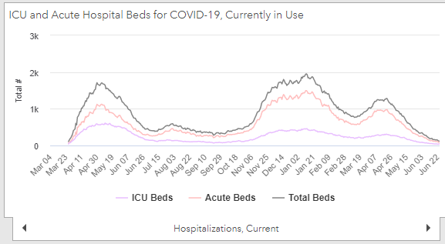
Maryland: COVID-19
Source: https://coronavirus.maryland.gov/, accessed 6/25/21

Slide 13
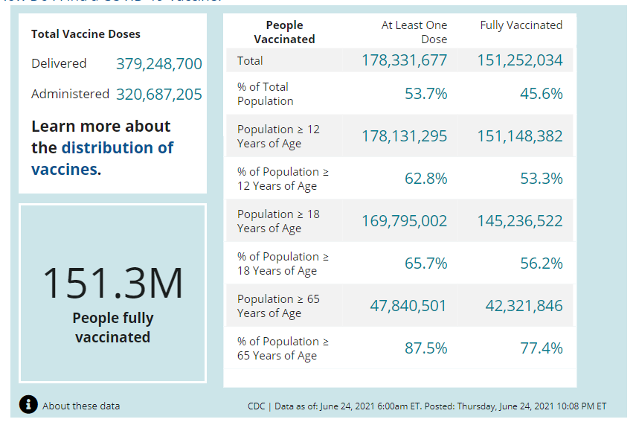
US: COVID-19 Vaccinations
Source: https://covid.cdc.gov/covid-data-tracker/#vaccinations accessed 6/25/21

Slide 14
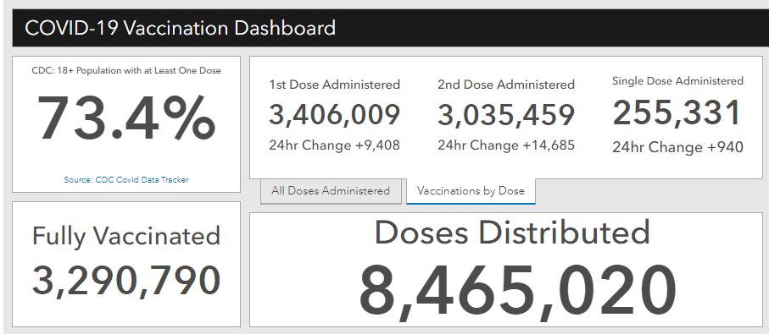
Maryland Vaccine Dashboard
https://coronavirus.maryland.gov/#Vaccine accessed 6/25/2021

Slide 15
Guidance Updates
Current as of 6/25/21

Slide 16
Governor’s Executive Orders
Maryland
1. No. 21-06-15-01 TERMINATING VARIOUS EMERGENCY ORDERS
  Effective July 1, 2021, certain orders will end including the order mandating the wearing of face coverings
  Effective Aug 15, 2021, certain other orders will end
2. No. 21-06-15-02 AUTHORIZING SUSPENSION OF CERTAIN LEGAL TIME REQUIREMENTS BY THE COMPTROLLER OF MARYLAND
  Effective Aug 15, 2021, authority of the Comptroller to extend certain timelines ends
3. No. 21-06-15-03 DELAYING EXPIRATION OF NURSING LICENSES
  Expiration dates for all licenses, permits, and registrations issued by the Board of Nursing will extend to August 15, 202
https://governor.maryland.gov/covid-19-pandemic-orders-and-guidance/

Slide 17
Updated MDH Orders
Maryland
1. MDH No. 2021-06-15-01 Directive and Order Regulating Certain Businesses and Facilities & General Directives Concerning Limiting The Spread of COVID-19
  Effective July 1, 2021, certain MDH orders will terminate including the order pertaining to face coverings
  Effective August 15, 2021, existing COVID-19 MDH orders, guidance documents, and bulletins will terminate
  Effective December 31, 2021, certain MDH orders will terminate, including the Healthcare Matters order, the Nursing Home Matters order, and the Vaccination Matters order
https://coronavirus.maryland.gov/pages/cdc-resources

Slide 18
MDH Orders
Maryland
2. MDH No. 2021-06-15-02 Amended…Vaccination Matters
  Continues requirement that each COVID-19 vaccine administered be reported within 24 hours of administration
3. MDH No. 2021-06-15-03 Amended…Healthcare Matters
  Continues provision to authorize local health officers to order quarantine and isolation of certain individuals
  Extends certain patient transfer items
4. MDH No. 2021-06-15-04 Amended…Nursing Home Matters
  Adds provision that skilled nursing facilities register in ImmuNet as a COVID-19 provider by July 15, 2021
https://coronavirus.maryland.gov/pages/cdc-resources

Slide 19
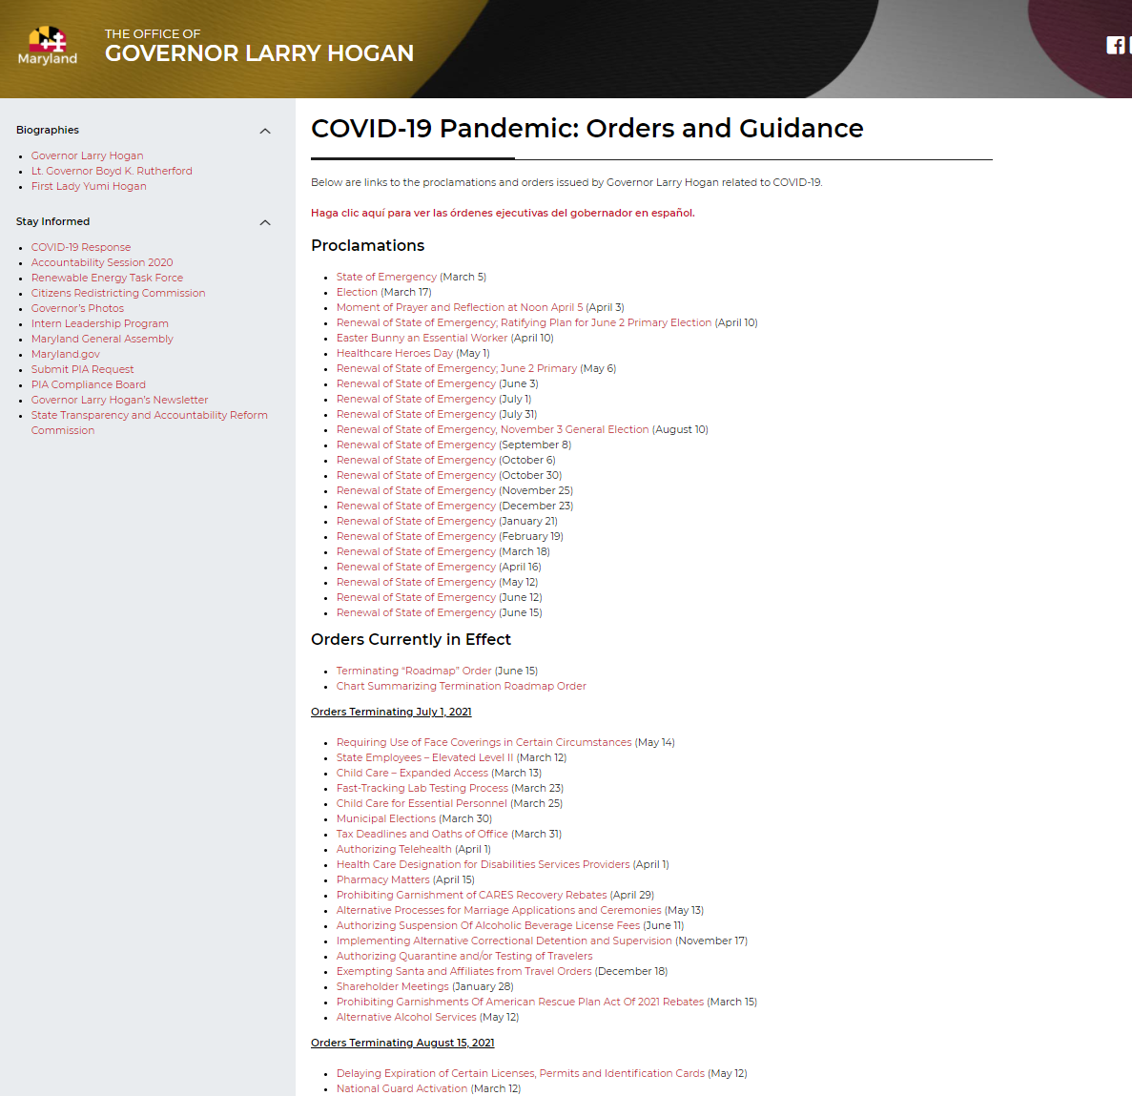
State COVID-19 Orders Terminating
Maryland
Full list of orders terminating on July 1st and August 15th can be found here:
https://governor.maryland.gov/covid-19-pandemic-orders-and-guidance/

Slide 20
Occupational Health and Safety Administration (OSHA) Healthcare Emergency Temporary Standard (ETS)
Federal
OSHA has determined that employee exposure to SARS-CoV-2, the virus that causes COVID-19, presents a grave danger to workers in healthcare settings where people with suspected or confirmed COVID-19 are reasonably expected to be present
Follow up with your facility’s legal team about how this applies to your setting
https://www.osha.gov/sites/default/files/publications/OSHA4122.pdf

Slide 21
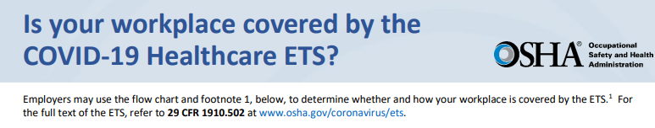
OSHA Definition- Healthcare
Federal
Hospitals and acute care
Post acute healthcare settings- SNF and AL
Doctors' offices and outpatient care setting
Dialysis
Ambulatory surgery
https://www.osha.gov/sites/default/files/publications/OSHA4125.pdf

Slide 22
OSHA Requirements
Federal
Personal protective equipment (PPE):
  Provide and ensure each employee wears a facemask when indoors and when occupying a vehicle with other people for work purposes
  Provide and ensure employees use respirators and other PPE for exposure to people with suspected or confirmed COVID-19, and for aerosol-generating procedures on a person with suspected or confirmed COVID-19.
Patient screening and management:
  Limit and monitor points of entry to settings where direct patient care is provided
  Screen and triage patients, clients, and other visitors and non-employees; implement patient management strategies.
https://www.osha.gov/sites/default/files/publications/OSHA4122.pdf

Slide 23
OSHA Requirements
Federal
Health screening and medical management:
  (1) Screen employees before each workday and shift;
  (2) Require each employee to promptly notify the employer when the employee is COVID-19 positive, suspected of having COVID-19, or experiencing certain symptoms;
  (3) Notify certain employees within 24 hours when a person who has been in the workplace is COVID-19 positive;
  (4) Follow requirements for removing employees from the workplace;
  (5) Employers with more than 10 employees- provide medical removal protection benefits in accordance with the standard to workers who must isolate or quarantine
https://www.osha.gov/sites/default/files/publications/OSHA4122.pdf

Slide 24
OSHA Requirements
Federal
Training:
  Ensure all employees receive training so they comprehend COVID-19 transmission, tasks and situations in the workplace that could result in infection, and relevant policies and procedures
Vaccination:
  Provide reasonable time and paid leave for vaccinations and vaccine side effects
Physical distancing:
  Keep people at least 6 feet apart when indoors
Report work-related COVID-19 fatalities and in-patient hospitalizations to OSHA
https://www.osha.gov/sites/default/files/publications/OSHA4122.pdf

Slide 25
Evaluating and Caring for Patients with Post-COVID Conditions
https://www.cdc.gov/coronavirus/2019-ncov/hcp/clinical-care/post-covid-index.html

Slide 26
Post-COVID Conditions
An umbrella term for the wide range of physical and mental health consequences experienced by some patients that are present four or more weeks after SARS-CoV-2 infection, including by patients who had initial mild or asymptomatic acute infection
Objective laboratory or imaging findings should not be used as the only measure or assessment of a patient’s well-being; lack of laboratory or imaging abnormalities does not invalidate the existence, severity, or importance of a patient’s symptoms or conditions.

Slide 27
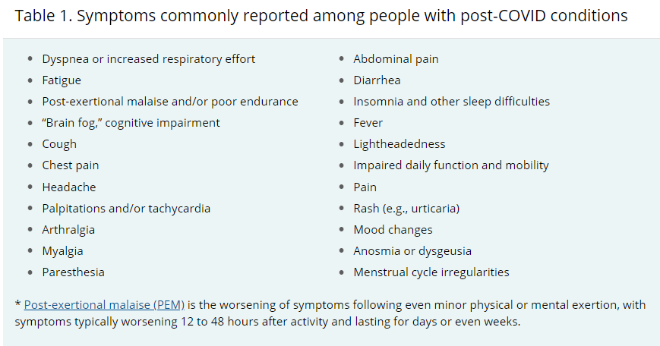
Post-COVID Presentation
https://www.cdc.gov/coronavirus/2019-ncov/hcp/clinical-care/post-covid-workup.html

Slide 28
Assessment and Testing
no laboratory test can definitively distinguish post-COVID conditions from other etiologies, in part due to the heterogeneity of post-COVID conditions.
The absence of laboratory-confirmed abnormalities or the decision to forgo extensive laboratory testing should not lead to dismissing the possible impact of a patient’s symptoms on their daily function.
Where clinically indicated, symptom management and a comprehensive rehabilitation plan can be initiated simultaneously with laboratory testing for most patients.

Slide 29
Management of Post-COVID Conditions
The goal of medical management of post-COVID conditions is to optimize function and quality of life
Many post-COVID conditions can be improved through already established symptom management approaches
Creating a comprehensive rehabilitation plan may be helpful for some patients and might include physical and occupational therapy, speech and language therapy, vocational therapy, as well as neurologic rehabilitation for cognitive symptoms.
Optimizing management of underlying medical conditions might include counseling on lifestyle components such as nutrition, sleep, and stress reduction
https://www.cdc.gov/coronavirus/2019-ncov/hcp/clinical-care/post-covid-management.html

Slide 30
Questions?
mdh.ipcovid@maryland.gov

