Slide 1
Maryland Situation Update on
Coronavirus Disease (COVID-19) for BHA
Maryland Department of Health
Infectious Disease Epidemiology and Outbreak Response Bureau
June 12, 2020

Slide 2
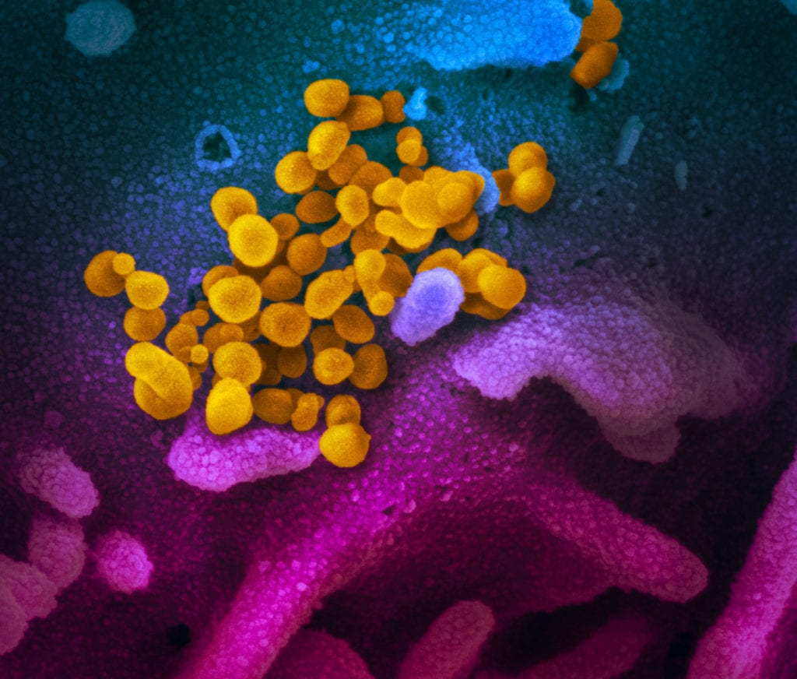
Call Agenda
Picture Courtesy of NIAID-RML
Review current situation of COVID-19
CDC Updates
Re-opening guidance
Questions and Answers

Slide 3
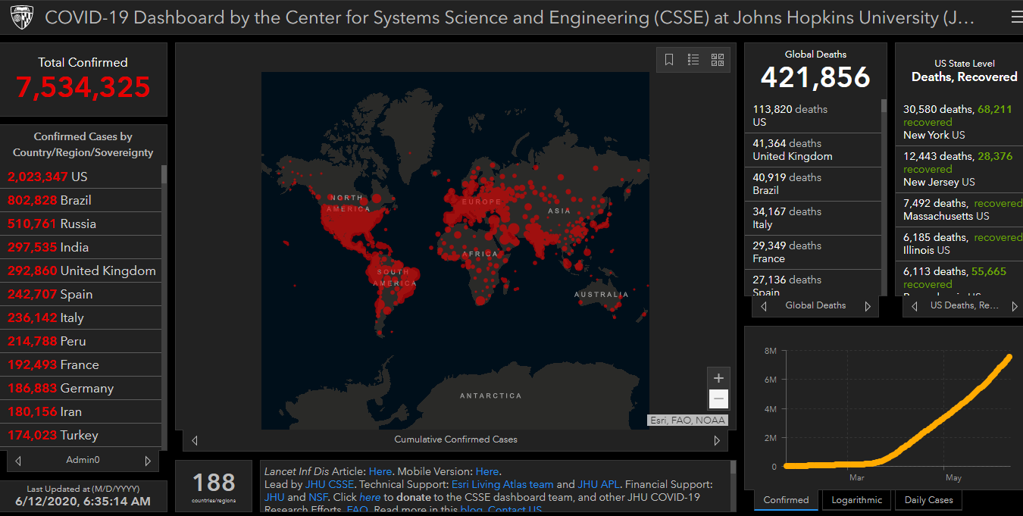
COVID-19 Global Situation Summary

Slide 4
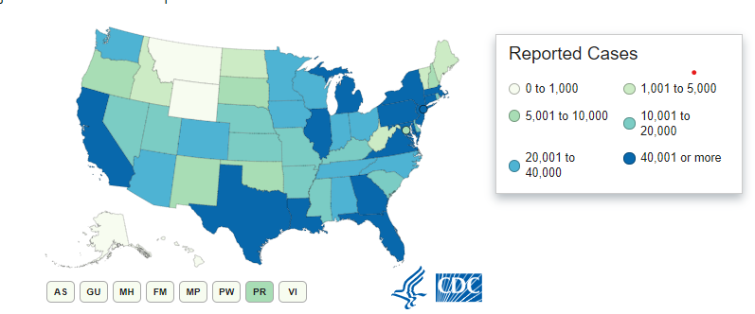
U.S.: COVID-19 Cases
1,994,283 Confirmed Cases
  20,486 new
112,967 total deaths
  834 new
55 states and territories reporting
Source: www.cdc.gov, accessed June 11, 2020

Slide 5
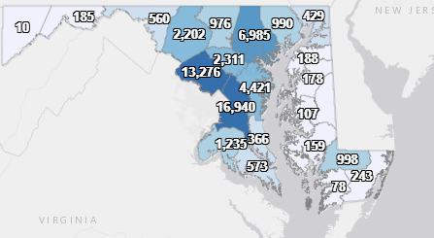
Maryland: COVID-19 Cases
http://health.maryland.gov/coronavirus
Data current as of 6/12/2020
Cases: 60,613
  416 new
Deaths: 2,773
  23 new
Hospitalizations: 9,023
  134 new
Negative tests 412,658

Slide 6
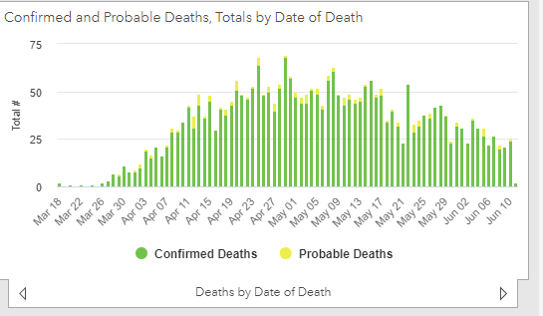

Slide 7
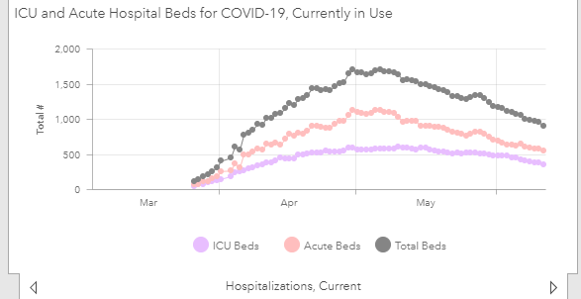

Slide 8
Asymptomatic and Pre-symptomatic Transmission
Asymptomatic: someone who never develops symptoms
Pre-symptomatic- someone who develops symptoms later
Remember symptoms can be very mild/ may be hard to distinguish from life
We do not know what role or how much of a role asymptomatic transmission plays in the spread of COVID-19
  Probably something
Presymptomatic people can be infectious (not sure exactly how infectious)

Slide 9
Precautions against asymptomatic spread
Universal masking
Physical distancing
Small groups
Quarantine after known exposure
  Stay home and away from other people for 14 days since the last exposure
Consider testing after exposure/high risk activities
  Remember a negative does not preclude infection at a later date

Slide 10
Re-infection
Nearly all immune competent individuals will develop an immune response following SARS-CoV-2 infection
Recurrence of COVID-19 illness appears to be very uncommon, suggesting that the presence of antibodies could confer at least short-term immunity to infection with SARS-CoV-2
Definitive data are lacking, and it remains uncertain whether individuals with antibodies are protected against reinfection with SARS-CoV-2
https://www.cdc.gov/coronavirus/2019-ncov/lab/resources/antibody-tests.html

Slide 11
Re-infection
HOWEVER:
If a currently asymptomatic, previously infected person who has recovered tests positive as part of a contact investigation consider the possibility of reinfection
  Public Health and clinical teams should decide if additional isolation should be required
If an infected person has recovered, and Is later identified as a contact, still recommend quarantine
If an infected person who has recovered develops symptoms again, they should be isolated and tested again
https://www.cdc.gov/coronavirus/2019-ncov/hcp/faq.html

Slide 12
Antibody testing
Available at some commercial labs
Do I need antibody testing?
  Yes if:
    I was sick, never got tested for COVID, and am curious if COVID may have caused my illness
    I am in a scientific study
  No if:
    I want to know if I am immune
    If I want to know if I have COVID now
    I want to know if I was asymptomatically infected at some point

Slide 13
What antibody results mean
Positive
  Your body is producing antibodies to COVID-19
    You may have been exposed and infected
  Positive predictive value in the general population is not good: Risk of false positives is high in healthy people
Negative
  Your body is not producing antibodies to COVID-19
  May not have been infected to COVID-19

Slide 14
COVID-19 Outbreaks in “Congregate Community Settings”

Slide 15
Congregate Community Settings
For the purposes of this guidance, congregate community settings are NOT:
  Long-term care facilities, assisted living facilities, correctional facilities, group homes, hospices, and other congregate residential facilities;
  Acute care facilities;
  Dialysis facilities;
  Child care programs, or
  Youth camps

Slide 16
Congregate Community Settings
Outbreak Definition
Five* or more lab-confirmed COVID-19 cases among people associated with a facility, who have symptom onset dates (or, if asymptomatic, specimen collection dates) within a 14-day period, and who are epidemiologically linked, but not household contacts.
*A smaller number of cases may be considered an outbreak in certain situations, such as a small facility (e.g. fewer than 5 staff) or a facility that serves or includes high-risk populations.

Slide 17
Congregate Community Settings
LHD Action Steps
Initial investigation by phone
Gather basic information (facility and case characteristics, timeline of cases, response steps)
Provide isolation and quarantine recs
CDC Restart Readiness Checklist
https://www.cdc.gov/coronavirus/2019-ncov/community/resuming-business-toolkit.html#restart-readiness-checklist
Other CDC guidance

Slide 18
Congregate Community Settings
LHD Action Steps
Advise the facility that they must report any new COVID-19 cases, or suspected cases, immediately to the LHD.
Determine frequency and type of follow-up with facility, based on initial investigation and recommendations.
In-person site visits may be conducted at the discretion of the local health department.

Slide 19
Congregate Community Settings
LHD Action Steps
Before investigating a facility for possible issuance of a either an Order or Immediate Compliance or issuance of an Order of Partial Closure or Closure, consult with the Office of the Attorney General (Mary Bearden).
Issuance of these orders is at the discretion of local health authorities, as per Executive Order 20-04-05-02 (https://governor.maryland.gov/wp-content/uploads/2020/04/Delegation-to-County-Health-Officials-4.5.20.pdf)
See also Health Officer Memorandum EH20-005 for guidance on this Executive Order.

Slide 20
Next two stages of Maryland reopening
June 10th Governor Hogan announced that as health metrics around COVID-19 continue to trend downward, Maryland may begin to enter into the next steps of reopening.
On Friday June 12th, indoor dining and outdoor amusement activities may reopen.
On Friday June 19th, indoor fitness, casinos, arcades, and malls may reopen.
https://governor.maryland.gov/2020/06/10/governor-hogan-announces-next-stage-two-reopenings-including-indoor-dining-and-outdoor-amusements/

Slide 21
Low Risk Does Not Mean No Risk
Individuals should still wear a face covering, practice social distancing of at least 6ft apart, practice good hand hygiene, and frequently clean high touch surfaces
“Just because it’s open doesn’t mean you have to participate”
“We can prevent a second wave if we use common sense and practice social distancing”
Staff members of long-term care facilities should continue to take care to avoid infection in the community

Slide 22
Resources
MDH Novel Coronavirus: http://health.maryland.gov/coronavirus
MDH Laboratory Coronavirus: https://health.maryland.gov/laboratories/Pages/Novel-Coronavirus.aspx
COVID-19 People at risk https://www.cdc.gov/coronavirus/2019-ncov/specific-groups/high-risk-complications.html
CDC Guidance for Infection Control https://www.cdc.gov/coronavirus/2019-nCoV/infection-control.html
Behavioral Health https://www.cdc.gov/coronavirus/2019-ncov/hcp/infection-control-faq.html?CDC_AA_refVal=https%3A%2F%2Fwww.cdc.gov%2Fcoronavirus%2F2019-ncov%2Finfection-control%2Finfection-prevention-control-faq.html
Memory Care https://www.cdc.gov/coronavirus/2019-ncov/hcp/memory-care.html

Slide 23
Questions?
Email : mdh.ipcovid@Maryland.gov

