Slide 1
Maryland Situation Update on
Coronavirus Disease (COVID-19) for BHA
Maryland Department of Health
Infectious Disease Epidemiology and Outbreak Response Bureau
May 8, 2020

Slide 2
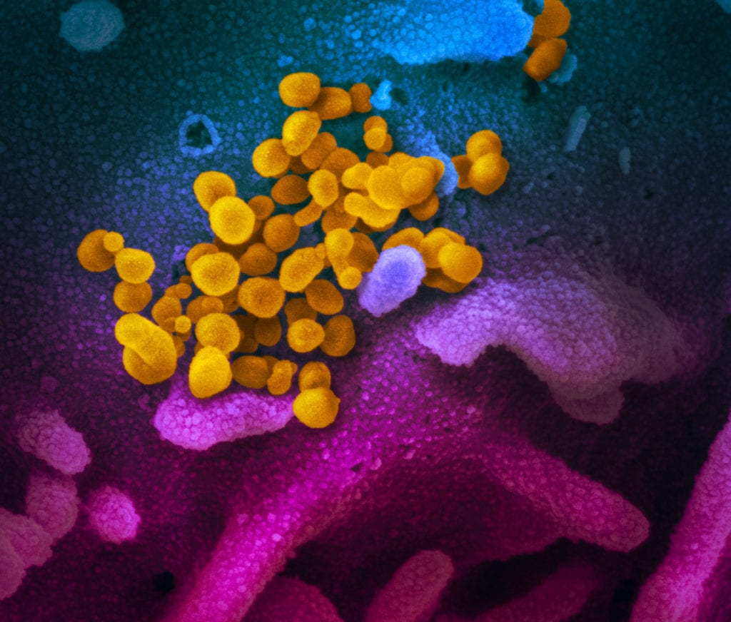
Call Agenda
Picture Courtesy of NIAID-RML
Review current situation of COVID-19
Reporting and Surveillance 101
Miscellaneous
Questions and Answers

Slide 3
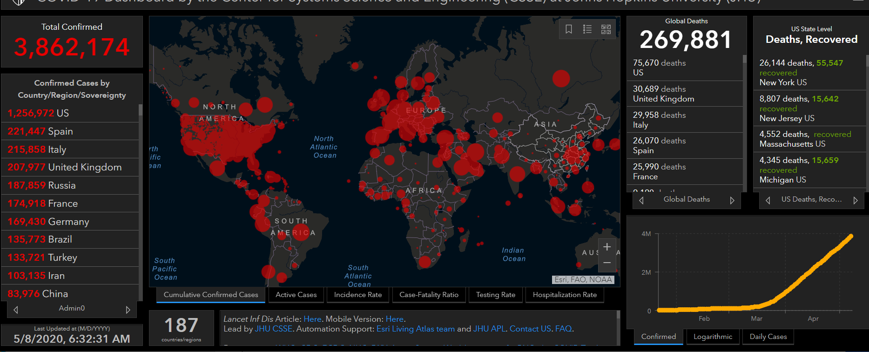
COVID-19 Global Situation Summary

Slide 4
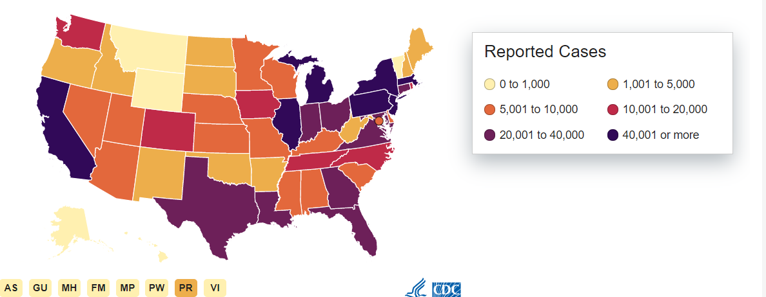
U.S.: COVID-19 Cases
1,219,006 Confirmed Cases
  25,253 new
73,297 total deaths
  2,495 new
55 states and territories reporting
Source: www.cdc.gov, accessed May 8, 2020

Slide 5
Case Fatality Rate and infectiousness
Case fatality rate
  (Number of deaths in cases/number of cases)*100
  Flu is about 0.1%
  Covid-19 is about 6% in the US
How infectious is a disease? (this is called R0, pronounced R naught)
  The number of secondary cases one case would produce in a completely susceptible population
  If one person is infected- how many people on average will they infect
    Flu is about 1.4
    COVID-19 is about 5.7
Notes:
https://wwwnc.cdc.gov/eid/article/26/7/20-0282_article
https://wwwnc.cdc.gov/eid/article/25/1/17-1901_article

Slide 6
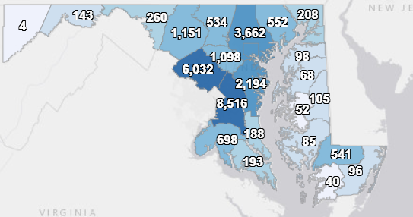
Maryland: COVID-19 Cases
http://health.maryland.gov/coronavirus
Data current as of 5/8, 2020
Cases: 30,485
  1,111 new
Deaths: 1,453
  52 new
Hospitalizations: 5,811
  148 new
Negative tests 121,702

Slide 7
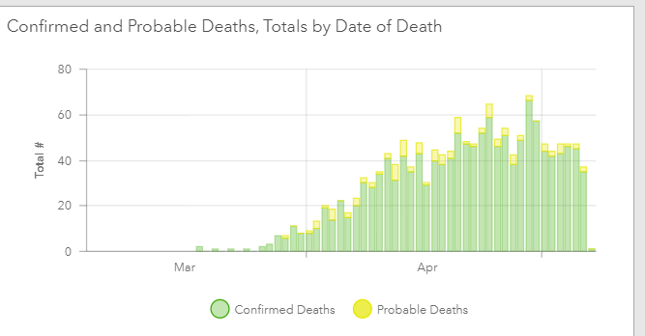

Slide 8
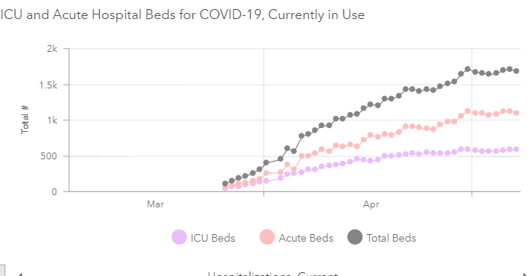

Slide 9
Outbreaks in Residential Facilities

Slide 10
Precautions to Prevent COVID-19 Outbreak
  Hand hygiene – washing or alcohol-based sanitizer
  Clean frequently touched surfaces regularly
  Social distancing
    No group activities
    No communal dining
    No visitation
    Stay in rooms as much as possible
  Universal masking
    All Americans recommended to wear cloth masks in public
    Medical masks for health professionals
Notes:
Repeat from last week

Slide 11
COVID Outbreak Management
  Identify and Isolate
  Test for COVID-19
  Quarantine exposed persons
  Exclude possibly contagious staff
  Use personal protective equipment (PPE)
  Cohorting: separating the ill from the well
  COMMUNICATE
Notes:
Repeat from last week

Slide 12
Identify and Isolate
  Screen all persons who enter the facility for symptoms
  Screen all residents three times daily
  What to look for:
    Any elevated temperature
    Coughing
    Shortness of breath
    Any other symptoms of respiratory illness (e.g., sore throat, aches, tiredness)
    Have you been tested for COVID-19?
Notes:
Repeat from last week

Slide 13
Identify and Isolate
  Immediately isolate ill residents
  Immediately send home ill staff to self-isolate
  Isolation = alone:
    Stay in room with door closed
    If must leave, wear a mask
    Never within 6 feet of other person except healthcare provider in full personal protective equipment
    No shared bathrooms or eating spaces
    Post sign outside room warning others before entering
Notes:
Repeat from last week

Slide 14
Identify and Isolate
  How long must isolation last?
    At least 10 days after symptom onset
    At least 3 days after any fever is gone
    At least 3 days after any other symptoms are mostly better
Notes:
Repeat from last week

Slide 15
Test for COVID-19
  If resident has symptoms of COVID-19, contact local health department immediately to arrange testing
  Work with local health department to collect a specimen for COVID-19 testing (swab from the nose)
  Specimen will be sent to Maryland Department of Health lab for testing
  Results take 24-48 hours. Don’t wait to isolate!
  If resident or staff tests positive elsewhere (e.g., urgent care, hospital) immediately report it to local health department
Notes:
Repeat from last week

Slide 16
Cohorting: Separate Ill from Well
Cohorting: Basic idea is that people who are ill share neither space nor staff with people who are well to stop spread
Best case:
  Ill residents reside in one location and well residents in another
  Ill residents have dedicated staff who do not serve well residents
Sometimes necessary to only have dedicated staff

Slide 17
Communication
Provide regular updates to:
  Residents
  Families
  Staff
  Health departments
Transparency is the best policy
It’s OK not to know the answer
  Confused about infection control? Call your local health department
  Health departments are here to help

Slide 18
Lessons Learned from Other Outbreaks
Assume it will happen to you. Plan accordingly. It saves lives.
Social distancing is key
COVID symptoms can be mild. Have a low threshold for testing and excluding symptomatic people
Dedicating staff helps to slow the spread
Even if you haven’t detected a case protect staff and residents as if you have.
Supply shortages complicate the response and adapting is necessary
Collaboration + communication = stronger response

Slide 19
What is an outbreak of COVID-19
A single case of lab confirmed COVID-19 in Staff or Resident of a congregate living setting
Step 1: call your local health department to report!

Slide 20
Create a line list
Separate lists for staff and residents
  Name
  DOB
  Unit or room number
  Date of symptom onset
  Date of positive test
  Hospitalized yes/no
  Deceased yes/ no

Slide 21
Resources
MDH Novel Coronavirus: http://health.maryland.gov/coronavirus
MDH Laboratory Coronavirus: https://health.maryland.gov/laboratories/Pages/Novel-Coronavirus.aspx
COVID-19 People at risk https://www.cdc.gov/coronavirus/2019-ncov/specific-groups/high-risk-complications.html
CDC Guidance for Infection Control https://www.cdc.gov/coronavirus/2019-nCoV/infection-control.html
EPA List N Disinfectants with COVID-19 claim https://www.epa.gov/pesticide-registration/list-n-disinfectants-use-against-sars-cov-2
Conserving PPE https://www.cdc.gov/coronavirus/2019-ncov/hcp/ppe-strategy/index.html

Slide 22
Questions?
Email : mdh.ipcovid@Maryland.gov

