Slide 1
Maryland Situation Update on Coronavirus Disease (COVID-19) for BHA
Maryland Department of Health
Infectious Disease Epidemiology and Outbreak Response Bureau
May 22, 2020

Slide 2
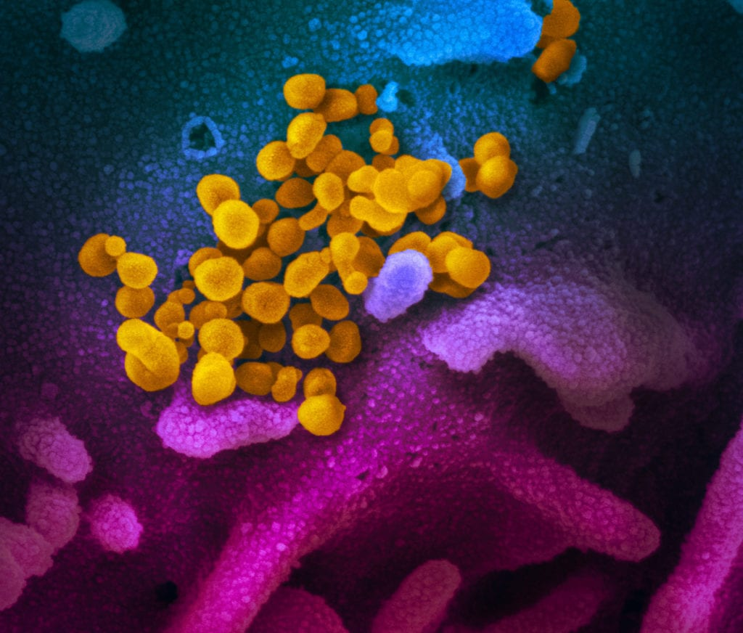
Call Agenda
Picture Courtesy of NIAID-RML
Review current situation of COVID-19
SARS-CoV2 Diagnostic Tests
Contact Tracing 101
Multisystem Inflammatory Syndrome in Children
Questions and Answers

Slide 3
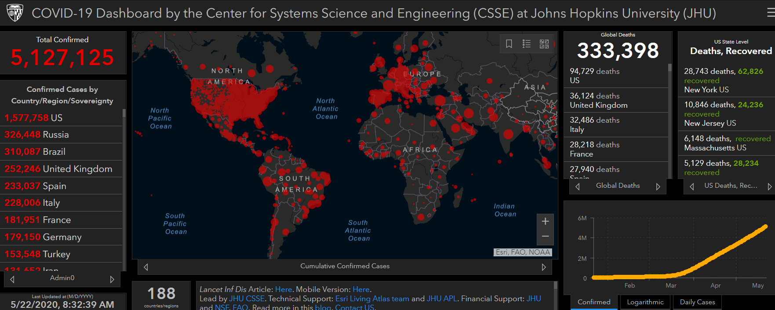
COVID-19 Global Situation Summary

Slide 4
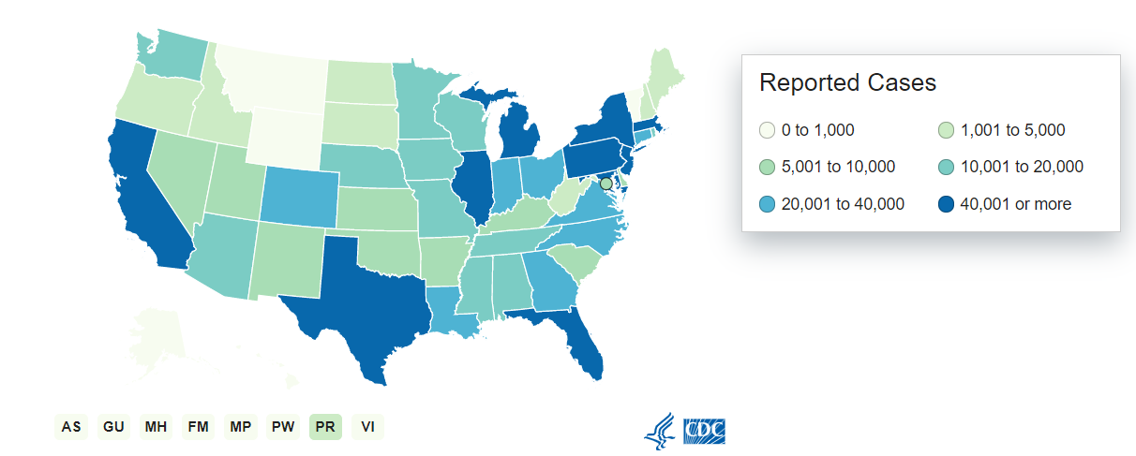
U.S.: COVID-19 Cases
1,551,095 Confirmed Cases
22,860 new
93,061 total deaths
1,387 new
55 states and territories reporting
Source: www.cdc.gov, accessed May 22, 2020

Slide 5
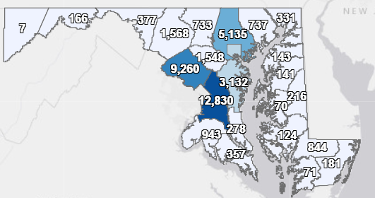
Maryland: COVID-19 Cases
http://health.maryland.gov/coronavirus
Data current as of 5/22/2020
Cases: 44,424
893 new
Deaths: 2,045*
41 new
Hospitalizations: 7,634
149 new
Negative tests 183,478

Slide 6
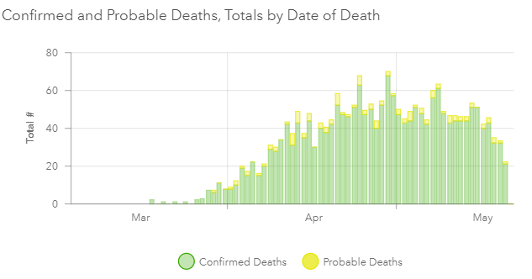

Slide 8
SARS-CoV 2 Diagnostic Tests

Slide 9
Diagnostic tests for SARS-CoV-2
Real-time polymerase chain reaction (RT-PCR)
Most reliable w/ very, very high specificity
Detects SARS-CoV-2 RNA (envelope (env), nucleocapsid (N), spike (S), RNA-dependent RNA polymerase (RdRp) or ORF1 genes)
Usually detectable as early as Day 1 of symptoms and peaks within 1 week
May persist for beyond 3 weeks → not necessarily viable virus
Timeline of positivity differs for different specimen types

Slide 10
Diagnostic tests for SARS-CoV-2
Antibodies to SARS-CoV-2 (IgM and IgG)
Measures host immune response to SARS-Cov-2
Potentially useful for late diagnosis, beyond 1st 2 weeks of illness (though has been + as early as day 4)
Will also be useful to better understand extend of exposure in the community (“serosurveys”)
Combined with PCR testing, offers higher sensitivity
High specificity but even better w/ paired serum samples
Most abundant antibodies are against NC (so most sensitive)
Qualitative assays less useful

Slide 11
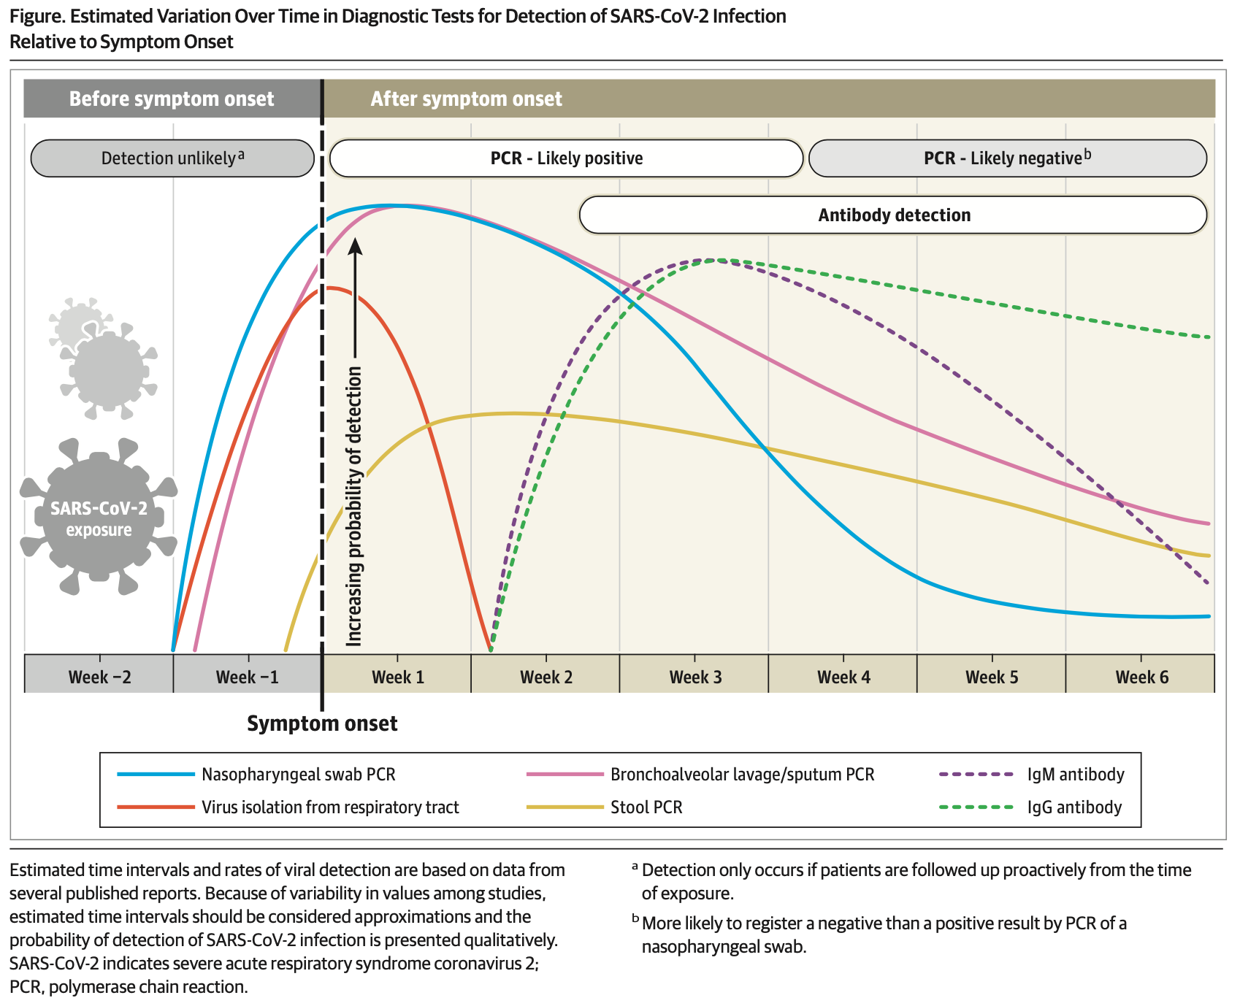
SARS-CoV-2 PCR vs. IgM/IgG Antibodies
Sethuraman, N. Interpreting Diagnostic Tests for SARS-CoV-2. JAMA. Published online May 6, 2020. doi: 10.1001/jama.2020.8259

Slide 12
Contact Tracing: Coming soon to a phone near you

Slide 13
Step 1: Case Investigation
Detailed interview and investigation of any person who has tested positive
When did they test positive
Did they have symptoms? When?
During your infectious period:
Where did you go?
Who did you see?
Did you spend time with any specific people? How long?
How about strangers?

Slide 14
Step 2: Trace the contacts
Find a phone number/email address/ mail address for everyone the case mentioned
Call them. Email them. Send them a letter.
Inform the contact that they have been in contact with a known case of COVID-19
Do they have symptoms now? Did they have symptoms before?
If yes, send for testing
If no, consider sending for testing anyways

Slide 15
Step 3: Restrict the contacts
Inform the person that they need to be in quarantine for 14 days after their last exposure to the case
Can refer to an event or a place, rather than a person to protect patient confidentiality
Ensure that the quarantined individual has what they need
Access to food
A work excuse note
Work from home capacity
Homework
Can this person stay isolated from others in the household?
Assist with housing needs

Slide 16
Step 4: Arrange for Symptom monitoring
Contact needs to do AT LEAST daily temperature check, and have a low threshold to report symptoms
Report daily to public health/contact tracer
Can be done electronically
There are lots of aps for that!
If the contact does report symptoms, test

Slide 17
Final thoughts on contact tracing
When a contact tests positive, the whole process starts over again
Maybe consider serology testing a month out, if the testing technology and capacity are reliable
Cultural, linguistic, and interpersonal considerations
Data management
How do you get people to answer the phone?

Slide 18
Multisystem Inflammatory Syndrome in Children
Cheryl De Pinto, MD, MPH, FAAP
May 22, 2020

Slide 19
What is Multisystem Inflammatory Syndrome in Children (MIS-C)?
Multisystem inflammatory syndrome in children (MIS-C) is a new health condition associated with COVID-19 that is appearing in children the US and elsewhere. The syndrome was previously called pediatric multisystem inflammatory syndrome or PMIS.
Features of Kawasaki Disease and Toxic Shock Syndrome
Previously healthy children presenting with a severe inflammatory syndrome with Kawasaki disease-like features
Most positive for current or recent infection by SARS-CoV-2, or had an epi link to a COVID-19 case

Slide 20
Situational Descriptions
May 5, 2020 case series in NYS
May 6, 2020 case series in the UK
May 13, 2020 one case series in Italy

Slide 21
Signs and Symptoms
Prolonged fever (temperature of 100.4 degrees F or 38.0 degrees C or greater)
Irritability or decreased activity
Abdominal pain without another explanation (often very severe), diarrhea, vomiting
Rash, Swollen hands and feet, which might also be red
Conjunctivitis (red or pink eyes)
Poor feeding
Hypotension
Multiorgan involvement (cardiac, gastrointestinal, renal, hematologic, dermatologic and neurologic)
Respiratory symptoms NOT present in all cases

Slide 22
Centers for Disease Control and Prevention: HAN (5/14/2020)
Situational summary
Case definition
Reporting requirements
https://emergency.cdc.gov/han/2020/han00432.asp

Slide 23
CDC Case Definition
https://emergency.cdc.gov/han/2020/han00432.asp

Slide 24
Reporting MIS-C in Maryland
Information to Collect
Patient demographic information
Date of symptom onset
Maximum temperature
Laboratory value(s) fulfilling the above listed laboratory evidence of inflammation
Hospitalization status
Types of organ system involvement
SARS-CoV-2 testing results
Other relevant testing results (for example, those that have been used to exclude an alternative diagnosis)

Slide 25
Serum specimen
Serum specimen
Must be prior to administration of IVIG
Tube types: Red top, tiger top, or gold top serum separator tube
Refrigerate to 2-8 degrees C
Serological Testing requisition https://health.maryland.gov/laboratories/docs/MDH%204677%20Serological%20Testing%20Form%20and%20Instructions%202-2018.pdf

Slide 26
MIS-C Resources
CDC HAN https://emergency.cdc.gov/han/2020/han00432.asp
MDH One-Pager https://phpa.health.maryland.gov/Documents/MIS-C_onepage_051920.pdf
MDH Clinician Letter https://content.govdelivery.com/attachments/MDMBP/2020/05/15/file_attachments/1452516/COVID%20MIS-C%20Clinician%20Letter_5.15.2020%20FINAL.pdf

Slide 27
Resources
MDH Novel Coronavirus: http://health.maryland.gov/coronavirus
MDH Laboratory Coronavirus: https://health.maryland.gov/laboratories/Pages/Novel-Coronavirus.aspx
COVID-19 People at risk https://www.cdc.gov/coronavirus/2019-ncov/specific-groups/high-risk-complications.html
CDC Guidance for Infection Control https://www.cdc.gov/coronavirus/2019-nCoV/infection-control.html
Behavioral Health https://www.cdc.gov/coronavirus/2019-ncov/hcp/infection-control-faq.html?CDC_AA_refVal=https%3A%2F%2Fwww.cdc.gov%2Fcoronavirus%2F2019-ncov%2Finfection-control%2Finfection-prevention-control-faq.html
Memory Care https://www.cdc.gov/coronavirus/2019-ncov/hcp/memory-care.html

Slide 28
Questions?
Email : mdh.ipcovid@Maryland.gov

