Slide 1
Maryland Situation Update on Coronavirus Disease (COVID-19) for BHA
Maryland Department of Health
Infectious Disease Epidemiology and Outbreak Response Bureau
May 21th, 2021

Slide 2
Call Agenda
Review current situation of COVID-19
Vaccine Effectiveness
Childcare Outbreaks
Aerosols
Q and A
https://covidlink.maryland.gov/content/vaccine/govax/

Slide 3
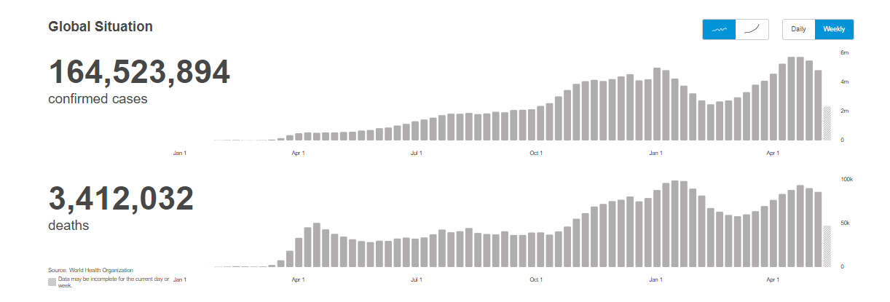
COVID-19 Global Situation Summary
https://covid19.who.int/ accessed 5/21/2021

Slide 4
Highest Case Count Last 7 Days
https://covid19.who.int/ accessed 5/21/2021

Slide 5
US Case Counts and Rates
https://www.cdc.gov/coronavirus/2019-ncov/cases-updates/cases-in-us.html Accessed 5/21/2021

Slide 6
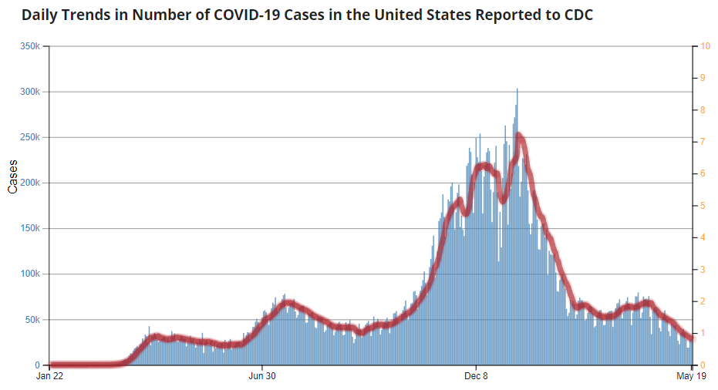
Number of Cases Reported in the USA, by Day
https://covid.cdc.gov/covid-data-tracker/#trends_dailytrendscases Updated 5/21/2021

Slide 7
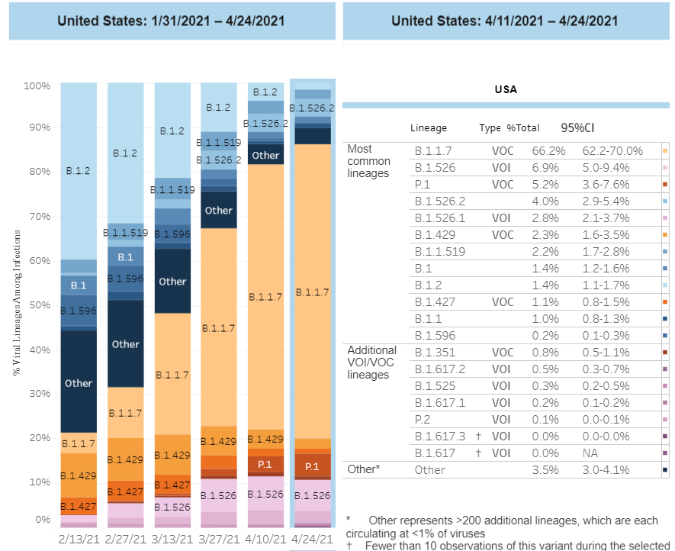
US: SARS-CoV-2 Variants
https://www.cdc.gov/coronavirus/2019-ncov/cases-updates/variant-proportions.html accessed 5/21/21

Slide 8
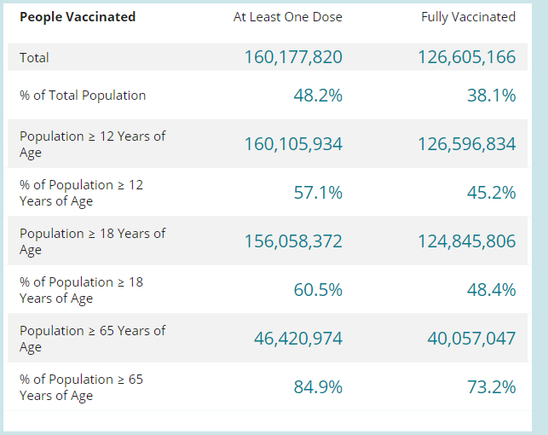
COVID-19 Vaccinations in the United States
https://covid.cdc.gov/covid-data-tracker/#vaccinations accessed 5/21/2021

Slide 9
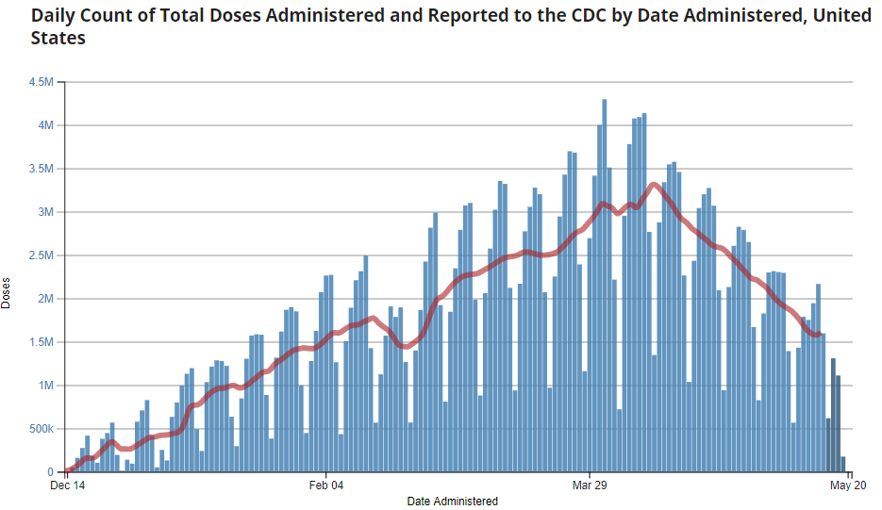
https://covid.cdc.gov/covid-data-tracker/#vaccination-demographics-trends 5/21/2021

Slide 10
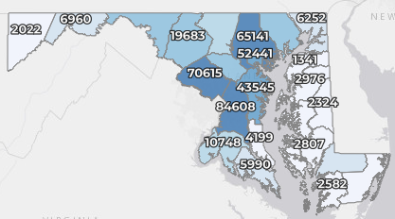
Maryland: COVID-19 Cases
http://health.maryland.gov/coronavirus
Data current as of 5/6/2021
Cases: 457,527
443 new
Deaths: 8,782
14 new
Hospitalizations: 42,864
Current: 521 (down 34)
Total tests: 10,208,203
Case rate: 5.4 per 100,000
Percent Positivity: 1.96%

Slide 11
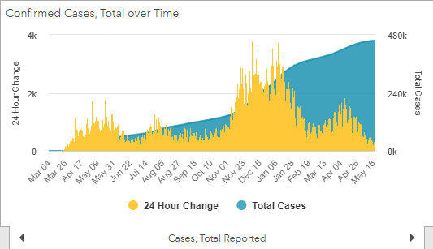
https://coronavirus.maryland.gov/ 5/21/2021

Slide 12
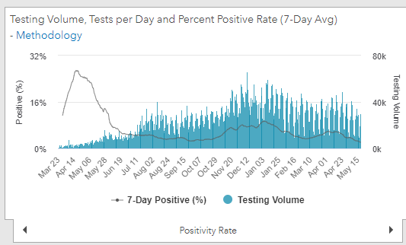
Testing Volume and % Positivity
https://coronavirus.maryland.gov/ 5/21/2021

Slide 13
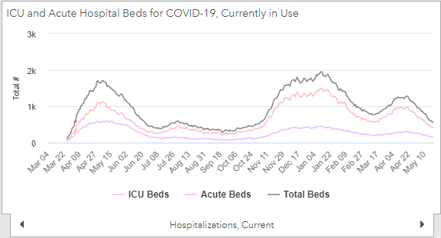
https://coronavirus.maryland.gov/ 5/21/2021

Slide 14
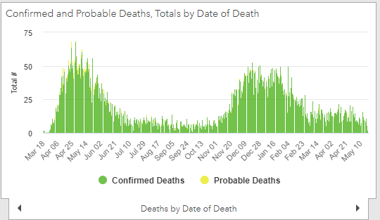
https://coronavirus.maryland.gov/ 5/21/2021

Slide 15
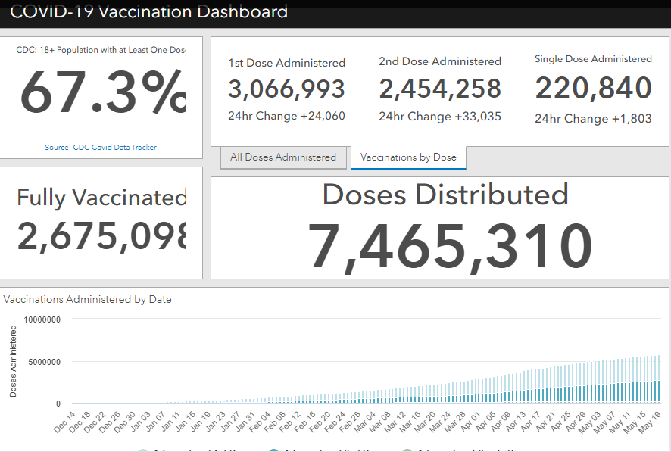
Maryland Vaccine Dashboard
https://coronavirus.maryland.gov/#Vaccine accessed 5/21/2021

Slide 16
Vaccine Effectiveness among Healthcare Personnel

Slide 17
Interim Estimates of Vaccine Effectiveness of Pfizer-BioNTech and Moderna COVID-19 Vaccines Among Health Care Personnel — 33 U.S. Sites, January–March 2021
Single dose of Pfizer or Moderna COVID-19 vaccine appears to be 82% effective against symptomatic COVID-19
Two doses of Pfizer or Moderna COVID-19 vaccine appear to be 94% effective against symptomatic COVID-19
The mRNA vaccines are highly effective at preventing symptomatic COVID-19 among U.S. HCP. High vaccination coverage among HCP and the general population is critical to prevent COVID-19 in the United States.
https://www.cdc.gov/mmwr/volumes/70/wr/mm7020e2.htm?s_cid=mm7020e2_x

Slide 18
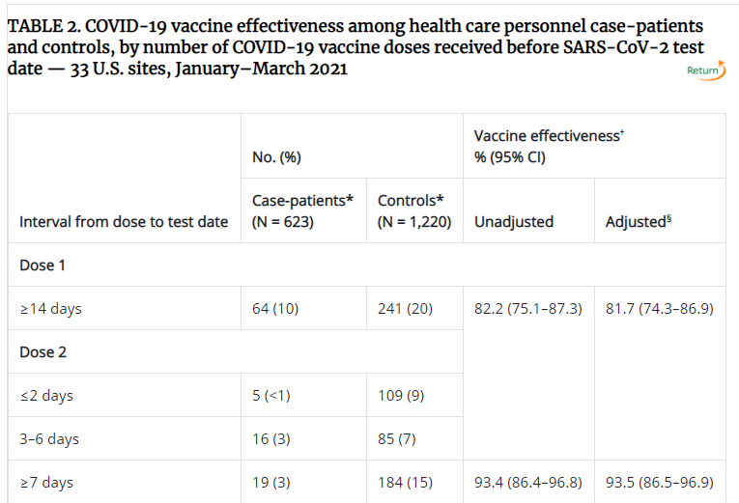

Slide 19
COVID-19 Outbreaks in Childcare

Slide 20
Characteristics of COVID-19 Cases and Outbreaks at Child Care Facilities — District of Columbia, July–December 2020
Among 469 child care facilities in the District of Columbia, 23.9% reported at least one COVID-19 case, and 5.8% reported outbreak-associated cases during July 1–December 31, 2020.
Among 319 cases, approximately one half were among teachers or staff members.
Outbreak risk was increased in facilities operating <3 years, with symptomatic persons who sought testing ≥3 days after symptom onset, or with asymptomatic cases.
https://www.cdc.gov/mmwr/volumes/70/wr/mm7020a3.htm?s_cid=mm7020a3_x

Slide 21
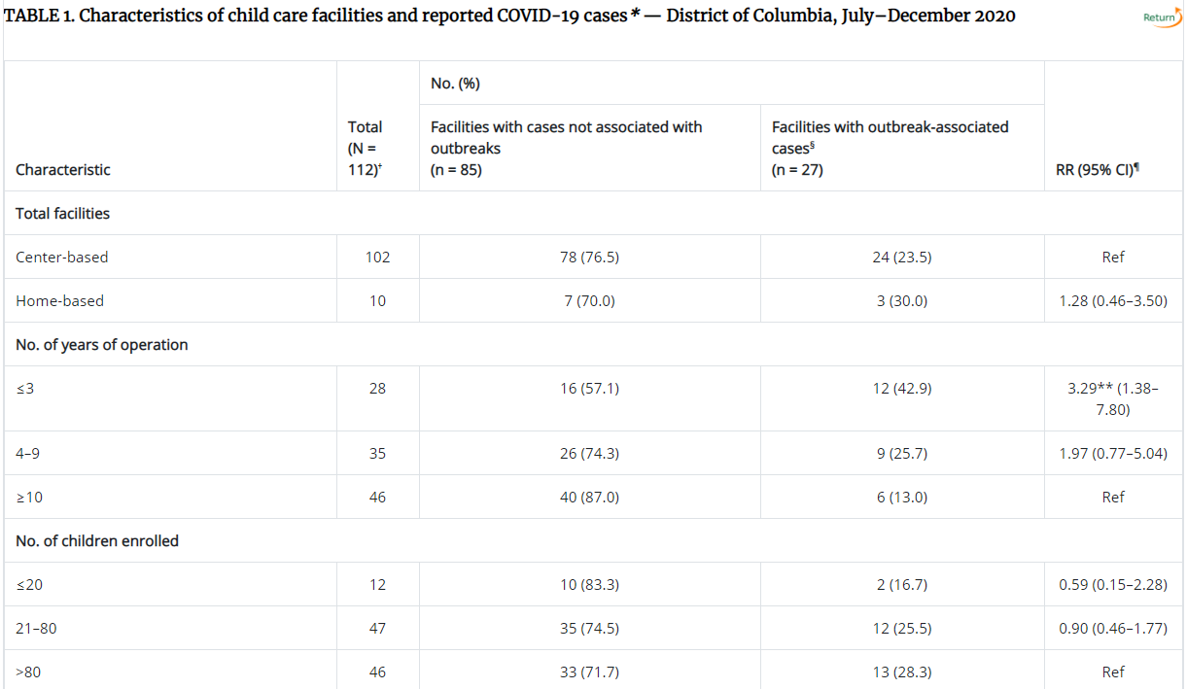

Slide 22
Coughing and Aerosols

Slide 23
Visualization of Coughing and Aerosols
When a healthy volunteer coughs, he expels a turbulent jet of air
A maximum airspeed of 8 m per second (18 mph) was observed, averaged during the half-second cough
The cough plume may project infectious aerosols into the surrounding air.
https://www.nejm.org/doi/full/10.1056/NEJMicm072576

Slide 24
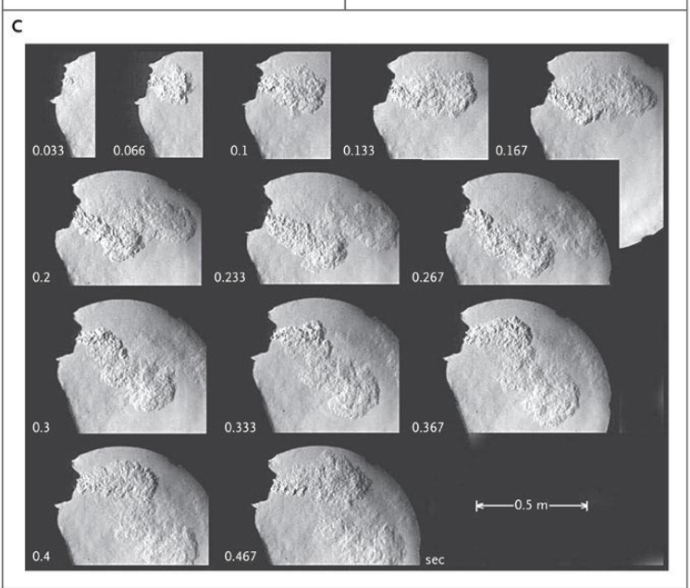

Slide 25
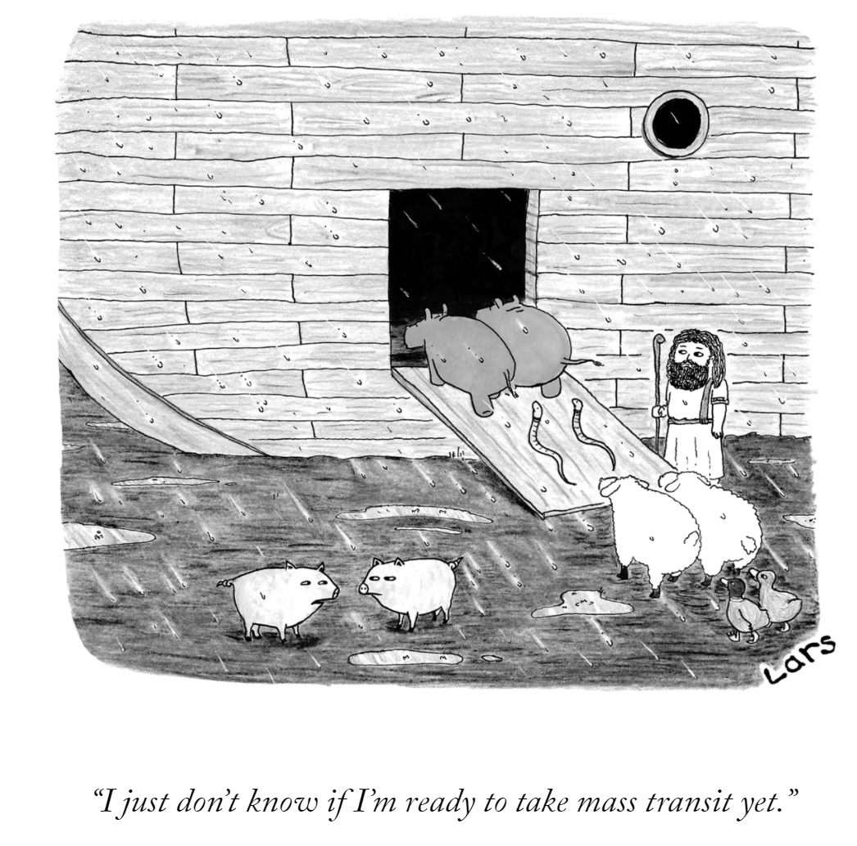
Questions?
mdh.ipcovid@maryland.gov

