Slide 1
Maryland Situation Update on Coronavirus Disease (COVID-19) for BHA
Maryland Department of Health
Infectious Disease Epidemiology and Outbreak Response Bureau
May 15, 2020

Slide 2
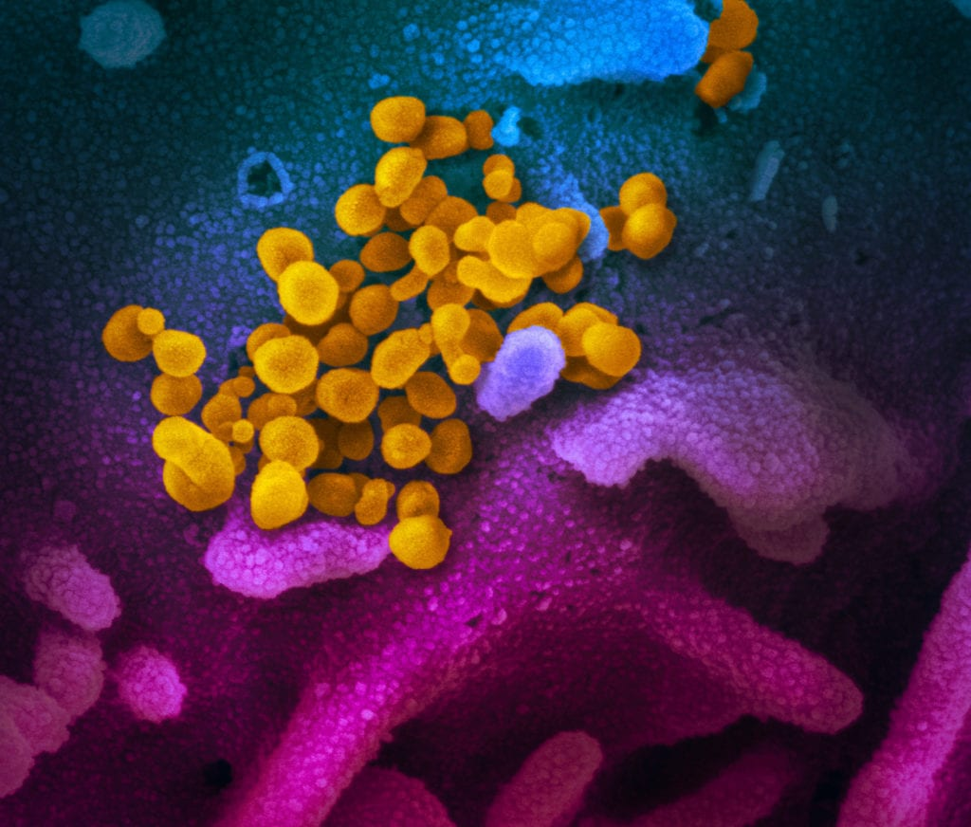
Call Agenda
Picture Courtesy of NIAID-RML
Review current situation of COVID-19
CDC Guidance for Behavioral Health
Staff exclusion
MDH updates
Questions and Answers

Slide 3
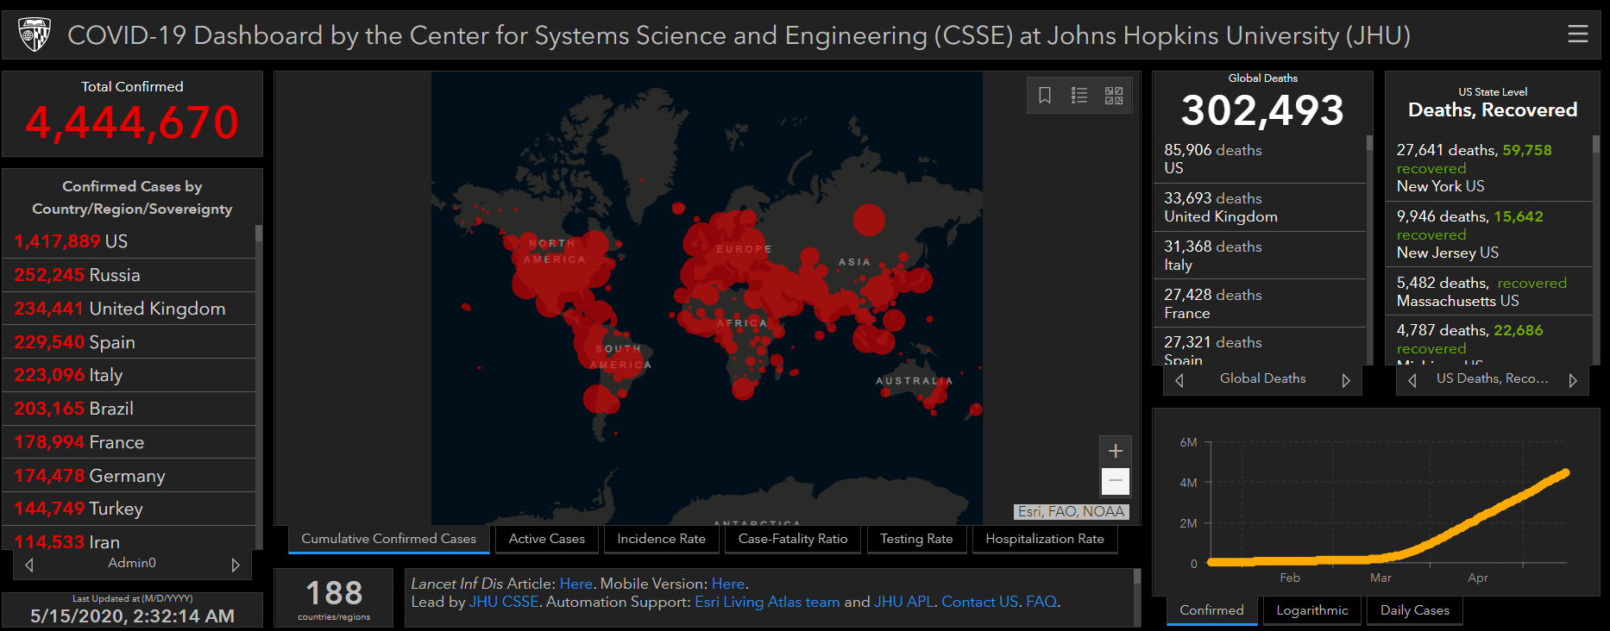
COVID-19 Global Situation Summary

Slide 4
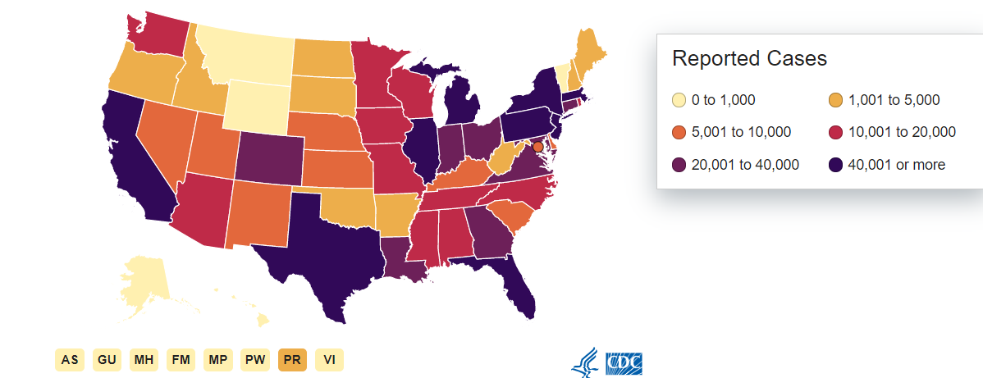
U.S.: COVID-19 Cases
1,384,930 Confirmed Cases
20,869 new
83,947 total deaths
1,701 new
55 states and territories reporting
Source: www.cdc.gov, accessed May 15, 2020

Slide 5
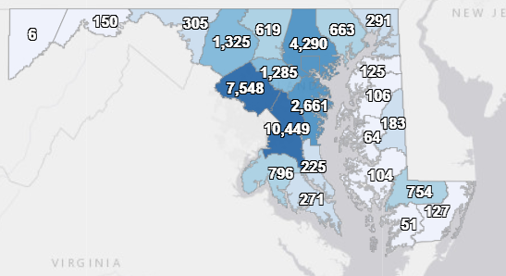
Maryland: COVID-19 Cases
http://health.maryland.gov/coronavirus
Data current as of 5/15/2020
Cases: 36,986
1,083 new
Deaths: 1,792
44 new
Hospitalizations: 6679
146 new
Negative tests 145,840

Slide 6
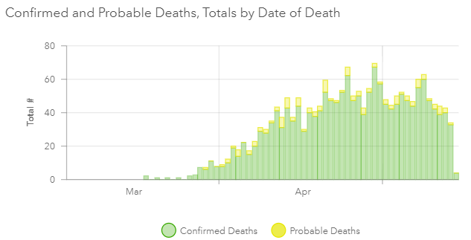

Slide 8
CDC Guidance for Behavioral Health

Slide 9
Challenge: Cohorting
Residents who test positive for COVID-19 should be transferred to a dedicated section of the facility, or house positive cases together, or have dedicated staff
Because of security concerns this might not be possible in some settings
Potential solutions
Implement measures to keep residents 6 feet apart
Designate a bathroom for COVID+ residents
Ensure that staff wear masks when interacting with residents
Notes:
Repeat from last week

Slide 10
Isolation and Quarantine
Residents should be encouraged to stay in their rooms as much as possible to avoid close contact with other residents
Routines may be very important and hard to disrupt
Try to stagger times for residents who do leave their rooms
Keep staff consistent when possible
Continue to provide structured activities in room or at staggered times

Slide 11
Challenge: Group Therapy
Critical part of treatment and care but not compatible with social distancing measures
Consider virtual platforms for group therapy or decrease group size so distance can be maintained
If a facility has cases of COVID, group therapy should move to a video platform until transmission is contained

Slide 12
Challenge: Face coverings
Face masks may cause emotional distress for some residents
Mask ties and metal nose bridges may be used for self harm or as a weapon
Face masks should not be used for anyone who can’t remove the mask on their own
Consider Allowing low risk residents to wear cloth face masks
Short ear loop design is preferred to ties
Ensure that staff and healthcare workers do wear medical masks when interacting with the residents
Notes:
Repeat from last week

Slide 13
Challenge: Alcohol Hand Sanitizer
Staff must take care to ensure residents do not ingest hand sanitizer
Consider not placing hand sanitizer in residents’ rooms
Encourage resident hand hygiene with soap and water
Provide small pocket-sized bottles for staff to carry with them
Notes:
Repeat from last week

Slide 14
Challenge: Dining
Potential for choking hazards, self harm
Consider one on one supervision for meal times in resident rooms
Consider staggered communal dining so residents are at least 6 feet apart
Notes:
Repeat from last week

Slide 15
Challenge: Smoking
High proportion of residents may smoke
Smoking can be a risk factor for severe disease
Smokers tend to congregate, especially when the weather is bad
Limit the number of patients who go smoke at a time
Ensure that physical distance is maintained even while smoking outdoors
Notes:
Repeat from last week

Slide 16
Return to Work Guidance

Slide 17
When to exclude
Staff with any symptoms of COVID-19
Recommend testing!
If testing is negative and COVID is not suspected, staff may return to work
Symptoms may be mild
Cough
Upper respiratory illness
Loss of smell or taste
“just allergies”
If not tested, staff should be excluded, even with mild illness
Now is a good time to plan for staffing shortages

Slide 18
When to come back
If tested positive or not tested
10 days after onset
If the person had a fever, 3 days after fever resolution
Improving symptoms
If other symptoms have not fully resolved, staff should avoid caring for clients who are severely immunocompromised until complete resolution of symptoms
Wear a mask at all times

Slide 19
MDH Updates

Slide 20
Stage One of the Roadmap to Recovery
May 13th Governor Hogan announced commencement of phase one including moving from a stay at home order to a safer at home advisory and the gradual reopening of retail, manufacturing, houses of worship, and some personal services.
Commencement of phase one does not change recommendations from CDC, MDH, and CMS for residential
Residential facilities should continue to restrict visitation, actively screen employees, and encourage healthcare personnel to maintain social distancing in and out of the workplace.
https://www.whitehouse.gov/openingamerica/
https://governor.maryland.gov/recovery/

Slide 21
Resources
MDH Novel Coronavirus: http://health.maryland.gov/coronavirus
MDH Laboratory Coronavirus: https://health.maryland.gov/laboratories/Pages/Novel-Coronavirus.aspx
COVID-19 People at risk https://www.cdc.gov/coronavirus/2019-ncov/specific-groups/high-risk-complications.html
CDC Guidance for Infection Control https://www.cdc.gov/coronavirus/2019-nCoV/infection-control.html
Behavioral Health https://www.cdc.gov/coronavirus/2019-ncov/hcp/infection-control-faq.html?CDC_AA_refVal=https%3A%2F%2Fwww.cdc.gov%2Fcoronavirus%2F2019-ncov%2Finfection-control%2Finfection-prevention-control-faq.html
Memory Care https://www.cdc.gov/coronavirus/2019-ncov/hcp/memory-care.html

Slide 22
Questions?
Email : mdh.ipcovid@Maryland.gov

