Slide 1
Maryland Situation Update on Coronavirus Disease (COVID-19) for BHA
Maryland Department of Health
Infectious Disease Epidemiology and Outbreak Response Bureau
May 14th, 2021

Slide 2
Call Agenda
Review current situation of COVID-19
CDC Updates
FDA Updates
MD Updates
Q and A
https://covidlink.maryland.gov/content/vaccine/govax/

Slide 3
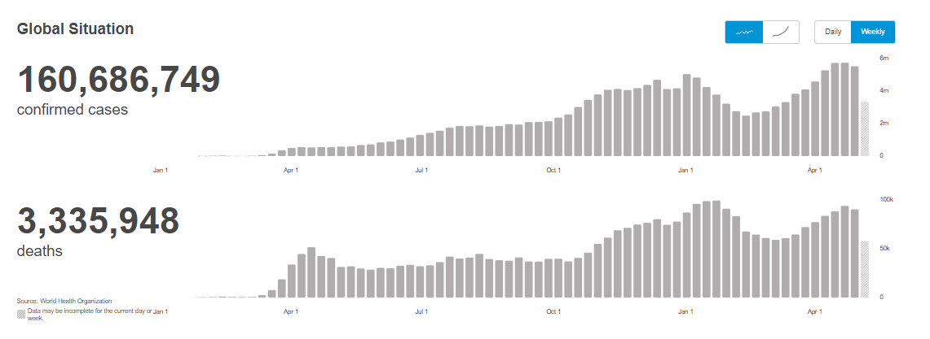
COVID-19 Global Situation Summary
https://covid19.who.int/ accessed 5/14/2021

Slide 4
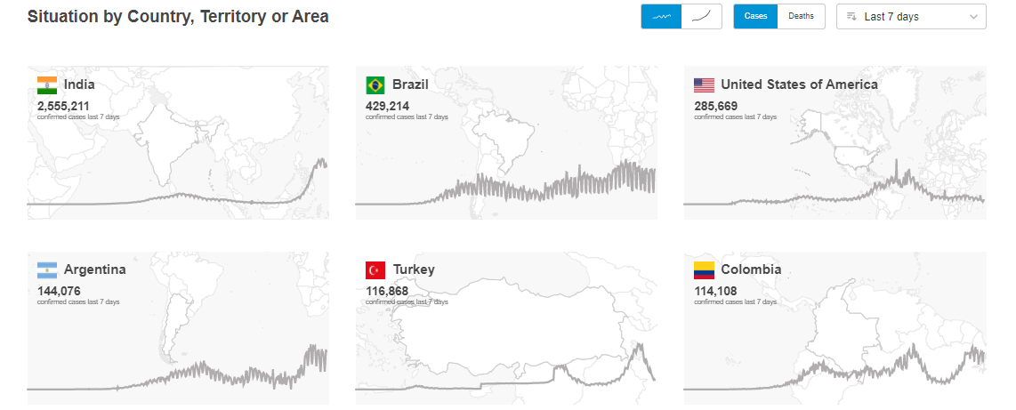
Highest Case Count Last 7 Days
https://covid19.who.int/ accessed 5/14/2021

Slide 5
US Case Counts and Rates
https://www.cdc.gov/coronavirus/2019-ncov/cases-updates/cases-in-us.html Accessed 5/14/2021

Slide 6
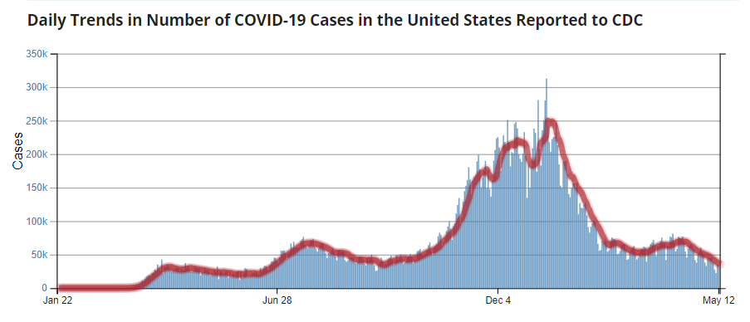
Number of Cases Reported in the USA, by Day
https://covid.cdc.gov/covid-data-tracker/#trends_dailytrendscases Updated 5/14/2021

Slide 7
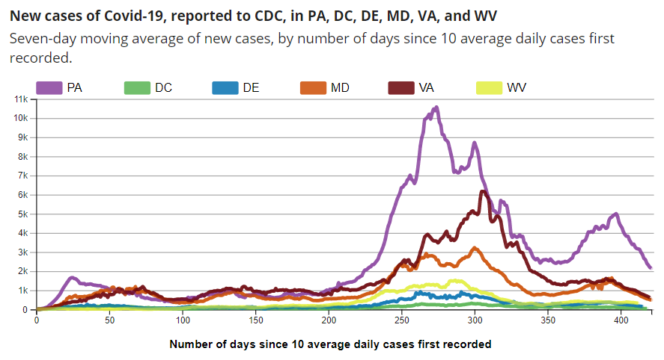
https://covid.cdc.gov/covid-data-tracker/#trends_dailytrendscases Updated 5/14/2021

Slide 8
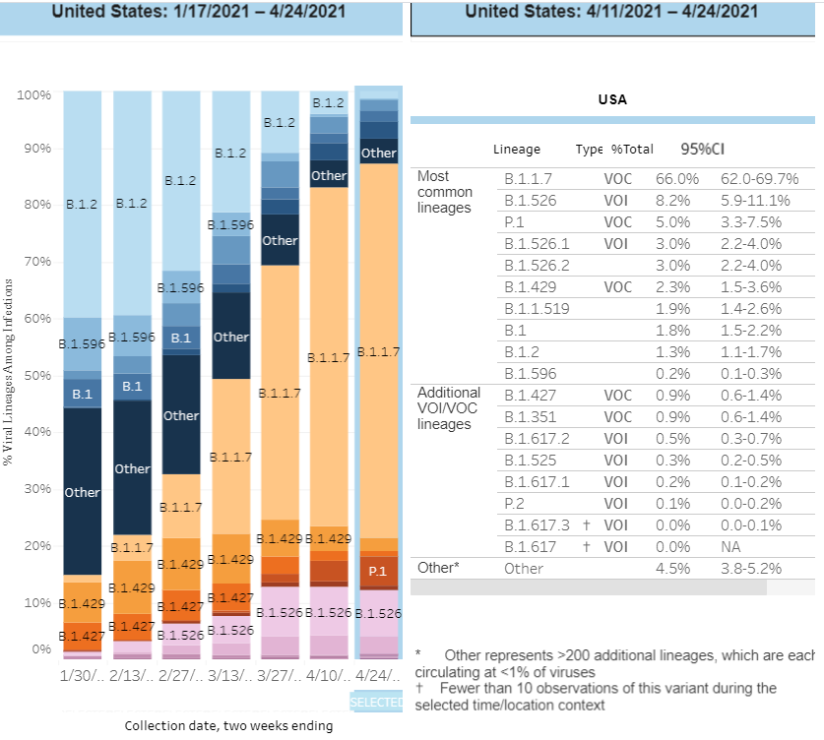
US: SARS-CoV-2 Variants
https://www.cdc.gov/coronavirus/2019-ncov/cases-updates/variant-proportions.html accessed 5/14/21

Slide 9
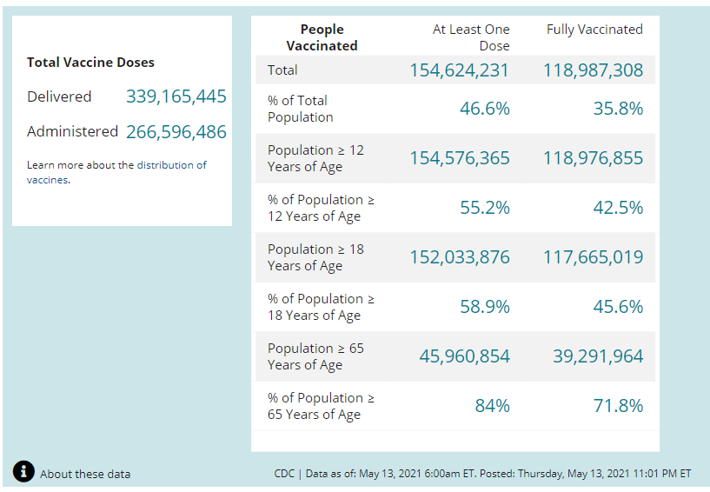
COVID-19 Vaccinations in the United States
https://covid.cdc.gov/covid-data-tracker/#vaccinations accessed 5/14/2021

Slide 10
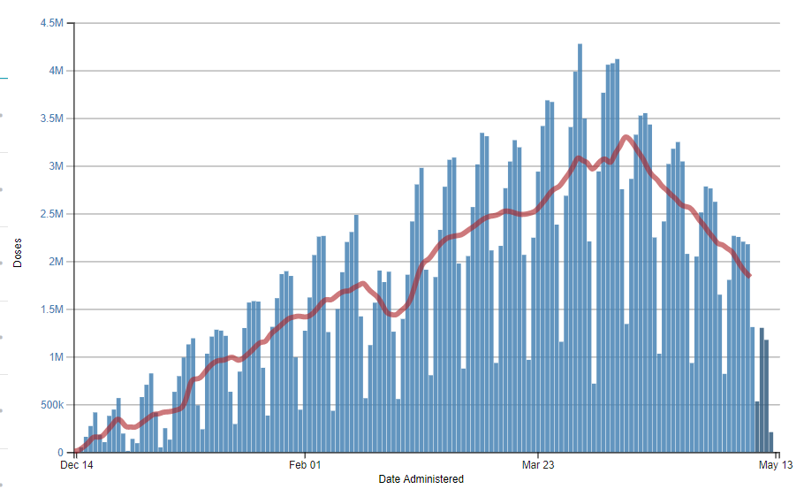
https://covid.cdc.gov/covid-data-tracker/#vaccination-demographics-trends 5/6/2021

Slide 11
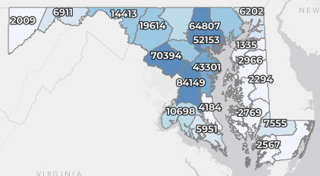
Maryland: COVID-19 Cases
http://health.maryland.gov/coronavirus
Data current as of 5/14/2021
Cases: 455,257
512 new
Deaths: 8,716
12 new
Hospitalizations: 42,469
Current: 680 (down 50)
Total tests: 9,874,331
Case rate: 7.6 per 100,000
Percent Positivity: 1.91% !!!

Slide 12
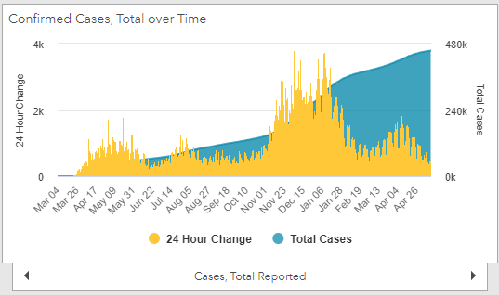
https://coronavirus.maryland.gov/ 5/14/2021

Slide 13
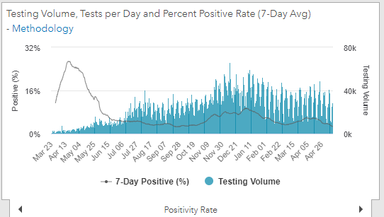
Testing Volume and % Positivity
https://coronavirus.maryland.gov/ 5/14/2021

Slide 14
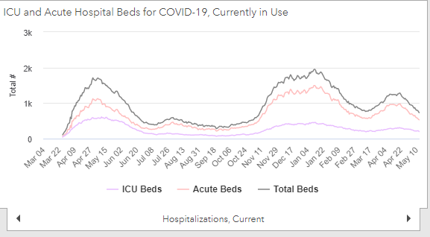
https://coronavirus.maryland.gov/ 5/14/2021

Slide 15
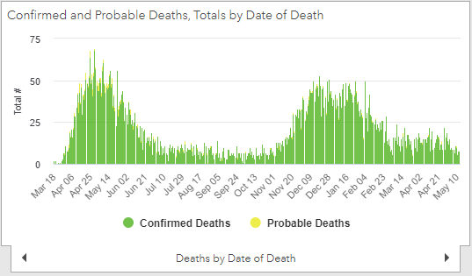
https://coronavirus.maryland.gov/ 5/14/2021

Slide 16
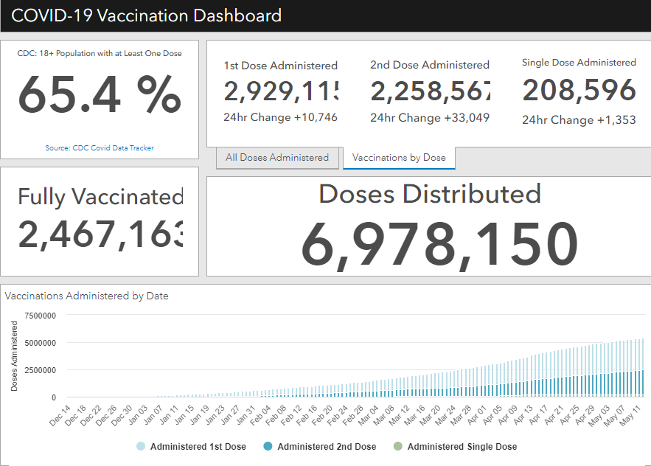
Maryland Vaccine Dashboard
https://coronavirus.maryland.gov/#Vaccine accessed 5/14/2021

Slide 17
Maryland Influenza Epi Update
Week Ending May 1, 2021
Influenza-like illness (ILI) activity in Maryland was minimal.
Maryland sentinel clinical laboratories tested 2,465 specimens for flu and 23 (0.9%) tested positive. Of those, 8 (35%) were influenza Type A and 15 (65%) were influenza Type B.
The Maryland Public Health Laboratory tested 26 specimens for influenza and 0 tested positive.
0 influenza-associated hospitalization was reported.
0 influenza-associated deaths were reported.
https://phpa.health.maryland.gov/influenza/Pages/flu-dashboard.aspx Accessed 5/12/2021

Slide 18
CDC Updates

Slide 19
CDC Interim Public Health Recommendations for Vaccinated People
Update that fully vaccinated people no longer need to wear a mask or physically distance in any setting, except where required by federal, state, local, tribal, or territorial laws, rules, and regulations, including local business and workplace guidance
Update that fully vaccinated people can refrain from testing following a known exposure unless they are residents or employees of a correctional or detention facility or a homeless shelter

Slide 20
CDC Interim Public Health Recommendations for Vaccinated People
For the purposes of this guidance, people are considered fully vaccinated for COVID-19 ≥2 weeks after they have received the second dose in a 2-dose series (Pfizer-BioNTech or Moderna), or ≥2 weeks after they have received a single-dose vaccine (Johnson and Johnson [J&J]/Janssen)±; there is currently no post-vaccination time limit on fully vaccinated status. Unvaccinated people refers to individuals of all ages, including children, that have not completed a vaccination series.

Slide 21
CDC Interim Public Health Recommendations for Vaccinated People
A growing body of evidence suggests that fully vaccinated people are less likely to have asymptomatic infection or transmit SARS-CoV-2 to others.
Indoor and outdoor activities pose minimal risk to fully vaccinated people.
Fully vaccinated people have a reduced risk of transmitting SARS-CoV-2 to unvaccinated people.
Fully vaccinated people should still get tested if experiencing COVID-19 symptoms
Fully vaccinated people should not visit private or public settings if they have tested positive for COVID-19 in the prior 10 days or are experiencing COVID-19 symptoms.
Fully vaccinated people should continue to follow any applicable federal, state, local, tribal, or territorial laws, rules, and regulations.
Note that MD still has an indoor mask mandate in place

Slide 22
FDA Updates

Slide 23
Pfizer Expanded Emergency Use Authorization
FDA authorizes the use of Pfizer-BioNTech COVID-19 vaccine for use in adolescents 12-15 years old
Already authorized for ages 16 and up
Clinical trial included 2,260 participants
1,131 adolescent participants received the vaccine
1,129 received a saline placebo.
The side effects in adolescents were consistent with those reported in clinical trial participants 16 years of age and older.
In this analysis, the immune response of adolescents was non-inferior to (at least as good as) the immune response of the older participants

Slide 24
MDH Updates

Slide 25
Governor’s Executive Orders 5/12/21
Governor's Executive Orders:
1. Certain Businesses and Facilities and Generally Requiring Use of Face Coverings
Effective 12:01 am on May 15:
All occupancy and operating restrictions are eliminated (indoor and outdoor)
Cruise terminal closure order is terminated
Order delegating authority to local health officials is terminated
2. Order Enabling Alternative Alcohol Services
Effective immediately, outdoor table size and distancing requirements for state-licensed alcoholic beverage manufacturers are eliminated
NOTE: Indoor mask mandates are still in effect
https://governor.maryland.gov/covid-19-pandemic-orders-and-guidance/

Slide 26
MDH Orders 5/12/21
MDH Orders:
1. Directive and Order Regulating Certain Businesses and Facilities & General Directives Concerning Limiting The Spread of COVID-19
As of 12:01 am, May 15, 2021:
All restrictions related to indoor dining will be lifted
6 ft distance between individuals becomes advisory for indoor dining, retail establishments
https://phpa.health.maryland.gov/Documents/2021.05.12.01%20General%20Directives%20Certain%20Businesses%20and%20Facilities.pdf

