Slide 1
Maryland Situation Update on Coronavirus Disease (COVID-19) for BHA
Maryland Department of Health
Infectious Disease Epidemiology and Outbreak Response Bureau
April 9, 2021

Slide 2
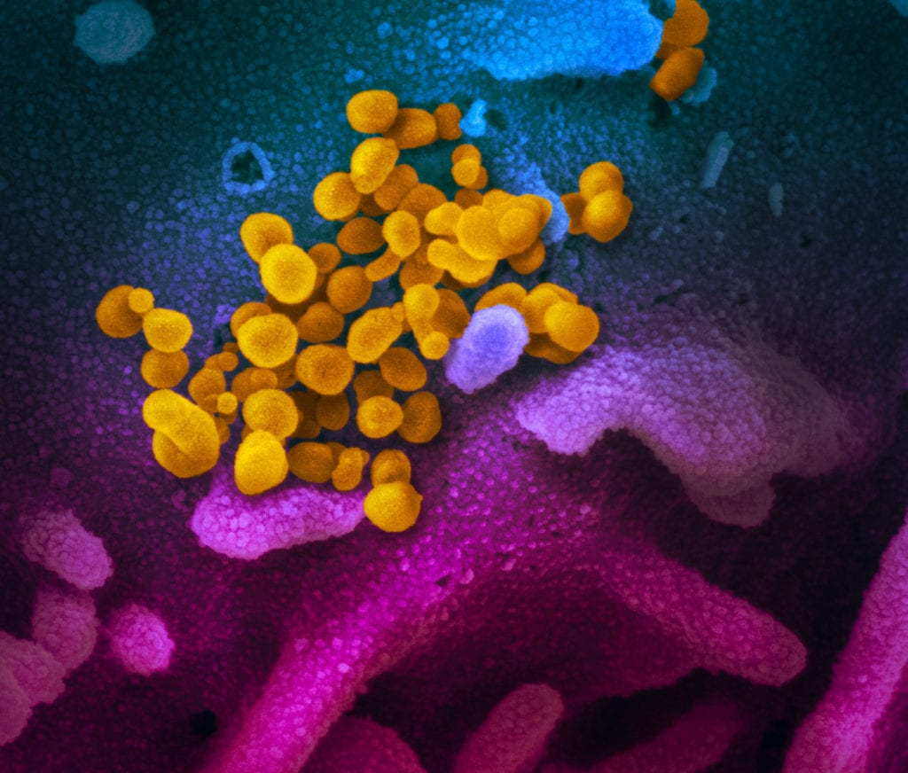
Call Agenda
Picture Courtesy of NIAID-RML
Review current situation of COVID-19
CDC Travel Updates
Lineages of COVID-19 in Maryland
Q and A

Slide 3
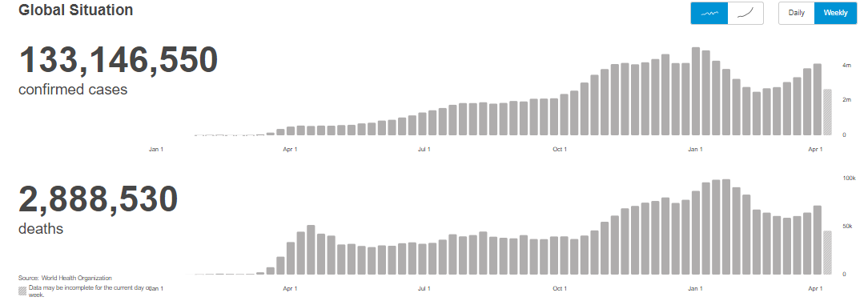
COVID-19 Global Situation Summary
https://covid19.who.int/ accessed 4/9/2021

Slide 4
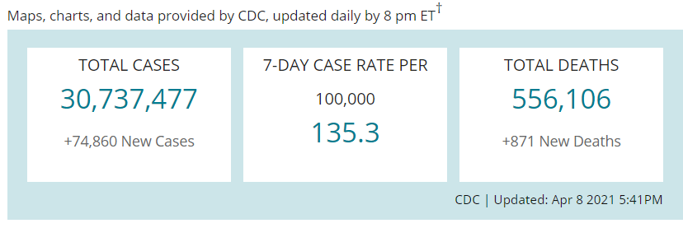
US Case Counts and Rates
https://www.cdc.gov/coronavirus/2019-ncov/cases-updates/cases-in-us.html Accessed 4/9/2021

Slide 5
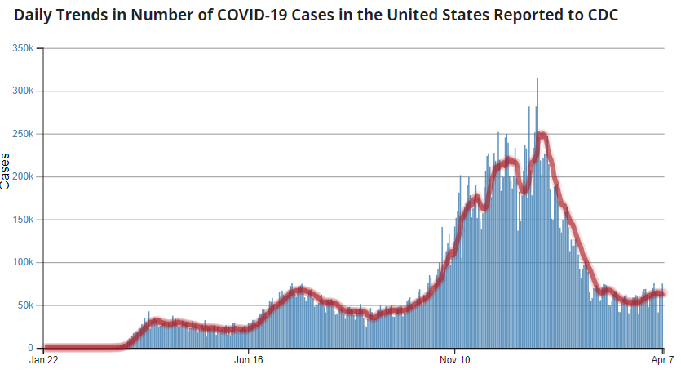
Number of Cases Reported in the USA, by Day
https://covid.cdc.gov/covid-data-tracker/#trends_dailytrendscases Updated 4/9/2021

Slide 6
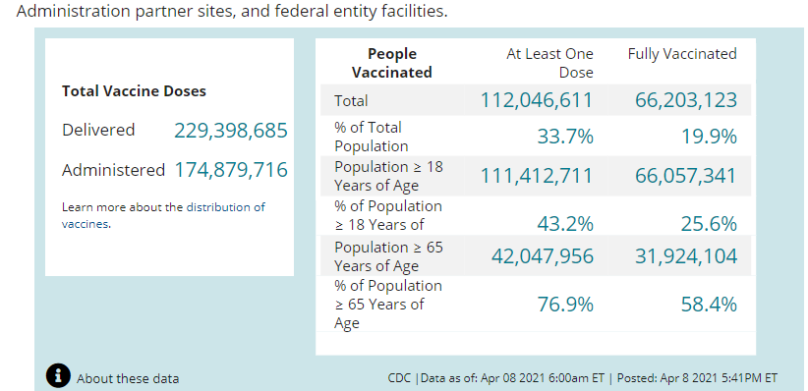
COVID-19 Vaccinations in the United States
https://covid.cdc.gov/covid-data-tracker/#vaccinations accessed 4/9/2021

Slide 7
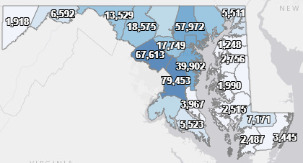
Maryland: COVID-19 Cases
http://health.maryland.gov/coronavirus
Data current as of 4/9/2021
Cases: 423,663
1,840 new
Deaths: 8,238
14 new
Hospitalizations: 38,969
Current: 1,249 Up 33)
Total tests: 9,046,422
Case rate: 21.9 per 100,000
Percent Positivity: 4.73%

Slide 8
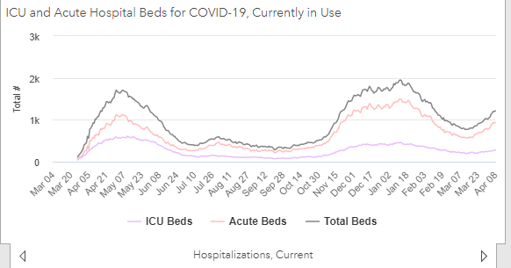
https://coronavirus.maryland.gov/ 4/9/2021

Slide 9
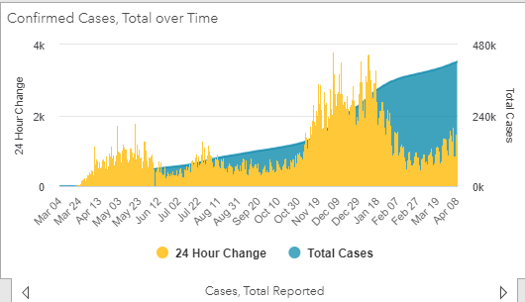
https://coronavirus.maryland.gov/ 4/9/2021

Slide 10
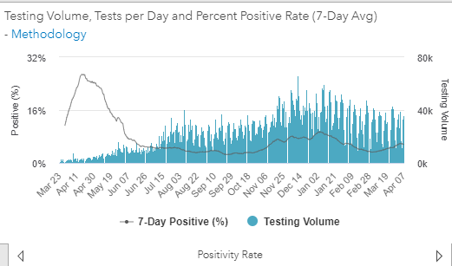
Testing Volume and % Positivity
https://coronavirus.maryland.gov/ 4/9/2021

Slide 11
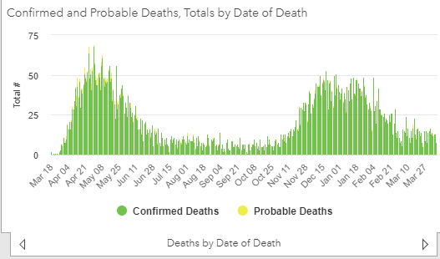
https://coronavirus.maryland.gov/ 4/9/2021

Slide 12
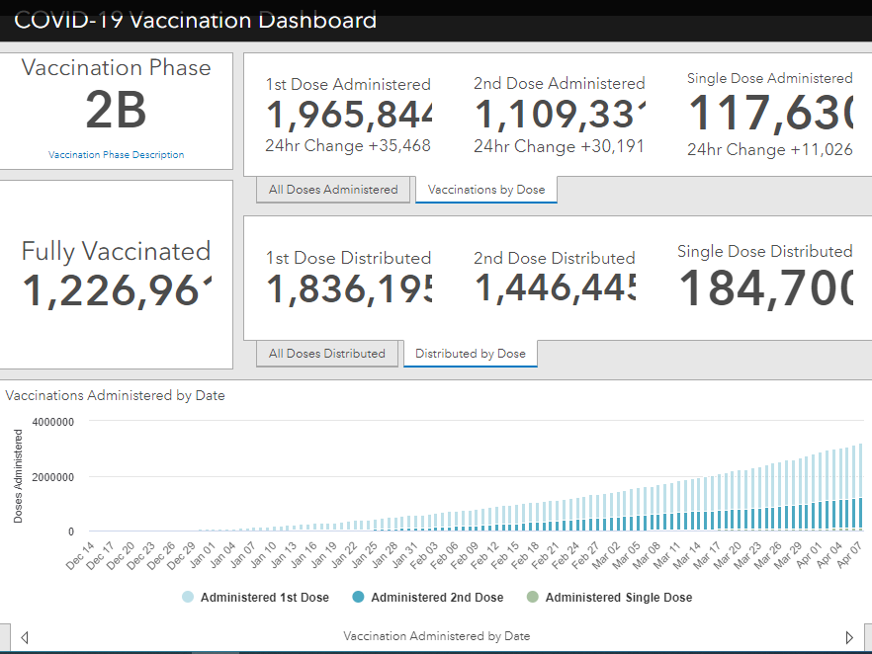
Maryland Vaccine Dashboard
https://coronavirus.maryland.gov/#Vaccine accessed 4/9/2021

Slide 13
Maryland Influenza Epi Update
Week Ending March 27th, 2021
Influenza-like illness (ILI) activity in Maryland was minimal

Slide 14
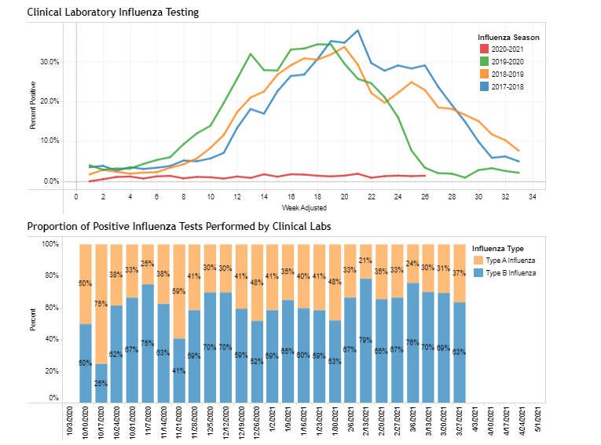
https://phpa.health.maryland.gov/influenza/Pages/flu-dashboard.aspx
4/9/2021

Slide 15
CDC Updates

Slide 16
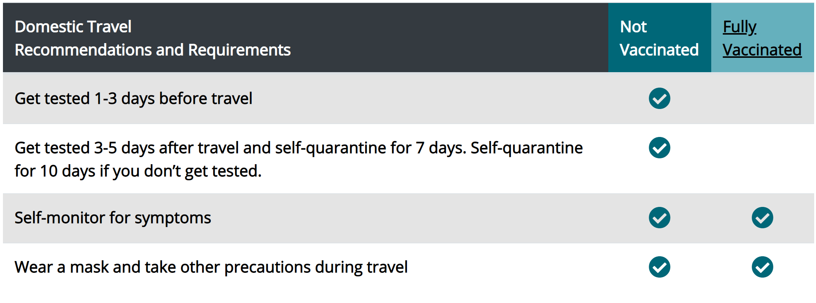
CDC: Domestic Travel During COVID-19
https://www.cdc.gov/coronavirus/2019-ncov/travelers/infographic/infographic-quick-reference.html accessed 4/6/21

Slide 17
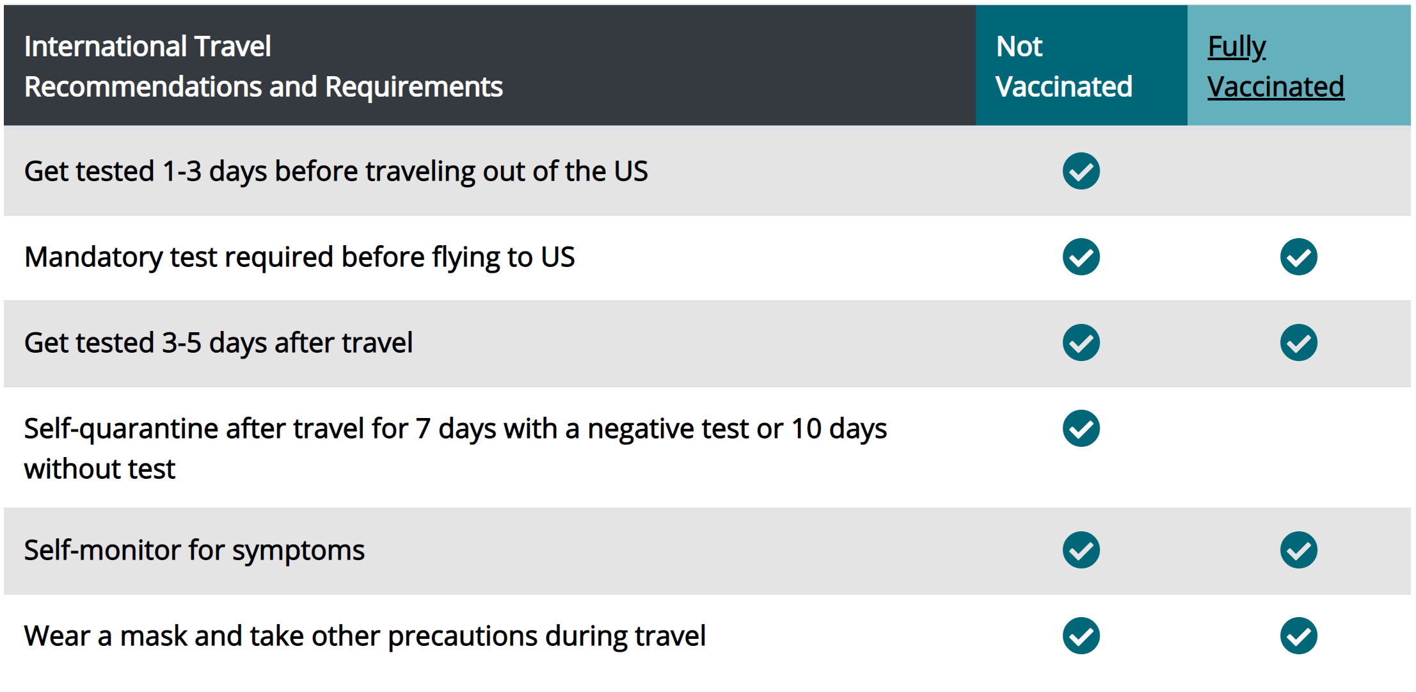
CDC: International Travel During COVID-19
https://www.cdc.gov/coronavirus/2019-ncov/travelers/infographic/infographic-international-quick-reference.html accessed 4/6/21

Slide 18
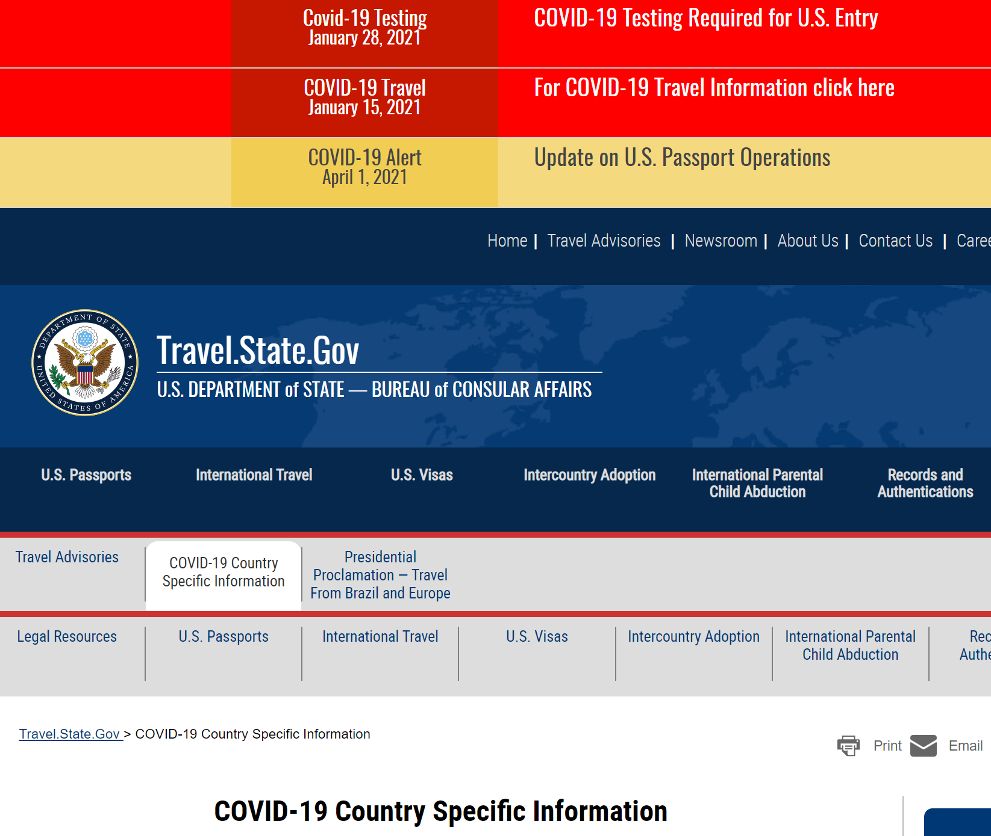
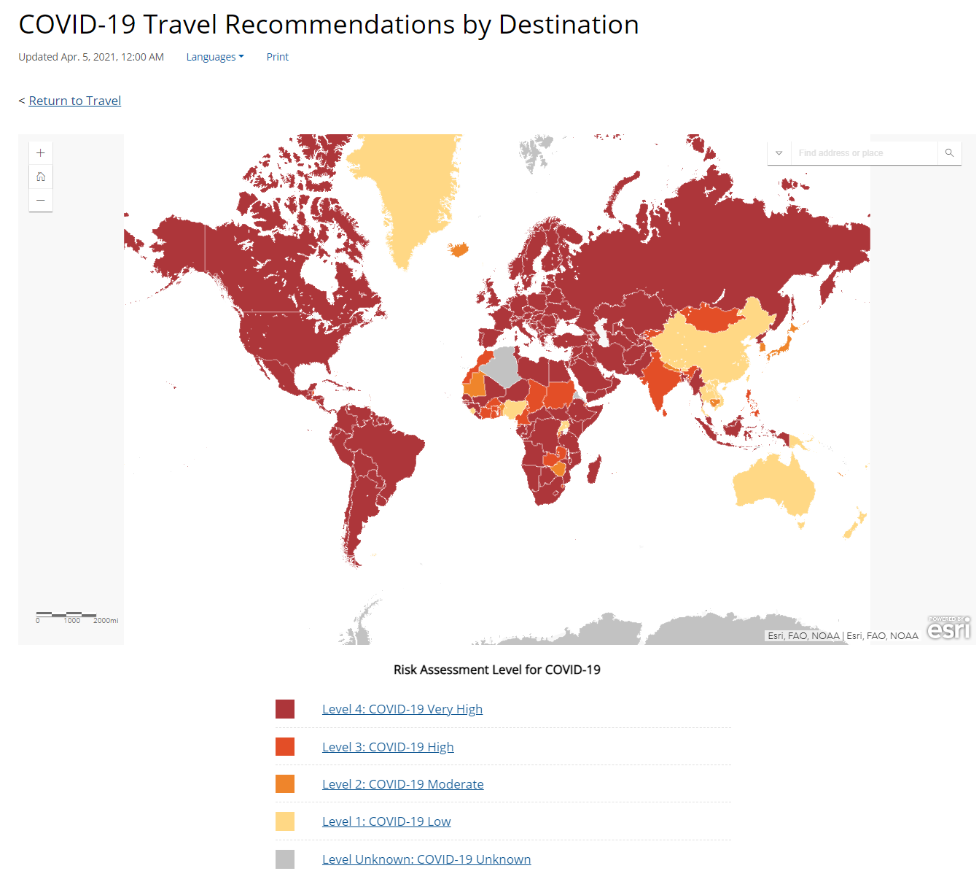
CDC: International Travel During COVID-19
https://travel.state.gov/content/travel/en/traveladvisories/COVID-19-Country-Specific-Information.html
https://www.cdc.gov/coronavirus/2019-ncov/travelers/map-and-travel-notices.html

Slide 19
Lineages of Published Sequenced Maryland SARS-CoV-2 Specimens
Kenneth A Feder, PhD
Epidemic Intelligence Service Officer
Centers for Disease Control and Prevention

Slide 20
Background
Variants of Interest and Concern: Designated SARS-Cov-2 lineages identified by CDC as being of elevated concern.
Possible reasons:
Increased infectiousness
Increased severity of illness
Reduced protection from acquired immunity from vaccination or previous infection
Reduced response to treatment
Current variants of concern: B.1.1.7, B.1.351, P.1, B.1.427, B.1.429
Current variants of interest: B.1.525, B.1.526, P.2

Slide 21
Tracking Variants of Concern in Maryland
Question: What is the prevalence of variants of concern and interest in Maryland?
Question: How much data do we have available to track these variants?

Slide 22
Data and Methods
Source: GISAID (formerly Global Initiative for Sharing Avian Influenza Data)
Largest public, online repository of results from SARS-CoV-2 sequencing
What is uploaded:
Full sequence (i.e. AATGTC…)
Lineage, based on sequence (e.g., B.1, B.1.351…)
Date and location of collection
Patients are not identified
Includes data from Maryland Public Health Laboratory, other participating private labs
Shown here:
Number GISAID specimens sequenced each week, by date of collection
Percent of GISAID specimens that are variants of concern, by date of collection

Slide 23
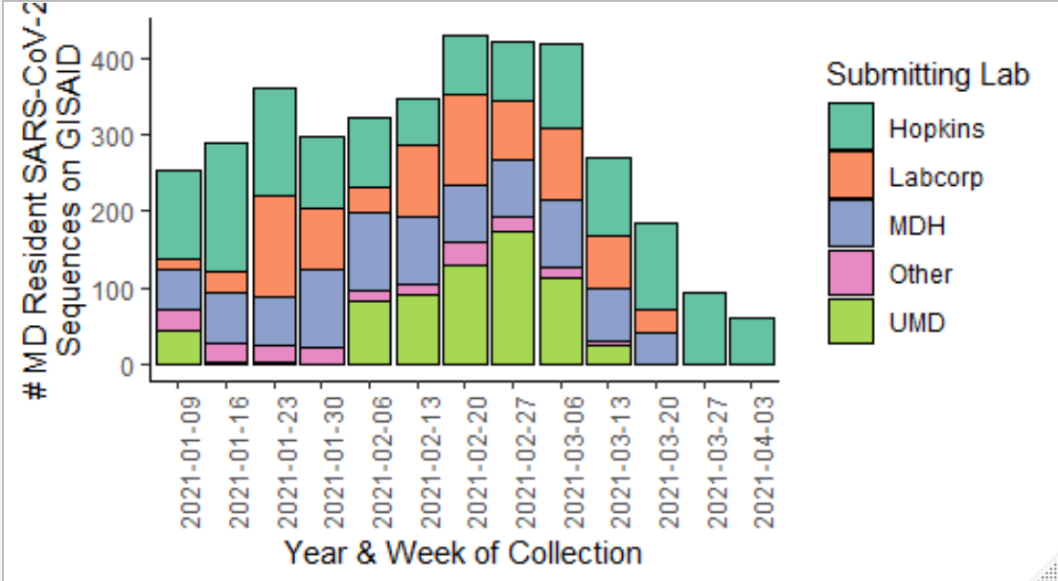
Volume of SARS-CoV-2 Specimens on GISAID by Sequencing Laboratory – Maryland, 2021

Slide 24
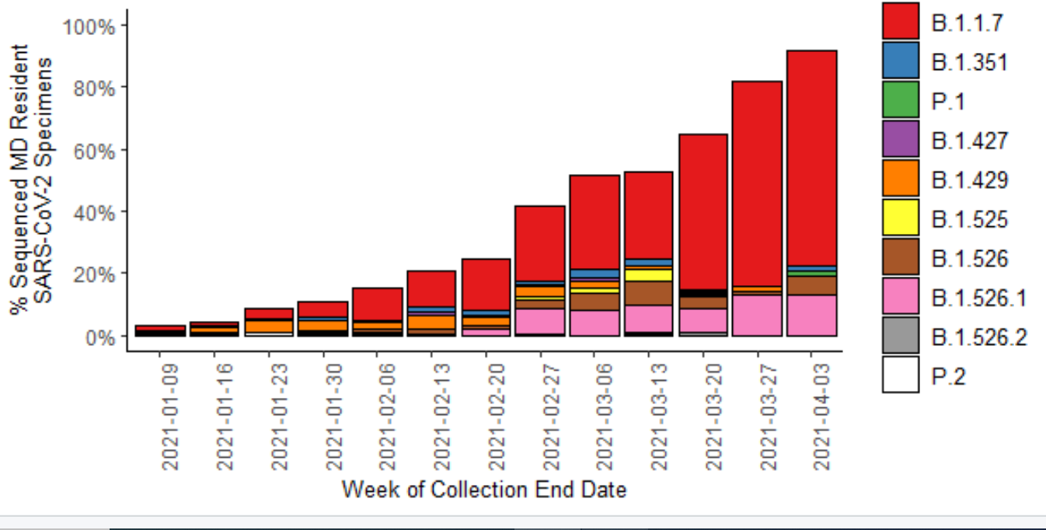
Prevalence of SARS-CoV-2 Lineages on GISAID by Week – Maryland, 2021

Slide 25
Key Points
CDC-designated “variants of concern” and “variants of interest” now majority of sequenced SARS-CoV-2 specimens in Maryland
Exponential growth, primarily driven by B.1.1.7 (“UK Variant”)
Key points on B.1.1.7:
Increased transmissibility
Increased severity of illness
Vaccines offer comparable protection
Also Significant growth of B.1.526 and its descendants
Possible reduced effectiveness of vaccines
Possible reduced effectiveness of some treatments
No increased severity of illness

Slide 26
Have a question?
Email MDH.IPCOVID@maryland.gov

