Slide 1
Maryland Situation Update on
Coronavirus Disease (COVID-19) for BHA
Maryland Department of Health
Infectious Disease Epidemiology and Outbreak Response Bureau
April 30, 2021

Slide 2
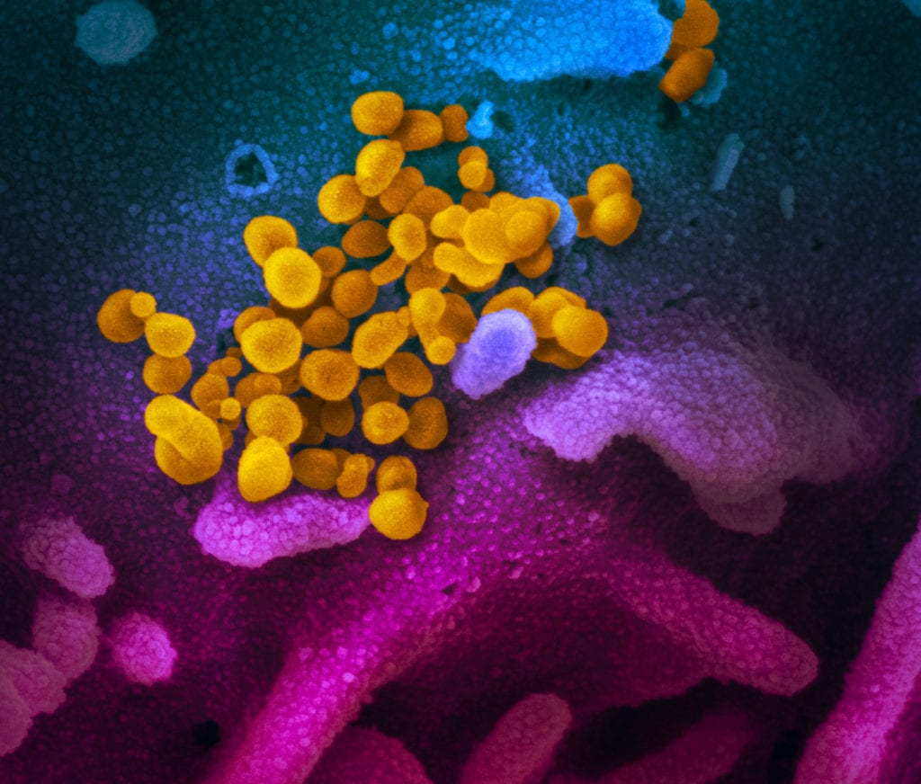
Call Agenda
Picture Courtesy of NIAID-RML
Review current situation of COVID-19
New MD Guidance
New CDC Guidance
Q and A

Slide 3
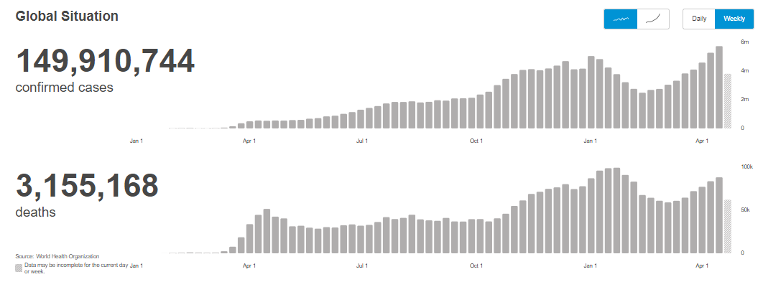
COVID-19 Global Situation Summary
https://covid19.who.int/ accessed 4/30/2021

Slide 4
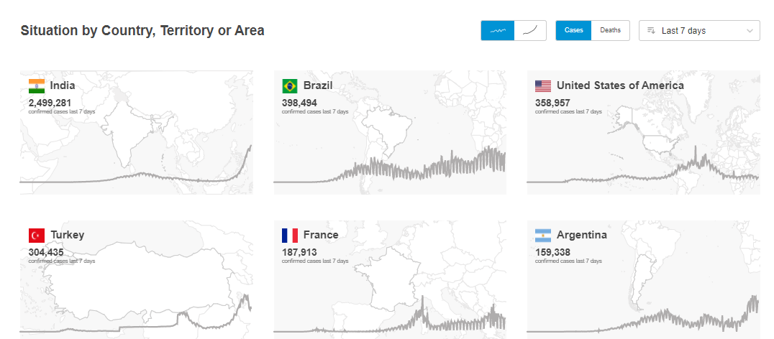
Highest Case Count Last 7 Days
https://covid19.who.int/ accessed 4/30/2021

Slide 5
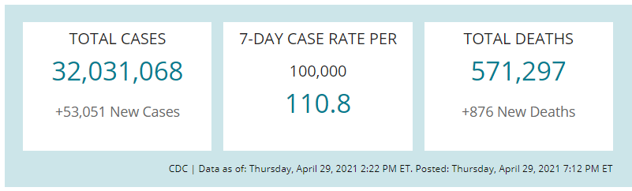
US Case Counts and Rates
https://www.cdc.gov/coronavirus/2019-ncov/cases-updates/cases-in-us.html Accessed 4/30/2021

Slide 6
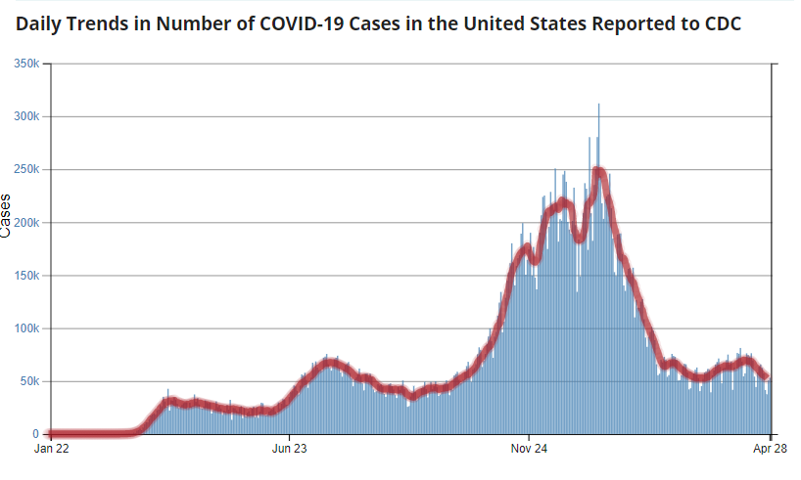
Number of Cases Reported in the USA, by Day
https://covid.cdc.gov/covid-data-tracker/#trends_dailytrendscases Updated 4/30/2021

Slide 7
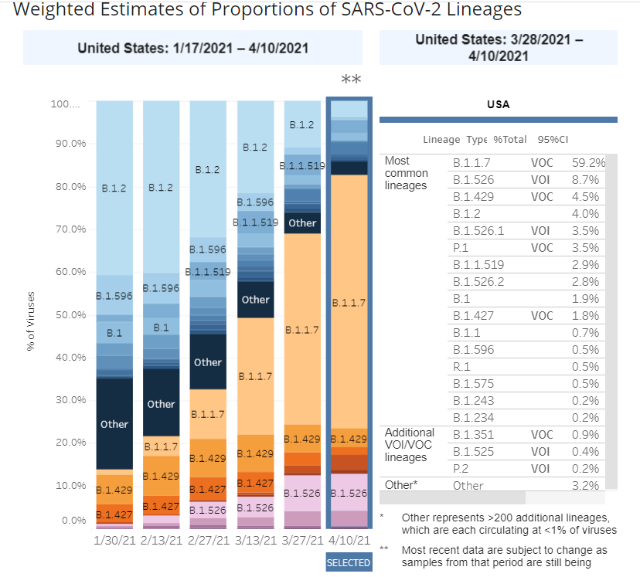
US: SARS-CoV-2 Variants
https://www.cdc.gov/coronavirus/2019-ncov/cases-updates/variant-proportions.html accessed 4/30/21

Slide 8
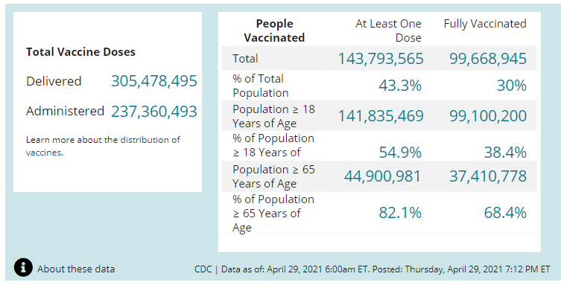
COVID-19 Vaccinations in the United States
https://covid.cdc.gov/covid-data-tracker/#vaccinations accessed 4/30/2021

Slide 9
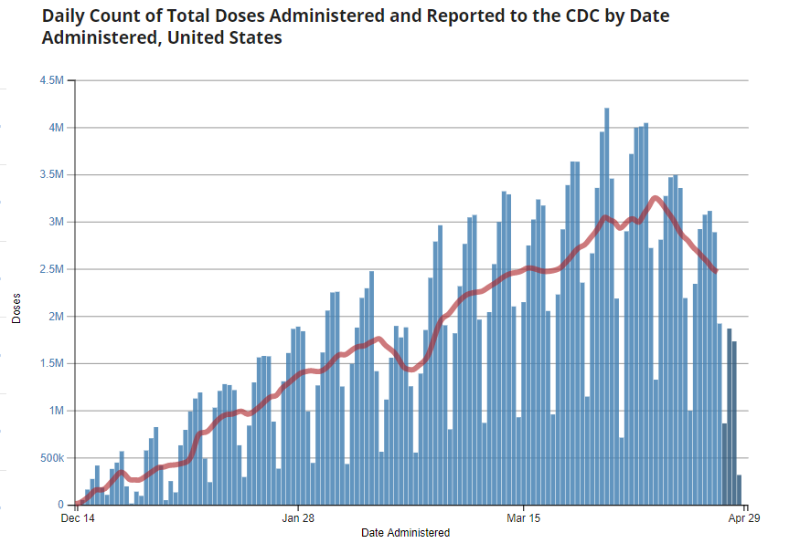
https://covid.cdc.gov/covid-data-tracker/#vaccination-demographics-trends 4/30/2021

Slide 10
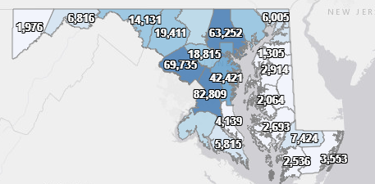
Maryland: COVID-19 Cases
http://health.maryland.gov/coronavirus
Data current as of 4/30/2021
Cases: 447,401
  942 new
Deaths: 8,555
  25 new
Hospitalizations: 41,434
  Current: 1,042 (down 38)
Total tests: 9,689,373
Case rate: 14.8 per 100,000
Percent Positivity: 3.24%

Slide 11
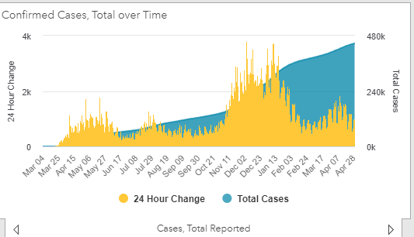
https://coronavirus.maryland.gov/ 4/30/2021

Slide 12
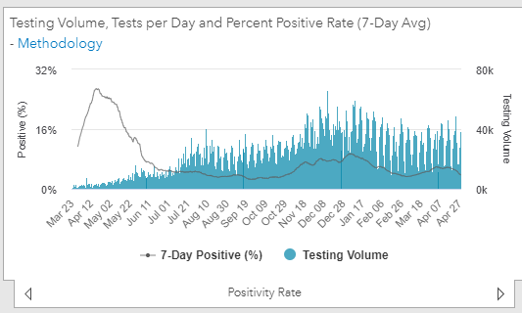
Testing Volume and % Positivity
https://coronavirus.maryland.gov/ 4/30/2021

Slide 13
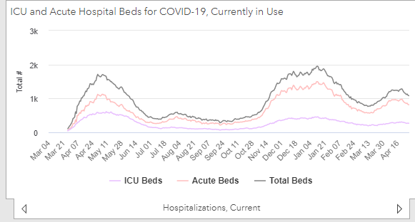
https://coronavirus.maryland.gov/ 4/30/2021

Slide 14
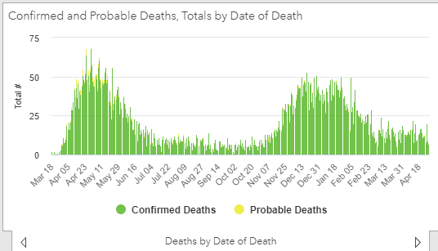
https://coronavirus.maryland.gov/ 4/30/2021

Slide 15
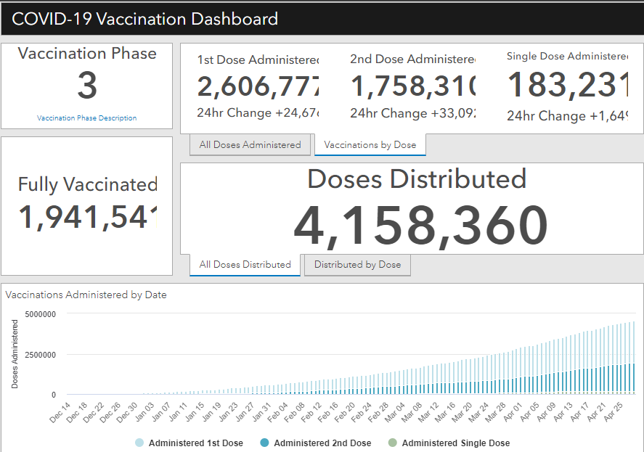
Maryland Vaccine Dashboard
https://coronavirus.maryland.gov/#Vaccine accessed 4/30/2021

Slide 16
Maryland Influenza Epi Update
Week Ending April 10, 2021
Influenza-like illness (ILI) activity in Maryland was minimal.
Maryland sentinel clinical laboratories tested 2,868 specimens for flu and 45 (1.6%) tested positive. Of those, 15 (33%) were influenza Type A and 30 (67%) were influenza Type B.
The Maryland Public Health Laboratory tested 34 specimens for influenza and 0 tested positive.
0 influenza-associated hospitalization was reported.
0 influenza-associated deaths were reported.
https://phpa.health.maryland.gov/influenza/Pages/flu-dashboard.aspx Accessed 4/20/2021

Slide 17
Maryland Influenza Epi Update
Week Ending April 17, 2021
Influenza-like illness (ILI) activity in Maryland was minimal.
Maryland sentinel clinical laboratories tested 3,088 specimens for flu and 32 (1.0%) tested positive. Of those, 9 (28%) were influenza Type A and 23 (72%) were influenza Type B.
The Maryland Public Health Laboratory tested 40 specimens for influenza and 0 tested positive.
0 influenza-associated hospitalization was reported.
0 influenza-associated deaths were reported.
https://phpa.health.maryland.gov/influenza/Pages/flu-dashboard.aspx Accessed 4/27/2021

Slide 18
Maryland Updates
Current as of 4/28/21

Slide 19
Governor’s Executive Order 21-04-28-01
OUTDOOR MASK MANDATE:
  Masks and face coverings are no longer required outdoors in the State of Maryland, in line with new CDC guidance.
  Face coverings are still required for all Marylanders at all large ticketed venues, indoors at all public and private businesses, and when using public transportation.
  Marylanders who are not yet vaccinated are strongly encouraged to continue wearing masks, especially when physical distancing is not possible.
  https://governor.maryland.gov/wp-content/uploads/2021/04/Gatherings-22d-AMENDED-4.28.21.pdf

Slide 20
Governor’s Executive Order 21-04-28-01
EFFECTIVE SATURDAY, MAY 1:
OUTDOOR DINING- Standing service may resume outdoors at bars and restaurants and all restrictions related to outdoor dining capacity and distancing will be lifted. Seated service and physical distancing requirements will remain in place indoors at bars and restaurants.
https://governor.maryland.gov/wp-content/uploads/2021/04/Gatherings-22d-AMENDED-4.28.21.pdf

Slide 21
Updates to CDC Guidance and CMS Regulations
Current as of 4/27/21

Slide 22
CDC: Interim Public Health Guidelines for Fully Vaccinated People (in non-healthcare settings) Updated 4/27/21
Fully vaccinated people can:
Visit with other fully vaccinated people indoors without wearing masks or physical distancing
Visit with unvaccinated people (including children) from a single household who are at low risk for severe COVID-19 disease indoors without wearing masks or physical distancing
Participate in outdoor activities and recreation without a mask, except in certain crowded settings and venues
Resume domestic travel and refrain from testing before or after travel or self-quarantine after travel
Refrain from testing before leaving the United States for international travel (unless required by the destination) and refrain from self-quarantine after arriving back in the United States
Refrain from testing following a known exposure, if asymptomatic, with some exceptions for specific settings
Refrain from quarantine following a known exposure if asymptomatic
Refrain from routine screening testing if asymptomatic and feasible
https://www.cdc.gov/coronavirus/2019-ncov/vaccines/fully-vaccinated-guidance.html

Slide 23
CDC: Interim Public Health Guidelines for Fully Vaccinated People (in non-healthcare settings) Updated 4/27/21
For now, fully vaccinated people should continue to:
Take precautions in indoor public settings like wearing a well-fitted mask
Wear well-fitted masks when visiting indoors with unvaccinated people who are at increased risk for severe COVID-19 disease or who have an unvaccinated household member who is at increased risk for severe COVID-19 disease
Wear well-fitted masks when visiting indoors with unvaccinated people from multiple households
Avoid indoor large-sized in-person gatherings
Get tested if experiencing COVID-19 symptoms
Follow guidance issued by individual employers
Follow CDC and health department travel requirements and recommendations
https://www.cdc.gov/coronavirus/2019-ncov/vaccines/fully-vaccinated-guidance.html

Slide 24
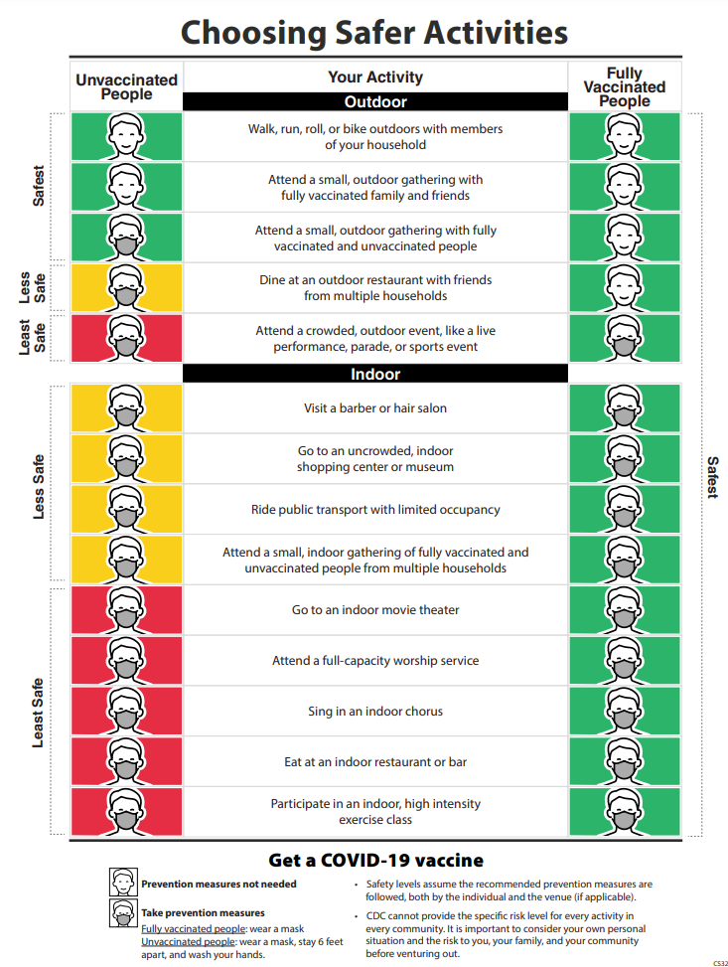
CDC: Fully Vaccinated Individuals In Non-Healthcare Settings
CDC Interim Public Health Guidelines for Fully Vaccinated People (updated 4/27/21: https://www.cdc.gov/coronavirus/2019-ncov/vaccines/fully-vaccinated-guidance.html

Slide 25
CDC: Updated Healthcare Infection Prevention and Control Recommendations in Response to COVID-19 Vaccination
Updated 4/27/21
VISITOR MASK USE
Visitors, regardless of their vaccination status, should wear a well-fitting cloth mask, facemask, or respirator for source control, except:
When both the patient and all their visitors are fully vaccinated:
  While alone in the patient/resident’s room or the designated visitation room, patients/residents and their visitor(s) can choose to have close contact (including touch) and to not wear source control.
Visitors should wear source control and physically distance from healthcare personnel and other residents/visitors that are not part of their group at all other times while in the facility.
https://www.cdc.gov/coronavirus/2019-ncov/hcp/infection-control-after-vaccination.html

Slide 26
CDC: Updated Healthcare Infection Prevention and Control Recommendations in Response to COVID-19 Vaccination
Updated 4/27/21
COMMUNAL ACTIVITIES
Group activities:
  If all residents participating in the activity are fully vaccinated, then they may choose to have close contact and to not wear source control during the activity
  If unvaccinated residents are present, then all participants in the group activity should wear source control and unvaccinated residents should physically distance from others
Communal dining:
  Fully vaccinated residents can participate in communal dining without use of source control or physical distancing
  If unvaccinated residents are dining in a communal area (e.g., dining room) all residents should use source control when not eating and unvaccinated residents should continue to remain at least 6 feet from others.
https://www.cdc.gov/coronavirus/2019-ncov/hcp/infection-control-after-vaccination.html

Slide 27
CDC: Updated Healthcare Infection Prevention and Control Recommendations in Response to COVID-19 Vaccination
Updated 4/27/21
COMMUNAL ACTIVITIES
Who should not participate in communal activities (or visitation except compassionate care)?
  Vaccinated and unvaccinated residents with SARS-CoV-2 infection, or in isolation because of suspected COVID-19, until they have met criteria to discontinue Transmission-Based Precautions.
  Vaccinated and unvaccinated residents in observation/quarantine until they have met criteria for release from quarantine.
If vaccination status cannot be determined, the safest practice is for all participants to follow all recommended infection prevention and control practices including maintaining physical distancing and wearing source control.
https://www.cdc.gov/coronavirus/2019-ncov/hcp/infection-control-after-vaccination.html

Slide 28
CMS: QSO-20-39 Nursing Home Visitation- COVID-19
Updated 4/27/21
Revised the Core Principles of COVID-19 Infection Prevention to include:
  Face covering or mask (covering mouth and nose) and social distancing at least six feet between persons, in accordance with CDC guidance.
Revised communal dining section to match CDC guidance:
  Residents who are fully vaccinated may dine and participate in activities without face coverings or social distancing if all participating residents are fully vaccinated; if unvaccinated residents are present during communal dining or activities, then all residents should use face coverings when not eating and unvaccinated residents should physically distance from others.
https://www.cms.gov/files/document/qso-20-39-nh-revised.pdf

Slide 29
CDC: Updated Healthcare Infection Prevention and Control Recommendations in Response to COVID-19 Vaccination
Updated 4/27/21
HCP MASKING
In general, fully vaccinated HCP should continue to wear source control while at work. However, fully vaccinated HCP could dine and socialize together in break rooms and conduct in-person meetings without source control or physical distancing.*
If unvaccinated HCP are present, everyone should wear source control and unvaccinated HCP should physically distance from others.
*Note the current MDH Nursing Home Matters Order requires masks at all times in the facility.
https://www.cdc.gov/coronavirus/2019-ncov/hcp/infection-control-after-vaccination.html

Slide 30
CDC: Updated Healthcare Infection Prevention and Control Recommendations in Response to COVID-19 Vaccination
Updated 4/27/21
SARS-CoV-2 TESTING
Anyone with symptoms of COVID-19, regardless of vaccination status, should receive a viral test immediately.
Asymptomatic HCP with a higher-risk exposure and residents with prolonged close contact with someone with SARS-CoV-2 infection, regardless of vaccination status, should have a series of two viral tests for SARS-CoV-2 infection. In these situations, testing is recommended immediately and 5–7 days after exposure.
  Exception: people with SARS-CoV-2 infection in the last 90 days do not need to be tested if they remain asymptomatic, including those with a known contact.
https://www.cdc.gov/coronavirus/2019-ncov/hcp/infection-control-after-vaccination.html

Slide 31
CDC: Updated Healthcare Infection Prevention and Control Recommendations in Response to COVID-19 Vaccination
Updated 4/27/21
SARS-CoV-2 TESTING
In healthcare facilities with an outbreak of SARS-CoV-2, recommendations for viral testing of HCP and residents (regardless of vaccination status) remain unchanged:
  Test HCP and residents every 3-7 days until no new cases are identified for 14 days.*
*MDH orders require at least one PCR per week during outbreak testing
https://www.cdc.gov/coronavirus/2019-ncov/hcp/infection-control-after-vaccination.html

Slide 32
CDC: Updated Healthcare Infection Prevention and Control Recommendations in Response to COVID-19 Vaccination
Updated 4/27/21
SARS-CoV-2 TESTING
Fully vaccinated HCP may be exempt from screening testing. However, vaccinated HCP should be tested if the HCP is symptomatic, has a higher-risk exposure or is working in a facility experiencing an outbreak.
Unvaccinated HCP should be tested as previously recommended in QSO-28-38.
https://www.cdc.gov/coronavirus/2019-ncov/hcp/infection-control-after-vaccination.html

Slide 33
CMS: QSO-20-38 LTC Facility Testing Requirements
Updated 4/27/21
Routine testing of unvaccinated staff should be based on the extent of the virus in the community. Fully vaccinated staff do not have to be routinely tested.
Facilities should use their county positivity rate in the prior week as the trigger for routine staff testing frequency.
COVID-19 county-level positivity rates are available on the following website (see section titled, “COVID19 Testing”): https://data.cms.gov/stories/s/COVID-19-Nursing-Home-Data/bkwz-xpvg
https://www.cms.gov/files/document/qso-20-38-nh.pdf

Slide 34
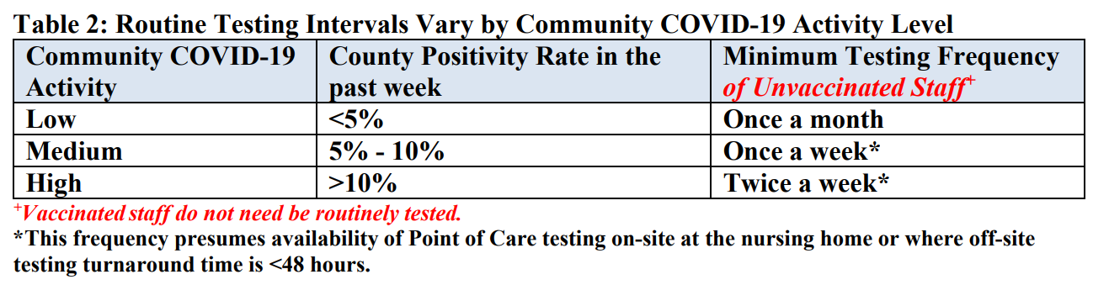
CMS: QSO-20-38 LTC Facility Testing Requirements
Updated 4/27/21
https://www.cms.gov/files/document/qso-20-38-nh.pdf

Slide 35
CMS: QSO-20-38 LTC Facility Testing Requirements
Updated 4/27/21
Testing of Staff and Residents with COVID-19 Symptoms or Signs
Staff with symptoms or signs of COVID-19, vaccinated or not vaccinated, must be tested immediately and are expected to be restricted from the facility pending the results of COVID-19 testing.
If COVID-19 is confirmed, staff should follow existing CDC Guidelines: Criteria for Return to Work for Healthcare Personnel with SARSCoV2 Infection.
Staff who do not test positive for COVID-19 but have symptoms should follow facility policies to determine when they can return to work.
https://www.cms.gov/files/document/qso-20-38-nh.pdf

Slide 36
CMS: QSO-20-38 LTC Facility Testing Requirements
Updated 4/27/21
Testing of Staff and Residents with COVID-19 Symptoms or Signs
Residents who have signs or symptoms of COVID-19, vaccinated or not vaccinated, must be tested immediately.
While test results are pending, residents with signs or symptoms should be placed on transmission-based precautions (TBP).
Once test results are obtained, the facility must take the appropriate actions based on the results.
https://www.cms.gov/files/document/qso-20-38-nh.pdf

Slide 37
CMS: QSO-20-38 LTC Facility Testing Requirements
Updated 4/27/21
Testing of Staff and Residents with an Exposure
For information on testing staff and residents who may have been exposed to COVID-19, see the CDC’s Updated Healthcare Infection Prevention and Control Recommendations in Response to COVID-19 Vaccination.
Test twice after higher-risk exposure
Resident quarantine still required for 14 days after exposure
https://www.cms.gov/files/document/qso-20-38-nh.pdf

Slide 38
CMS: QSO-20-38 LTC Facility Testing Requirements
Updated 4/27/21
Testing of Staff and Residents in Response to an Outbreak
Upon identification of a single new case of COVID-19 infection in any staff or residents, all staff and residents, regardless of vaccination status, should be tested immediately*, and all staff and residents that tested negative should be retested every 3 days to 7 days until testing identifies no new cases of COVID-19 infection among staff or residents for a period of at least 14 days since the most recent positive result.
*MDH orders require at least one PCR per week during outbreak testing
https://www.cms.gov/files/document/qso-20-38-nh.pdf

Slide 39
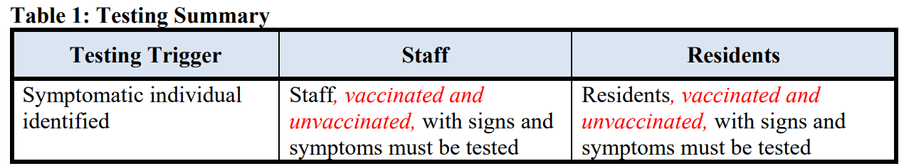
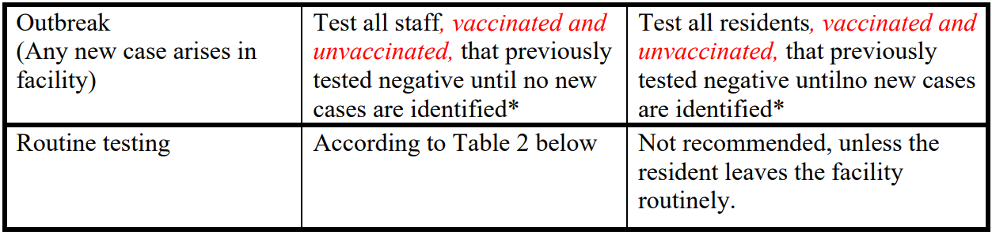
CMS: QSO-20-38 LTC Facility Testing Requirements
Updated 4/27/21
https://www.cms.gov/files/document/qso-20-38-nh.pdf

