Slide 1
Maryland Situation Update on Coronavirus Disease (COVID-19) for BHA
Maryland Department of Health
Infectious Disease Epidemiology and Outbreak Response Bureau
April 24, 2020

Slide 2
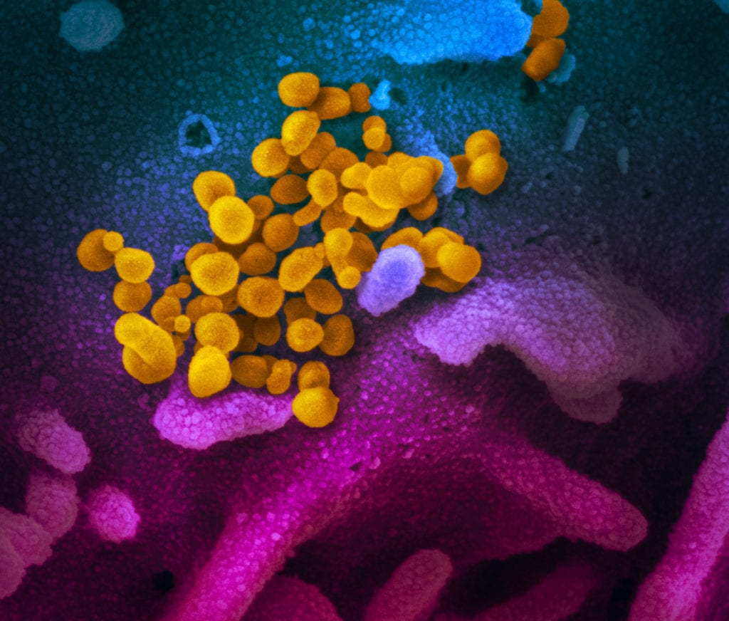
Call Agenda
Picture Courtesy of NIAID-RML
Review current situation of COVID-19
Asymptomatic testing
Types of masks
Antibody tests
Questions and Answers

Slide 3
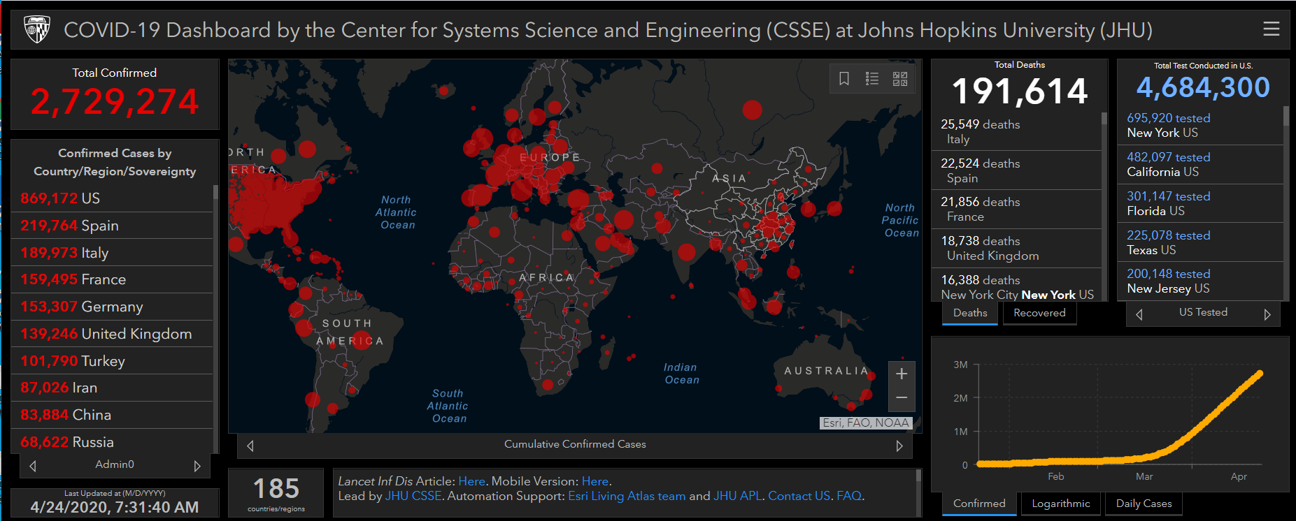
COVID-19 Global Situation Summary

Slide 4
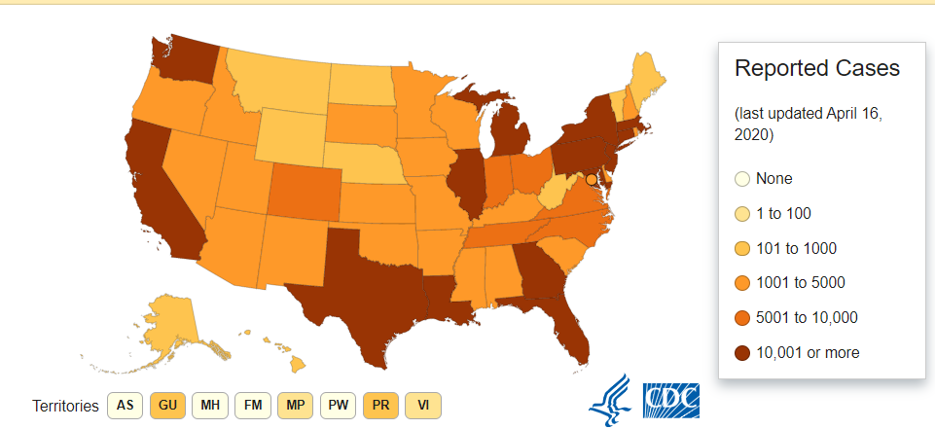
U.S.: COVID-19 Cases
828,441 Confirmed Cases
46,379 total deaths
55 states and territories reporting
Source: www.cdc.gov, accessed April 24th

Slide 5
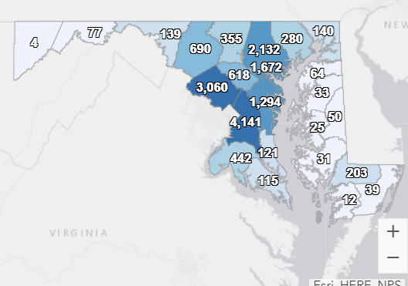
Maryland: COVID-19 Cases
http://health.maryland.gov/coronavirus
Data current as of April 24, 2020
Cases: 16,616
879 new
Deaths: 723
43 new
Hospitalizations: 3,618
141 new
Negative tests 68,100

Slide 6
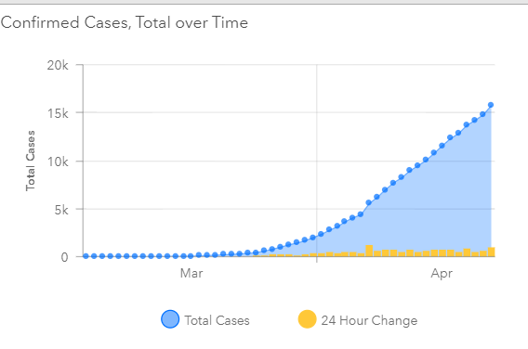

Slide 7
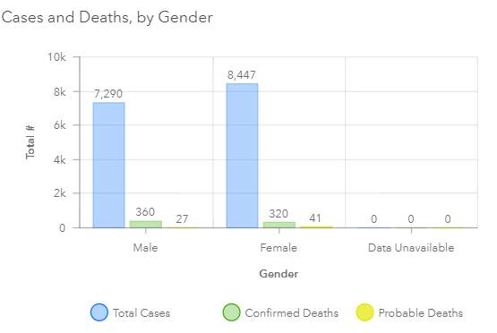

Slide 8
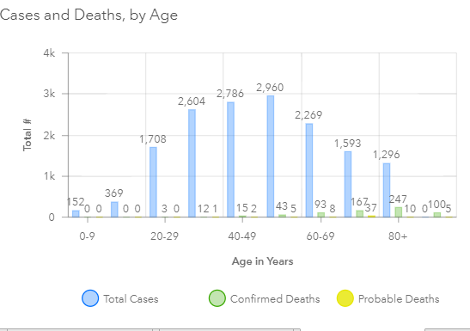

Slide 9
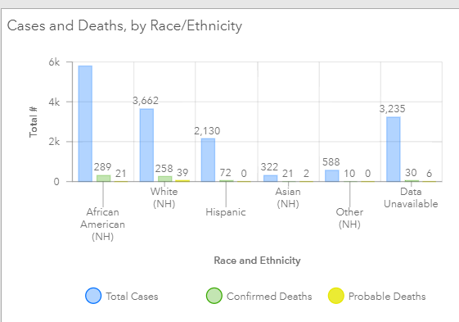

Slide 10
Notes about testing asymptomatic people
A negative test does not rule out COVID infection at a later date
Negative patients need to be re-tested if/when they develop symptoms
Negative patients may have asymptomatic infection after the date of test
Role of asymptomatic or pre-symptomatic shedding in transmission is unknown
Testing asymptomatic people is not a priority for laboratories, and is not recommended by providers
Not recommended to allow people to come to an appointment

Slide 11
COVID-19 and HIV infection
Risks of infection with COVID-19 in HIV + people are unknown
Immunosuppression is a documented risk factor for more severe disease
Low CD4 count
People with HIV who are not on ART
People with HIV should practice standard preventive measures
Social distancing
Hand hygiene
Public masking
Keep taking all prescribed medicines
https://www.cdc.gov/coronavirus/2019-ncov/need-extra-precautions/hiv.html

Slide 12
Surgical mask vs N95
N-95 Filters airborne particles (as small as 0.3 microns)
Not recommended for the general public
Not comfortable
Requires fit -testing
Surgical mask will catch most droplets
Large-particle droplets, splashes, sprays that may contain germs
Blocks droplets and fluids from outside sources
Contains droplets from the wearer too
https://www.fda.gov/medical-devices/personal-protective-equipment-infection-control/n95-respirators-and-surgical-masks-face-masks

Slide 13
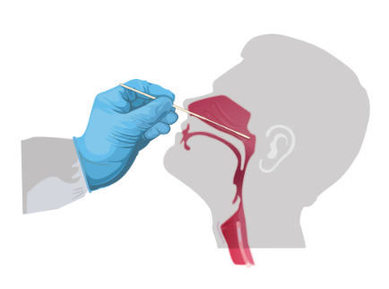
PCR testing
Detects viral RNA in the nose
May or may not indicate active infection
Viral shedding can be intermittent
Detects current or recent infection

Slide 14
Antibody testing
Not a diagnostic tool
May help identify people who have recovered from COVID-19
Unknown if antibodies confer immunity
Not all people who have recovered from COVID-19 have antibodies
Some tests may detect antibodies to some human coronaviruses
Lots of tests out there, but only 4 have gotten FDA emergency use authorization

Slide 15
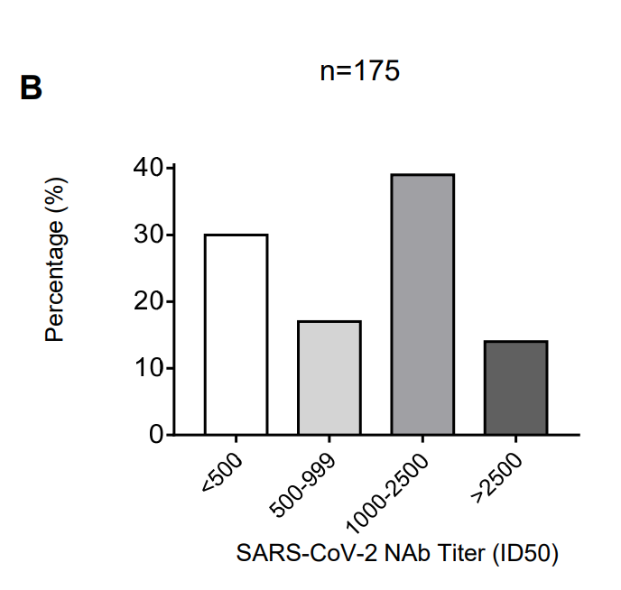
SARS-CoV-2 antibody responses
New Chinese study in medRxiv (not peer-reviewed)
175 recovered COVID-19+ patients with mild symptoms
Neutralizing Ab did not x-react w/ SARS-Cov
SARS-CoV-2 Ab detected 10-15d after onset
10/175 (5.7%) had undetectable levels of Ab → still undetectable 2 weeks later
30% overall had very low levels of Ab
Does not answer question of whether these Ab provide immunity or whether people w/o Ab response are vulnerable to re-infection
Wu et al. Neutralizing antibody responses to SARS-CoV-2 in a COVID-19 recovered patient cohort and their implications.

Slide 16
Resources
MDH Novel Coronavirus: http://health.maryland.gov/coronavirus
MDH Laboratory Coronavirus: https://health.maryland.gov/laboratories/Pages/Novel-Coronavirus.aspx
COVID-19 People at risk https://www.cdc.gov/coronavirus/2019-ncov/specific-groups/high-risk-complications.html
CDC Guidance for Infection Control https://www.cdc.gov/coronavirus/2019-nCoV/infection-control.html
EPA List N Disinfectants with COVID-19 claim https://www.epa.gov/pesticide-registration/list-n-disinfectants-use-against-sars-cov-2
Conserving PPE https://www.cdc.gov/coronavirus/2019-ncov/hcp/ppe-strategy/index.html

Slide 17
Questions?
Email : mdh.ipcovid@Maryland.gov

