Slide 1
Maryland Situation Update on Coronavirus Disease (COVID-19) for BHA
Maryland Department of Health
Infectious Disease Epidemiology and Outbreak Response Bureau
April 16, 2021

Slide 2
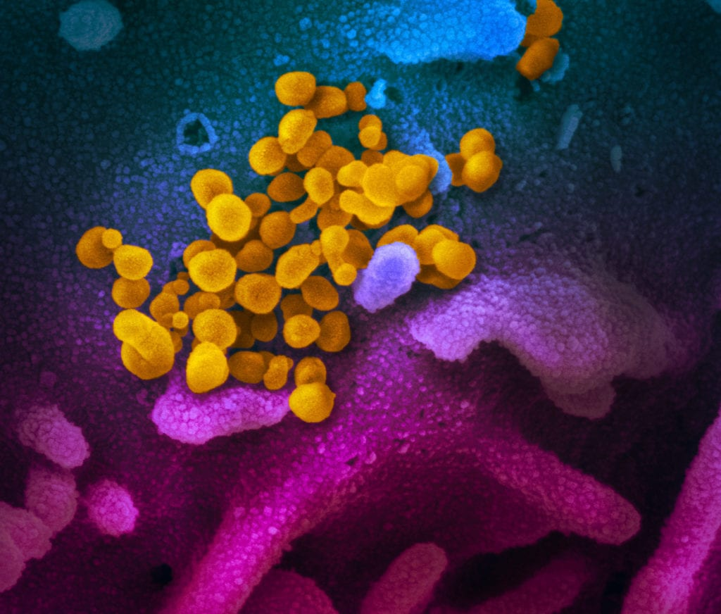
Call Agenda
Picture Courtesy of NIAID-RML
Review current situation of COVID-19
Janssen Vaccine Update
Q and A

Slide 3
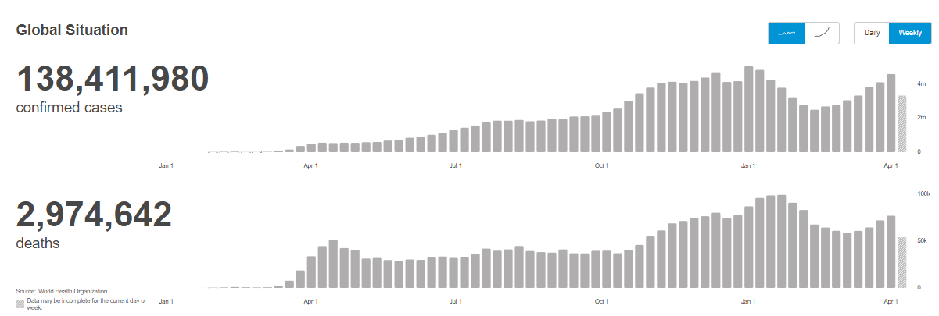
COVID-19 Global Situation Summary
https://covid19.who.int/ accessed 4/9/2021

Slide 4
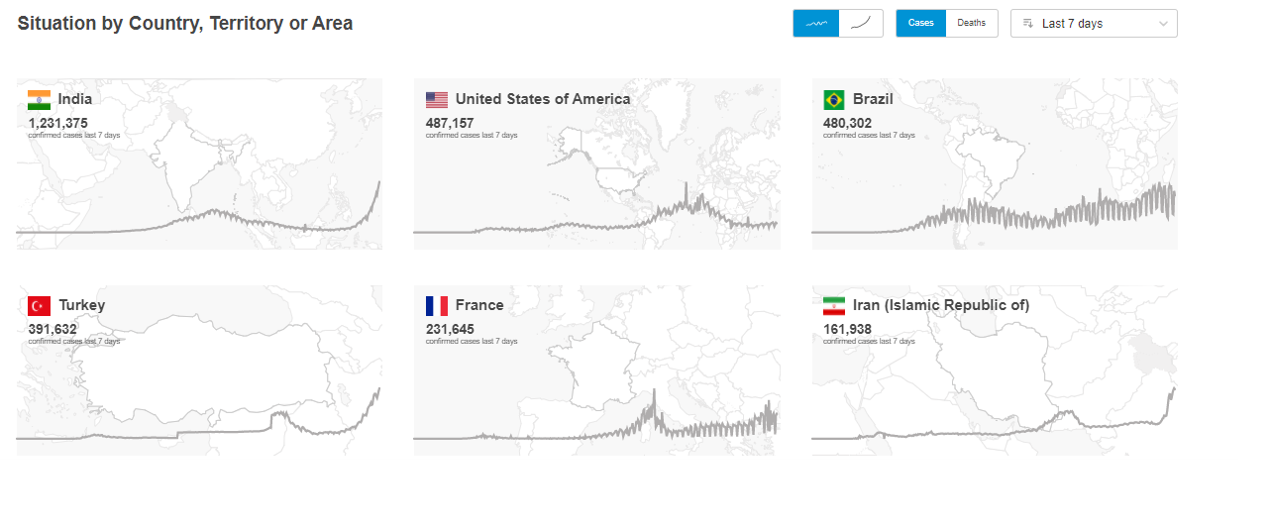
Highest Case Counts in the Last 7 Days

Slide 5
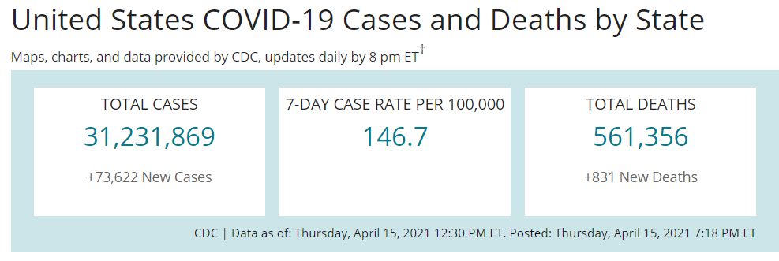
US Case Counts and Rates
https://www.cdc.gov/coronavirus/2019-ncov/cases-updates/cases-in-us.html Accessed 4/16/2021

Slide 6
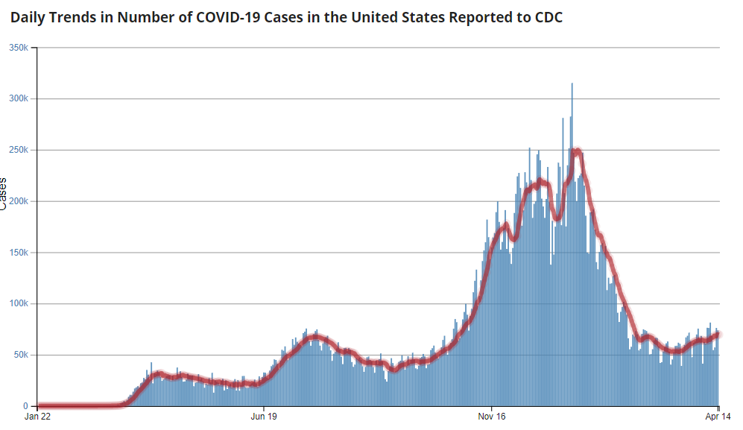
Number of Cases Reported in the USA, by Day
https://covid.cdc.gov/covid-data-tracker/#trends_dailytrendscases Updated 4/16/2021

Slide 7
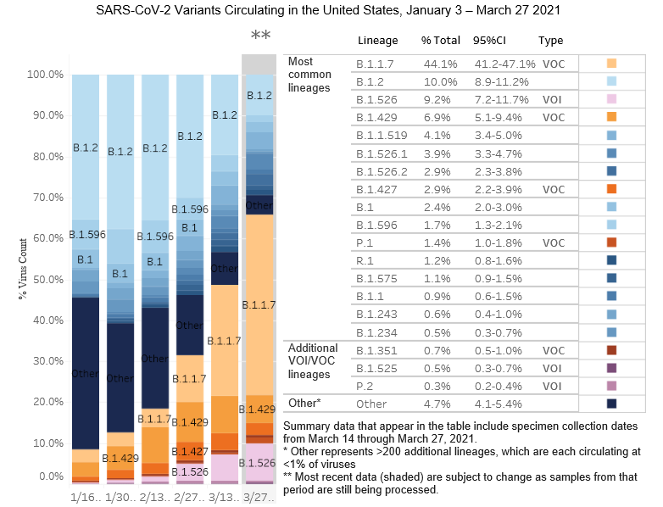
US: SARS-CoV-2 Variants
https://www.cdc.gov/coronavirus/2019-ncov/cases-updates/variant-proportions.html accessed 4/16/21

Slide 8
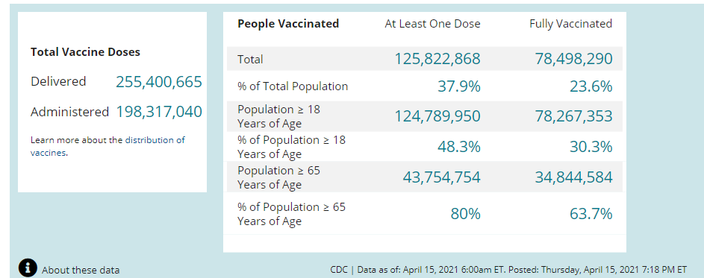
COVID-19 Vaccinations in the United States
https://covid.cdc.gov/covid-data-tracker/#vaccinations accessed 4/16/2021

Slide 9
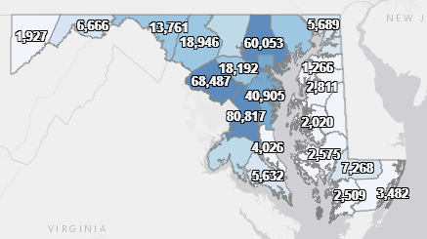
Maryland: COVID-19 Cases
http://health.maryland.gov/coronavirus
Data current as of 4/16/2021
Cases: 433,359
1,564 new
Deaths: 8,348
16 new
Hospitalizations: 38,969
Current: 1,249 (down 12)
Total tests: 9,265,525
Case rate: 22.9 per 100,000
Percent Positivity: 3.93%

Slide 10
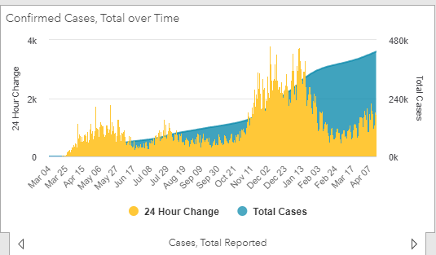
https://coronavirus.maryland.gov/ 4/16/2021

Slide 11
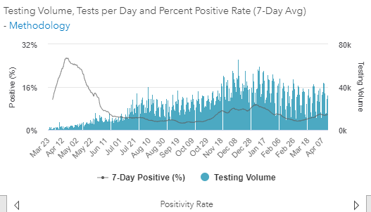
Testing Volume and % Positivity
https://coronavirus.maryland.gov/ 4/16/2021

Slide 12
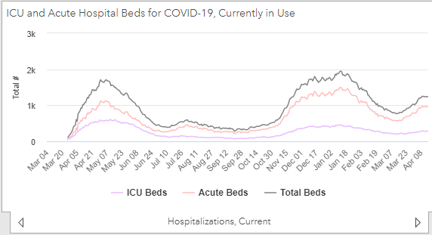
https://coronavirus.maryland.gov/ 4/16/2021

Slide 13
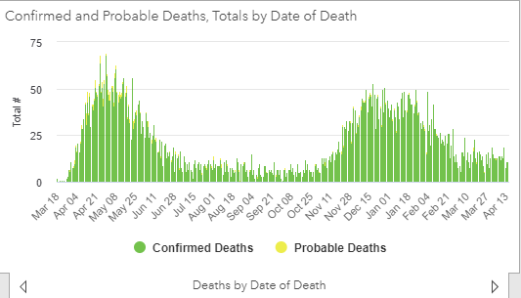
https://coronavirus.maryland.gov/ 4/16/2021

Slide 14
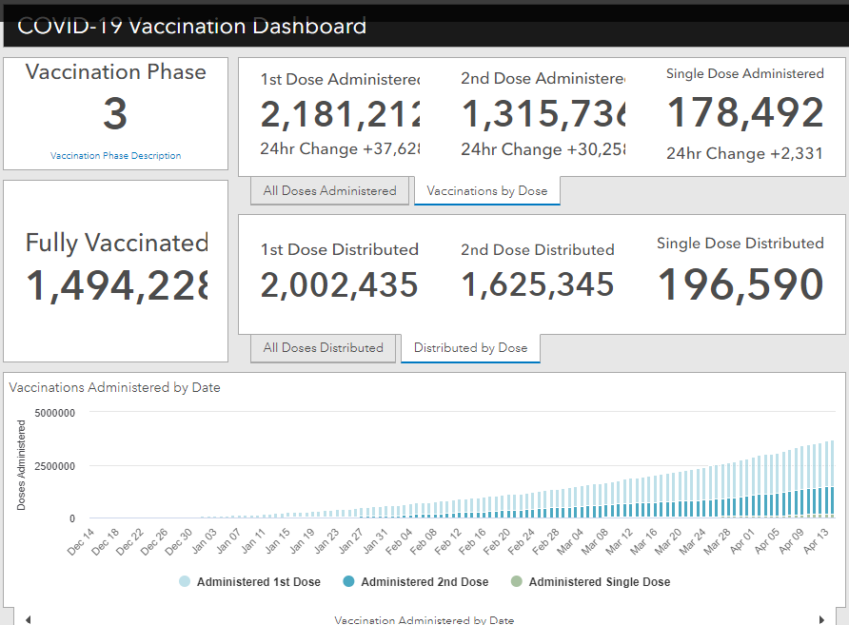
Maryland Vaccine Dashboard
https://coronavirus.maryland.gov/#Vaccine accessed 4/16/2021

Slide 15
Maryland Influenza Epi Update
Week Ending April 3rd, 2021
Influenza-like illness (ILI) activity in Maryland was minimal

Slide 16
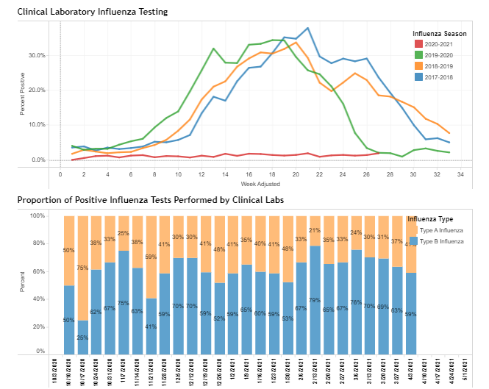
https://phpa.health.maryland.gov/influenza/Pages/flu-dashboard.aspx
4/15/2021

Slide 17
Joint CDC and FDA Update
Monique Duwell, MD, MPH
Chief, Center for Infectious Disease Surveillance and Outbreak Response

Slide 19
CDC Health Alert (April 13, 2021)
The CDC and FDA are reviewing data involving six U.S. cases of a rare type of blood clot in individuals after receiving the J&J COVID-19 vaccine that were reported to the Vaccine Adverse Event Reporting System (VAERS).
In these cases, a cerebral venous sinus thrombosis (CVST) was seen in combination with thrombocytopenia. All six cases occurred among women aged 18–48 years. The interval from vaccine receipt to symptom onset ranged from 6–13 days. One patient died.
The pathogenesis of these rare and unusual adverse events after vaccination may be associated with platelet-activating antibodies against platelet factor-4 (PF4), a type of protein.

Slide 20
CDC Health Alert (April 13, 2021)
Providers should maintain a high index of suspension for symptoms that might represent serious thrombotic events or thrombocytopenia in patients who have recently received the J&J COVID-19 vaccine.
When these specific types of blood clots are observed following J&J COVID-19 vaccination, treatment is different from the treatment that might typically be administered for blood clots.
Usually, the anticoagulant drug called heparin is used to treat blood clots. In this setting, the use of heparin may be harmful, and alternative treatments need to be given.
CDC and FDA are recommending a pause in the use of the J&J COVID-19 vaccine out of an abundance of caution.

Slide 21
CDC Health Alert (April 13, 2021)
To date, VAERS has received no reports of CVST with thrombocytopenia among persons who received either of the two mRNA-based COVID-19 vaccines.
These reports following the J&J COVID-19 vaccine are similar to reports of thrombotic events with thrombocytopenia after receipt of the AstraZeneca COVID-19 vaccine in Europe. Both vaccines contain replication-incompetent adenoviral vectors that encode the spike glycoprotein of SARS-CoV-2.

Slide 22
CDC Health Alert (April 13, 2021)
For the Public
If you have received the J&J COVID-19 vaccine and develop severe headache, abdominal pain, leg pain, or shortness of breath within three weeks after vaccination, contact your healthcare provider, or seek medical care.
Report adverse events following receipt of any COVID-19 vaccine to VAERS.
If you are scheduled to receive the J&J vaccine, please contact your healthcare provider, vaccination location, or clinic to learn about additional vaccine availability.

Slide 23
MDH Clinician Letter (April 13, 2021)
Maryland Department of Health directs all Maryland COVID-19 vaccine providers to pause the administration of Johnson & Johnson COVID-19 vaccines.
Providers should mark any Janssen/J & J vaccine in their inventory “Do not use. Awaiting guidance,” and continue to maintain the cold chain for all supplies of Johnson & Johnson vaccines in a manner that prevents wastage.

Slide 24
MDH Clinician Letter (April 13, 2021)
Preliminary CDC recommendations:
Pause the use of the J&J COVID-19 vaccine until the ACIP is able to further review these CVST cases in the context of thrombocytopenia and assess their potential significance.
Maintain a high index of suspicion for symptoms that might represent serious thrombotic events or thrombocytopenia in patients who have recently received the J&J COVID-19 vaccine, including severe headache, backache, new neurologic symptoms, severe abdominal pain, shortness of breath, leg swelling, petechiae (tiny red spots on the skin), or new or easy bruising. Obtain platelet counts and screen for evidence of immune thrombotic thrombocytopenia.
In patients with a thrombotic event and thrombocytopenia after the J&J COVID-19 vaccine, evaluate initially with a screening PF4 enzyme-linked immunosorbent (ELISA) assay as would be performed for autoimmune heparin-induced thrombocytopenia (HIT). Consultation with a hematologist is strongly recommended.
Do not treat patients with thrombotic events and thrombocytopenia following receipt of J&J COVID-19 vaccine with heparin, unless HIT testing is negative.
If HIT testing is positive or unable to be performed in patients with thrombotic events and thrombocytopenia following receipt of J&J COVID-19 vaccine, non-heparin anticoagulants and high-dose intravenous immune globulin should be strongly considered.
Report adverse events to VAERS (https://vaers.hhs.gov/reportevent.html), including serious and life-threatening adverse events and deaths in patients following receipt of COVID-19 vaccines as required under the Emergency Use Authorizations for COVID-19 vaccines.

Slide 25
The Maryland Department of Health will provide more information on this situation when it becomes available.

Slide 26
Have a question?
Email MDH.IPCOVID@maryland.gov

