Slide 1
Maryland Situation Update on
Coronavirus Disease (COVID-19) for BHA
Maryland Department of Health
Infectious Disease Epidemiology and Outbreak Response Bureau
April 17, 2020

Slide 2

Call Agenda
Picture Courtesy of NIAID-RML
Review current situation of COVID-19
Updated Guidance
Questions and Answers

Slide 3
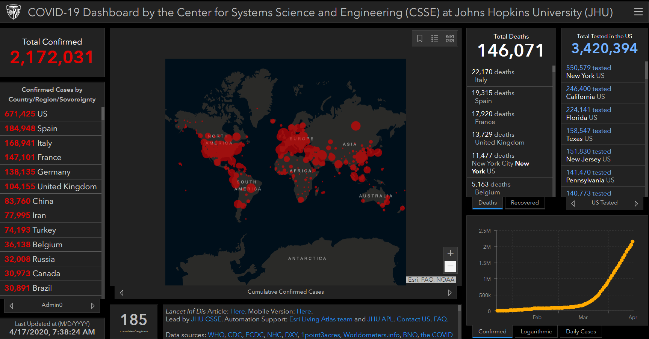
COVID-19 Global Situation Summary

Slide 4
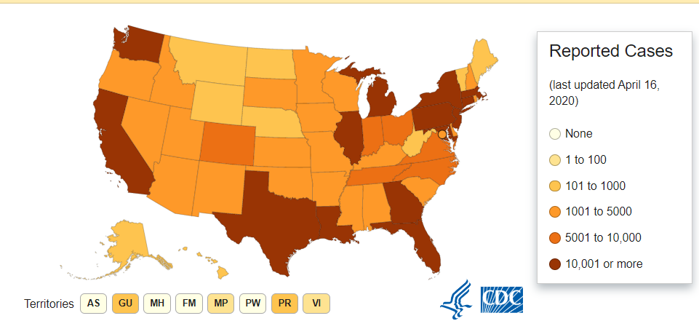
U.S.: COVID-19 Cases
632,548 Confirmed Cases
  6,814 Travel-related cases
  14,728 Close contact
  611,006 “Under investigation”
31071 total deaths
55 states and territories reporting
Source: www.cdc.gov, accessed April 17th

Slide 5
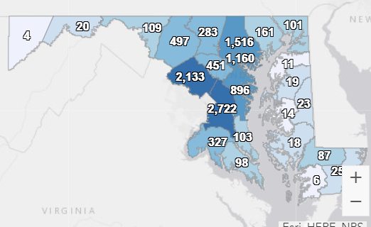
Maryland: COVID-19 Cases
http://health.maryland.gov/coronavirus
Data current as of April 9, 2020
Cases: 11,572
  788 new
Deaths: 425
Hospitalizations: 6216
  161 new

Slide 6
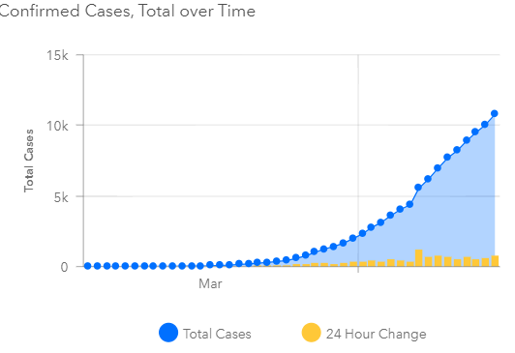

Slide 7
Updated Return to Work Guidance
For Healthcare Workers
  Prefer test based strategy
    72 hours after fever resolution, improving symptoms
    2 negative COVID-19 tests at least 24 hours apart
  If test based is not available, symptom based strategy is acceptable
    72 hours after fever resolution, improving symptoms
    7 days after symptom onset
  When returning to work, HCW should avoid caring for severe immunocompromised patients until symptoms are completely resolved or 14 days after onset (whichever is later)
For everyone else (Non-healthcare workers)
  Symptom based strategy
For all asymptomatic people
  Exclude for 10 days after the positive test

Slide 8
Staff Exclusion Updates: Exposures
New CDC Guidance 4/15
“Given the ongoing transmission of COVID-19 in communities across the United States and the role that asymptomatic and pre-symptomatic individuals with COVID-19 play in transmission, the feasibility and benefits of formal contact tracing for exposures in healthcare settings are likely limited”
“Healthcare facilities should consider foregoing contact tracing for exposures in a healthcare setting in favor of universal source control for healthcare personnel (HCP) and screening for fever and symptoms of COVID-19 before every shift.”

Slide 9
Staff Exclusion Updates: Exposure
In other words:
  Staff who have been in close contact with a COVID-19 positive case SHOULD NOT be excluded from work
    Work contacts
    Household contacts
  Instead, practice universal masking
    May be cloth or home made masks
    Staff and clients/patients should be masked
    Provide bandannas or washable masks to clients who may not have their own (use once and launder)

Slide 10
How to use Universal Masking
Don a mask when you enter the facility
Mask must cover nose and mouth
Do not touch the outside of the mask- assume there are germs on the outside of the mask
  If you need to adjust your mask, wash your hands before and after touching mask

Slide 11
General Infection Control
Post signage encouraging respiratory etiquette and hand hygiene
Provide alcohol based hand rub through out the facility
Ensure sinks are stocked with soap and paper towels for staff hand hygiene
Reduce crowding in waiting rooms and care spaces
Supplies for hand hygiene and respiratory etiquette (tissues, waste receptacles, ABHR) should be available for clients and patients

Slide 12
Steps to Responding to a COVID-19 Case
Consult your local health department
Ensure symptomatic patients are on appropriate transmission based precautions when in the facility
Ensure sick staff are excluded
Contact investigation to determine exposed healthcare workers or patients- the local health department can help you
Exclusions as appropriate for healthcare workers with medium - high risk exposures

Slide 13
Resources
MDH Novel Coronavirus: http://health.maryland.gov/coronavirus
MDH Laboratory Coronavirus: https://health.maryland.gov/laboratories/Pages/Novel-Coronavirus.aspx
COVID-19 People at risk https://www.cdc.gov/coronavirus/2019-ncov/specific-groups/high-risk-complications.html
CDC Guidance for Infection Control https://www.cdc.gov/coronavirus/2019-nCoV/infection-control.html
EPA List N Disinfectants with COVID-19 claim https://www.epa.gov/pesticide-registration/list-n-disinfectants-use-against-sars-cov-2
Conserving PPE https://www.cdc.gov/coronavirus/2019-ncov/hcp/ppe-strategy/index.html

Slide 14
Questions?
Email : mdh.ipcovid@Maryland.gov

