Slide 1
Maryland Situation Update on
Coronavirus Disease (COVID-19) for BHA
Maryland Department of Health
Infectious Disease Epidemiology and Outbreak Response Bureau
April 10, 2020

Slide 2
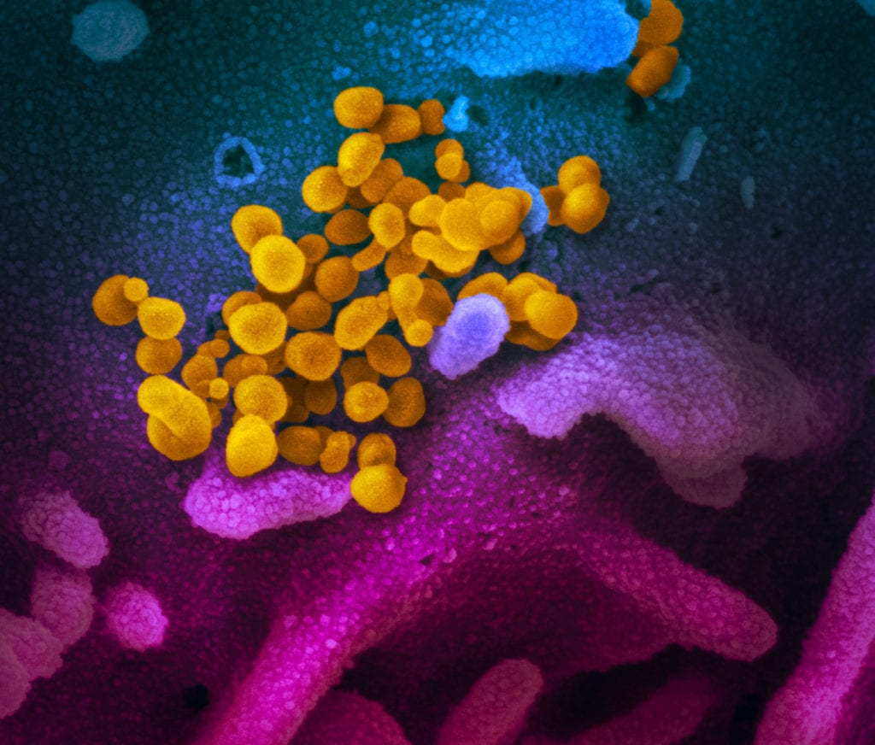
Call Agenda
Picture Courtesy of NIAID-RML
Review current situation of COVID-19
Updated Guidance
Questions and Answers

Slide 3
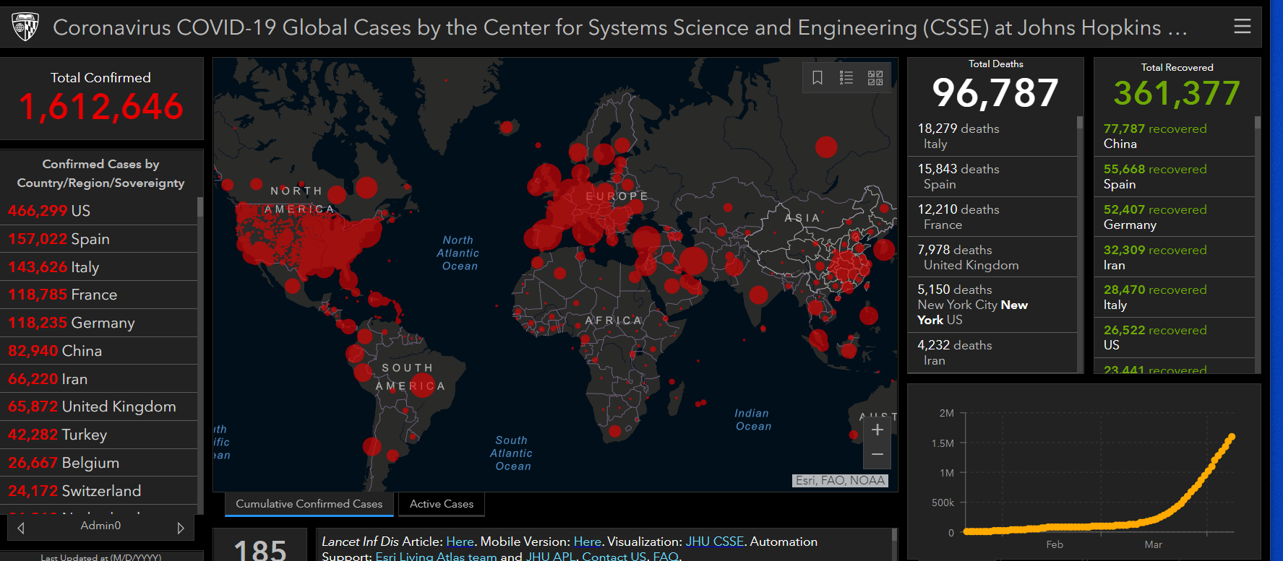
COVID-19 Global Situation Summary
Data current as of April 10, 8:30 AM 2020

Slide 4
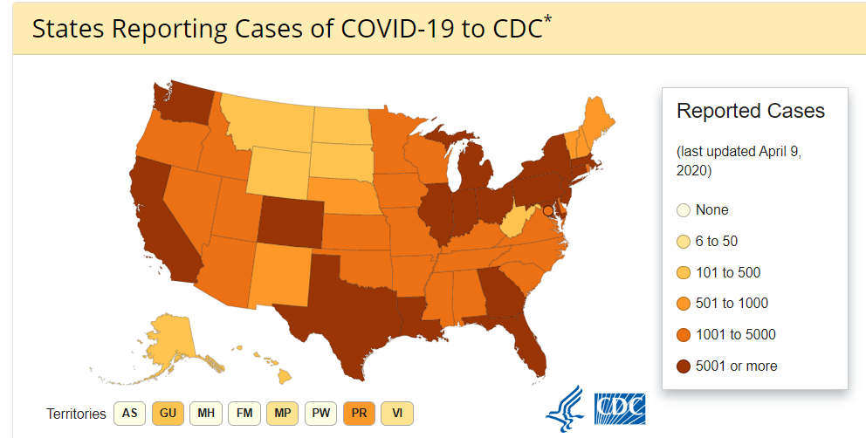
U.S.: COVID-19 Cases
427,460 Confirmed Cases
  1,930 Travel-related cases
  9763 Close contact
  415,767 “Under investigation”
14,696 total deaths
55 states and territories reporting
Source: www.cdc.gov, accessed April 2nd

Slide 5
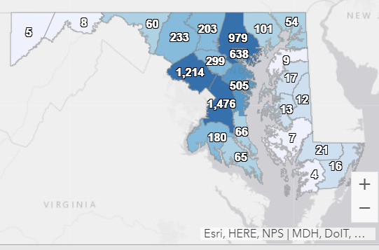
Maryland: COVID-19 Cases
http://health.maryland.gov/coronavirus
Data current as of April 9, 2020
Cases: 6,986
  783 new
Deaths: 171
  33 new
Hospitalizations: 1,413
  65 new

Slide 6
Clinical Presentation
Incubation period is 2-14 days
*Fever
*Cough
*Shortness of Breath
May include:
  Sore throat
  Congestion
  Fatigue
  Headache
May be mild to severe

Slide 7
General Infection Control: PPE
Use droplet and contact precautions
Healthcare workers in contact with COVID-19 patients should wear:
  Gloves
  Disposable isolation gown
    To be worn over/ in place of coat or apron
  Facemask
    Surgical or procedure masks are fine
  Eye protection
    Goggles or face shield
PPE shortages

Slide 8
Conserving PPE: Gowns
Cloth isolation gowns
  Can be washed and reused
Extended use of gowns (cloth or disposable)
    One gown may be used by 1 provider for multiple patients who have the same infectious condition
    Example- 1 gown may be used to see 2 clients with norovirus (puking bug), but should be changed before seeing someone with coronavirus
Use expired gowns (as long as they are intact)
Prioritize disposable gowns for seeing ill clients

Slide 9
Conserving PPE: Masks
Remove masks for patients/clients, unless they are ill
  Clients may wear homemade/ cloth face masks
Use masks that are expired/ beyond shelf life
Extended use of face masks
  One mask may be used by 1 provider for multiple patients who have the same infectious condition
  Masks must be discarded if wet, soiled, or broken
Prioritize face masks for staff caring for patients with respiratory illness

Slide 10
General Infection Control
Post signage encouraging respiratory etiquette and hand hygiene
Provide alcohol based hand rub through out the facility.
Ensure sinks are stocked with soap and paper towels for staff hand hygiene
Avoid any aerosol generating procedures
Supplies for hand hygiene and respiratory etiquette (tissues, waste receptacles, ABHR) should be available at each station for patient use

Slide 11
Steps to Responding to a COVID-19 Case
Consult your local health department
Ensure symptomatic patients are on appropriate transmission based precautions when in the facility
Ensure sick staff are excluded
Contact investigation to determine exposed healthcare workers or patients- the local health department can help you
Exclusions as appropriate for healthcare workers with medium - high risk exposures

Slide 12
Resources
MDH Novel Coronavirus: http://health.maryland.gov/coronavirus
MDH Laboratory Coronavirus: https://health.maryland.gov/laboratories/Pages/Novel-Coronavirus.aspx
COVID-19 People at risk https://www.cdc.gov/coronavirus/2019-ncov/specific-groups/high-risk-complications.html
CDC Guidance for Infection Control https://www.cdc.gov/coronavirus/2019-nCoV/infection-control.html
EPA List N Disinfectants with COVID-19 claim https://www.epa.gov/pesticide-registration/list-n-disinfectants-use-against-sars-cov-2
Conserving PPE https://www.cdc.gov/coronavirus/2019-ncov/hcp/ppe-strategy/index.html

Slide 13
Questions?
Email : mdh.ipcovid@Maryland.gov

