Slide 1
Maryland Situation Update on
Coronavirus Disease (COVID-19) for BHA
Maryland Department of Health
Infectious Disease Epidemiology and Outbreak Response Bureau
March 5, 2021

Slide 2
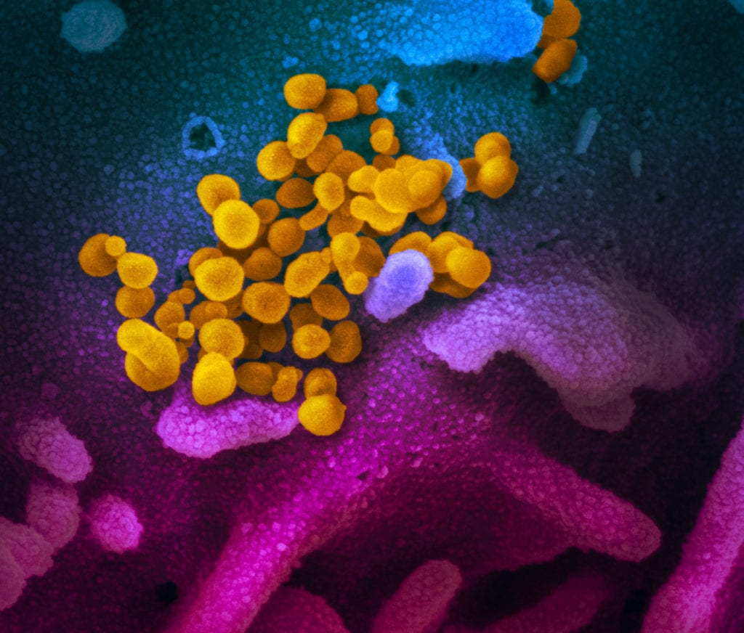
Call Agenda
Picture Courtesy of NIAID-RML
Review current situation of COVID-19
Influenza Updates
Vaccine Update
Quarantine Guidance Updates
Q and A

Slide 3
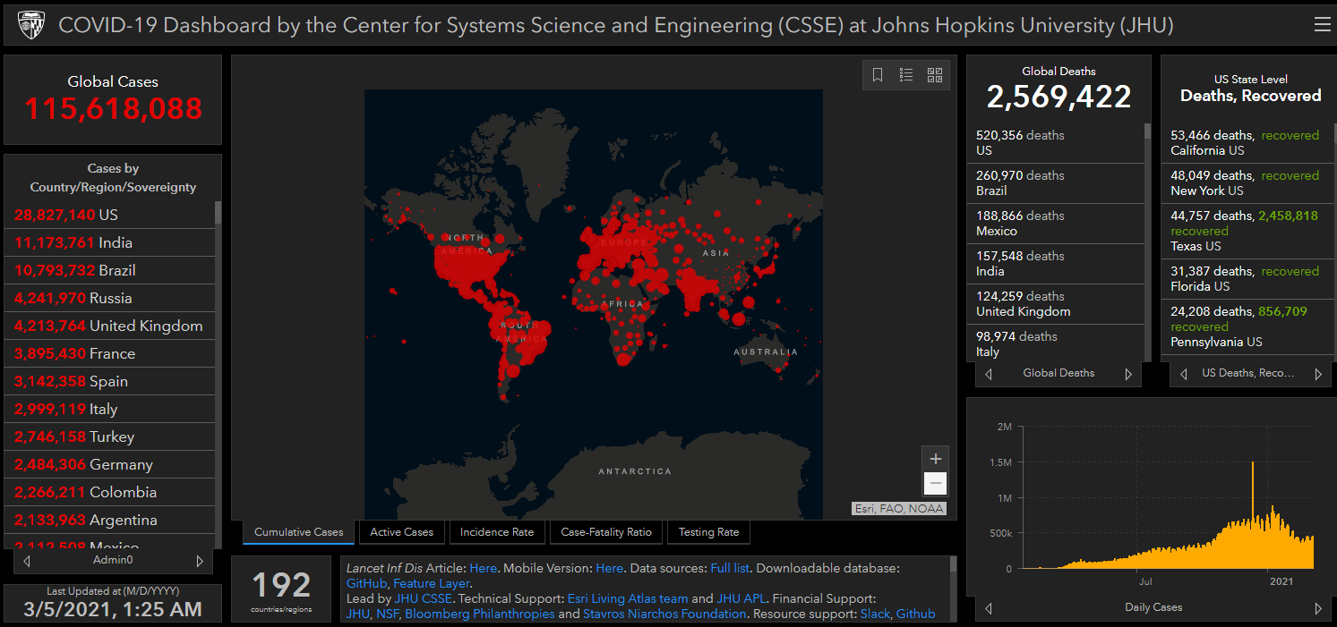
COVID-19 Global Situation Summary
https://gisanddata.maps.arcgis.com/apps/opsdashboard/index.html#/bda7594740fd40299423467b48e9ecf6

Slide 4
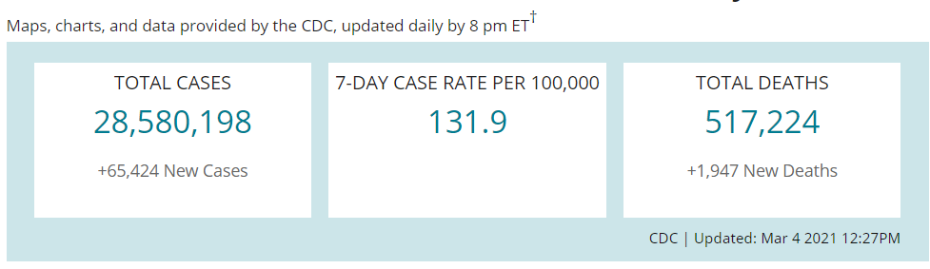
US Case Counts and Rates
https://www.cdc.gov/coronavirus/2019-ncov/cases-updates/cases-in-us.html Accessed 3/5/2021

Slide 5
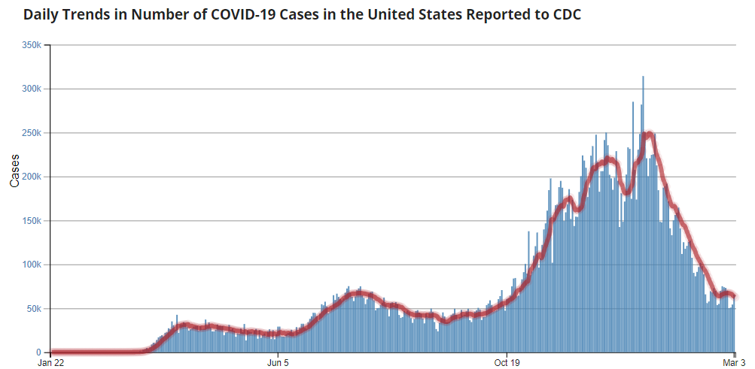
Number of Cases Reported in the USA, by Day
https://covid.cdc.gov/covid-data-tracker/#trends_dailytrendscases
Updated 3/4/2021

Slide 6
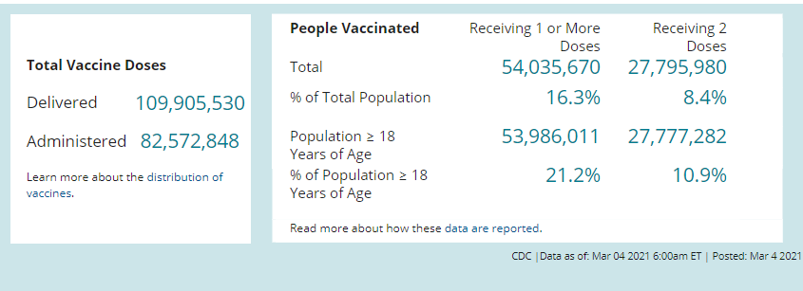
COVID-19 Vaccinations in the United States

Slide 7
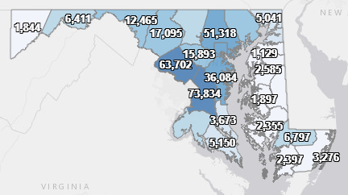
Maryland: COVID-19 Cases
http://health.maryland.gov/coronavirus
Data current as of 3/5/2021
Cases: 385,678
  913 new
Deaths: 7,748
  8 new
Hospitalizations: 35,378
  Current: 849 ( Down 7)
Total tests performed: 8,024,078
Case rate: 12.4 per 100,000

Slide 8
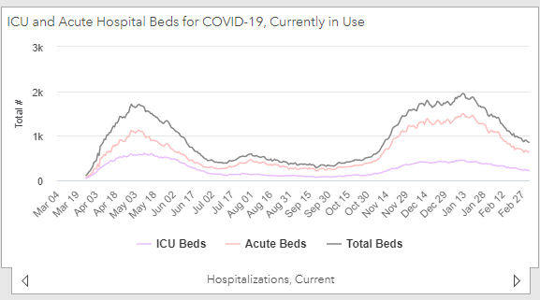
https://coronavirus.maryland.gov/ 3/5/2021

Slide 9
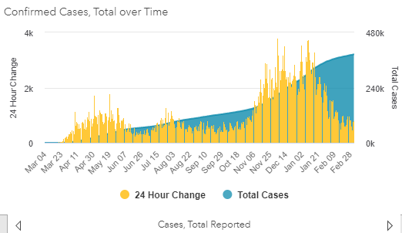
https://coronavirus.maryland.gov/ 3/5/2021

Slide 10
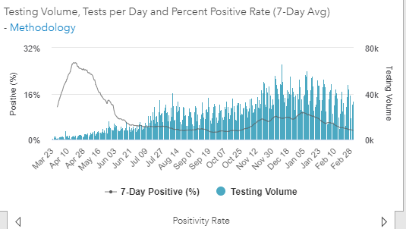
Testing Volume and % Positivity

Slide 11
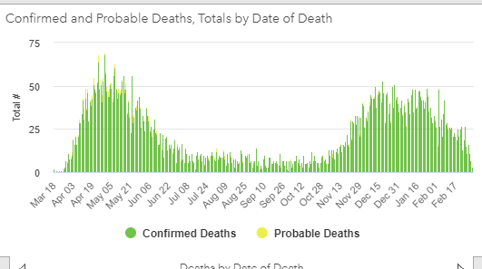

Slide 12
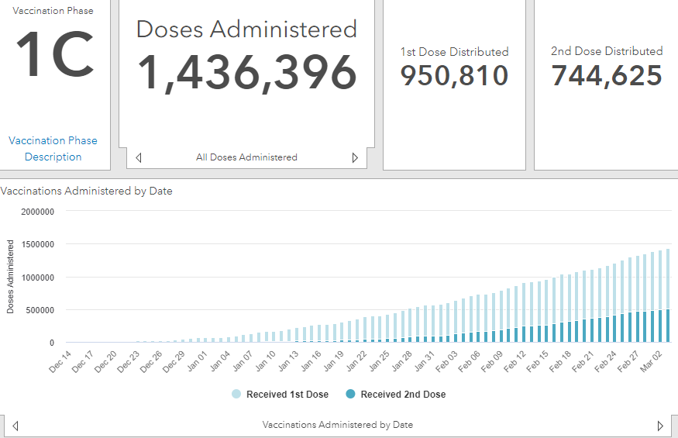
Maryland Vaccine Dashboard
https://coronavirus.maryland.gov/#Vaccine accessed March 5, 2021

Slide 13
Maryland Influenza Epi Update
Week Ending February 20th, 2021
Influenza-like illness (ILI) activity in Maryland was minimal

Slide 14
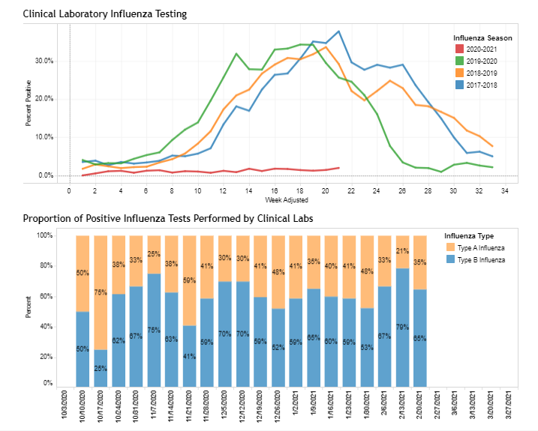
https://phpa.health.maryland.gov/influenza/Pages/flu-dashboard.aspx

Slide 15
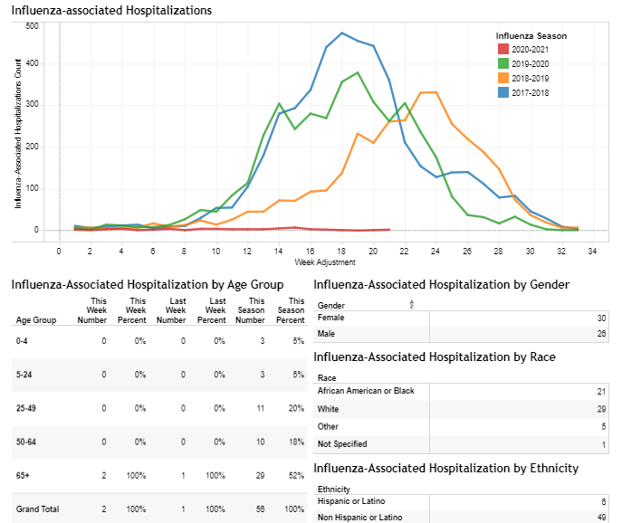
https://phpa.health.maryland.gov/influenza/Pages/flu-dashboard.aspx

Slide 16
Vaccine Update

Slide 17
Janssen Ad26.COVs2.s Vaccine
EUA approval on 2/27/21
3rd SARS CoV2 vaccine in the US to receive EUA
The Janssen COVID-19 vaccine has high efficacy against COVID-19–associated hospitalization and death.
Persons may receive any ACIP-recommended COVID-19 vaccine and are encouraged to receive the earliest vaccine available to them.
Use of all EUA-authorized COVID-19 vaccines is critical in controlling the pandemic.
https://www.cdc.gov/mmwr/volumes/70/wr/mm7009e4.htm?s_cid=mm7009e4_w

Slide 18
Quarantine Guidance Update

Slide 19
Quarantine Guidance
Vaccinated people with an exposure to someone with suspected or confirmed COVID-19 are not required to quarantine if they meet all of the following criteria†:
  Are fully vaccinated (i.e., ≥2 weeks following receipt of the second dose in a 2-dose series, or ≥2 weeks following receipt of one dose of a single-dose vaccine)
  Are within 3 months following receipt of the last dose in the series
  Have remained asymptomatic since the current COVID-19 exposure
People who do not meet all three of the above criteria should continue to follow current quarantine guidance after exposure to someone with suspected or confirmed COVID-19.
https://www.cdc.gov/vaccines/covid-19/info-by-product/clinical-considerations.html
https://phpa.health.maryland.gov/Documents/Quarantine%20Guidance_Vaccinated_2.26.2021.pdf

Slide 20
Quarantine Guidance
The risk of SARS-CoV-2 transmission from vaccinated people to others is still uncertain
  Vaccination has been demonstrated to prevent symptomatic COVID-19
  Symptomatic and presymptomatic transmission are thought to have a greater role in transmission than purely asymptomatic transmission
Fully vaccinated people who do not quarantine should still watch for symptoms of COVID-19 for 14 days following an exposure.
If they experience symptoms, they should be clinically evaluated for COVID-19, including SARS-CoV-2 testing, if indicated.

Slide 21
Quarantine Guidance
Vaccinated people should continue to follow current guidance to protect themselves and others, including all other SARS-CoV-2 testing recommendations and requirements and state, territorial, tribal, and local travel recommendations or requirements
This includes:
  Mask use
  Quarantine and testing after travel
  Physical distancing and avoiding large crowds

Slide 22
Strategies to Mitigate Healthcare Personnel Staffing Shortages: Vaccinated HCP
As of February 14, 2021
Added, as a contingency strategy to allow:
  Asymptomatic fully vaccinated HCP who have had a higher-risk exposure to SARS-CoV-2 but are not known to be infected to continue to work onsite throughout their 14-day post-exposure period.
https://www.cdc.gov/coronavirus/2019-ncov/hcp/guidance-risk-assesment-hcp.html

Slide 23
Strategies to Mitigate Healthcare Personnel Staffing Shortages: Vaccinated HCP
Healthcare facilities should understand that shortening the duration of work restriction might result in additional transmission risks.
Vaccinated HCP should be prioritized to first shorten their duration of work restriction followed by unvaccinated HCP.
These HCP should still report temperature and absence of symptoms each day before starting work.
If HCP develop even mild symptoms consistent with COVID-19, they should either not report to work, or stop working and notify their supervisor or occupational health services prior to leaving work. These individuals should be prioritized for testing.
If HCP are tested and found to be infected with SARS-CoV-2, they should be excluded from work until they meet all Return to Work Criteria.
https://www.cdc.gov/coronavirus/2019-ncov/hcp/mitigating-staff-shortages.html

Slide 24
Questions?
Email : mdh.ipcovid@Maryland.gov

