Slide 1
Maryland Situation Update on
Coronavirus Disease (COVID-19) for BHA
Maryland Department of Health
Infectious Disease Epidemiology and Outbreak Response Bureau
March 26, 2021

Slide 2

Call Agenda
Picture Courtesy of NIAID-RML
Review current situation of COVID-19
MDH Updates
Q and A

Slide 3
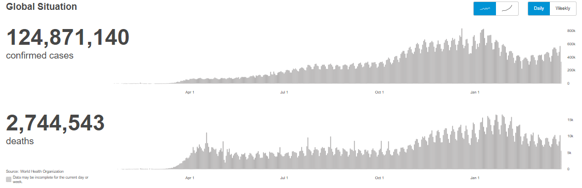
COVID-19 Global Situation Summary
https://covid19.who.int/ accessed 3/26/2021

Slide 4
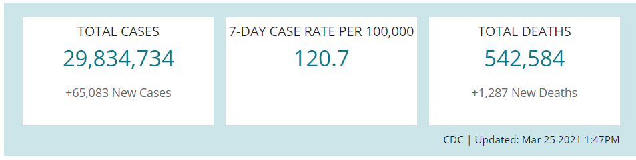
US Case Counts and Rates
https://www.cdc.gov/coronavirus/2019-ncov/cases-updates/cases-in-us.html Accessed 3/26/2021

Slide 5
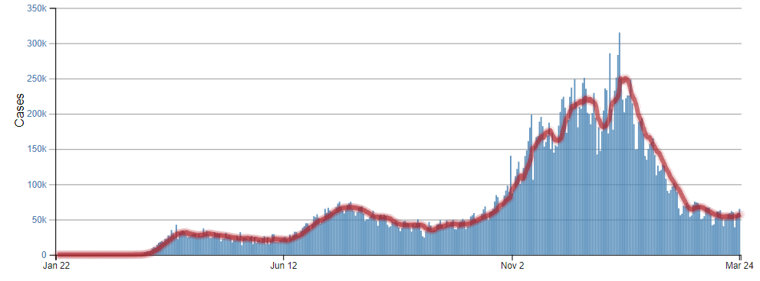
Number of Cases Reported in the USA, by Day
https://covid.cdc.gov/covid-data-tracker/#trends_dailytrendscases Updated 3/26/2021

Slide 6
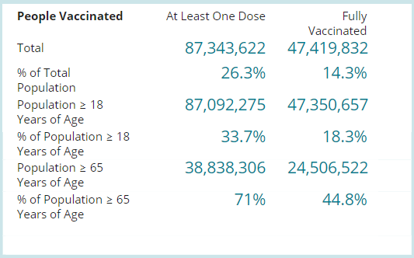
COVID-19 Vaccinations in the United States
https://covid.cdc.gov/covid-data-tracker/#vaccinations accessed 3/26/2021

Slide 7
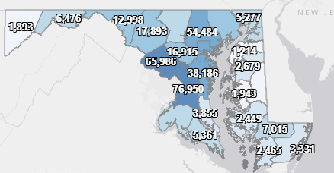
Maryland: COVID-19 Cases
http://health.maryland.gov/coronavirus
Data current as of 3/26/2021
Cases: 405,343
  1,361 new
Deaths: 8,047
  15 new
Hospitalizations: 37,254
  Current: 933 ( Up 14)
Total tests performed: 8,633,225
Case rate: 17.6 per 100,000
Percent Positivity: 3.74%

Slide 8
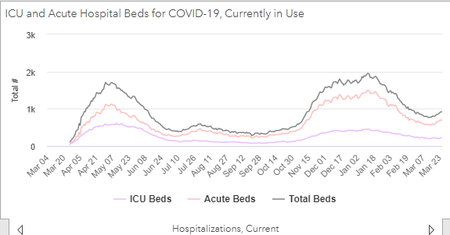
https://coronavirus.maryland.gov/ 3/26/2021

Slide 9
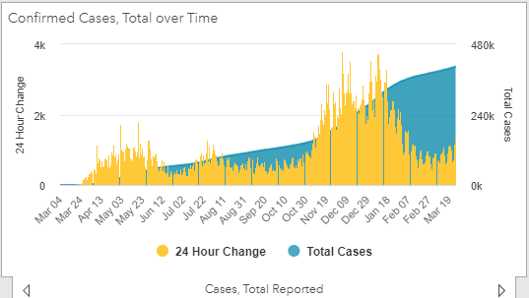
https://coronavirus.maryland.gov/ 3/26/2021

Slide 10
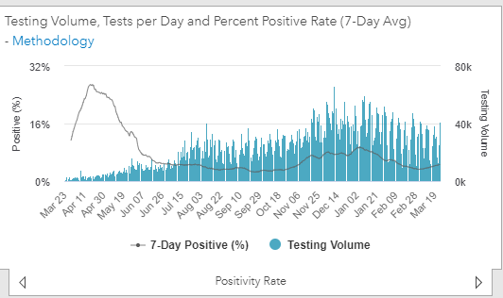
Testing Volume and % Positivity
https://coronavirus.maryland.gov/ 3/26/2021

Slide 11
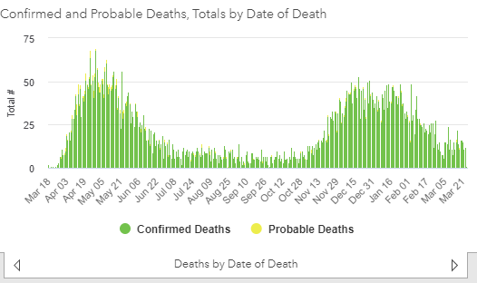
https://coronavirus.maryland.gov/ 3/26/2021

Slide 12
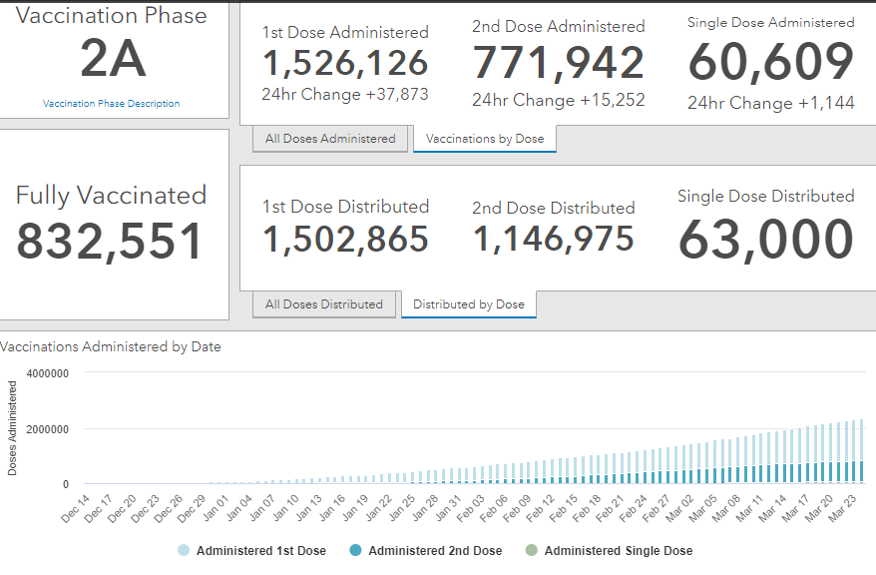
Maryland Vaccine Dashboard
https://coronavirus.maryland.gov/#Vaccine accessed March 26, 2021

Slide 13
Maryland Influenza Epi Update
Week Ending March 13th, 2021
Influenza-like illness (ILI) activity in Maryland was minimal

Slide 14
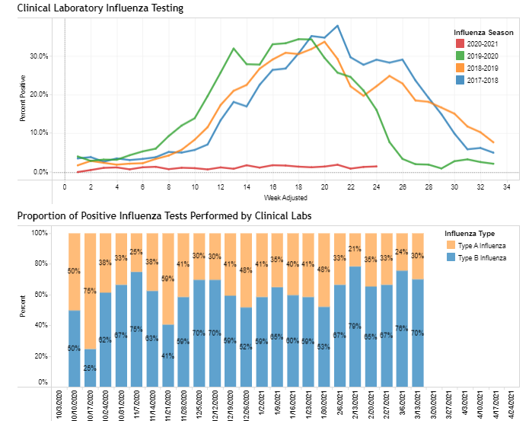
https://phpa.health.maryland.gov/influenza/Pages/flu-dashboard.aspx
3/26/21

Slide 15
Post-COVID Neuropsychiatric Symptoms

Slide 16
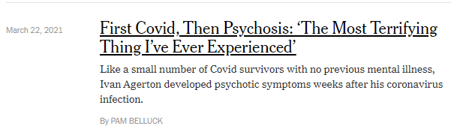
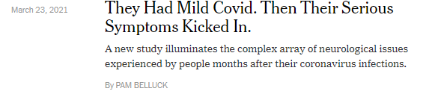
Post- COVID Psychosis in the news
https://www.nytimes.com/2021/03/22/health/covid-psychosis.html

Slide 17
Review of Post COVID Neuropsychiatric Complications
Recent evidence suggests that psychiatric illness is both a risk factor for and consequence of COVID-19
Studies reveal that mild and even asymptomatic infection may lead to cognitive impairment, delirium, extreme fatigue, and clinically relevant mood symptoms
Over 30% of patients hospitalized with COVID-19 may exhibit cognitive impairment, depression, and anxiety that persist for months after discharge
Over the 3 months following COVID-19 diagnosis, 18% of patients were diagnosed with a psychiatric diagnosis, with nearly 6% representing a new diagnosis
https://www.ncbi.nlm.nih.gov/pmc/articles/PMC7962429/

Slide 18
Four proposed mechanisms of CNS involvement by SARS-CoV-2
Biological and environmental factors, including electrolyte abnormalities, liver inflammation, impaired renal function, impaired oxygenation, hyperinflammation, and isolation due to public health concerns, which lead to a multifactorial delirium
Viral-induced immune reaction and autoimmunity; viral-induced inflammatory response can lead to blood brain barrier (BBB) dysfunction, resulting in immune cell infiltration and CNS tissue damage
SARS-CoV2-induced coagulopathy resulting in a wide variety of organ failure. Viral invasion of vascular endothelium leading to activated thrombotic and inflammatory cascades in the midst of a hypercoagulable state can lead to cerebrovascular events
Direct viral invasion of the CNS has been demonstrated, though this insult appears to be uncommon

Slide 19
Neurocognitive Disorders after SARS CoV2 Infection
One study of 279 patients hospitalized with COVID-19 found that 34% reported memory loss and 28% described impaired concentration approximately 3 months after discharge
Delirium occurs in at least 30% of patients hospitalized with COVID-19
Delirium has also been described in COVID-19 patients who do not experience severe medical complications
There have been reports of “brain fog” among patients experiencing milder symptoms who were never hospitalized and presumably did not experience delirium

Slide 20
What can we do?
Patients experiencing adverse cognitive effects of COVID-19 would benefit from longitudinal cognitive assessment with brief screening instruments (e.g., Montreal Cognitive Assessment) and self-report measures (e.g., Patient-Reported Outcomes Measurement Information System Cognitive Function
Comorbidities that affect cognition (e.g., depression, anxiety, fatigue, sleep disturbance) and reversible causes (e.g., nutritional deficiencies, endocrinopathies, metabolic derangements) should be screened for and corrected as indicated
Patients with more pronounced symptoms may benefit from formal neuropsychological evaluation, which may in turn clarify the potential utility of cognitive rehabilitation or pharmacotherapies

Slide 21
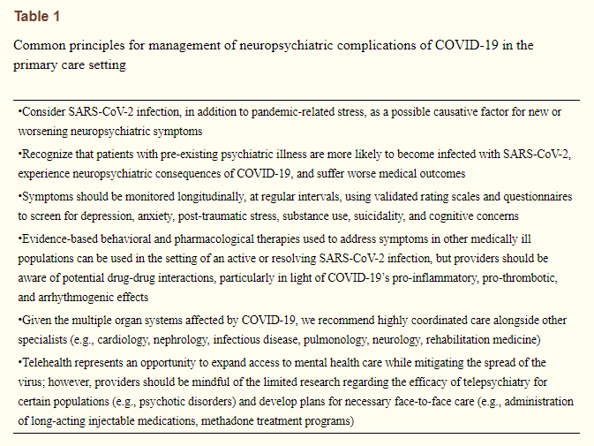
Management of Neuropsychiatric Symptoms

Slide 22
Mood and Anxiety Disorders
At approximately 1 month following infection, 31–38% of patients report depressive symptoms, 22–42% report anxiety symptoms, and 20% report obsessive-compulsive symptoms
Suicidal ideation is also elevated following COVID-19 diagnosis. In one study, 3.5% of respondents reported suicidality at 1 month following infection

Slide 23
Psychotic Disorders
Beginning with the Spanish Influenza pandemic in 1918, higher rates of psychosis have been observed during many pandemics or epidemics
Compared to patients who develop psychosis precipitated by pandemic-related stress, these patients may be less likely to endorse paranoia or delusional content about COVID-19
The ongoing CoroNerve surveillance study identified new-onset psychosis in 10 of the first 153 patients with acute COVID-19-related neuropsychiatric complications
COVID-19 treatment may also precipitate psychosis
  Chloroquine, high dose steroids, lopinavir/ritonavir

Slide 24
Substance Use Disorders
By June of 2020, the CDC reported that approximately one out of every 10 Americans had either started using illicit substances or increased the quantity and/or frequency of substance use because of the COVID-19 pandemic
Patients with SUDs are more susceptible to contracting COVID-19 due to the social and public restrictions implemented during the pandemic
Both COVID-19 and illicit substances, especially opioids, can profoundly impair pulmonary function

Slide 25
Conclusions
There are emerging data concerning for a wide range of neuropsychiatric sequelae following SARS-CoV-2 infection
Due to the complexity of COVID-19 and its treatment, affected patients may require longitudinal follow-up most appropriately delivered by multi-disciplinary teams
Clinical trials are urgently needed to clarify optimal treatment strategies for neuropsychiatric and other potentially long-term impacts of COVID-19
https://www.ncbi.nlm.nih.gov/pmc/articles/PMC7962429/

Slide 26
Have a question?
Email MDH.IPCOVID@maryland.gov

