Slide 1
Maryland Situation Update on Coronavirus Disease (COVID-19) for BHA
Maryland Department of Health
Infectious Disease Epidemiology and Outbreak Response Bureau
March 19, 2021

Slide 2
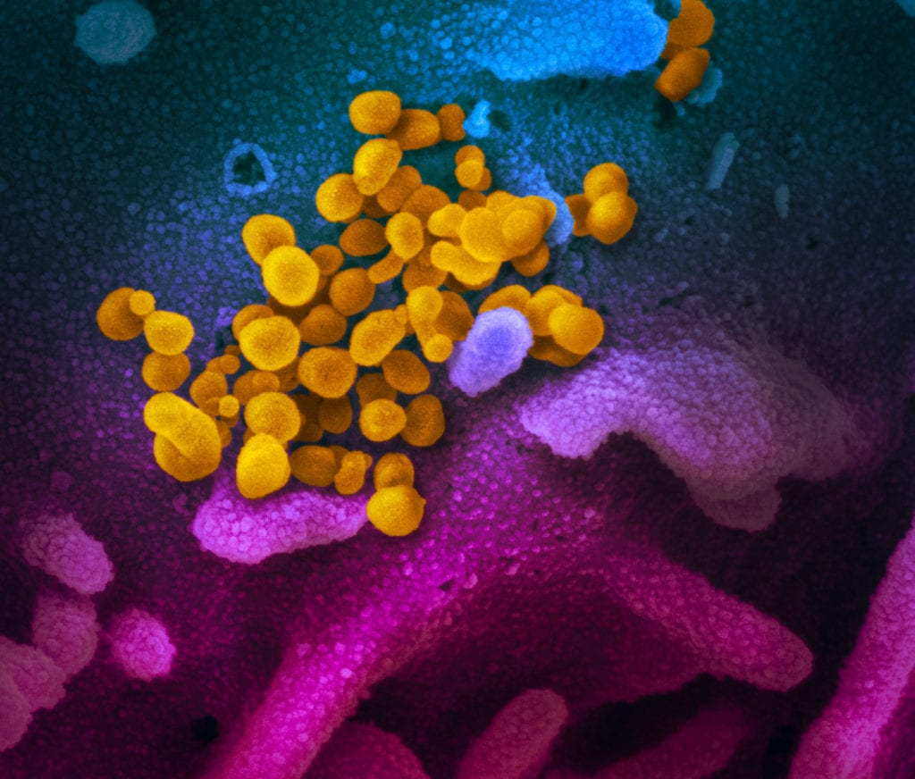
Call Agenda
Picture Courtesy of NIAID-RML
Review current situation of COVID-19
Variants of Concern
MDH Updates
Q and A

Slide 3
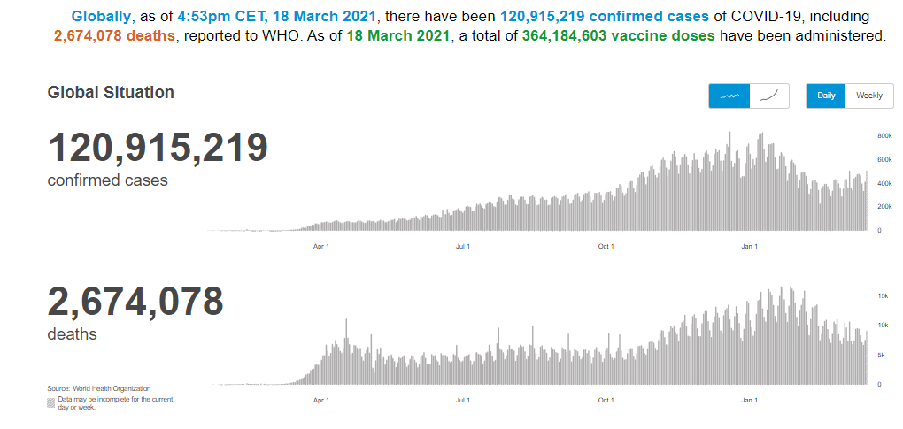
COVID-19 Global Situation Summary
https://covid19.who.int/ accessed 3/19/2021

Slide 4
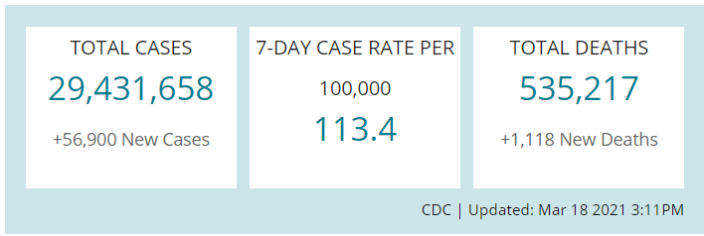
US Case Counts and Rates
https://www.cdc.gov/coronavirus/2019-ncov/cases-updates/cases-in-us.html Accessed 3/19/2021

Slide 5
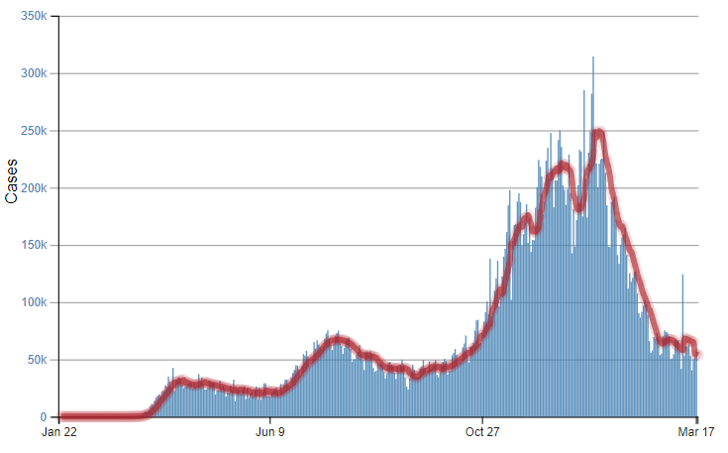
Number of Cases Reported in the USA, by Day
https://covid.cdc.gov/covid-data-tracker/#trends_dailytrendscases Updated 3/19/2021

Slide 6
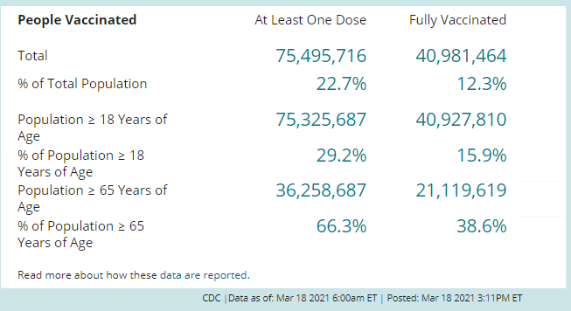
COVID-19 Vaccinations in the United States
https://covid.cdc.gov/covid-data-tracker/#vaccinations accessed 3/19/2021

Slide 7
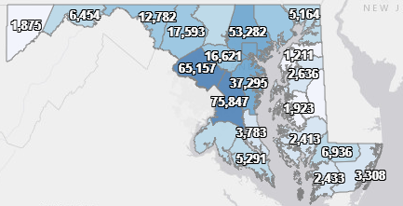
Maryland: COVID-19 Cases
http://health.maryland.gov/coronavirus
Data current as of 3/19/2021
Cases: 397,898
1,152 new
Deaths: 7,947
18 new
Hospitalizations: 36,579
Current: 816 ( Up 18)
Total tests performed: 8,433,019
Case rate: 15.2 per 100,000
Percent Positivity: 4.16%

Slide 8
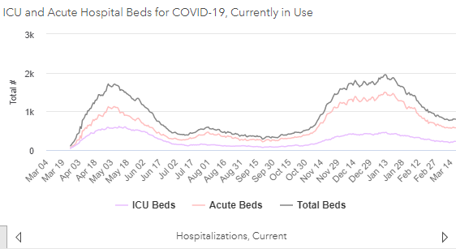
https://coronavirus.maryland.gov/ 3/19/2021

Slide 9
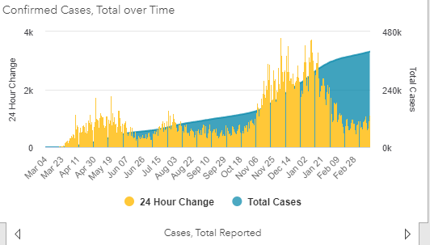
https://coronavirus.maryland.gov/ 3/19/2021

Slide 10
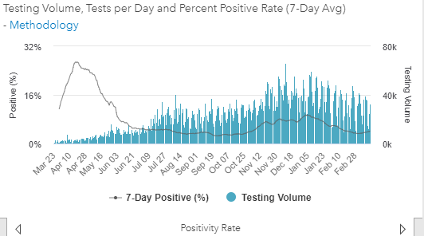
Testing Volume and % Positivity

Slide 11
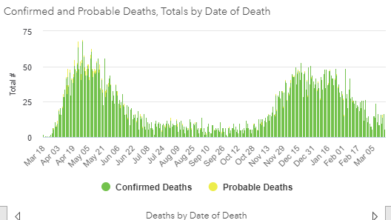

Slide 12
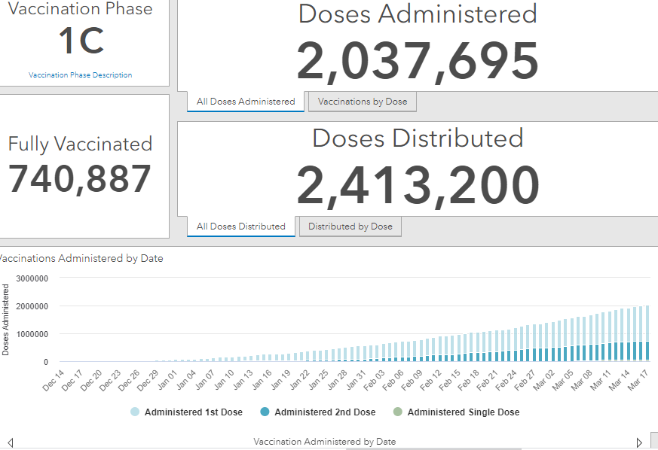
Maryland Vaccine Dashboard
https://coronavirus.maryland.gov/#Vaccine accessed March 19, 2021

Slide 13
Maryland Influenza Epi Update
Week Ending March 6th, 2021
Influenza-like illness (ILI) activity in Maryland was minimal

Slide 14
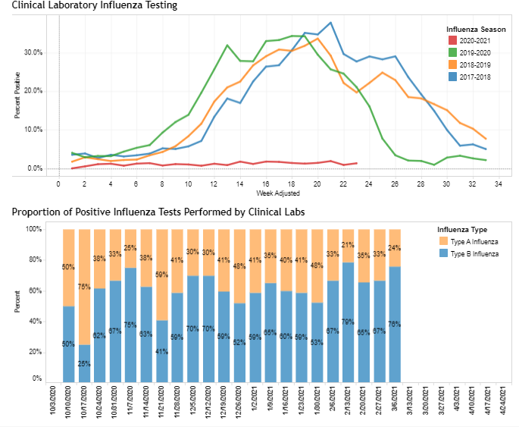
https://phpa.health.maryland.gov/influenza/Pages/flu-dashboard.aspx

Slide 15
SARS-CoV-2 Variants of Concern
Dr. Monique Duwell
Chief, Center for Infectious Disease Surveillance and Outbreak Response

Slide 16
Variant Classification
A US government interagency group developed a Variant Classification scheme that defines three classes of SARS-CoV-2 variants:
Variant of Interest
A variant with specific genetic markers that have been associated with changes to receptor binding, reduced neutralization by antibodies generated against previous infection or vaccination, reduced efficacy of treatments, potential diagnostic impact, or predicted increase in transmissibility or disease severity.
Variant of Concern
A variant for which there is evidence of an increase in transmissibility, more severe disease (increased hospitalizations or deaths), significant reduction in neutralization by antibodies generated during previous infection or vaccination, reduced effectiveness of treatments or vaccines, or diagnostic detection failures.
Variant of High Consequence
A variant of high consequence has clear evidence that prevention measures or medical countermeasures have significantly reduced effectiveness relative to previously circulating variants.
https://www.cdc.gov/coronavirus/2019-ncov/cases-updates/variant-surveillance/variant-info.html

Slide 17
Current Variants to Watch
Variants of Concern
B.1.1.7
B.1.351
P.1
B.1.427
B.1.429
Variants of Interest
B1.526
B.1.525
P.2
Note: No Variants of High Consequence currently identified

Slide 18
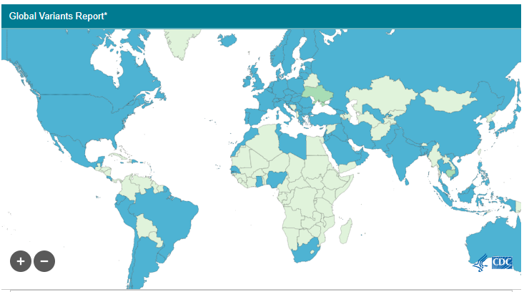
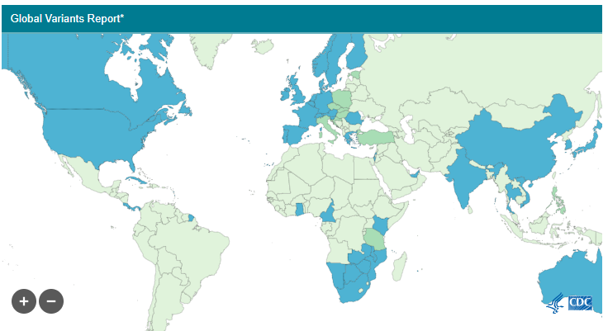
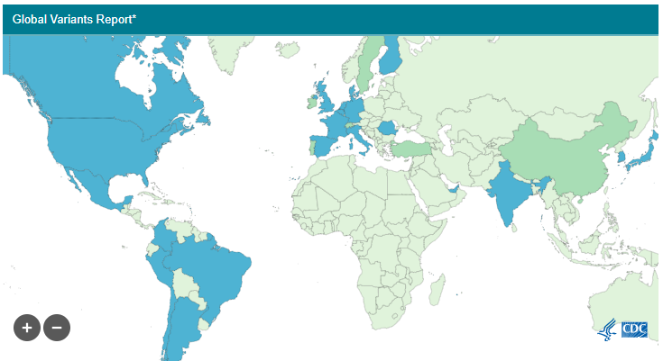


Worldwide: COVID Variants of Concern
B.1.1.7
B.1.351
P.1

Slide 19
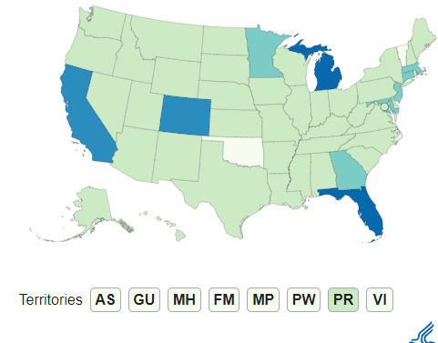
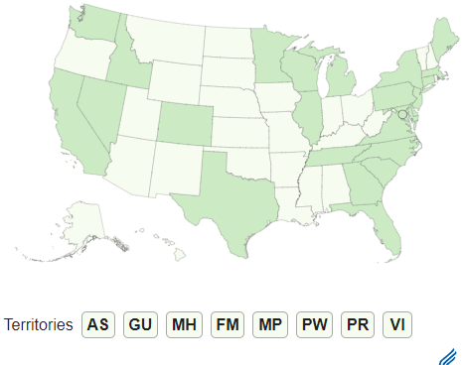
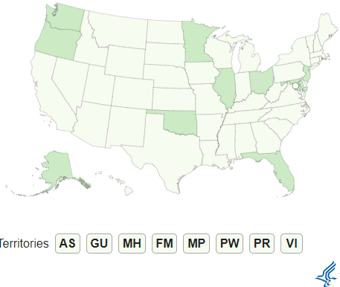
US: SARS-CoV-2 Variants of Concern
Variant | Reported Cases in U.S. | Number of Jurisdictions Reporting
B.1.1.7 | 4686 | 50
B.1.351 | 142 | 25
P.1. | 25 | 10
B.1.1.7
B.1.351
P.1
https://www.cdc.gov/coronavirus/2019-ncov/transmission/variant-cases.html

Slide 20
Maryland: SARS-CoV-2 Variants of Concern
Variant | Reported Cases in Maryland
B.1.1.7 | 209
B.1.351 | 22
P.1. | 1
https://www.cdc.gov/coronavirus/2019-ncov/transmission/variant-cases.html

Slide 21
B.1.427/B.1.429
Preliminary evidence:
Emerged around May 2020 in CA, increased from 0% to >50% of sequenced cases from Sept. 1, 2020 to Jan. 29, 2021
19-24% increase in transmissibility
2-fold increased viral shedding
Antibody neutralization assays showed decreases in neutralizing titers
4.0 to 6.7-fold decrease among convalescent patients
2.0-fold decrease among vaccine recipients
https://www.medrxiv.org/content/10.1101/2021.03.07.21252647v1

Slide 22
B.1.526
Preliminary evidence:
Emerged in New York, with a steady increase in the detection rate from late December to mid-February
Patients with this novel variant came from diverse neighborhoods in the metropolitan NYC area, and they were on average older and more frequently hospitalized.
Unique set of mutations may pose a challenge for current interventions
https://www.medrxiv.org/content/10.1101/2021.02.23.21252259v1

Slide 23
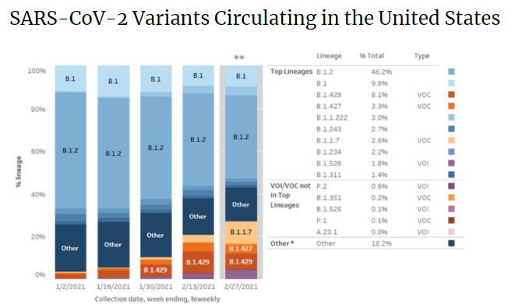
https://www.cdc.gov/coronavirus/2019-ncov/cases-updates/variant-proportions.html

Slide 24
MDH Clinician Letter (Feb. 2): Surveillance for Variants of Concern
MDH requests clinicians report COVID-19 cases among:
Individuals who first test positive for COVID-19 after receiving COVID-19 vaccination (either one or two doses)
Severely immunocompromised individuals with prolonged COVID-19 infection
Individuals suspected of reinfection – specifically, symptomatic individuals who test PCR positive for SARS-CoV-2 more than 90 days after an initial infection from which they clinically recovered
Individuals with recent international travel (travel in the 14 days prior to symptom onset)
Any other individuals for whom you have clinical suspicion of infection with a possible variant (e.g., unusual clinical manifestation, etc.)
Now prioritizing individuals who test positive 2+ weeks after their last dose

Slide 25
MDH Clinician Letter (Feb. 2): Surveillance for Variants of Concern
1) If possible, contact the testing laboratory to ensure the original specimen is not discarded
2) Complete and submit case information securely online at: https://redcap.link/qx8ieby3

Slide 26
Thank you!
For COVID sequencing-related questions: mdh.COVIDsequencing@maryland.gov

Slide 27
MDH Update

Slide 28
Vaccine Eligibility Timeline for All
Phase 2A includes all Marylanders over 60
Eligibility begins March 23rd
Phase 2B includes all Marylanders over 16 with underlying medical conditions that increase the risk of severe COVID-19 illness
Legibility begins March 30th
Phase 2C Marylanders age 55 and over, and essential workers in critical industries
Eligibility begins April 13th
Phase 3: All Marylanders over the age of 16
Begins April 27th
https://governor.maryland.gov/2021/03/18/governor-hogan-announces-vaccine-eligibility-timeline-for-all-marylanders-and-primary-care-hospital-equity-and-mobile-clinic-initiatives/

Slide 29
Primary Care Practices
Beginning this week, primary care practices throughout Maryland are joining the state’s vaccination effort, administering vaccines directly to vulnerable populations they serve.
To help achieve more equitable vaccine distribution, the first 37 practices were chosen for the program based on their connection to largely African American and Hispanic communities and areas with less geographic access to vaccination sites.

Slide 30
Vaccine Equity Taskforce
The Maryland Vaccine Equity Task Force, led by Brigadier General Janeen Birckhead, will launch mobile clinics in hard-to-reach areas utilizing mobile units provided by the University of Maryland School of Nursing. These units will be deployed and staffed by the Maryland National Guard.
Learn more about the task force at governor.maryland.gov/VETF.
Each mobile vaccine bus has the versatility to be used as a walk-in clinic or a drive-up site to administer between 60 to 160 vaccines per mission.

Slide 31
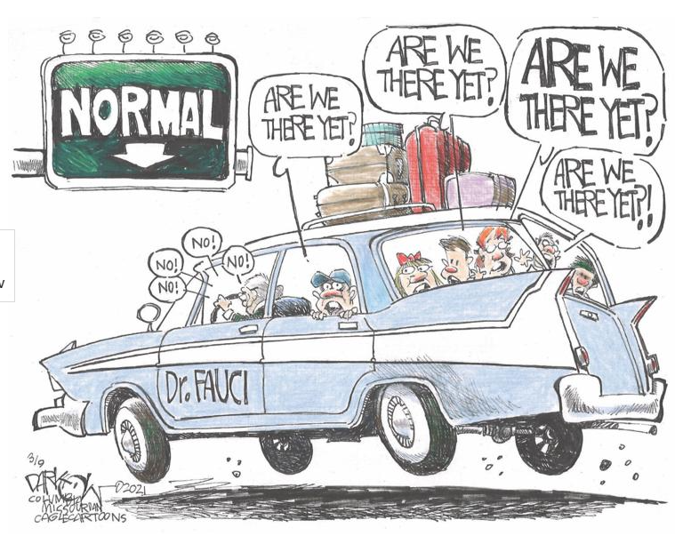
Have a question?
Email MDH.IPCOVID@maryland.gov

