Slide 1
Maryland Situation Update on
Coronavirus Disease (COVID-19) for BHA
Maryland Department of Health
Infectious Disease Epidemiology and Outbreak Response Bureau
March 11, 2021

Slide 2

Call Agenda
Picture Courtesy of NIAID-RML
Review current situation of COVID-19
CDC Updates
CMS Updates
MDH Updates
Q and A

Slide 3
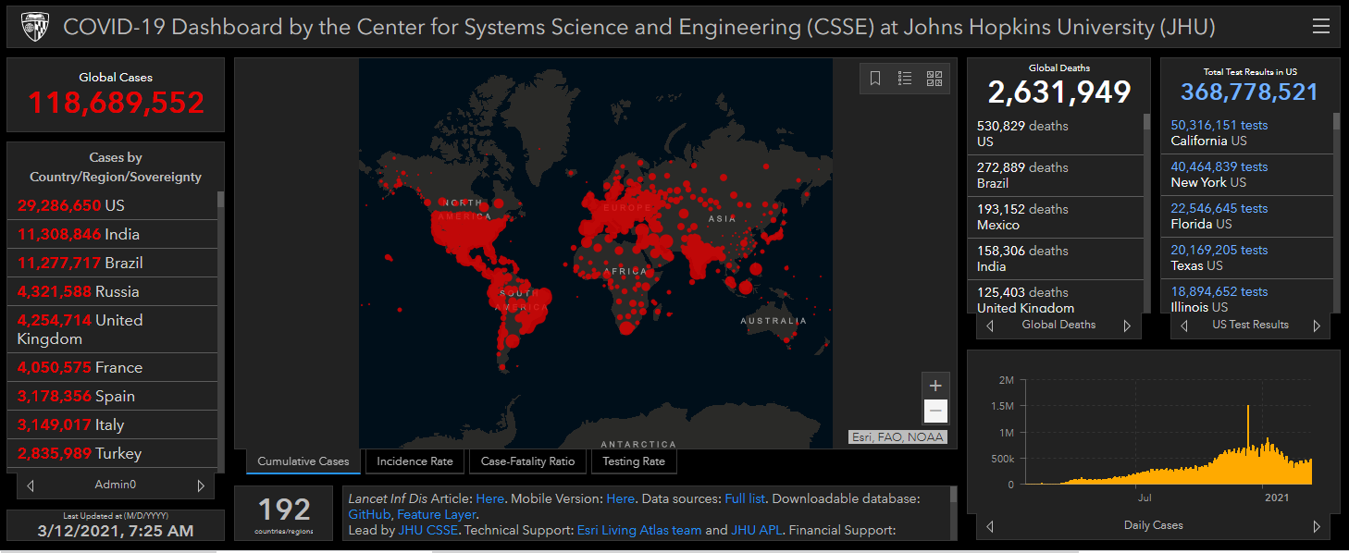
COVID-19 Global Situation Summary
https://gisanddata.maps.arcgis.com/apps/opsdashboard/index.html#/bda7594740fd40299423467b48e9ecf6

Slide 4
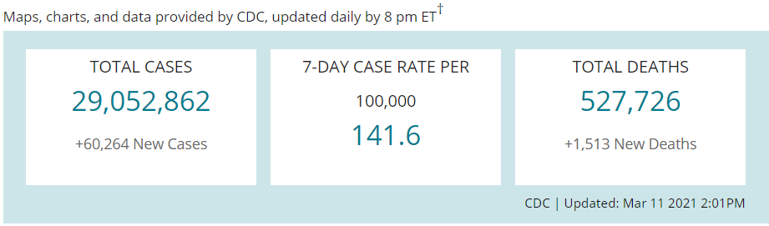
US Case Counts and Rates
https://www.cdc.gov/coronavirus/2019-ncov/cases-updates/cases-in-us.html Accessed 3/12/2021

Slide 5
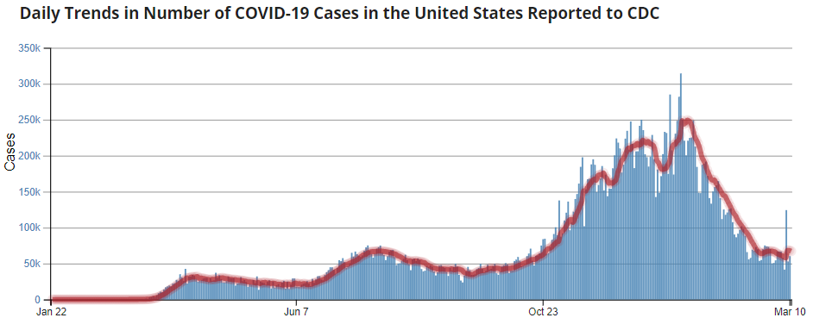
Number of Cases Reported in the USA, by Day
https://covid.cdc.gov/covid-data-tracker/#trends_dailytrendscases
Updated 3/12/2021

Slide 6
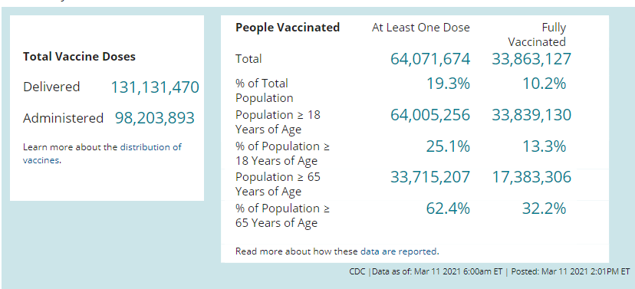
COVID-19 Vaccinations in the United States

Slide 7
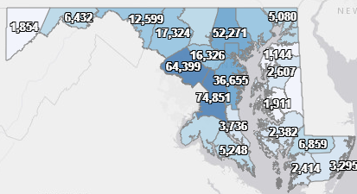
Maryland: COVID-19 Cases
http://health.maryland.gov/coronavirus
Data current as of 3/12/2021
Cases: 391,480
  990 new
Deaths: 7,848
  16 new
Hospitalizations: 35,990
  Current: 765 ( Down 23)
Total tests performed: 8,236,204
Case rate: 13.7 per 100,000

Slide 8
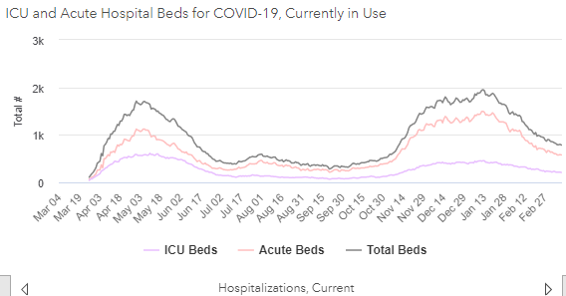
https://coronavirus.maryland.gov/ 3/12/2021

Slide 9
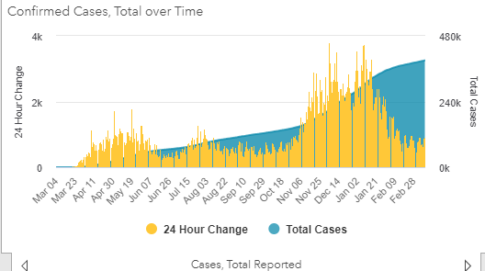
https://coronavirus.maryland.gov/ 3/12/2021

Slide 10
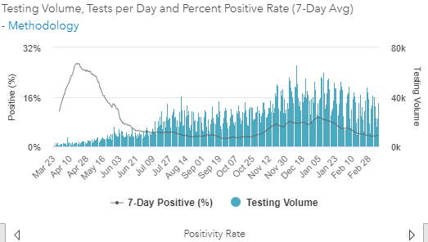
Testing Volume and % Positivity

Slide 11
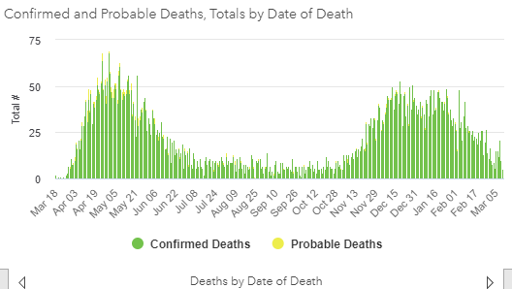

Slide 12
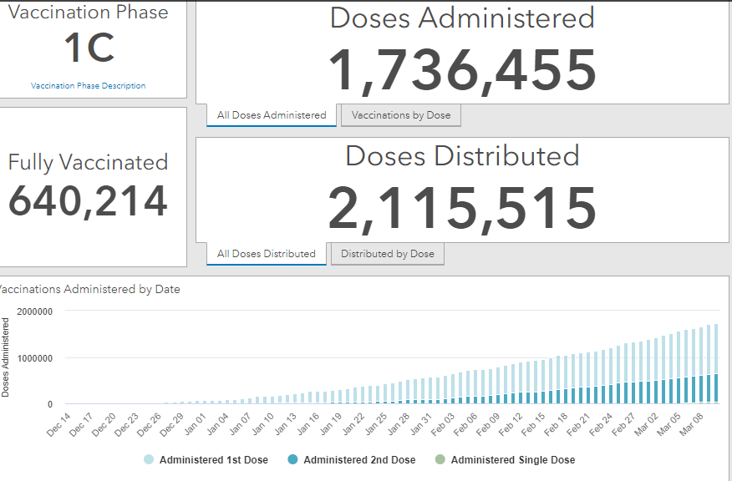
Maryland Vaccine Dashboard
https://coronavirus.maryland.gov/#Vaccine accessed March 12, 2021

Slide 13
Maryland Influenza Epi Update
Week Ending February 27th, 2021
Influenza-like illness (ILI) activity in Maryland was minimal

Slide 14
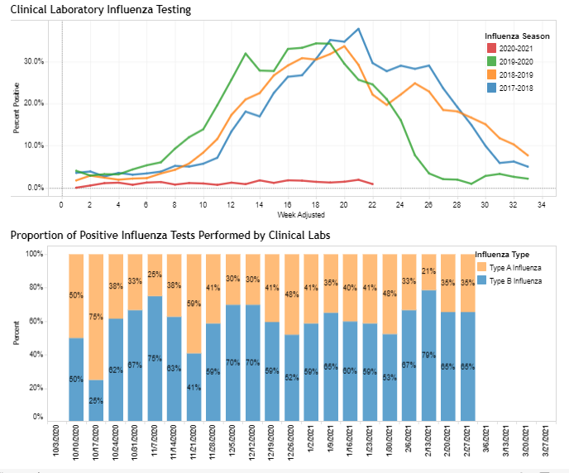
https://phpa.health.maryland.gov/influenza/Pages/flu-dashboard.aspx

Slide 15
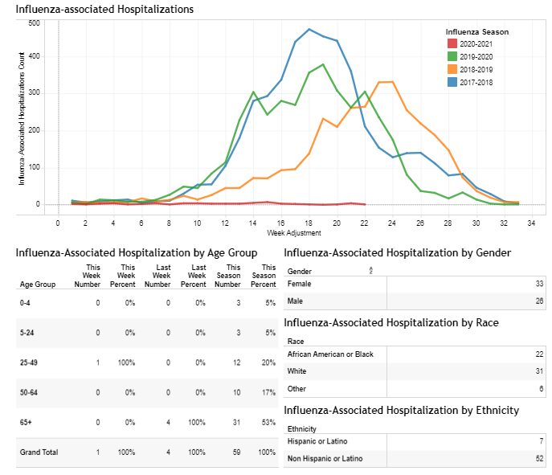
https://phpa.health.maryland.gov/influenza/Pages/flu-dashboard.aspx

Slide 16
CDC Update: Non- Healthcare Settings

Slide 17
CDC: Interim Public Health Recommendations for Fully Vaccinated People
The following recommendations apply to non-healthcare settings.
Fully vaccinated people can:
Visit with other fully vaccinated people indoors without wearing masks or physical distancing
Visit with unvaccinated people from a single household who are at low risk for severe COVID-19 disease indoors without wearing masks or physical distancing
Refrain from quarantine and testing following a known exposure if asymptomatic
https://www.cdc.gov/coronavirus/2019-ncov/vaccines/fully-vaccinated-guidance.html

Slide 18
CDC: Interim Public Health Recommendations for Fully Vaccinated People
For now, fully vaccinated people should continue to:
Take precautions in public like wearing a well-fitted mask and physical distancing
Wear masks, practice physical distancing, and adhere to other prevention measures when visiting with unvaccinated people who are at increased risk for severe COVID-19 disease or who have an unvaccinated household member who is at increased risk for severe COVID-19 disease
Wear masks, maintain physical distance, and practice other prevention measures when visiting with unvaccinated people from multiple households
Avoid medium- and large-sized in-person gatherings
Get tested if experiencing COVID-19 symptoms
Follow guidance issued by individual employers
Follow CDC and health department travel requirements and recommendations
https://www.cdc.gov/coronavirus/2019-ncov/vaccines/fully-vaccinated-guidance.html

Slide 19
“Fully Vaccinated”
≥2 weeks following receipt of the second dose in a 2-dose series,
≥2 weeks following receipt of one dose of a single-dose vaccine

Slide 20
CDC: Interim Public Health Recommendations for Fully Vaccinated People
Fully vaccinated residents of non-healthcare congregate settings (e.g. correctional and detention facilities, group homes)
  Continue to quarantine for 14 days and be tested for SARS-CoV-2 following an exposure
Fully vaccinated employees of non-healthcare congregate settings and other high-density workplaces (e.g. meat and poultry processing and manufacturing plants), with no COVID symptoms:
  Do NOT need to quarantine following exposure
  Testing following an exposure and through routine workplace screening programs (if present) is recommended)
https://www.cdc.gov/coronavirus/2019-ncov/vaccines/fully-vaccinated-guidance.html

Slide 21
CDC: Interim Public Health Recommendations for Fully Vaccinated People
Medium- or large-sized gatherings
  All people, regardless of vaccination status, should adhere to current guidance to avoid medium- or large-sized in-person gatherings
Other personal or social activities outside the home
  Fully vaccinated people engaging in social activities in public settings should continue to follow all guidance for these settings ( masking, distancing, etc.)
https://www.cdc.gov/coronavirus/2019-ncov/vaccines/fully-vaccinated-guidance.html

Slide 22
CDC: Interim Public Health Recommendations for Fully Vaccinated People
Small Gatherings
  Visits between fully vaccinated people
  Vaccinated people visiting with unvaccinated people from a single household that does not have individuals at risk of severe COVID-19
    Likely low risk
    No prevention methods recommended
https://www.cdc.gov/coronavirus/2019-ncov/vaccines/fully-vaccinated-guidance.html

Slide 23
CDC: Interim Public Health Recommendations for Fully Vaccinated People
Small Gatherings
  Vaccinated people visiting with unvaccinated people from a single household that has individuals at risk of severe COVID-19
  Vaccinated people visiting with unvaccinated people from multiple households at the same time
    All attendees should take precautions:
    Wear a well-fitted mask
    Stay at least 6 feet away from others
    Visit outdoors or in a well-ventilated space.
https://www.cdc.gov/coronavirus/2019-ncov/vaccines/fully-vaccinated-guidance.html

Slide 24
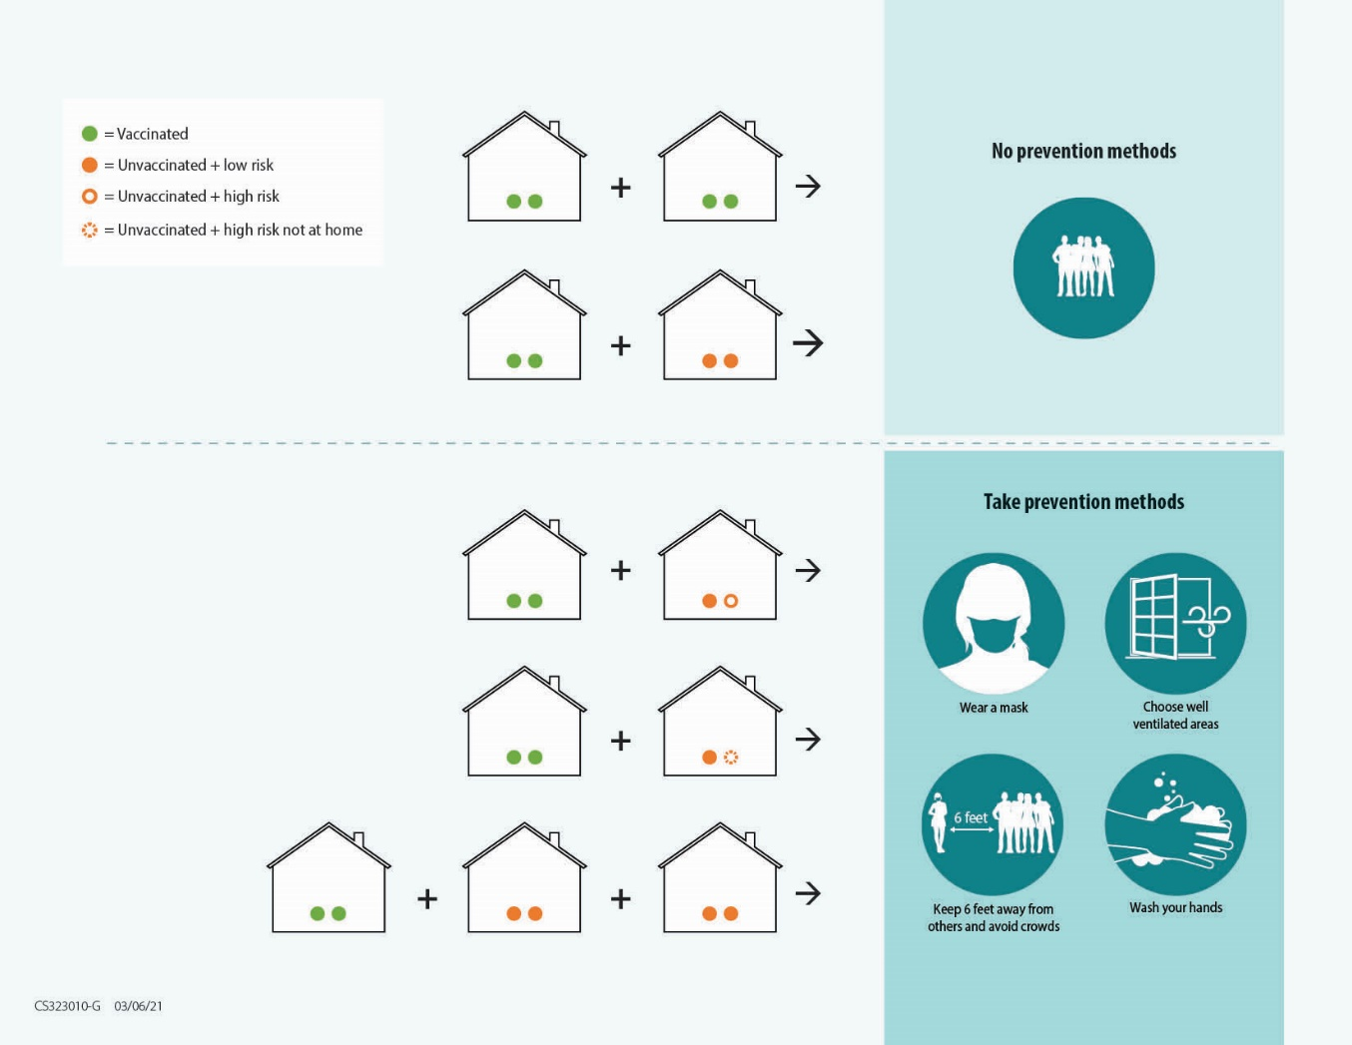
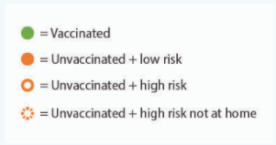
CDC: Interim Public Health Recommendations for Fully Vaccinated People
https://www.cdc.gov/coronavirus/2019-ncov/vaccines/fully-vaccinated-guidance.html

Slide 25
CDC Updates: Healthcare Settings

Slide 26
HCP Quarantine
Fully vaccinated HCP with higher-risk exposures who are asymptomatic do not need to be restricted from work for 14 days following their exposure. Work restrictions for the following fully vaccinated HCP populations with higher-risk exposures should still be considered for:
  HCP who have underlying immunocompromising conditions (e.g., organ transplantation, cancer treatment), which might impact level of protection provided by the COVID-19 vaccine. However, data on which immunocompromising conditions might affect response to the COVID-19 vaccine and the magnitude of risk are not available.
HCP who have traveled should continue to follow CDC travel recommendations and requirements, including restriction from work, when recommended for any traveler.
https://www.cdc.gov/coronavirus/2019-ncov/hcp/infection-control-after-vaccination.html

Slide 27
Resident Quarantine
Fully vaccinated inpatients and residents in healthcare settings should continue to quarantine following prolonged close contact (within 6 feet for a cumulative total of 15 minutes or more over a 24-hour period) with someone with SARS-CoV-2 infection; outpatients should be cared for using recommended Transmission-Based Precautions. This is due to limited information about vaccine effectiveness in this population, the higher risk of severe disease and death, and challenges with physical distancing in healthcare settings.
Quarantine is no longer recommended for residents who are being admitted to a post-acute care facility if they are fully vaccinated and have not had prolonged close contact with someone with SARS-CoV-2 infection in the prior 14 days.

Slide 28
Revised CMS Guidance on Visitation
https://www.cms.gov/files/document/qso-20-39-nh-revised.pdf

Slide 29
Indoor Visitation
Facilities should allow responsible indoor visitation at all times and for all residents (regardless of vaccination status), except for a few circumstances when visitation should be limited due to a high risk of COVID-19 transmission.
These scenarios include limiting indoor visitation for:
  Unvaccinated residents, if the nursing home’s COVID-19 county positivity rate is >10% and
  Residents with confirmed COVID-19 infection, whether vaccinated or unvaccinated until they have met the 2 criteria to discontinue Transmission-Based Precautions; or
  Residents in quarantine, whether vaccinated or unvaccinated, until they have met criteria for release from quarantine.

Slide 30
Responsible Indoor Visitation
CMS continues to recommend facilities, residents, and families adhere to the core principles of COVID-19 infection control, including maintaining physical distancing and conducting visits outdoors whenever possible
Visitors who are unable to adhere to the core principles of COVID-19 infection prevention should not be permitted to visit or should be asked to leave
Relaxing current restrictions on indoor visitation might increase the risk for transmission of SARS-CoV-2 in post-acute care facilities. However, vaccination of residents and HCP can mitigate some of these risks, and expanding visitation has substantial benefits to residents.

Slide 31
Core Principles of Infection Control
Screening of all who enter the facility for signs and symptoms of COVID-19 (e.g., temperature checks, questions about and observations of signs or symptoms), and denial of entry of those with signs or symptoms or those who have had close contact with someone with COVID-19 infection in the prior 14 days (regardless of the visitor’s vaccination status)
Hand hygiene (use of alcohol-based hand rub is preferred)
Face covering or mask (covering mouth and nose)
Social distancing at least six feet between persons
Instructional signage throughout the facility and proper visitor education on COVID19 signs and symptoms, infection control precautions, other applicable facility practices (e.g., use of face covering or mask, specified entries, exits and routes to designated areas, hand hygiene)
Cleaning and disinfecting high-frequency touched surfaces in the facility often, and designated visitation areas after each visit
Appropriate staff use of Personal Protective Equipment (PPE)
Effective cohorting of residents (e.g., separate areas dedicated to COVID-19 care)
Resident and staff testing conducted as required at 42 CFR § 483.80(h) (see QSO20- 38-NH)

Slide 32
Visitors
Screen all who enter the facility for signs and symptoms of COVID-19 (e.g., temperature checks, questions about and observations of signs or symptoms), and deny of entry of those with signs or symptoms or those who have had close contact with someone with COVID-19 infection in the prior 14 days (regardless of the visitor’s vaccination status)
We encourage visitors to become vaccinated when they have the opportunity.
While visitor testing and vaccination can help prevent the spread of COVID-19, visitors should not be required to be tested or vaccinated (or show proof of such) as a condition of visitation.

Slide 33
Visitors
Facilities should have a plan to manage visitation and visitor flow.
Visitors should physically distance from other residents and HCP in the facility.
Facilities may need to limit the number of visitors per resident at one time as well as the total number of visitors in the facility at one time in order to maintain infection control precautions.
Visits for residents who share a room should ideally not be conducted in the resident’s room. If in-room visitation must occur (e.g., resident is unable to leave the room), an unvaccinated roommate should not be present during the visit. If neither resident is able to leave the room, facilities should attempt to enable in-room visitation while maintaining recommended infection prevention and control practices, including physical distancing and source control."

Slide 34
Close Contact
Note: CMS and CDC continue to recommend facilities, residents, and families adhere to the core principles of COVID-19 infection, including physical distancing (maintaining at least 6 feet between people). This continues to be the safest way to prevent the spread of COVID-19, particularly if either party has not been fully vaccinated.
If the resident is fully vaccinated, they can choose to have close contact (including touch) with their visitor while wearing a well-fitting face mask and performing hand-hygiene before and after.
Regardless, visitors should physically distance from other residents and staff in the facility.

Slide 35
Indoor Visitation During an Outbreak
When a new case of COVID-19 among residents or staff is identified, a facility should immediately begin outbreak testing and suspend all visitation until at least one round of facility-wide testing is completed.
Visitation can resume based on the following criteria:
If the first round of outbreak testing reveals no additional COVID-19 cases in other areas (e.g., units) of the facility, then visitation can resume for residents in areas/units with no COVID-19 cases. However, the facility should suspend visitation on the affected unit until the facility meets the criteria to discontinue outbreak testing.
If the first round of outbreak testing reveals one or more additional COVID-19 cases in other areas/units of the facility (e.g., new cases in two or more units), then facilities should suspend visitation for all residents (vaccinated and unvaccinated), until the facility meets the criteria to discontinue outbreak testing.
If subsequent rounds of outbreak testing identify one or more additional COVID-19 cases in other areas/units of the facility, then facilities should suspend visitation for all residents (vaccinated and unvaccinated), until the facility meets the criteria to discontinue outbreak testing

Slide 36
Outbreak Testing
If subsequent rounds of outbreak testing identify one or more additional COVID-19 cases in other areas/units of the facility, then facilities should suspend visitation for all residents (vaccinated and unvaccinated), until the facility meets the criteria to discontinue outbreak testing
This guidance provides information on how visitation can occur during an outbreak, but does not change any expectations for testing and adherence to infection prevention and control practices

Slide 37
Compassionate Care
Compassionate care visits, and visits required under federal disability rights law, should be allowed at all times, regardless of a resident’s vaccination status, the county’s COVID-19 positivity rate, or an outbreak.

Slide 38
MDH Update

Slide 39
As of 5PM March 12th 2021
Occupancy limitations are lifted for the following facilities:
  Religious facilities, retail establishments, personal services, indoor recreation, bars and restaurants, fitness centers, gaming and racing facilities
50% occupancy limitations are in effect for Convention and Banquet Facilities, indoor and outdoor venues
Food service establishments shall not serve customers who are not seated
Testing requirements for travelers into Maryland becomes advisory guidance

Slide 40
Healthcare Matters
Adult Medical Daycares may reopen as of 5PM March 12, 2021
AMDC may enroll new attendees starting May 1 2021
AMDC providers have the option to:
  deliver services in-person and bill at the standard in-person rate for those attendees that have been vaccinated or
  continue to provide certain services telephonically to individuals for whom they provide care now

Slide 41
Adult Medical Daycare
Pursuant to the Secretary’s Directive and Order Regulating Certain Businesses, MDH No. 2021- 03-09-01, all facilities shall follow all applicable federal and state regulations and COVID-19 specific guidance with regards to wearing Face Coverings, hand hygiene, physical distancing, and ventilation.

Slide 42
Adult Medical Daycare: Vaccination
• All individuals who are attending the facility for in-person services shall be fully vaccinated before receiving in-person services.
• All staff members shall be offered the opportunity to be vaccinated and are strongly encouraged to be vaccinated.
Note: The Maryland Department of Health will work with all adult day care facilities to make COVID-19 vaccine doses available through retail pharmacy partners or local health departments to offer the opportunity to receive a vaccine for staff and clients if they have not already received a vaccine

Slide 43
Adult Medical Day Care
Facilities shall develop and implement reopening plans for their individual facility. The plans shall address the following considerations, in alignment with CDC guidelines where applicable: Employee and Participant Screening, Social Distancing, Personal Hygiene, Cleaning and Disinfecting Areas, Universal Masking, Personal Items, Activities and Outings, Meal Service, Visitation, PPE Maintenance, Medical Appointments, Infection Control, and Procedures for Suspected or Confirmed COVID-19 cases.

Slide 44
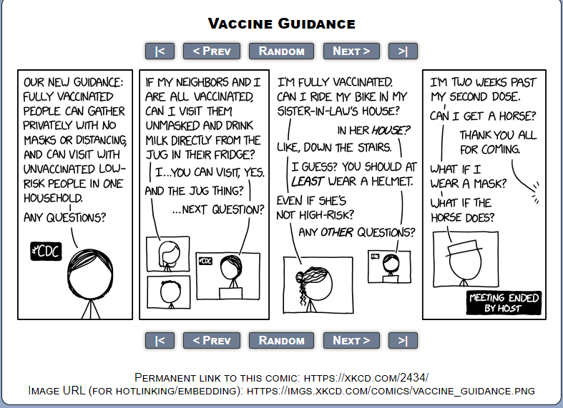
Have a question?
Email MDH.IPCOVID@maryland.gov
https://imgs.xkcd.com/comics/vaccine_guidance.png

