Slide 1
Maryland Situation Update on Coronavirus Disease (COVID-19) for BHA
Maryland Department of Health
Infectious Disease Epidemiology and Outbreak Response Bureau
February 5, 2021

Slide 2

Call Agenda
Picture Courtesy of NIAID-RML
Review current situation of COVID-19
Influenza Updates
Variants of Concern
Q and A

Slide 3
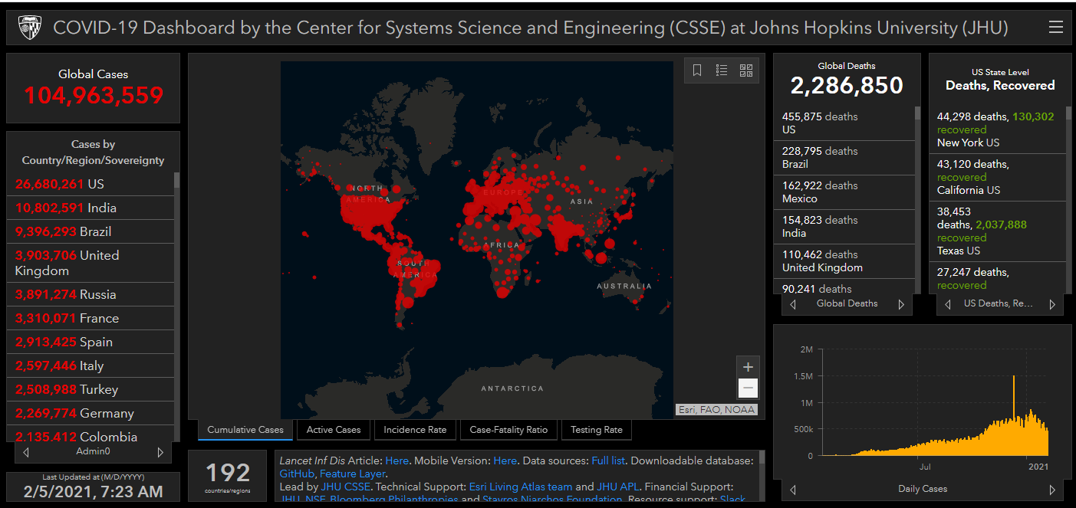
COVID-19 Global Situation Summary
https://gisanddata.maps.arcgis.com/apps/opsdashboard/index.html#/bda7594740fd40299423467b48e9ecf6

Slide 4
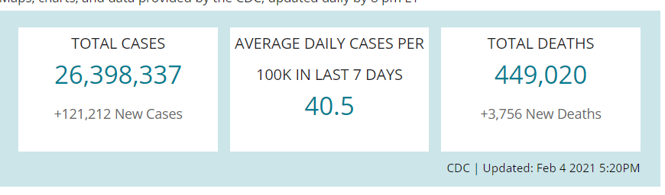
US Case Counts and Rates
https://www.cdc.gov/coronavirus/2019-ncov/cases-updates/cases-in-us.html Accessed 2/5/2021

Slide 5
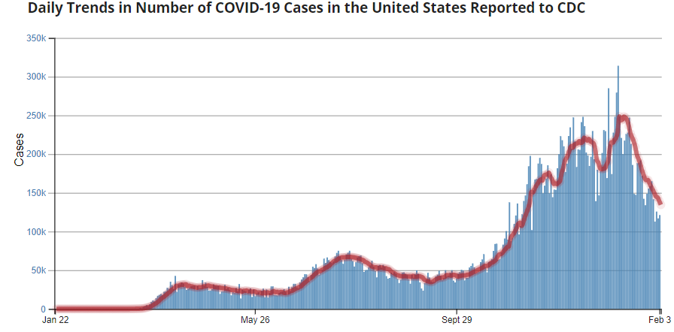
Number of Cases Reported in the USA, by Day
https://covid.cdc.gov/covid-data-tracker/#trends_dailytrendscases
Updated 2/4/2021

Slide 6
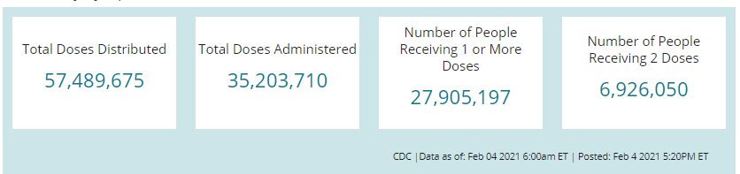
COVID-19 Vaccinations in the United States

Slide 7
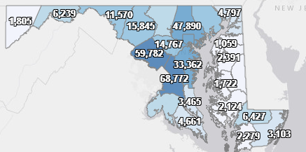
Maryland: COVID-19 Cases
http://health.maryland.gov/coronavirus
Data current as of 2/5/2021
Cases: 360,584
1,547 new
Deaths: 7,109
35 new
Hospitalizations: 32,687
Current: 1,444 ( Up 18)
Total tests performed: 7,144,618
Case rate: 23.5 per 100,000

Slide 8
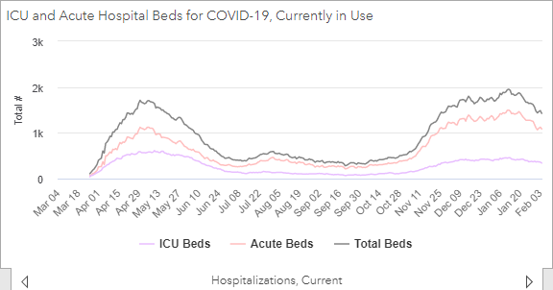
https://coronavirus.maryland.gov/ 2/4/2021

Slide 9
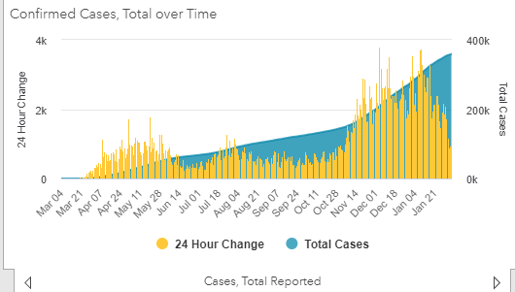
https://coronavirus.maryland.gov/ 1/29/2021

Slide 10
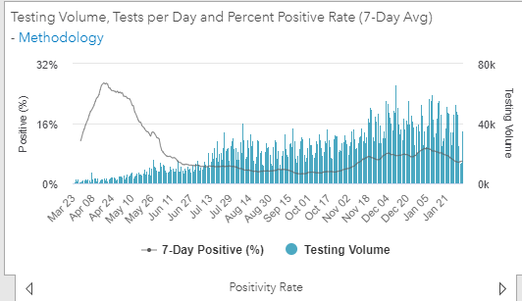
Testing Volume and % Positivity

Slide 11
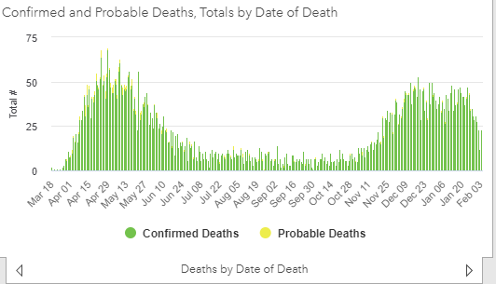

Slide 12
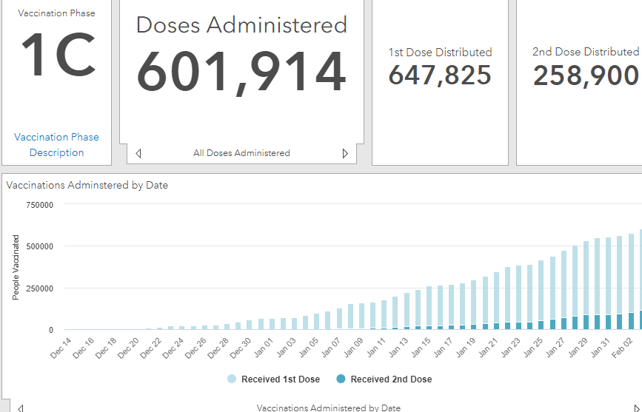
Maryland Vaccine Dashboard
https://coronavirus.maryland.gov/#Vaccine accessed Febuary 5, 2021

Slide 13
Maryland Influenza Epi Update
Week Ending January 23rd, 2021
Influenza-like illness (ILI) activity in Maryland was minimal

Slide 14
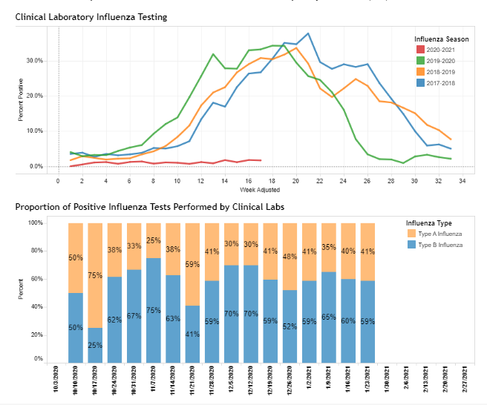
https://phpa.health.maryland.gov/influenza/Pages/flu-dashboard.aspx

Slide 15
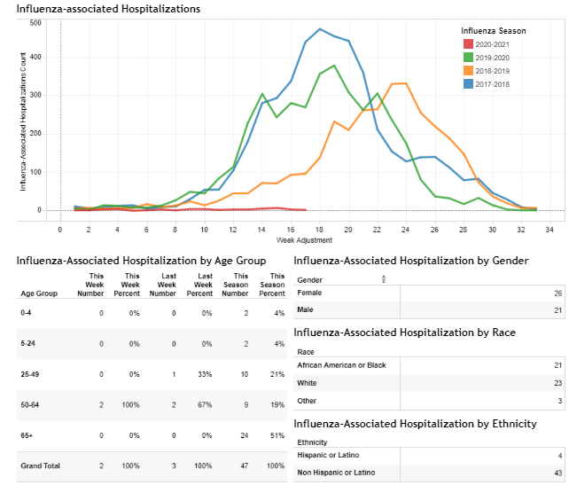
https://phpa.health.maryland.gov/influenza/Pages/flu-dashboard.aspx

Slide 16

CDC Update

Slide 17
Variants of Concern
Monique Duwell, MD, MPH Chief, Center for Infectious Disease Surveillance and Outbreak Response

Slide 18
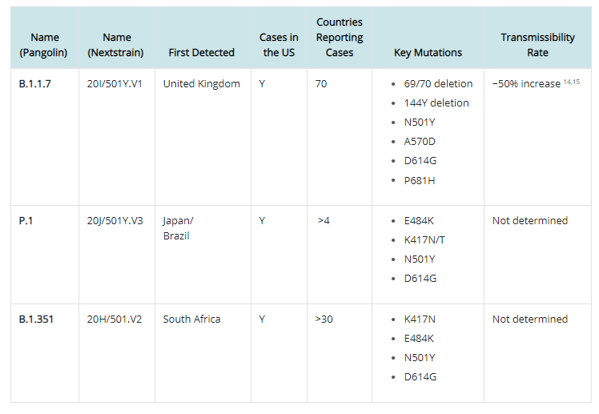
https://www.cdc.gov/coronavirus/2019-ncov/cases-updates/variant-surveillance/variant-info.html

Slide 19
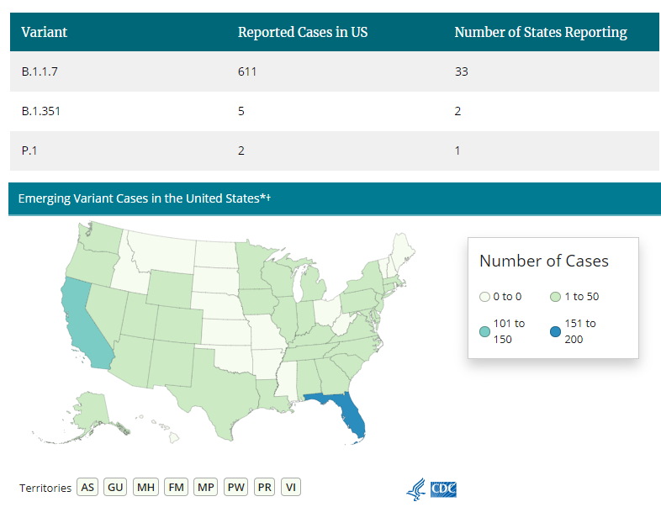
U.S.: COVID-19 Variant Cases
https://www.cdc.gov/coronavirus/2019-ncov/transmission/variant-cases.html, Accessed 2/5/21
Notes:
The COVID-19-Associated Hospitalization Surveillance Network (COVID-NET) conducts population-based surveillance for laboratory-confirmed COVID-19-associated hospitalizations in select counties participating in the Emerging Infections Program (EIP) and the Influenza Hospitalization Surveillance Project (IHSP).
A total of 106,532 laboratory-confirmed COVID-19-associated hospitalizations were reported by sites between March 1, 2020 and December 26, 2020. The overall cumulative hospitalization rate was 326.7 per 100,000 population. The overall weekly hospitalization rate reached its highest point at 16.9 per 100,000 during the week ending December 5, 2020 (Week 49) and remains elevated. Rates in recent weeks have declined but these rates are likely to change as additional data are reported for those weeks.

Slide 20
B.1.351 (“South African Variant”) Detected in MD and SC
January 28: South Carolina announced detection of two cases of B.1.351
“no known travel history and no connection between these two cases”
January 30: Maryland announced detection of one case of B.1.351
“an adult living in the Baltimore metro region”
“The individual has not traveled internationally, making community transmission likely.”
https://scdhec.gov/news-releases/south-carolina-public-health-officials-detect-nations-first-known-cases-covid-19
https://governor.maryland.gov/2021/01/30/governor-hogan-announces-south-african-covid-19-variant-identified-in-maryland/
Notes:
The COVID-19-Associated Hospitalization Surveillance Network (COVID-NET) conducts population-based surveillance for laboratory-confirmed COVID-19-associated hospitalizations in select counties participating in the Emerging Infections Program (EIP) and the Influenza Hospitalization Surveillance Project (IHSP).
A total of 106,532 laboratory-confirmed COVID-19-associated hospitalizations were reported by sites between March 1, 2020 and December 26, 2020. The overall cumulative hospitalization rate was 326.7 per 100,000 population. The overall weekly hospitalization rate reached its highest point at 16.9 per 100,000 during the week ending December 5, 2020 (Week 49) and remains elevated. Rates in recent weeks have declined but these rates are likely to change as additional data are reported for those weeks.

Slide 21
Research: B.1.1.7
CDC: “In January 2021, scientists from UK reported evidence that suggests the B.1.1.7 variant may be associated with an increased risk of death compared with other variants. More studies are needed to confirm this finding.” https://www.cdc.gov/coronavirus/2019-ncov/more/science-and-research/scientific-brief-emerging-variants.html Horby P, Huntley C, Davies N, et al. NERVTAG note on B.1.1.7 severity. SAGE meeting report. January 21, 2021.

Slide 22
Research: B.1.351
CDC: “Preliminary evidence from non-peer-reviewed publications suggests that the Moderna mRNA-1273 vaccine currently used in the US may be less effective against this variant [B.1.351].”
https://www.cdc.gov/coronavirus/2019-ncov/cases-updates/variant-surveillance/variant-info.html
Wu K, Werner AP, Moliva JI, et al. MRNA-1273 vaccine induces neutralizing antibodies against spike mutants from global SARS-CoV-2 variants. BioRxiv 2021. doi: https://doi.org/10.1101/2021.01.25.427948

Slide 23
MDH Clinician Letter (2/2/21): Variant Virus Surveillance
As part of COVID-19 variant virus surveillance efforts, MDH requests that clinicians report COVID-19 cases among any of the following groups:
Individuals who first test positive for COVID-19 after receiving COVID-19 vaccination (either one or two doses)
Severely immunocompromised individuals with prolonged COVID-19 infection
Individuals suspected of reinfection – specifically, symptomatic individuals who test PCR positive for SARS-CoV-2 more than 90 days after an initial infection from which they clinically recovered
Individuals with recent international travel (travel in the 14 days prior to symptom onset)
Any other individuals for whom you have clinical suspicion of infection with a possible variant (e.g., unusual clinical manifestation, etc.)

Slide 24
Clinician Letter and HO Memo (2/2/21): Variant Virus Surveillance
If COVID-19 cases in people in any of these groups are identified to be considered for sequencing prioritization:
If possible, contact the testing laboratory to ensure the original specimen is not discarded
Complete and submit case information securely online at: https://redcap.link/qx8ieby3
Questions should be directed to: mdh.COVIDsequencing@maryland.gov

Slide 25
Questions?
Email : mdh.ipcovid@Maryland.gov

