Slide 1
Maryland Situation Update on
Coronavirus Disease (COVID-19) for BHA
Maryland Department of Health
Infectious Disease Epidemiology and Outbreak Response Bureau
February 19, 2021

Slide 2

Call Agenda
Picture Courtesy of NIAID-RML
Review current situation of COVID-19
Influenza Updates
CDC Updates
MDH Updates
Q and A

Slide 3
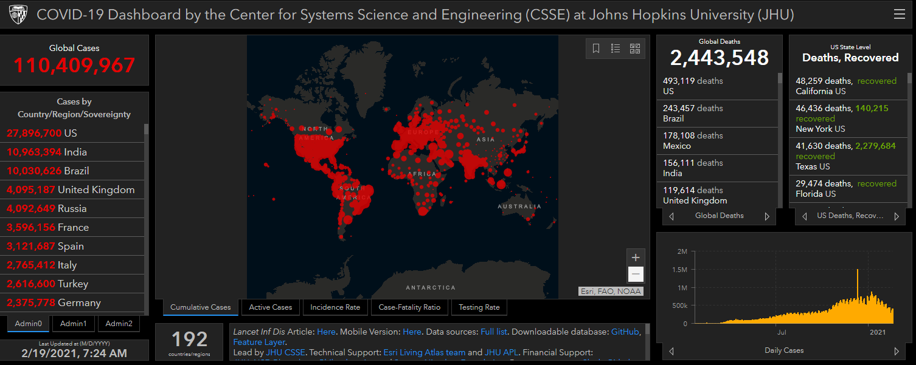
COVID-19 Global Situation Summary
https://gisanddata.maps.arcgis.com/apps/opsdashboard/index.html#/bda7594740fd40299423467b48e9ecf6

Slide 4
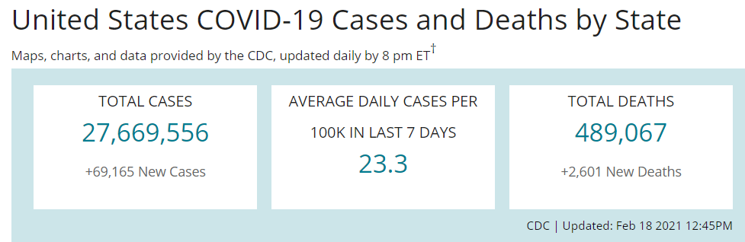
US Case Counts and Rates
https://www.cdc.gov/coronavirus/2019-ncov/cases-updates/cases-in-us.html Accessed 2/19/2021

Slide 5
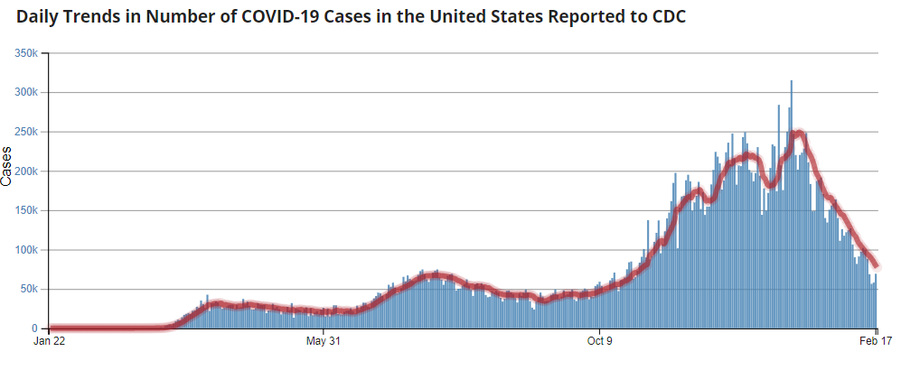
Number of Cases Reported in the USA, by Day
https://covid.cdc.gov/covid-data-tracker/#trends_dailytrendscases
Updated 2/19/2021

Slide 6
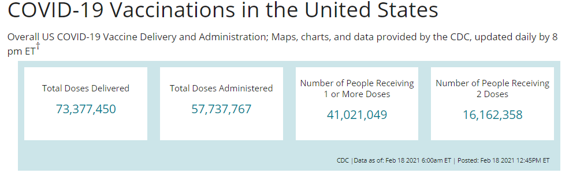
COVID-19 Vaccinations in the United States

Slide 7
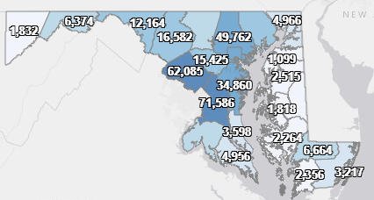
Maryland: COVID-19 Cases
http://health.maryland.gov/coronavirus
Data current as of 2/19/2021
Cases: 374,974
  1,008 new
Deaths: 7,495
  16 new
Hospitalizations: 34,265
  Current: 1,016 ( Down 32)
Total tests performed: 7,597,220
Case rate: 14.2 per 100,000

Slide 8
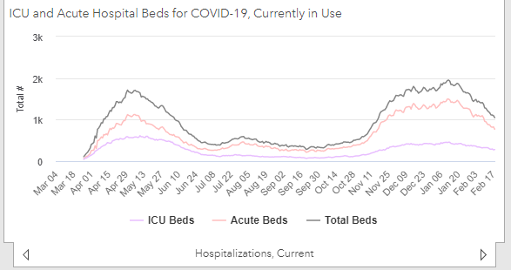
https://coronavirus.maryland.gov/ 2/19/2021

Slide 9
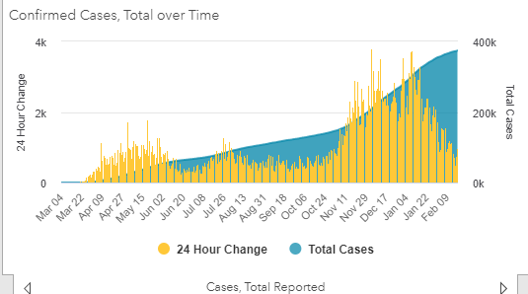
https://coronavirus.maryland.gov/ 2/19/2021

Slide 10
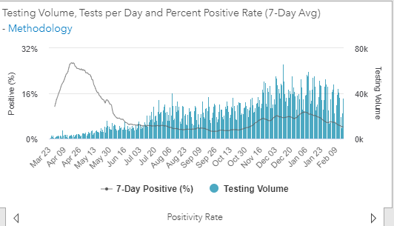
Testing Volume and % Positivity

Slide 11
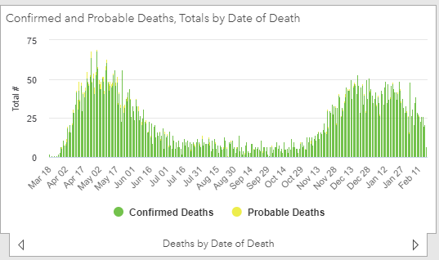

Slide 12
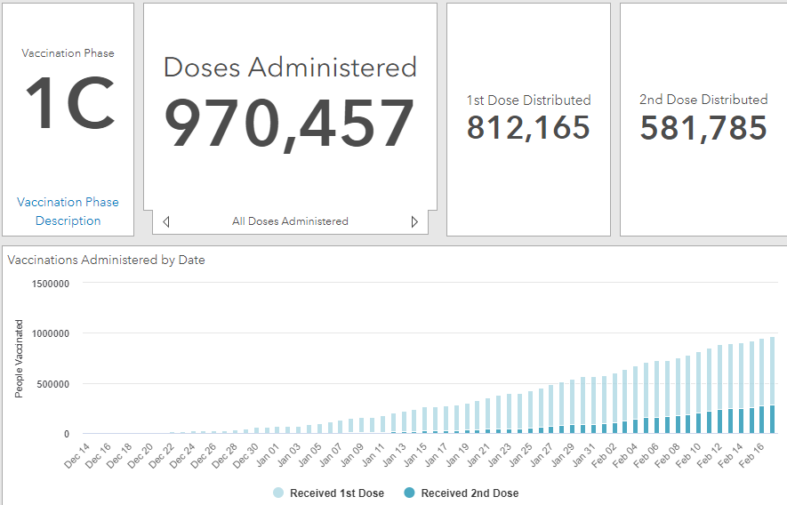
Maryland Vaccine Dashboard
https://coronavirus.maryland.gov/#Vaccine accessed February 19, 2021

Slide 13
Maryland Influenza Epi Update
Week Ending February 6th, 2021
Influenza-like illness (ILI) activity in Maryland was minimal

Slide 14
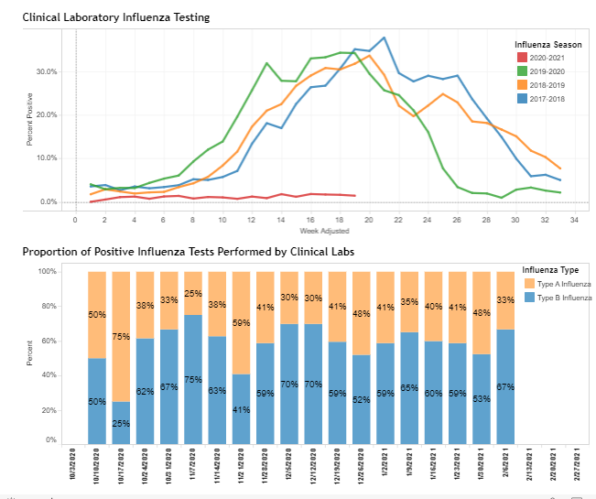
https://phpa.health.maryland.gov/influenza/Pages/flu-dashboard.aspx

Slide 15
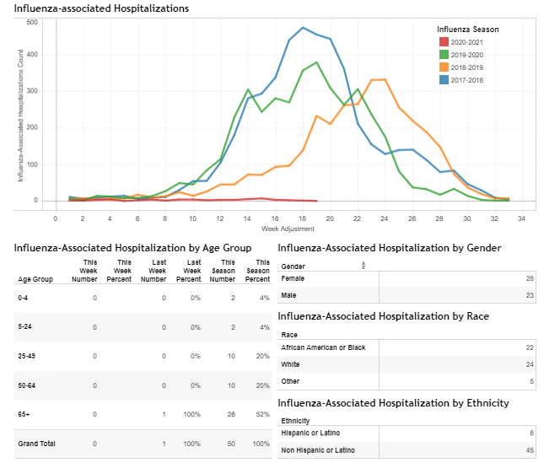
https://phpa.health.maryland.gov/influenza/Pages/flu-dashboard.aspx

Slide 16
CDC Updates

Slide 17
Early COVID-19 Vaccine Coverage in Skilled Nursing Facilities
Data from 11,460 SNFs who had at least one vaccine clinic with the federal CDC Pharmacy Partnership for Long Term Care between 12/18/20 and 1/17/21
For residents: Median 77.5% received at least one dose
  Range by state 65.7%-100%
For staff: Median 37.5% received at least one dose
  Range by state 19.4% -67.4%
https://www.cdc.gov/mmwr/volumes/70/wr/mm7005e2.htm

Slide 18
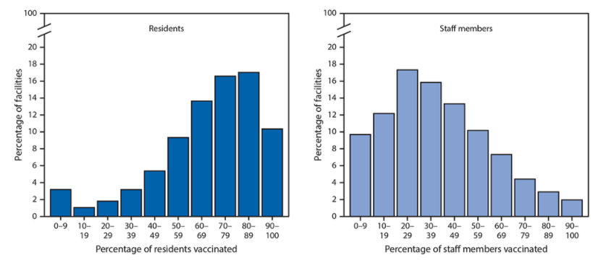

Slide 19
Return to Work Criteria for Healthcare Personnel with SARS-CoV-2 Infection
As of February 16, 2021
HCP who are severely immunocompromised, could remain infectious more than 20 days after symptom onset. Consultation with infectious diseases specialists is recommended; use of a test-based strategy for determining when these HCP may return to work could be considered.
https://www.cdc.gov/coronavirus/2019-ncov/hcp/return-to-work.html

Slide 20
Discontinuation of Transmission-Based Precautions and Disposition of Patients with SARS-CoV-2 Infection in Healthcare Settings (Interim Guidance)
As of February 16, 2021
Patients who are severely immunocompromised could remain infectious more than 20 days after symptom onset. Consultation with infectious diseases specialists is recommended; use of a test-based strategy for determining when to discontinue Transmission-Based Precautions could be considered.
https://www.cdc.gov/coronavirus/2019-ncov/hcp/disposition-hospitalized-patients.html

Slide 21
Interim U.S. Guidance for Risk Assessment and Work Restrictions for Healthcare Personnel with Potential Exposure to SARS-CoV-2
As of February 16, 2021
The interim guidance was updated:
Clarified that work exclusion of asymptomatic HCP with a higher-risk exposure who have recovered from SARS-CoV-2 infection in the prior 3 months might not be necessary. Additional information about this scenario is available here.
https://www.cdc.gov/coronavirus/2019-ncov/hcp/guidance-risk-assesment-hcp.html

Slide 22
Strategies to Mitigate Healthcare Personnel Staffing Shortages
As of February 14, 2021
Added, as a contingency strategy to allow:
  Asymptomatic fully vaccinated HCP who have had a higher-risk exposure to SARS-CoV-2 but are not known to be infected to continue to work onsite throughout their 14-day post-exposure period.
https://www.cdc.gov/coronavirus/2019-ncov/hcp/guidance-risk-assesment-hcp.html

Slide 23
Strategies to Mitigate Healthcare Personnel Staffing Shortages
Healthcare facilities should understand that shortening the duration of work restriction might result in additional transmission risks.
Vaccinated HCP should be prioritized to first shorten their duration of work restriction followed by unvaccinated HCP.
These HCP should still report temperature and absence of symptoms each day before starting work.
If HCP develop even mild symptoms consistent with COVID-19, they should either not report to work, or stop working and notify their supervisor or occupational health services prior to leaving work. These individuals should be prioritized for testing.
If HCP are tested and found to be infected with SARS-CoV-2, they should be excluded from work until they meet all Return to Work Criteria.
https://www.cdc.gov/coronavirus/2019-ncov/hcp/mitigating-staff-shortages.html

Slide 24
MDH Updates

Slide 25
MDH Amended Directive and Order On Health Care Matters (Feb. 11)
Extended out of state travel testing requirement from February 28, 2021 to March 31, 2021
Extended Hospital Surge Plans and Patient Transfer Provisions (Section 10.A) from March 31, 2021 to April 30, 2021
Updated hospital visitation guidelines (Section 9)
  Hospitals shall establish such patient visitation policies as they deem appropriate, in accordance with CDC guidance regarding visitation and relevant accreditation and regulatory standards.
Removal of remaining limitations on Elective and Non-Urgent Medical Procedures (Section 5)
Changed PPE Use and Conservation Requirements to Guidelines (Section 6)

Slide 26
MDH Amended Directive and Order Related to Nursing Home Matters (Feb. 11)
Updated indoor visitation (Section 9.A)
Reverted testing requirements to CMS requirements from August 26, 2020 (Section 4)
Updated PPE supply stockpile requirements to 30 days (Section 2)
Clarifies that cosmetologists and barbers that are providing services to nursing home residents shall be considered as vendors for the purposes of this order
Other Technical amendments

Slide 27
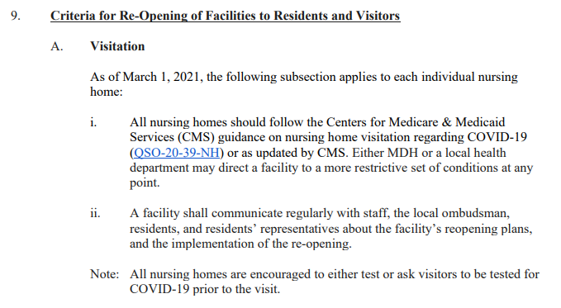
MDH Amended Directive and Order Related to Nursing Home Matters (Feb. 11)
Updated indoor visitation (Section 9.A)

Slide 28
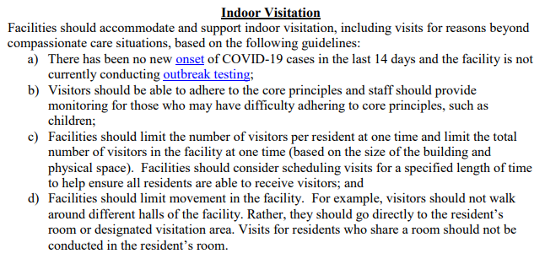
REVIEW: CMS QSO-20-39-NH
https://www.cms.gov/files/document/qso-20-39-nh.pdf

Slide 29
Questions?
Email : mdh.ipcovid@Maryland.gov

